Slide 1
Reproducible research: Tools and Practices
Jean Morrison
10-23-2020

Slide 2
Goals of (Bio)Statistical Research
Applied: Learn true facts about the world and share them.
Methods: Make tools others can use to learn true facts.

Slide 3
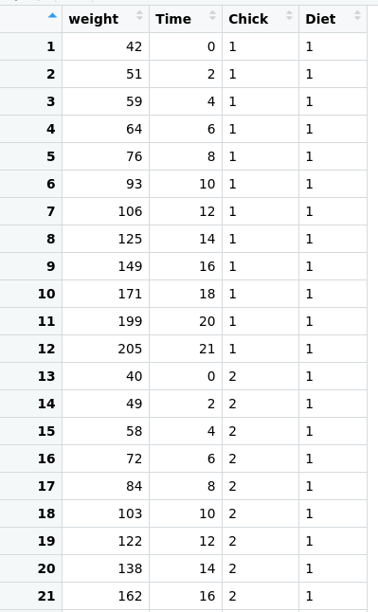


What Can Go Wrong?
?

Slide 4
What Can Go Wrong?
?
Study design doesn’t answer Q
Sloppy data collection
Technical errors in analysis
Mis-copied results
Bad statistics
Misinterpreted results
Random error
Fraud/lying
Mangled data
Lost data
Fraud/lying

Slide 5
What is reproducibility?
?
Same Investigators = Repeatable

Slide 6
What is reproducibility?
?
New Investigators = Reproducible

Slide 7
What is reproducibility?
?
New investigators, new experiment = Replicable

Slide 8
What Can Go Wrong?
?
Study design doesn’t answer Q
Sloppy data collection
Technical errors in analysis
Mis-copied results
Bad statistics
Misinterpreted results
Random error
Fraud/lying
Mangled data
Lost data
Fraud/lying

Slide 9
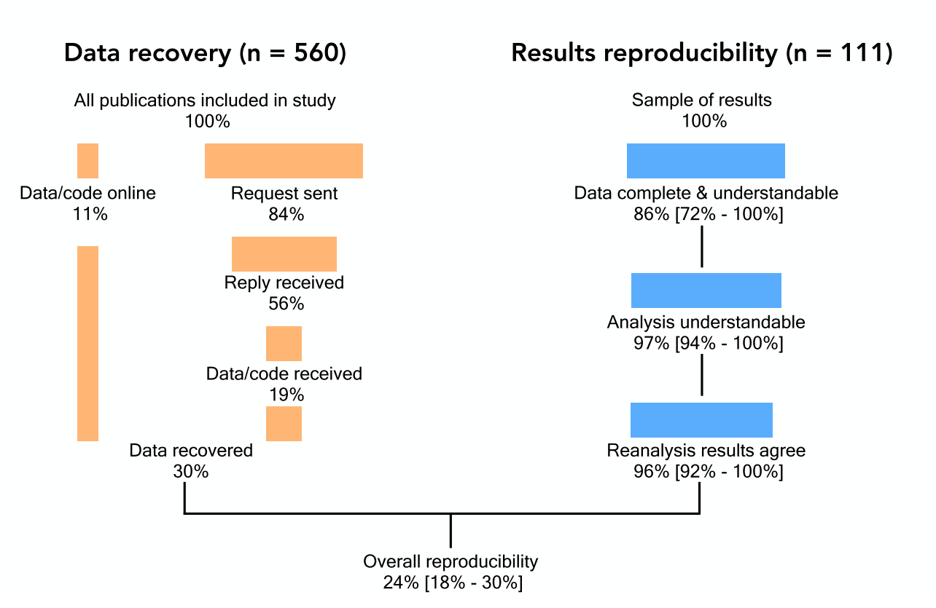
Reproducibility in Published Lit
Minocher et al.
psyarxiv 2020

Slide 10
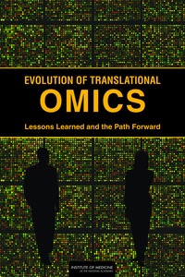

Slide 11
Questions to ask as you go:
Could I redo this analysis easily tomorrow?
Could I redo it in a month?
In a year?
In five years after it is published and I have graduated?
Could I easily tell someone else how to do this analysis?

Slide 12
Practical Tools For Reproducible Research jean997.github.io/rr_tools

Slide 13
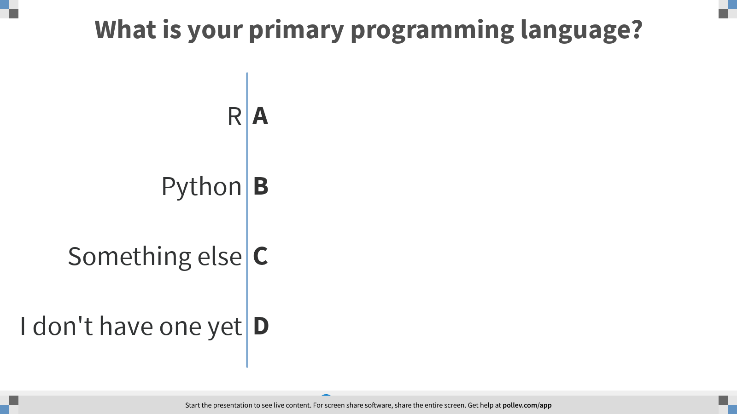
Notes:
What is your primary programming language?
https://www.polleverywhere.com/multiple_choice_polls/h4TMvctSaScvkZRvX9sbZ?flow=Default&onscreen=persist

Slide 14
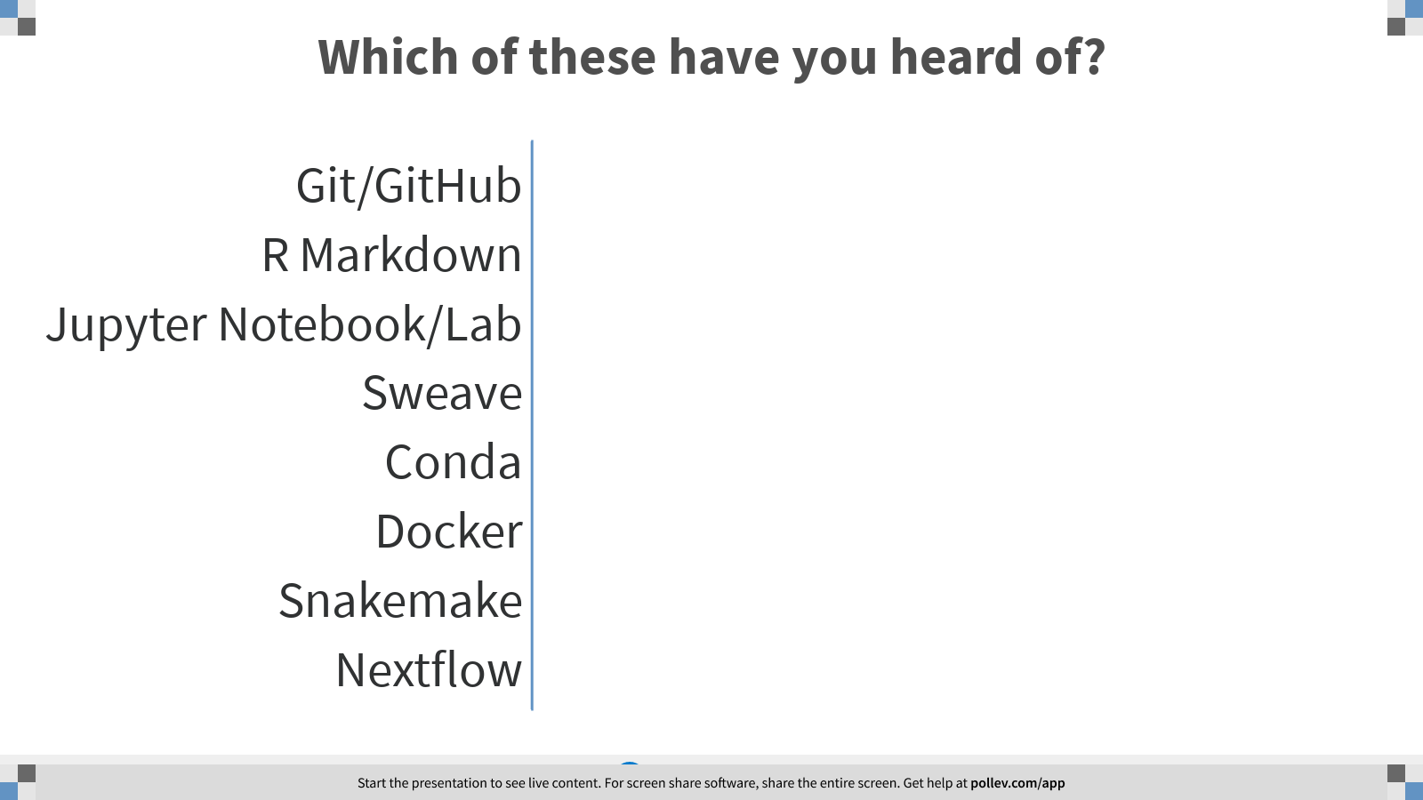
Notes:
Click every item you have heard of
https://www.polleverywhere.com/multiple_choice_polls/7jqTFMK7ESKmIHRpWG7PS?flow=Default&onscreen=persist

Slide 15
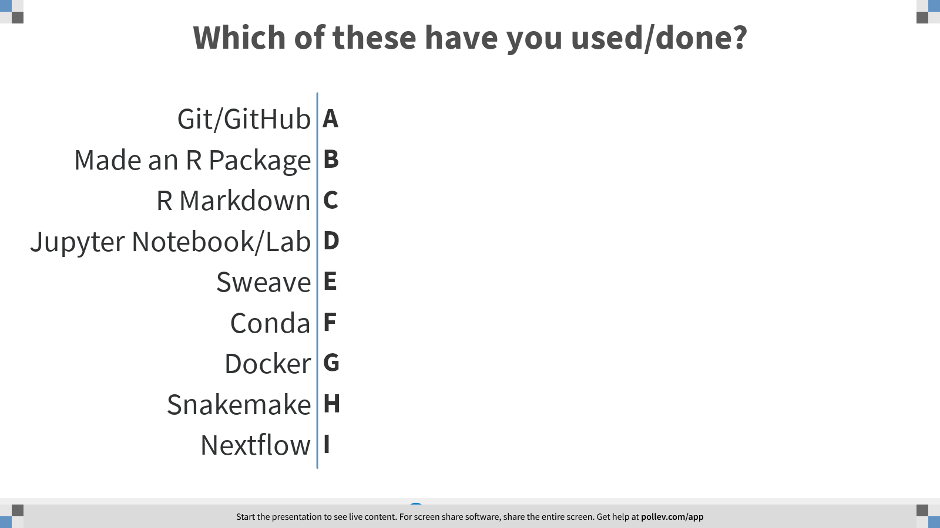
Notes:
Which of these have you used?
https://www.polleverywhere.com/multiple_choice_polls/b7VoDzvNlqWywALFe49bq?flow=Default&onscreen=persist

Slide 16
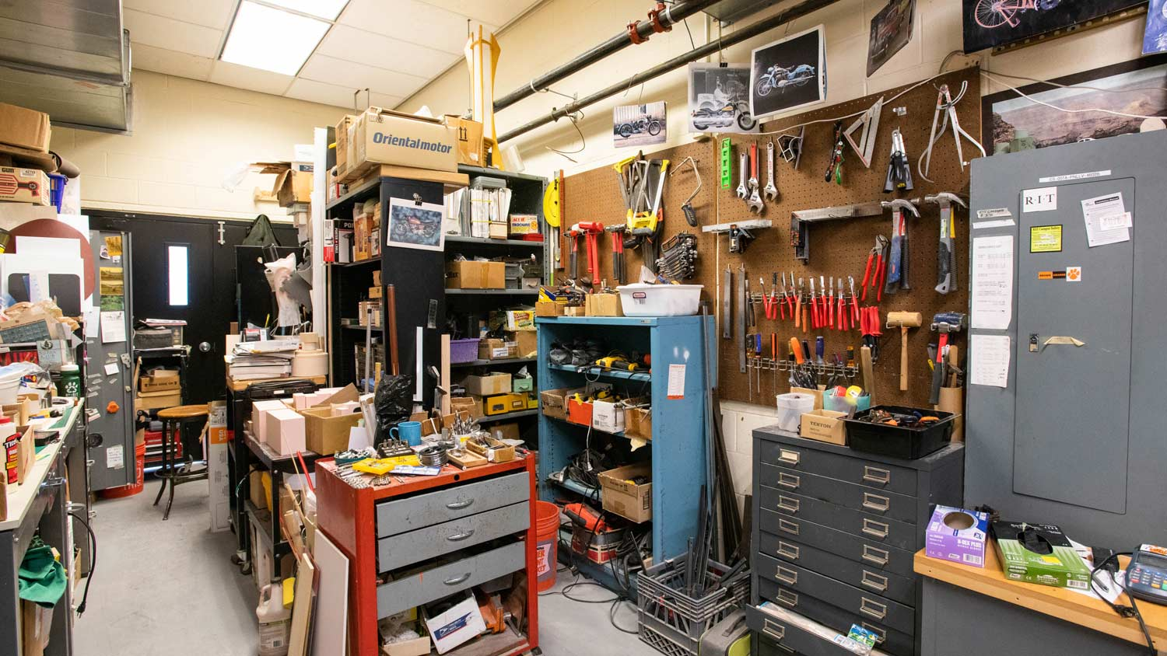
Reproducibility Tool Bench
Mindful Organization and File Names
Version Control
Safe Programming Practices
Dynamic Reports/Workbooks
Reproducible Pipelines

Slide 17
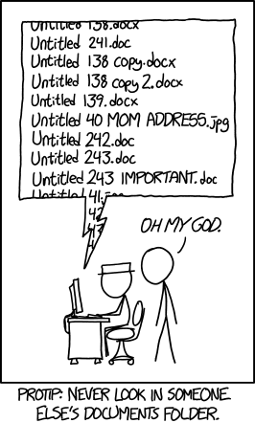
1. File Organization and Naming
https://xkcd.com/1459/

Slide 18
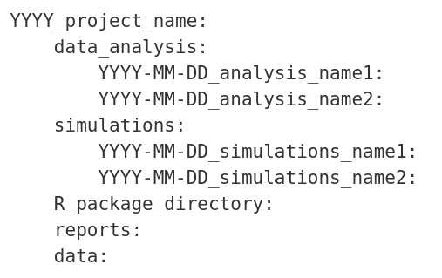
1.1 File Organization
Organization is personal but give it some thought
My favorite system:
You can add symbolic links to files in weird places

Slide 19
1.2 File Names
Use descriptive file names.
Put dates in file names. YYYY-MM-DD is a nice format (sys.Date()in R).

Slide 20
2. Version Control (Git)
Git will track the status of a ”repository” (collection of files).
You can see the whole history of changes.
You can rewind to before you broke everything!
You can record the commit number at the time of your analysis.
Put your repository on GitHub (or GitLab or Bitbucket) to share with collaborators (or yourself).
I recommend the Git tutorial from ”R packages” by Hadley Wickham.

Slide 21
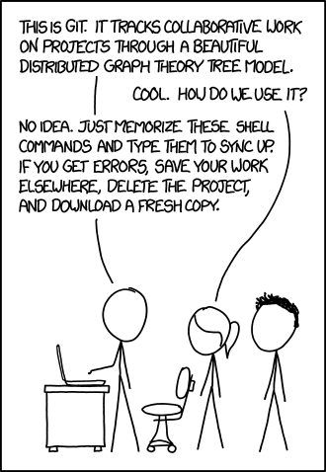
2. Version Control (Git)
Learn enough to track your repository:
If/When you need other functionality go back to the docs or search the internet and find the answer on stack exchange.
RStudio makes git pretty easy.
There is a git GUI app.
git init
git add
git commit
git push
git pull
https://xkcd.com/1597/

Slide 22
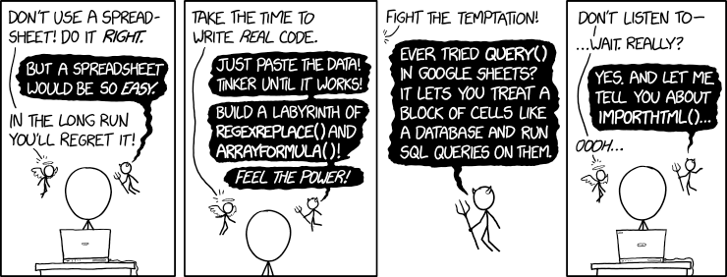
3.1 Data Manipulation
Don’t modify data in place.
Avoid opening data in Excel.
Considering saving checksums for data you would like to preserve.
https://xkcd.com/2180/

Slide 23
3.2 Programming Habits
Write functions.
If there is more than one function, make a package.
Document your package!
Check input parameters for type and known features.
Consider adding unit tests (testthat).
[R package example in RStudio]

Slide 24
3.3 Things to Avoid in R (or Python)
In Scripts and Packages
Changing the working directory (setwd)
Sourcing in other R scripts (consider a package or a pipeline)
Removing variables from the workspace (rm)
Hard coding input/output files and parameters
Running system commands (system)
Interactively
Saving the workspace

Slide 25
4.1 Dynamic Reports
R Markdown and Sweave both integrate text and R code.
Sweave integrates R with LaTex.
For Python, Jupyter Notebook/Lab has similar functionality to R Md.
Dynamic Reports can’t be used for computationally intensive tasks but are great for summarizing results.
[Quick demo of R Markdown]

Slide 26
4.2 workflowr
One of my favorite R packages!
Turn a collection of R Markdown files into a research website.
Does a lot of the reproducibility work for you (checks the cache, takes care of git commits, gives you warnings if you do something sketchy).
[Look at a workflowr website]

Slide 27
5.1 Pipelines
A pipeline is just a series of analysis steps that take you from data to output:
File A
make_a.sh
Final Result
Data
get_result.py
File B1
gen_b_from_data.R
File B2
File B3

Slide 28
5.1 Pipelines
Your first pipeline might just be a readme and a directory of code. This is ok!
But there are drawbacks to the manual approach:
Easy to make an error (modifying upstream files or code without rerunning)
Manual cluster submission is tedious.
Hard to change parameters or know which parameters you ran with.
There are tools that automate the common parts of pipeline building!

Slide 29
5.1 Snakemake
make_a.sh
File A
get_result.py
Data
Final Result
File B1
gen_b_from_data.R
File B2
File B3
rule make_A:
input: in = "data.tsv"
output: out = "A"
shell: "./make_a.sh {input.in} {output.out}"
rule make_B:
input: in = "A"
out: expand("B{n}", n = range(1, 4))
shell: "Rscript gen_b_from_data.R {input.in} {output}"
rule make_final:
input: inA = "A", inB = expand("B{n}", n=range(1, 4))
output: out = "final_output.tsv"
shell: "python get_result.py {input.inA} {input.inB} {output.out}”
rule all:
input: "final_output.tsv"

Slide 30
5.1 Snakemake Advantages
User only worries about paths in the graph.
Automates cluster submission.
Less error prone.
Easy to reproduce.
Easy to generalize.

Slide 31
5.2 DSC (Dynamic Statistical Comparisons)
Simulations are a special kind of pipeline:
Method 1
Eval M1
Simulate
Data
Method 2
Eval M2
Method 3
Eval M3

Slide 32
5.2 DSC (Dynamic Statistical Comparisons)
DSC does the logistical overhead, you just write the simulation, method, and evaluation functions.
Very flexible!
Uses the same seed every time to make results replicable.
One of my favorite tools!
[A DSC example]

Slide 33
Reproducibility Take Aways
Start where you are!
Look out for your future self
Learn from your foibles ☺
Investing time learning tools that feel awkward now pays off later.
Resources website with lots of links
jean997.github.io/rr_tools

