Slide 1
Midterm
Jeana Chesnik

Slide 2


Concept

Slide 3
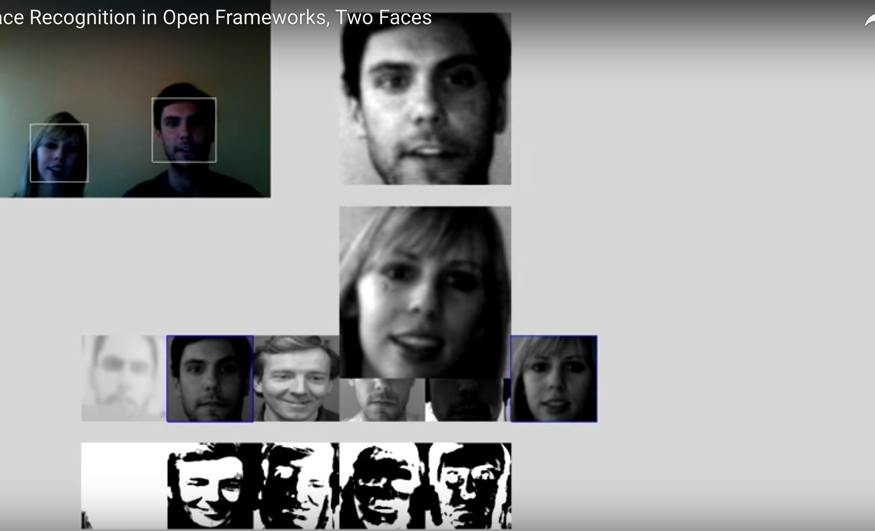
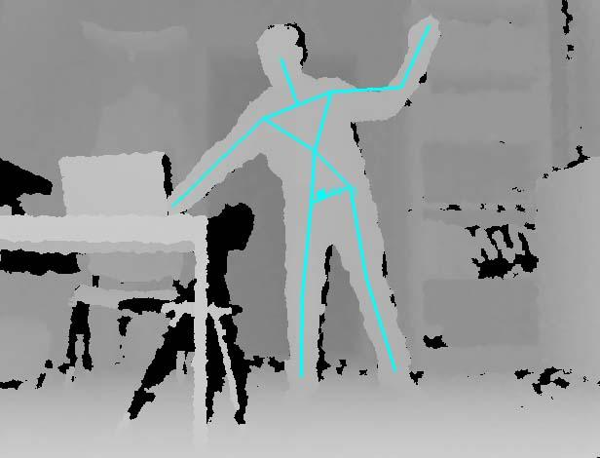
VideoGrabber, Face Tracking &
Skeleton Tracking

Slide 4
Instead

