Slide 1
Process Management

Slide 2
What is a process?
A process is an instance of a program. Any command that you give to your Linux machine starts a new process.
A program can have multiple processes
Types of processes: Foreground processes and Background processes
Foreground Processes run on the screen and need input from the user.
Background Processes run in the background and usually do not need user input.

Slide 3
Process Concept
An operating system executes a variety of programs
batch systems – jobs
time-shared systems - user programs or tasks
job and program used interchangeably
Process - a program in execution
process execution proceeds in a sequential fashion
A process contains
program counter, stack and data section

Slide 4
Managing process
To view running process in Linux: #top
The top command give system statistics, such as system load and the total number of tasks.
The first part of the information is an overview of the situation.
The second part, organized in columns, gives details for each process, including its unique reference number (PID), priority (PR), status (S), and resource usage (%CPU, for example).

Slide 5
Process State
A process changes state as it executes.
New created
exit
admitted
terminated
interrupt
ready
running
I/O or
event
completion
Scheduler
dispatch
I/O or
event wait
waiting

Slide 6
Process States
New - The process is being created.
Running - Instructions are being executed.
Waiting - Waiting for some event to occur.
Ready - Waiting to be assigned to a processor.
Terminated - Process has finished execution.

Slide 7
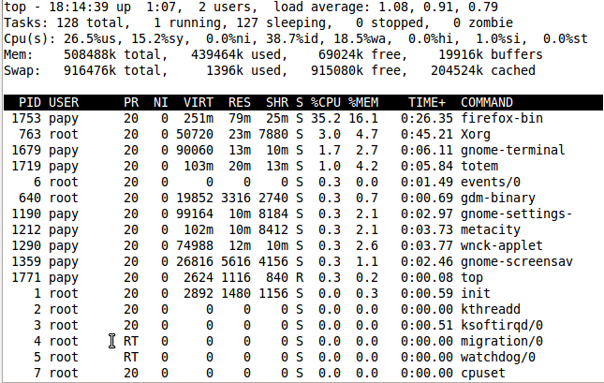

Slide 8
Field | Description
PID | The process ID of each task
User | The username of task owner
PR | Priority Can be 20(highest) or -20(lowest)
NI | The nice value of a task
VIRT | Virtual memory used (kb)
RES | Physical memory used (kb)
SHR | Shared memory used (kb)
S | Status There are five types: 'D' = uninterruptible sleep 'R' = running 'S' = sleeping 'T' = traced or stopped 'Z' = zombie
%CPU | % of CPU time
%MEM | Physical memory used
TIME+ | Total CPU time
Command | Command name

Slide 9
ps
This command stands for 'Process Status'.
To get more details, use #ps aux
Terminate a running process: #kill [PID]
To find the PID of a process : #pidof PID
Before terminating the process, you should make sure that no other users are using it.
Command #users gives information about users, #w gives users and what they are doing

Slide 10
NICE (Adjust process priority)
Linux can run a lot of processes at a time, which can slow down the speed of some high priority processes and result in poor performance. To avoid this, you can give priority to the process
This priority is called Niceness in Linux, and it has a value between -20 to 19. The lower the Niceness index, the higher would be a priority given to that task.
The default value of all the processes is 0.
Eg. To run a program with a certain nice value: #nice -n 15 command_to_execute #renice 0 PID_to_prioritize

Slide 11
Send Processes Signals
The most common way of passing signals to a program is with the #kill command: #kill PID_of_target_process
Signals are not only used to shut down programs. They can also be used to perform other actions. For instance, many daemons will restart when they are given the HUP, or hang-up signal. Apache is one program that operates like this. Eg. #sudo kill -HUP pid_of_apache
You can list all of the signals that are possible to send with kill by typing: kill -l

