Slide 1
Morphogenesis Of The Outside
hands-on workshop
Jb Labrune - Copyleft Pa-f 2015

Slide 2
11 - 17 August 2015 - Philosophy: (In)Formalizing the Outside: Sex, Mathematics, Cybernetics
Taint your horizons and decentralize thought by putting into question where philosophy happens. At PAF, philosophers transit between conceptual practices and situations to embody reason through an abundance of ruses, by amplifying the capacity to think alongside two or more incompatible perspectives at once. With the choice to go against itself and deepen the rifts of eroding neoliberal institutions, Philosophy must discover and explore the dynamics of new conceptual terrain, fractalizing void across a multitude of scales. Following on from last year’s rigorous week, with exceptional thinkers like Reza Negarestani, Nick Land, Lucca Fraser, Amy Ireland, Peter Wolfendale & Mark Fisher, this year's summer university will bring together practitioners and thinkers from contemporary fields of research in sexuality and gender studies, non-classical logic and mathematics, and next-wave cybernetics, in order for new contaminations to occur. The event will orient around two vectors. First, an examination of the conceptual histories of sex and cybernetics, suggesting a new thinking of libidinal politics. Second, a reopening of the questions of formalization and contemporary mathematical philosophy. What is it to think today ? To let one field of thought be a virus for another. Our aim is not to prescribe in advance a synthesis of these strands, but rather to create a space of collision, making a ‘solid’ and ‘fixed’ notion of the Outside tremble.
Organized by Katrina Burch, Matt Hare, Alina Popa

Slide 3
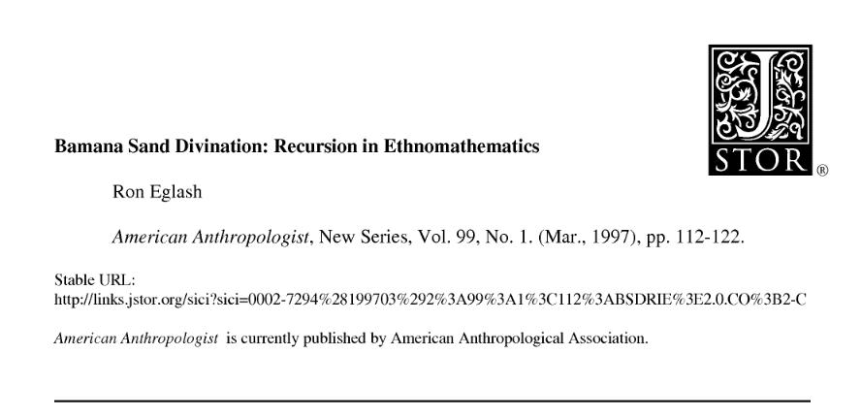
Ethnomathematics & the origin of feedback

Slide 4
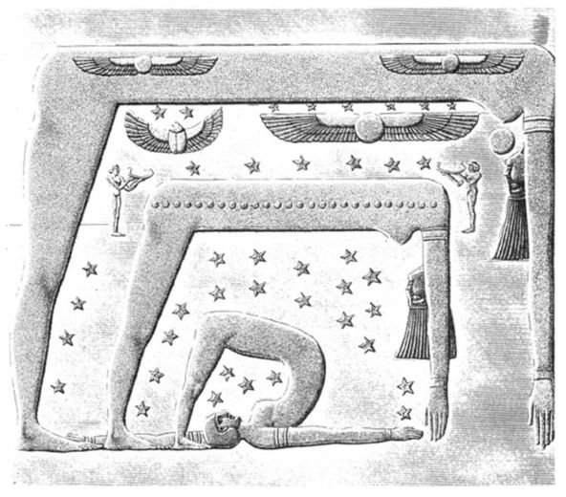

Slide 5
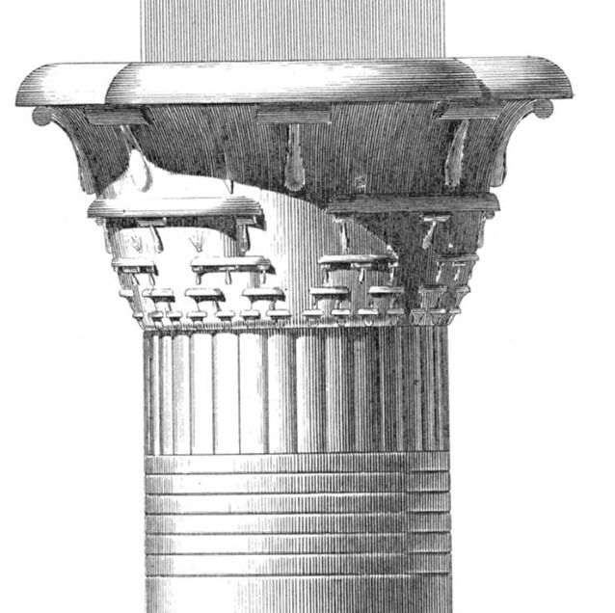

Slide 6
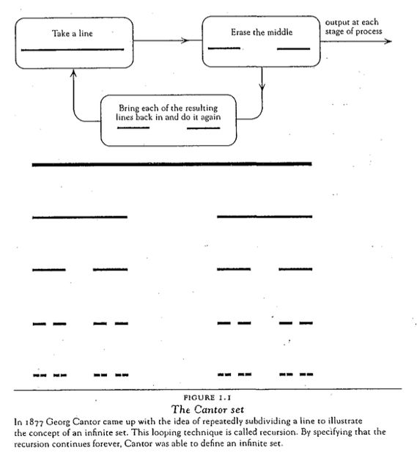

Slide 7
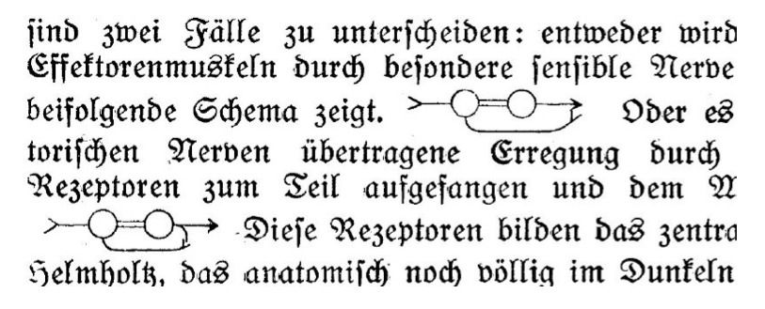
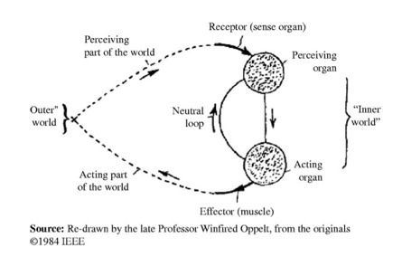

Slide 8
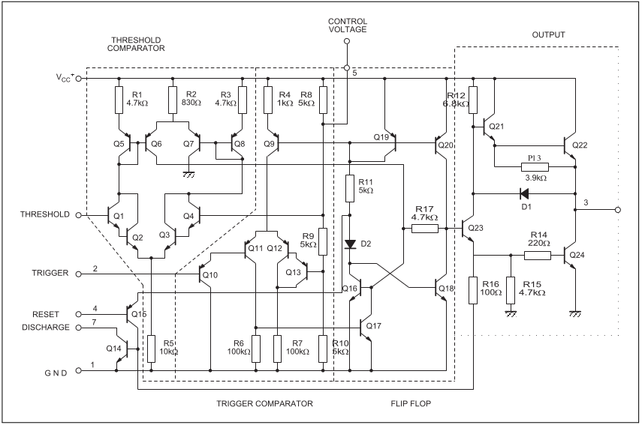
555

Slide 9
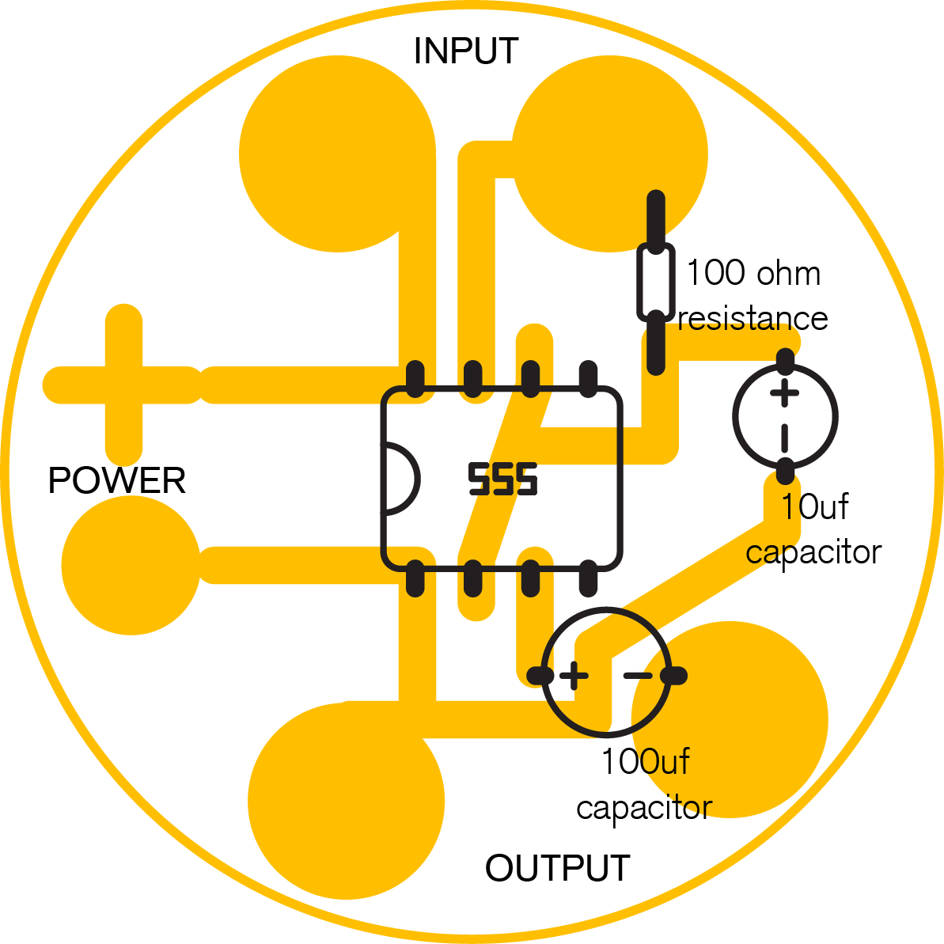
Textilo

