Slide 1
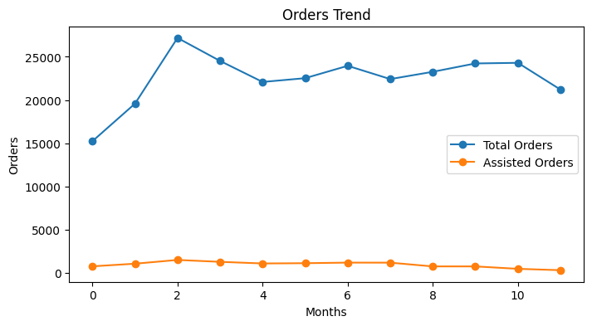
QBR report
Product usage & ROI

Slide 2

Collected x approved
“Collected posts, approved posts and ratio”
Remarks
On average, you collect nan posts per month and manually approve nan, resulting in an approval rate of nan%.
1
Notes:
Needed - Reviewed

Slide 3
Post approval and distribution
“Approved posts x Flows distribution (manual distribution, adding tags and adding products”
Remarks
On average, you distribute each approved post {{AVERAGEDISTRIBUTED}} times.
2
Notes:
Needed - Reviewed

Slide 4
Post distribution by adding products
Remarks
On a average per month, you distribute {{DISTRIBUTED}} posts by adding products. Keeping a regularly updated product Flow is essential for an effective sales strategy.
3
Notes:
Needed - Reviewed

Slide 5
Moderation insights
“Correlation between distribution and assisted sales”
Remarks
Assisted sales typically increase with greater platform usage, such as approving more posts.
This occurs when fresh content is published on your website, capturing users' attention.
4
Notes:
Double check / See if needed

Slide 6
Rights request sent
“Rights request sent via comments & DM”
Remarks
On average, you sent {{RIGHTREQUESTS}} rights requests per month.
We strongly recommend balancing rights requests between DMs and comments, using varied templates to ensure compliance with social media terms and conditions.
5
Notes:
Needed - Reviewed - is this metric counting comments and DMs together? Would it be possible to include the amount which was answered by the user (technical issues)

Slide 7
Impressions and engagement rate
“How often visitors interact with your Flows?”
Remarks
Your average engagement rate is {{AVERAGEENGAGEMENTRATE}}%.
As a proxy reference, platforms like Facebook, Instagram and Twitter, typically have an average engagement rate between 1 - 5%.
Important note
Proxy benchmarks were gathered by online research and artificial intelligence refinements.
6
Notes:
Needed - Reviewed

Slide 8
Engagement funnel
“Conversion metrics ratios from engagement to CTA clicks”
Remarks
Your average post engagement per engagement is {{POSTENGAGEMENT}}%, while your CTA engagement rate is {{CTAENGAGEMENT}}%.
As a benchmark, social media platforms like Facebook, Instagram, and Twitter typically have a CTA rate between 0.5% and 5%.
Important note
1 . Benchmarks do not account for the user journey, meaning they do not reflect how close
users are to making a purchase. 2 . Proxy benchmarks were gathered by online research and artificial intelligence refinements.
7
Notes:
Needed - Reviewed

Slide 9
CPI, CPE, CPC
“Average cost per 1k impressions, post engagement and product click”
Remarks
On average, your costs are as follows: Per 1k impressions is €{{PER1KIMPRESSIONS}} per post engagement is €{{PERPOSTENGAGEMEN}}T and per click is {{COSTPERCLICK}}.
As a proxy benchmark, here are some average costs:
Per 1k impressions
Facebook / Instagram: 5 - 15€
Google display network: 1 - 5€
YouTube ads: 4 - 12€
Cost per post engagement
Facebook ads: 0.05 - 0.20€
Twitter: 0.30 - 1.5€
Linkedin: 1 - 5€.
Cost per click
FB / IG ads: 0.20 - 1.50€
Google search: 1 - 3€
Twitter: 0.50 - 2€
Linkedin: 3 - 6€.
Important note
1 . Benchmarks do not account for the user journey, meaning they do not reflect how close
users are to making a purchase. 2 . Proxy benchmarks were gathered by online research and artificial intelligence refinements.
8
Notes:
Needed - Reviewed

Slide 10
Cost per post engagement
“Month invoice / post engagements”
Remarks
On average, your cost per post engagement is {{AVERAGEPERPOSTENGAGEMENT}}.
As a proxy benchmark, here are some average costs:
Facebook ads: 0.05 - 0.20€
Twitter: 0.30 - 1.5€
Linkedin: 1 - 5€.
Important note
1 . Benchmarks do not account for the user journey, meaning they do not reflect how close
users are to making a purchase. 2 . Proxy benchmarks were gathered by online research and artificial intelligence refinements.
10

Slide 11
Cost per click
“Month invoice / product clicks”
Remarks
On average, your cost per click is €{{AVERAGECOSTPERCLICK}}.
As a proxy benchmark, here are some average costs:
FB / IG ads: 0.20 - 1.50€
Google search: 1 - 3€
Twitter: 0.50 - 2€
Linkedin: 3 - 6€.
Important note
1 . Benchmarks do not account for the user journey, meaning they do not reflect how close
users are to making a purchase. 2 . Proxy benchmarks were gathered by online research and artificial intelligence refinements.
11

Slide 12
ROI
“Total assisted sales x attribution model (%) / Month invoice”
Remarks
A common metric for digital marketing is ROAS (Return on Ad Spend). The Flowbox model allows you to compare the return per euro invested based on three possible attribution percentages: 3%, 5%, or 7%, which are considered standard for online campaigns.
Your averages are as follows:
3% attribution of assisted sales:{{3%ATTRIBUTIONOFASSISTEDSALES}}€
5% attribution of assisted sales:{{5%ATTRIBUTIONOFASSISTEDSALES}}€
7% attribution of assisted sales: {{10%ATTRIBUTIONOFASSISTEDSALES}}€
12

Slide 13
Order size and value uplift
“Assisted x unassisted”
Remarks
On average, your order value uplift is {{ORDERVALUEUPLIFTAVERAGE}}% and order size value uplift is {{ORDERSIZEVALUEUPLIFT}}%.
9
Notes:
Needed - Reviewed

Slide 14
Order share
Remarks
On average, your order share is {{ORDERSHAREAVERAGE}}%.
9
Notes:
Needed - Reviewed

Slide 15
Key achievements and recommendations
Recommendations
Strategies to enhance community engagement and leverage it for better sales performance.
Suggestions for optimizing media creation processes to reduce costs and time while improving quality.
Include some recommendations
Include extra features like UGC DPA + Email Assets + Flow in email etc
Don’t include our newest feature - use the new feature slide for this
Action Items
List of specific actions to be taken based on the findings of the review.
Assign responsibilities and timelines for the action items.
13

Slide 16
New features in 2025
Out now!
Proud to present an array of groundbreaking features that will revolutionize your experience
Countdown Widget: Option to create time-limited sales campaigns - reveal one promo + product per day, each available for 24 hours before the next one appears.
Costs: €100 per month. Here you can find more information
Media Uploader: Allows users to share their content - images or videos - directly through your Flow or a shared link. You can tailor the uploader to match your brand and campaign goals. The Media Uploader Forms feature allows you to add custom questions to your media uploader in a flow. This helps you gather additional insights from users alongside the UGC they submit.
Costs: €100 per month. Here you can find more information
Analytics Moderation: The new analytics panel has additional metrics which Flowbox did not track before related to the moderation of content and of course a new design and fixed metrics.
Free! Here you can find more information.
14

Slide 17
Appendix
Additional data related to the ugc, additional features, etc.

Slide 18
Roadmap 2025
Our goals for next year - What’s coming next?
Deeper analytics development (Moderation Analytics)
Media Uploader Version 2
Feature updates and improvements
Revamp UX and UI Across the Platform
Flows new Designs and Behaviors
New Analytics Design
Revamp UX and UI on Flows Embed code
Ratings and Reviews further development
Replying reviews
Adding images to the reviews
16

Slide 19
Flow New Designs and Behaviors
16

Slide 20
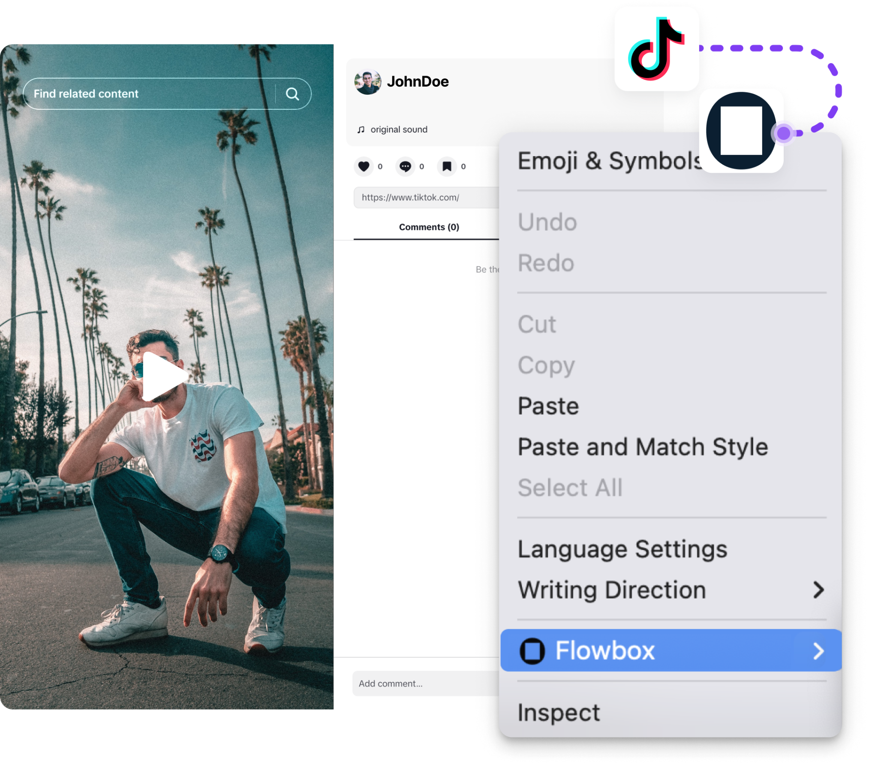
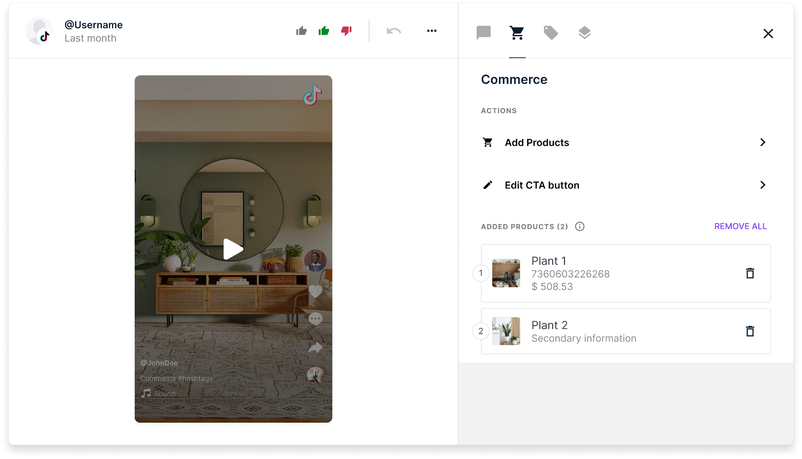
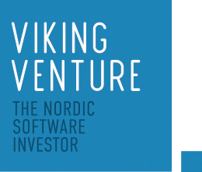
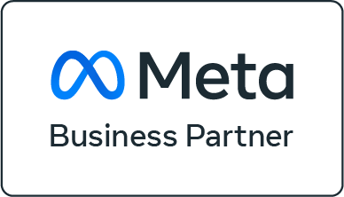






TikTok Collection
Add-on
You can connect TikTok content to your product catalog and showcase it in your Flows and galleries, just like with other social media platforms. Once your TikTok account is connected to Flowbox, you can start collecting content in two ways:
Username Source Type: Gather content that you have posted.
Chrome Extension: Collect content from other creators using the URL/Chrome extension.
What are the benefits?
Streamlined Content Management: Automatically organise and moderate collected content.
Enhanced Engagement: Tap into TikTok’s highly engaging UGC.
Effortless Integration: Easy connection of your TikTok account to Flowbox.
Diverse Content Sources: Gather your own posts and content from other creators.
Duplicate Prevention: Avoid collecting the same content multiple times.
Improved Brand Visibility: Leverage TikTok’s influence to boost brand discovery and sales.
Flowbox is backed by Viking Venture, the leading Nordic software investor.
Brands worldwide use Flowbox:
17
11

Slide 21
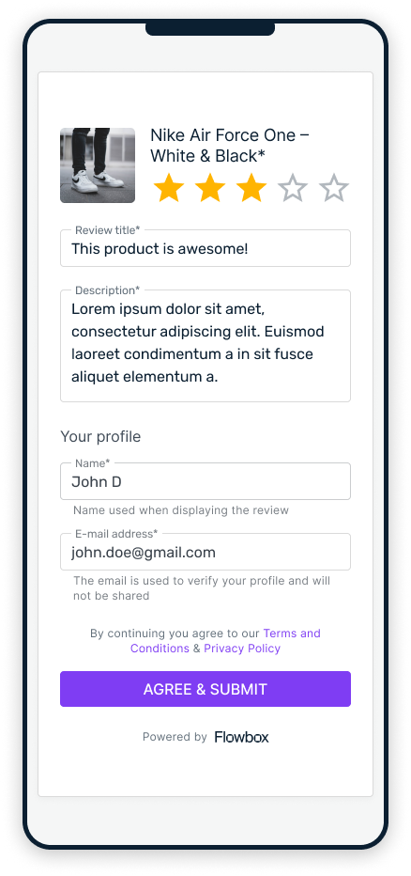
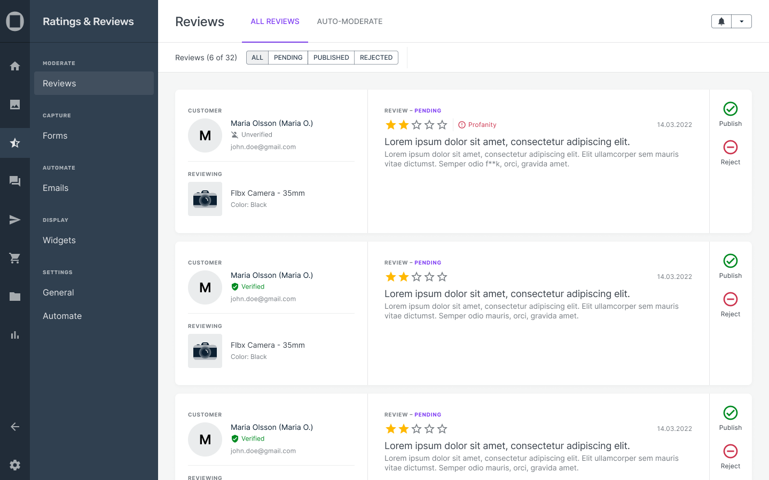
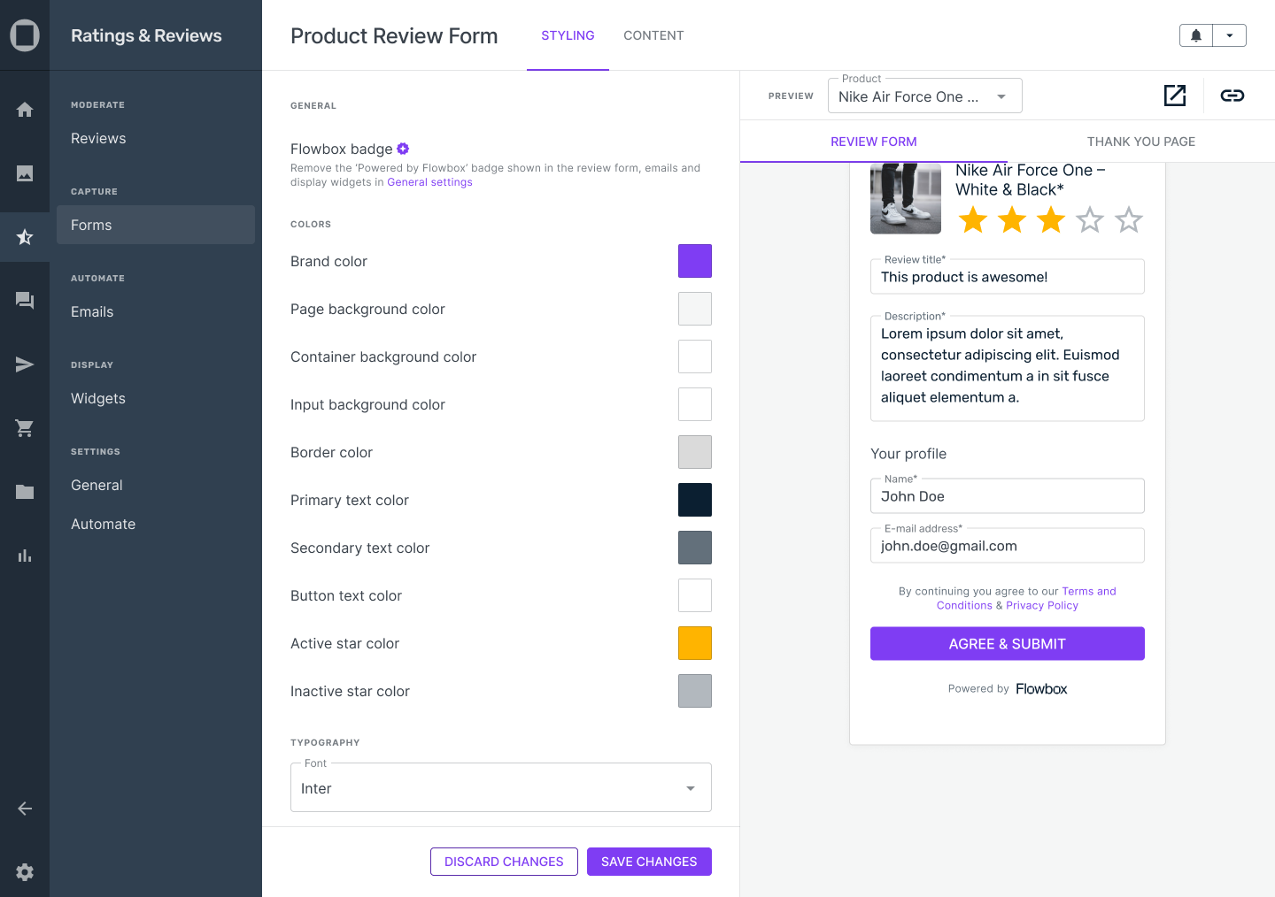
Ratings and reviews
Add-on
18

