Slide 1


Workshop PICo 14/04/2022
Alexis Jeandet <alexis.jeandet@member.fsf.org>
GitHub/IRC/Matrix(one.ems.host)/Gitter/...: jeandet

Slide 2
Schedule
14h00 Presentation
15h00 Experiments (pt 1)
16h00 Break
16h10 Experiments (pt 2)
17h30 Round table?

Slide 3
Laboratory of Plasma Physics (LPP)
~100 to 130 Researchers + ITA + Students
3 Research teams
Mostly using Python nowadays for:
  Lab experiments data analysis
  Lab instruments control
  Space data analysis
  Simulations post processing and data analysis
  Writing small simulation codes

Slide 4
Jupyter
Project which provides enhanced functionalities for programming languages used in science(Julia, Python, R, …)
Brought notebooks to many users and languages
Started as IPython and reorganized in 2015 with IPython 4
Several modules:
  UI (JupyterLab, Jupyter Notebook, Qt console…)
  Kernels (IJulia, IPython, IRkernel, …)
  Widgets (ipywidgets, ipyleaflet, ipympl)
  Tools (nbconvert, nbdime, nbviewer, …)
Improves a lot user experience with REPL programming languages

Slide 5
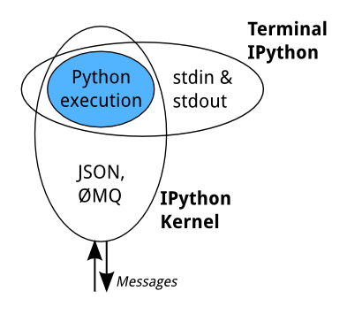
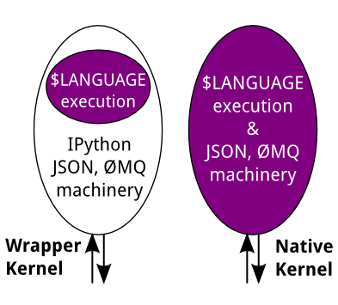
Read–eval–print loop (REPL)
Read more on:
- How IPython works
- Read–eval–print loop
- Making simple Python wrapper kernels

Slide 6
JupyterLab
What you can find the closest to an IDE for notebooks
Many features:
  Debugger
  Language server support
  Highly customizable layout (compared to notebook)
  Many plugins available

Slide 7
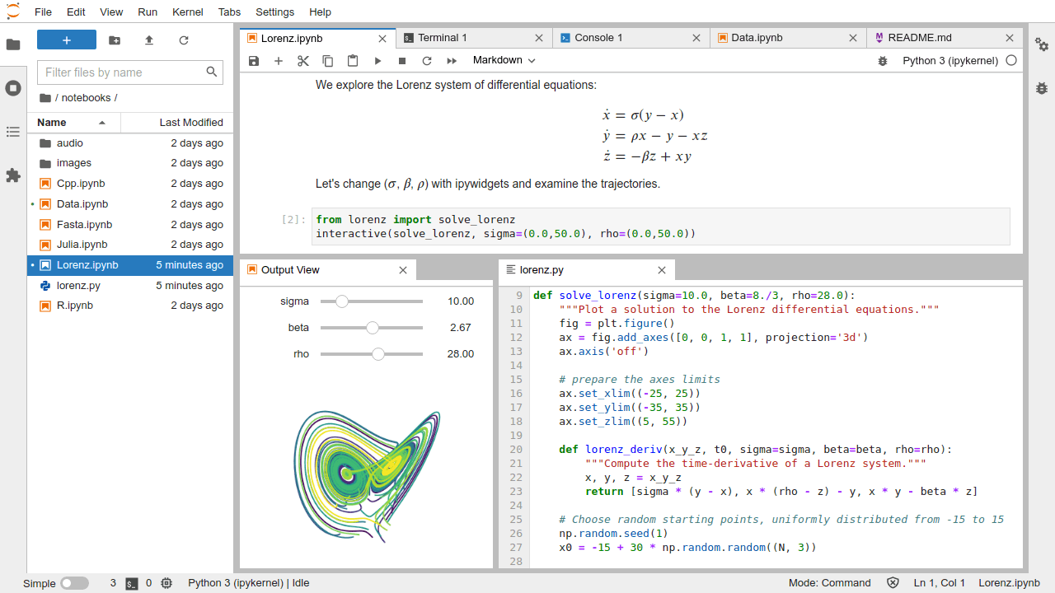
JupyterLab

Slide 8
How do we run JupyterLab?
Locally → just exec jupyter-lab
From a remote machine/cluster:
  Single user → exec jupyter-lab and bind network accordingly
  Multi-users → use JupyterHub or BinderHub

Slide 9
JupyterHub
An entry point for users
A login engine
A Jupyter lab or notebook spawner
An highly modular and customizable solution (Python)
A solution to have shared a multi-user Jupyter notebook server

Slide 10
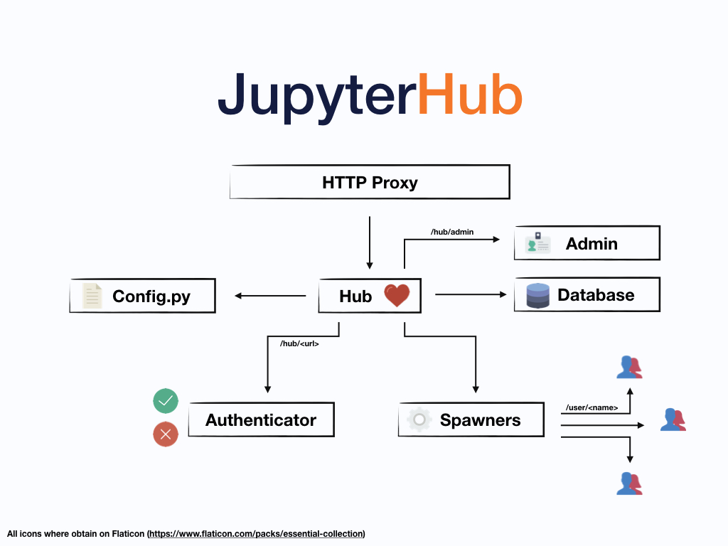

Slide 11
Possible setups
Hosting:
  Native/VM, k8s
Authentication:
  Local (PAM), ssh, Google, GitHub, Auth0, …
Spawners:
  Native, Docker, k8s, batch, ssh, Yarn, Any, …

Slide 12
LPP Setup (needs)
A ready to use Python environment for all lab users and collaborators (from students to advanced users)
An unique environment no matter from where or which machine you connect
A much bigger machine than you would have on your desk
A close to data servers post processing machine
A near 0 downtime service

Slide 13
LPP Setup (History)
2014, Started as a project wide shared machine with:
  Native Hub, PAM, Native spawner
  ~5 users, 8 CPU, 32 GB RAM (<2k€)
2018, Evoluted to a lab wide machine with public access:
  Native Hub, PAM, Native spawner
  30+ users, 32 CPU, 128GB RAM, 8TB SSD, 40TB HDD (<8k€)
2021, New bigger machine:
  Native Hub, SSH, Docker spawner
  30+ users, 48 CPU, 384GB, 70TB HDD, A100 GPU (~20k€)

Slide 14
LPP Setup (History highlights)
Mostly increase resources to host more users
Switch to Docker to both provide several environments and ease maintenance
Whole setup done with Ansible so each upgrade or modification can be tested on a VM in few minutes.
Custom Docker images are built from our CI

Slide 15






LPP Setup
CI
Registry
WAN
LAN

Slide 16
LPP Setup
Configuration mostly resides in JupyterHub config.py
1 c.JupyterHub.allow_named_servers = True
2 c.JupyterHub.named_server_limit_per_user = 5
3 c.JupyterHub.authenticator_class = 'sshauthenticator.SSHAuthenticator'
4 c.SSHAuthenticator.server_address = 'localhost'
5 c.SSHAuthenticator.server_port = 22

Slide 17
LPP Setup
1 c.JupyterHub.bind_url = 'http://:8000/jupyter/'
2 c.JupyterHub.hub_connect_ip = '172.17.0.1'
3 c.JupyterHub.hub_ip = '0.0.0.0'
4 c.JupyterHub.proxy_api_ip = '0.0.0.0'
5 c.Spawner.default_url = '/lab'

Slide 18
LPP Setup
1 c.JupyterHub.spawner_class = 'dockerspawner.SystemUserSpawner'
2 c.DockerSpawner.allowed_images = {...}
3 c.SystemUserSpawner.remove = True
4 c.DockerSpawner.extra_host_config = {
5 "mem_limit": "80g",
6 "cpu_percent": int(50),
7 "runtime": "nvidia",
8 "privileged": False
9 }

Slide 19
LPP Setup
1 c.DockerSpawner.pull_policy = "always"
2 c.SystemUserSpawner.host_ip = "0.0.0.0"
3 c.DockerSpawner.hub_ip_connect = "172.17.0.1"
4 c.DockerSpawner.volumes = {"/DATA": "/DATA", "/pplasma": "/pplasma"}
5 import os
6 c.DockerSpawner.environment = {
7 'XDG_CACHE_HOME': lambda spawner: os.path.join(spawner.homedir, '.cache')
8 }

Slide 20
LPP Setup
1 import docker
2 c.DockerSpawner.extra_host_config = {
3 "device_requests": [
4 docker.types.DeviceRequest(
5 count=-1,
6 capabilities=[["gpu"]],),
7 ],
8 }

Slide 21
Design considerations
You have to chose between many options with really different benefits and drawbacks

Slide 22
Design considerations
Do you want to persist users home directory?
Are your users able or willing to make their own environment?
How many different classes of users?
How different are your users needs?
How many users?
Will it scale?
What are your security rules? Selinux? Remote exec?
GPU?

Slide 23
Pitfalls
Prefer multiple small Python environments over a big one
Prefer PyPi over conda for python packages
Check your preferred Jupyter extensions compatibility before upgrading JupyterLab/Notebook/Python
Try to add few unit tests to validate a new stack
Monitor resources usage

Slide 24
Conclusion
Lab scale JupyterHub server worth it
You are really likely to find a setup for your needs
Try to avoid all maintenance nightmares!
Everything moves fast, issues get solved, stuff get deprecated...

Slide 25
Docker tips
Start a container from a given image:
  docker run -it [--rm] image:tag [cmd/entry point]
Build a docker image:
  docker build -t image_name .

Slide 26
Exercise 1 (basic)
Basic JupyterLab+IPython kernel setup with either docker or virtualenv

Slide 27
Exercise 2 (kernels)
Basic JupyterLab setup with either docker or virtualenv for another language of your choice
Bonus, try to propose more than two languages including Python

Slide 28
Exercise 3 (extensions)
JupyterLab setup with either docker or virtualenv, with ipympl and ipyleaflet
Bonus, find some plugins you might want to use and install them

Slide 29
Exercise 4 (docker stacks)
Find how to start and use Jupyter Docker stacks images:
  https://github.com/jupyter/docker-stacks
Bonus, customize one image with extra dependencies you might want

Slide 30
Exercise 5 (docker hub)
Install and configure JupyterHub to run locally on your machine with a compatible spawner
You should use either a virtual environment or a virtual machine, Docker won’t work

