Slide 1


Word recognition
Guénon Marie
Achard Jean-Paul
Favreau Jean-Dominique
MAM4 G1

Slide 2
Introduction
Guénon Marie
Achard Jean-Paul
Favreau Jean-Dominique

Slide 3
Contents
Sound treatment
Hamming window
Fourier transformation
Mel scale and filter bank
Comparison
Existent methods
Dynamic Time Warping
Method amelioration
Results
Human Machine Interface
Guénon Marie
Achard Jean-Paul
Favreau Jean-Dominique

Slide 4
Sound treatment
I. Sound treatment
a. Hamming window
b. Fourier transformation
c. Mel scale and filter bank
II. Comparison
III. Human Machine
Interface
Sound recording
Time split
Treatment of each slice
Guénon Marie
Achard Jean-Paul
Favreau Jean-Dominique

Slide 5
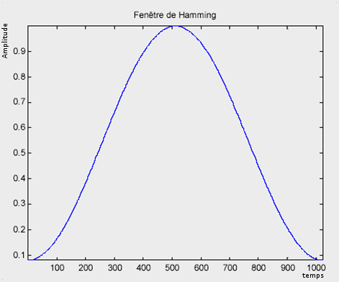


Hamming window
I. Sound treatment
a. Hamming window
b. Fourier transformation
c. Mel scale and filter bank
II. Comparison
III. Human Machine
Interface
Avoid big discontinuities on the borders
Avoid inconsistent results with the Fourier transformation
Guénon Marie
Achard Jean-Paul
Favreau Jean-Dominique

Slide 6
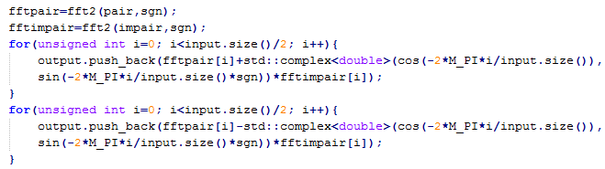
Fourier transformation
I. Sound treatment
a. Hamming window
b. Fourier transformation
c. Mel scale and filter bank
II. Comparison
III. Human Machine
Interface
Obtain the frequencies characteristics
Fast Fourier transformation
Guénon Marie
Achard Jean-Paul
Favreau Jean-Dominique

Slide 7

Mel scale and filter bank
I. Sound treatment
a. Hamming window
b. Fourier transformation
c. Mel scale and filter bank
II. Comparison
III. Human Machine
Interface
Mel scale:
Reduce the importance of high frequencies
From Hz to Mel
Guénon Marie
Achard Jean-Paul
Favreau Jean-Dominique

Slide 8
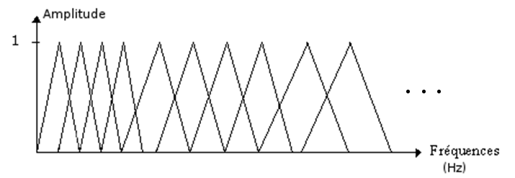
Mel scale and filter bank
I. Sound treatment
a. Hamming window
b. Fourier transformation
c. Mel scale and filter bank
II. Comparison
III. Human Machine
Interface
Filter bank:
Reduce the number of frequencies considered
Uniform on the Mel scale, non uniformly on the frequency scale
Guénon Marie
Achard Jean-Paul
Favreau Jean-Dominique

Slide 9
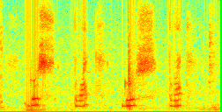
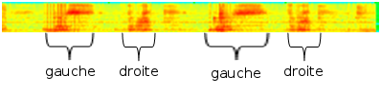
Mel scale and filter bank
I. Sound treatment
a. Hamming window
b. Fourier transformation
c. Mel scale and filter bank
II. Comparison
III. Human Machine
Interface
Guénon Marie
Achard Jean-Paul
Favreau Jean-Dominique

Slide 10
Comparison
I. Sound treatment
II. Comparison
a. Existent methods
b. Dynamic Time Warping
c. Method amelioration
d. Results
III. Human Machine
Interface
“Bas”
“Gauche”
“Haut”
“Droite”
Guénon Marie
Achard Jean-Paul
Favreau Jean-Dominique

Slide 11
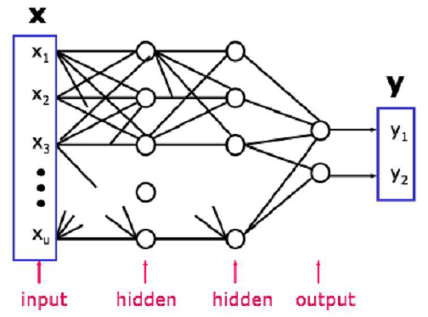
Existent methods
I. Sound treatment
II. Comparison
a. Existent methods
b. Dynamic Time Warping
c. Method amelioration
d. Results
III. Human Machine
Interface
Artificial neuronal networks:
Guénon Marie
Achard Jean-Paul
Favreau Jean-Dominique
Notes:
In our case, we have a small vocabulary (about twenty words) based on a single-speaker (considering that during a phase of recording a single person has to speak). That’s why it is not necessary here to use a neural network that is heavier to implement (on a computational point) and it suffices to change the comparison database for each new user.

Slide 12
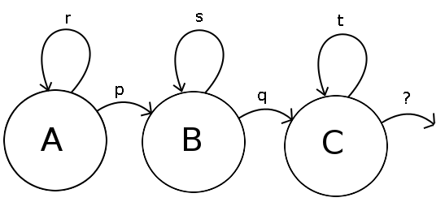
Existent methods
I. Sound treatment
II. Comparison
a. Existent methods
b. Dynamic Time Warping
c. Method amelioration
d. Results
III. Human Machine
Interface
Hidden Markov model
Guénon Marie
Achard Jean-Paul
Favreau Jean-Dominique
Notes:
However, it is not interesting in this case to use the hidden Markov model, because it is too complex for the small vocabulary we are using. So it is sufficient for us to use the Dynamic Time Warping which is a simplification of the hidden Markov model.

Slide 13
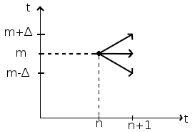
Dynamic Time Warping
I. Sound treatment
II. Comparison
a. Existent methods
b. Dynamic Time Warping
c. Method amelioration
d. Results
III. Human Machine
Interface
Guénon Marie
Achard Jean-Paul
Favreau Jean-Dominique

Slide 14
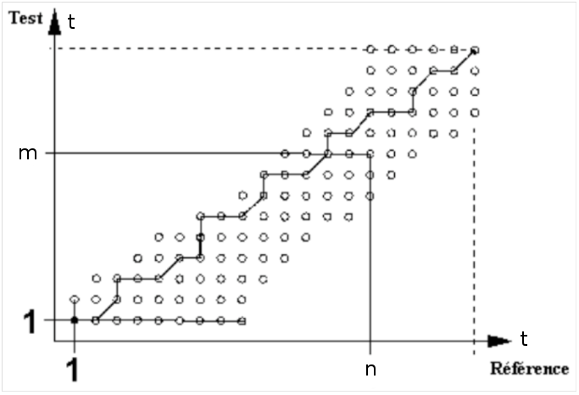
Dynamic Time Warping
I. Sound treatment
II. Comparison
a. Existent methods
b. Dynamic Time Warping
c. Method amelioration
d. Results
III. Human Machine
Interface
Guénon Marie
Achard Jean-Paul
Favreau Jean-Dominique

Slide 15
Dynamic Time Warping
I. Sound treatment
II. Comparison
a. Existent methods
b. Dynamic Time Warping
c. Method amelioration
d. Results
III. Human Machine
Interface
CODE !!!!
Guénon Marie
Achard Jean-Paul
Favreau Jean-Dominique

Slide 16
Dynamic Time Warping
I. Sound treatment
II. Comparison
a. Existent methods
b. Dynamic Time Warping
c. Method amelioration
d. Results
III. Human Machine
Interface
Limits
Guénon Marie
Achard Jean-Paul
Favreau Jean-Dominique

Slide 17
Method amelioration
I. Sound treatment
II. Comparison
a. Existent methods
b. Dynamic Time Warping
c. Method amelioration
d. Results
III. Human Machine
Interface
Guénon Marie
Achard Jean-Paul
Favreau Jean-Dominique

Slide 18
Results
I. Sound treatment
II. Comparison
a. Existent methods
b. Dynamic Time Warping
c. Method amelioration
d. Results
III. Human Machine
Interface
Guénon Marie
Achard Jean-Paul
Favreau Jean-Dominique

Slide 19
Conclusion
Guénon Marie
Achard Jean-Paul
Favreau Jean-Dominique

Slide 20

Do you have any question?

