Slide 1


Word recognition
Guénon Marie
Achard Jean-Paul
Favreau Jean-Dominique
MAM4 G1
Notes:
JP

Slide 2
Introduction
Home automation system
Disable persons
Games
Guénon Marie
Achard Jean-Paul
Favreau Jean-Dominique
MAM4
Notes:
JP

Slide 3
Contents
Sound treatment
Hamming window
Fourier transformation
Mel’s scale and filter bank
Comparison
Existing methods
Dynamic Time Warping
Method amelioration
Results
Human Machine Interface
Menu
How to play
Guénon Marie
Achard Jean-Paul
Favreau Jean-Dominique
MAM4
Notes:
JD

Slide 4
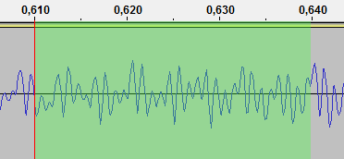
Sound treatment
I. Sound treatment
a. Hamming window
b. Fourier transformation
c. Mel’s scale and filter bank
II. Comparison
III. Human Machine
Interface
Sound recording
Time split
Treatment of each slice
Guénon Marie
Achard Jean-Paul
Favreau Jean-Dominique
MAM4
Notes:
JP

Slide 5
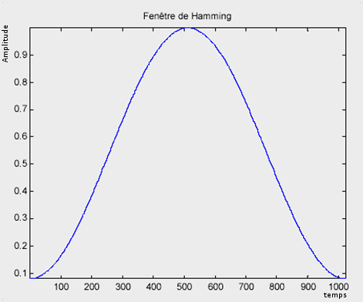


Hamming window
I. Sound treatment
a. Hamming window
b. Fourier transformation
c. Mel’s scale and filter bank
II. Comparison
III. Human Machine
Interface
Avoid big discontinuities on the borders
Avoid inconsistent results with the Fourier transformation
Guénon Marie
Achard Jean-Paul
Favreau Jean-Dominique
MAM4
Notes:
JD

Slide 6
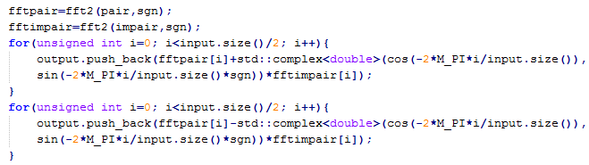
Fourier transformation
I. Sound treatment
a. Hamming window
b. Fourier transformation
c. Mel’s scale and filter bank
II. Comparison
III. Human Machine
Interface
Obtain the frequencies characteristics
Fast Fourier transformation
Guénon Marie
Achard Jean-Paul
Favreau Jean-Dominique
MAM4
Notes:
JP
TNS

Slide 7

Mel’s scale and filter bank
I. Sound treatment
a. Hamming window
b. Fourier transformation
c. Mel’s scale and filter bank
II. Comparison
III. Human Machine
Interface
Mel’s scale:
Reduce the importance of high frequencies
From Hz to Mel
Guénon Marie
Achard Jean-Paul
Favreau Jean-Dominique
MAM4
Notes:
M
the perception intensity of a stimulus does not linearly increase as a function of its power, but exponentially.

Slide 8
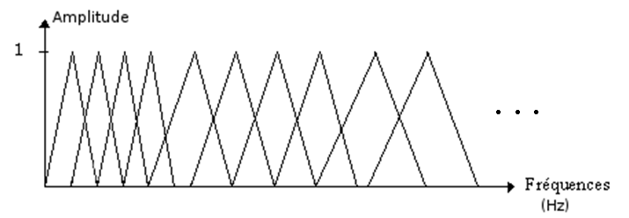
Mel’s scale and filter bank
I. Sound treatment
a. Hamming window
b. Fourier transformation
c. Mel’s scale and filter bank
II. Comparison
III. Human Machine
Interface
Filter bank:
Reduce the number of frequencies considered
Uniform on the Mel’s scale, non uniformly on the frequency scale
Guénon Marie
Achard Jean-Paul
Favreau Jean-Dominique
MAM4
Notes:
M

Slide 9
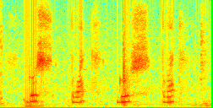
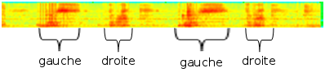
Mel’s scale and filter bank
I. Sound treatment
a. Hamming window
b. Fourier transformation
c. Mel’s scale and filter bank
II. Comparison
III. Human Machine
Interface
Guénon Marie
Achard Jean-Paul
Favreau Jean-Dominique
MAM4
Notes:
M

Slide 10
Comparison
I. Sound treatment
II. Comparison
a. Existing methods
b. Dynamic Time Warping
c. Method amelioration
d. Results
III. Human Machine
Interface
“Bas”
“Gauche”
“Haut”
“Droite”
Guénon Marie
Achard Jean-Paul
Favreau Jean-Dominique
MAM4
Notes:
JP

Slide 11
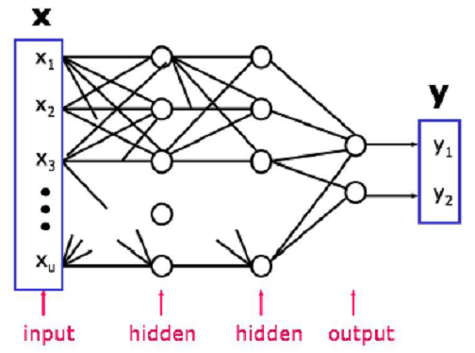
Existing methods
I. Sound treatment
II. Comparison
a. Existing methods
b. Dynamic Time Warping
c. Method amelioration
d. Results
III. Human Machine
Interface
Artificial neuronal networks:
Guénon Marie
Achard Jean-Paul
Favreau Jean-Dominique
MAM4
Notes:
JP
Infographie
In our case, we have a small vocabulary (about twenty words) based on a single-speaker (considering that during a phase of recording a single person has to speak). That’s why it is not necessary here to use a neural network that is heavier to implement (on a computational point) and it suffices to change the comparison database for each new user.

Slide 12
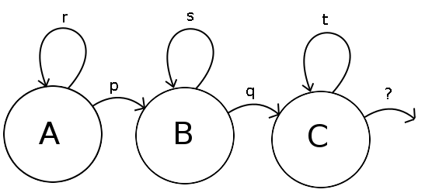
Existing methods
I. Sound treatment
II. Comparison
a. Existing methods
b. Dynamic Time Warping
c. Method amelioration
d. Results
III. Human Machine
Interface
Hidden Markov model
Guénon Marie
Achard Jean-Paul
Favreau Jean-Dominique
MAM4
Notes:
JP
However, it is not interesting in this case to use the hidden Markov model, because it is too complex for the small vocabulary we are using. So it is sufficient for us to use the Dynamic Time Warping which is a simplification of the hidden Markov model.

Slide 13
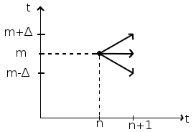
Dynamic Time Warping
I. Sound treatment
II. Comparison
a. Existing methods
b. Dynamic Time Warping
c. Method amelioration
d. Results
III. Human Machine
Interface
Guénon Marie
Achard Jean-Paul
Favreau Jean-Dominique
MAM4
Notes:
JD

Slide 14
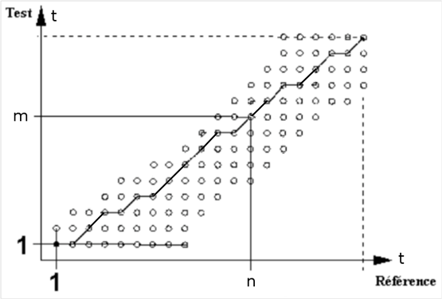
Dynamic Time Warping
I. Sound treatment
II. Comparison
a. Existing methods
b. Dynamic Time Warping
c. Method amelioration
d. Results
III. Human Machine
Interface
Example of minimal path
Guénon Marie
Achard Jean-Paul
Favreau Jean-Dominique
MAM4
Notes:
JD

Slide 15
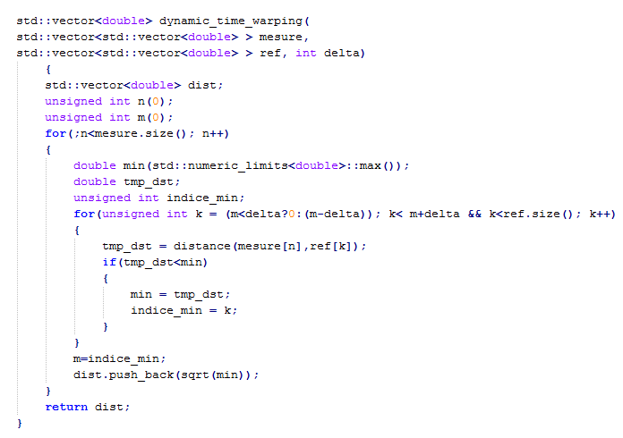
Dynamic Time Warping
I. Sound treatment
II. Comparison
a. Existing methods
b. Dynamic Time Warping
c. Method amelioration
d. Results
III. Human Machine
Interface
Guénon Marie
Achard Jean-Paul
Favreau Jean-Dominique
MAM4
Notes:
JD

Slide 16
Dynamic Time Warping
I. Sound treatment
II. Comparison
a. Existing methods
b. Dynamic Time Warping
c. Method amelioration
d. Results
III. Human Machine
Interface
Limits:
Euclidean distance
Slower for big vocabularies
Word width
Guénon Marie
Achard Jean-Paul
Favreau Jean-Dominique
MAM4
Notes:
JD
The difference between /a/ and /wa/ from “bas” and “droite”
Mahalanobis distance

Slide 17
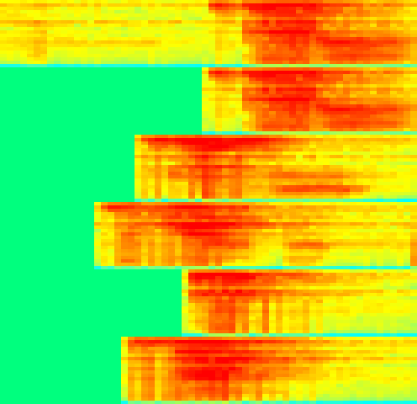
Method amelioration
I. Sound treatment
II. Comparison
a. Existing methods
b. Dynamic Time Warping
c. Method amelioration
d. Results
III. Human Machine
Interface
DTW parameters modifications
Word beginning detection
Global approach on DTW
Guénon Marie
Achard Jean-Paul
Favreau Jean-Dominique
MAM4
Notes:
M
Begining: difference of energy

Slide 18
Results
I. Sound treatment
II. Comparison
a. Existing methods
b. Dynamic Time Warping
c. Method amelioration
d. Results
III. Human Machine
Interface
Words Method …. | “gauche”, “droite”, “haut”, “bas” | “Bonjour”, “Hello”, “Maison”, ”Placard” | “vacherin”, “tiramisu”, “moelleux”, “bûche” | “Riri”, “Fifi”, “Loulou”, “toto”
DTW local | 62,5% | 80% | 70% | 70%
DTW local and beginning detection | 62,5% | 80% | 70% | 70%
DTW median and beginning detection | 85% | 85% | 98% | 65%
DTW global and beginning detection | 95% | 90% | 98% | 85%
Guénon Marie
Achard Jean-Paul
Favreau Jean-Dominique
MAM4
Notes:
M

Slide 19
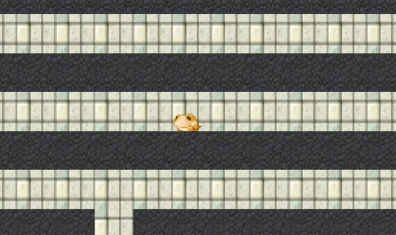
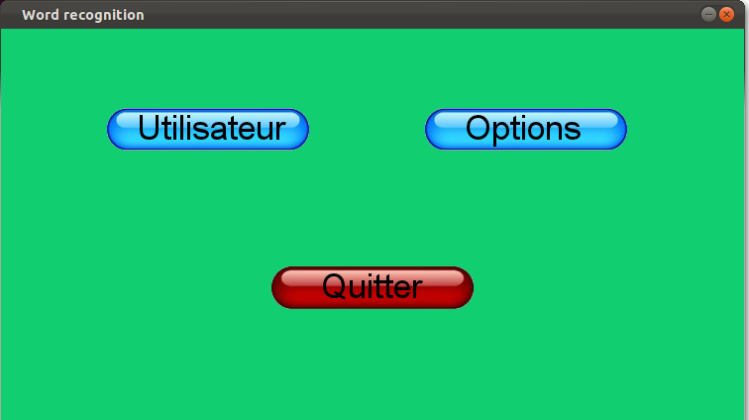
Human Machine Interface
I. Sound treatment
II. Comparison
III. Human Machine
Interface
a. Menu
b. How to play
Guénon Marie
Achard Jean-Paul
Favreau Jean-Dominique
MAM4
Notes:
JD
C++

Slide 20
Menu
I. Sound treatment
II. Comparison
III. Human Machine
Interface
a. Menu
b. How to play
Guénon Marie
Achard Jean-Paul
Favreau Jean-Dominique
MAM4
Notes:
JD

Slide 21
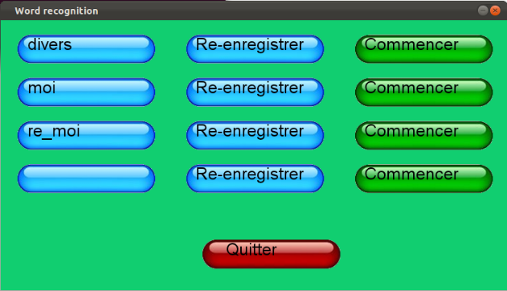
Menu
I. Sound treatment
II. Comparison
III. Human Machine
Interface
a. Menu
b. How to play
Guénon Marie
Achard Jean-Paul
Favreau Jean-Dominique
MAM4
Notes:
JD

Slide 22
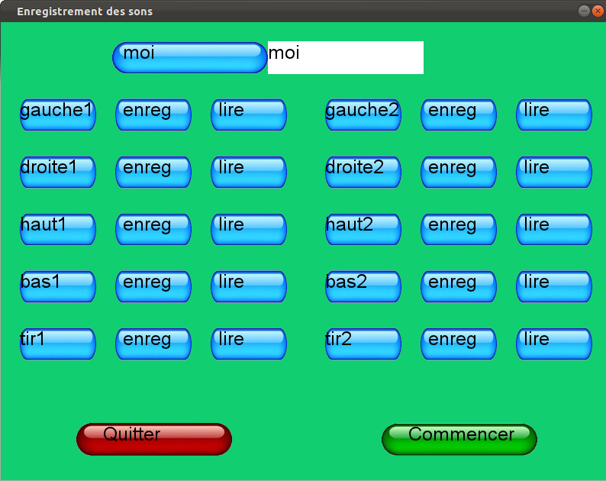
Menu
I. Sound treatment
II. Comparison
III. Human Machine
Interface
a. Menu
b. How to play
Guénon Marie
Achard Jean-Paul
Favreau Jean-Dominique
MAM4
Notes:
JP

Slide 23
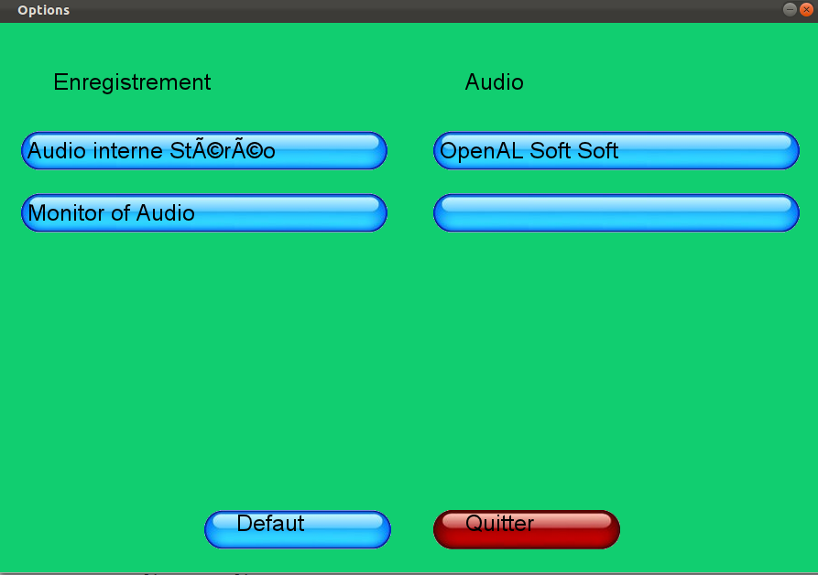
Menu
I. Sound treatment
II. Comparison
III. Human Machine
Interface
a. Menu
b. How to play
Guénon Marie
Achard Jean-Paul
Favreau Jean-Dominique
MAM4
Notes:
JP

Slide 24
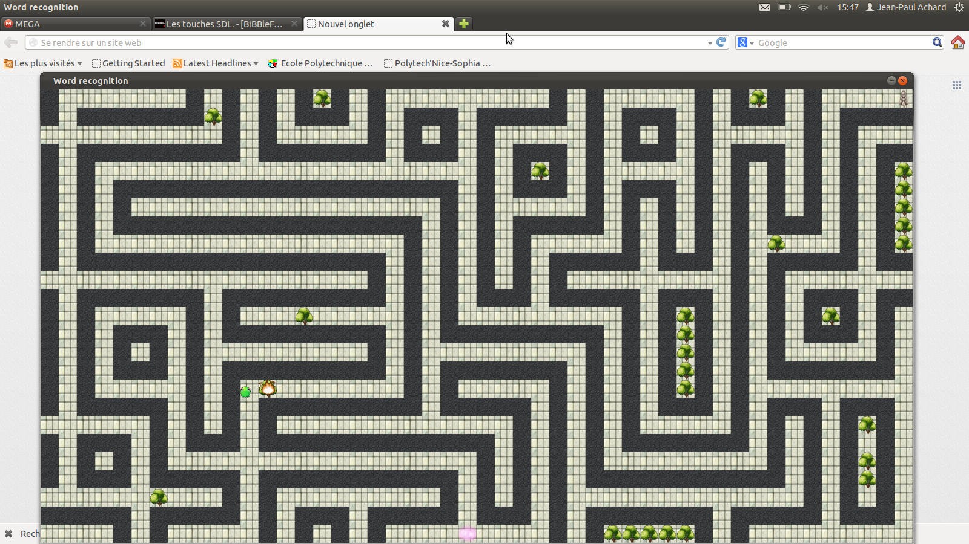
Human Machine Interface
I. Sound treatment
II. Comparison
III. Human Machine
Interface
a. Menu
b. How to play
Guénon Marie
Achard Jean-Paul
Favreau Jean-Dominique
MAM4
Notes:
M
Multi thread / synchronisation

Slide 25
Human Machine Interface
I. Sound treatment
II. Comparison
III. Human Machine
Interface
a. Menu
b. How to play
Beginning:
End:
Guénon Marie
Achard Jean-Paul
Favreau Jean-Dominique
MAM4
Notes:
M

Slide 26
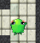
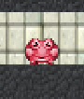
Human Machine Interface
I. Sound treatment
II. Comparison
III. Human Machine
Interface
a. Menu
b. How to play
Moving:
Waiting:
Wall:
Fire:
Guénon Marie
Achard Jean-Paul
Favreau Jean-Dominique
MAM4
Notes:
M

Slide 27
Human Machine Interface
I. Sound treatment
II. Comparison
III. Human Machine
Interface
a. Menu
b. How to play
Guénon Marie
Achard Jean-Paul
Favreau Jean-Dominique
MAM4
Notes:
M
Multi thread / synchronisation

Slide 28
Conclusion
Interesting project
Apply our courses(TNS, Infographie, C++)
Deepen our knowledge
Others ameliorations ?
Guénon Marie
Achard Jean-Paul
Favreau Jean-Dominique
MAM4
Notes:
M
Use of GitHub (revision control)
Random tree

Slide 29
Sources
J. Leroux « Dynamic time warping », « HMI », TNS
Wikipedia
J. Mariani « Reconnaissance de la parole, progrès et tendances », 1990
…
Guénon Marie
Achard Jean-Paul
Favreau Jean-Dominique
MAM4
Notes:
M

Slide 30

Practice !

Slide 31

Do you have any question?
Guénon Marie
Achard Jean-Paul
Favreau Jean-Dominique
MAM4

