Slide 1
A Pragmatic Interpretation of Hyperbole in Numbers
Jean Wu
In collaboration with Justine Kao and Leon Bergen
PI: Prof. Noah Goodman

Slide 2
Motivation
- In mathematics, a number has a precise semantic meaning that clearly distinguishes it from other numbers.
- In language, the meanings of numbers are much more flexible. People do not always mean what they say.
- Example: the psych textbook costs a million!

Slide 3
Problem Definition
What kind of inference mechanisms do people utilize to identify when a number is not intended to be interpreted literally?
Why might one exaggerate a statement? What additional information can we convey through hyperbolic statements?

Slide 4
Proposed Model
We want to use a Bayesian model to capture the pragmatic interpretation of the listener, i.e.,
Listener( message | utterance )

Slide 5
Methods
- 6 domains: coffee makers, electric kettles, headphones, laptops, sweaters, watches
- Empirical data for price distribution from scraping Amazon and Neweggs
- Experiment data for price prior and opinion prior using Amazon Mechanical Turk

Slide 6
Empirical Data: Price Prior
- We scraped 1000 price data points / item from Amazon
- Data for 'Laptop' were scraped from NewEgg

Slide 7
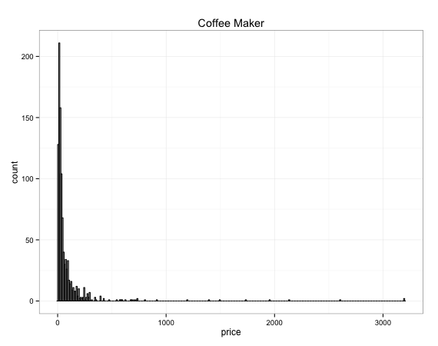

Slide 8
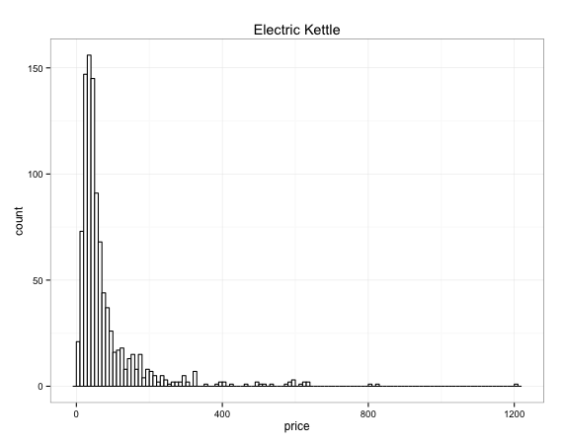

Slide 9
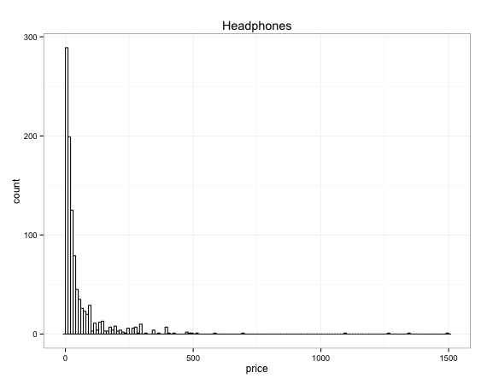

Slide 10
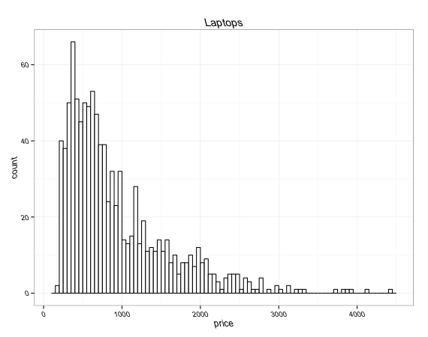

Slide 11
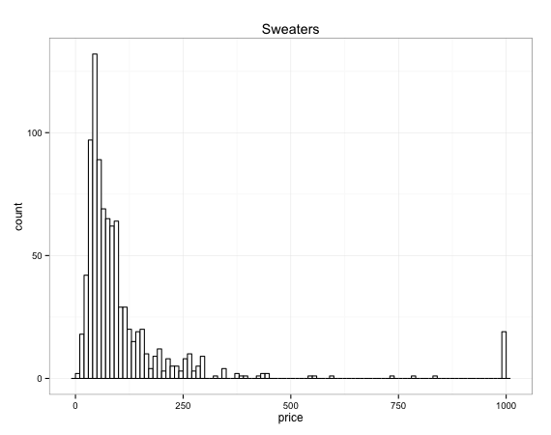

Slide 12
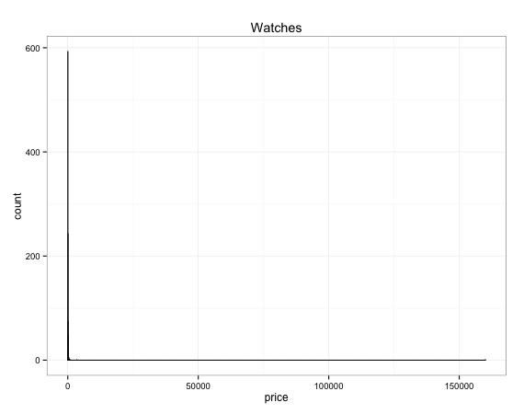

Slide 13
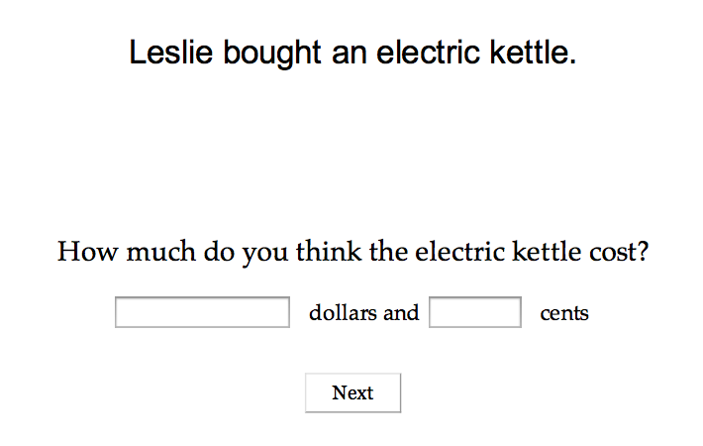
Experiment: Price Prior

Slide 14
Experiment: Price Prior
- Number of subjects = 126
- Problem: homogenous demographic of subjects
- Problem: regression to mean

Slide 15
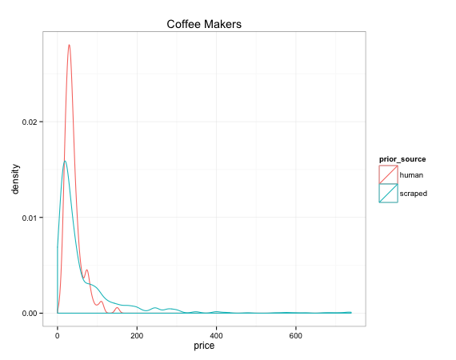
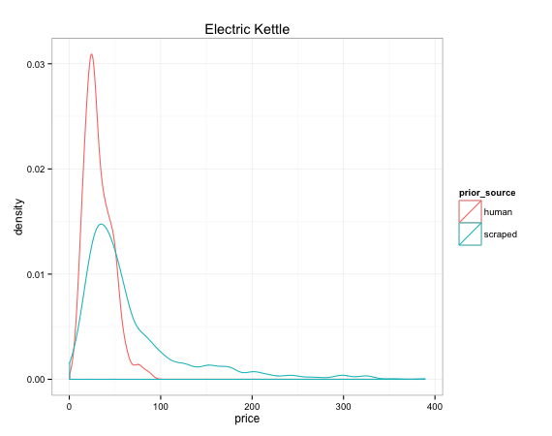

Slide 16
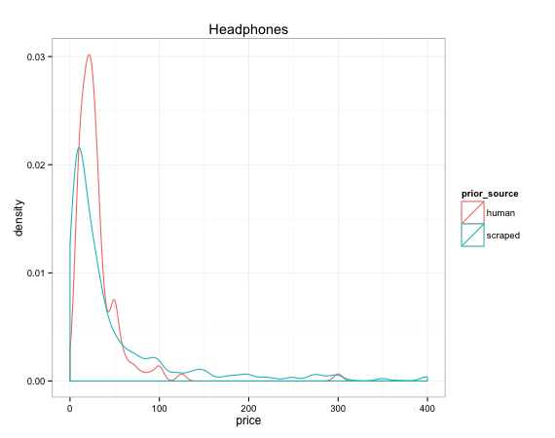
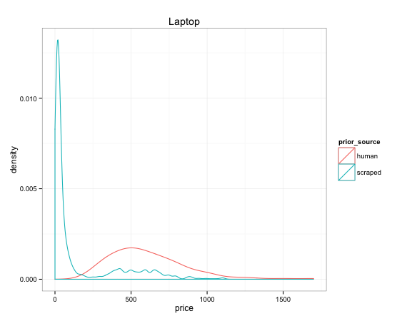
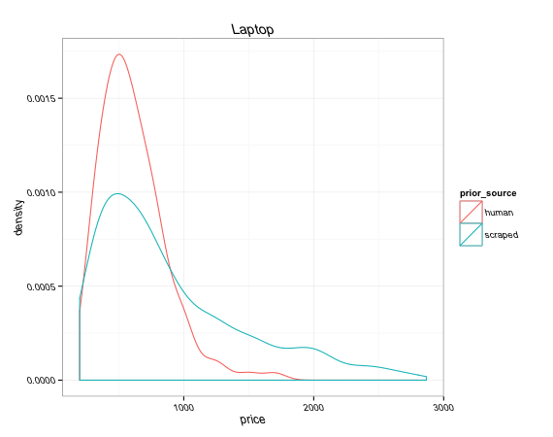

Slide 17
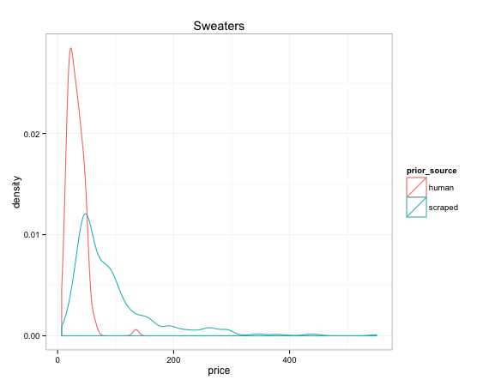
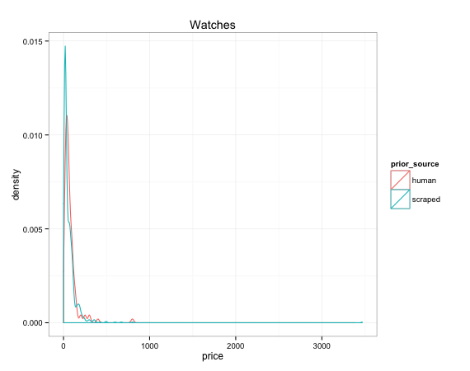

Slide 18
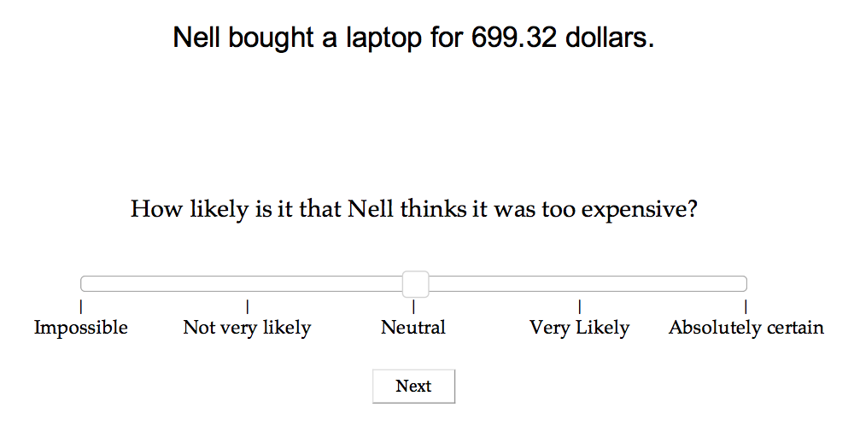
Experiment: Opinion Prior

Slide 19
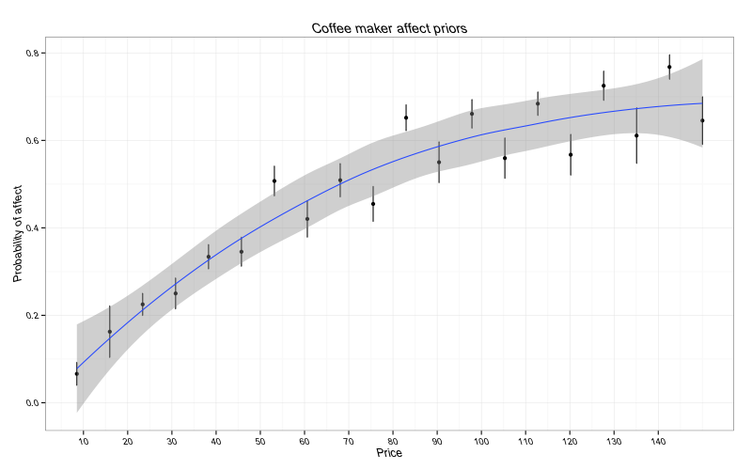

Slide 20
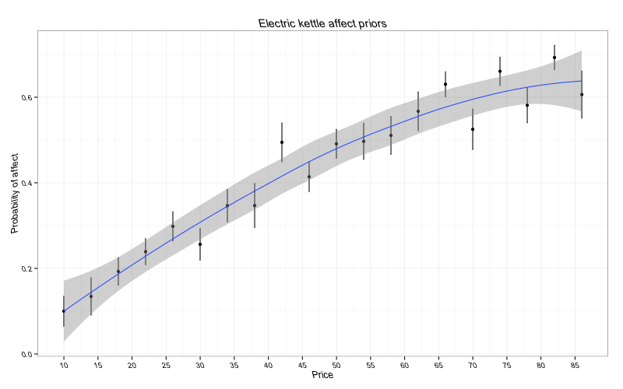

Slide 21
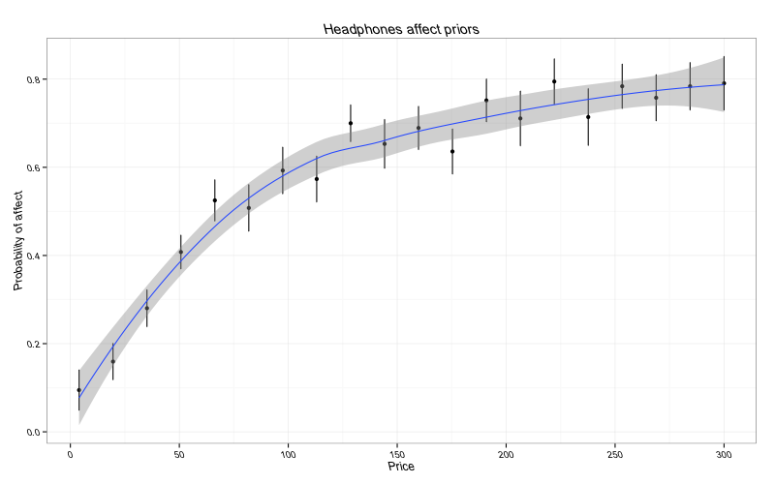

Slide 22
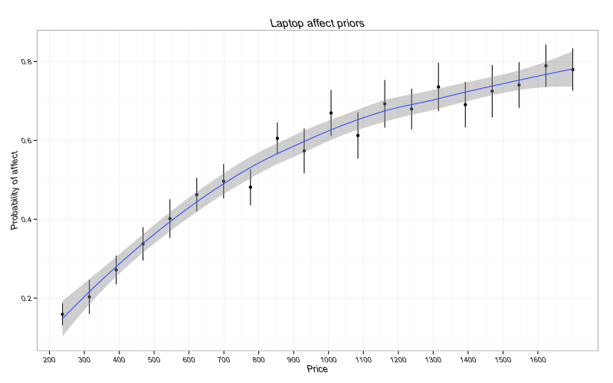

Slide 23
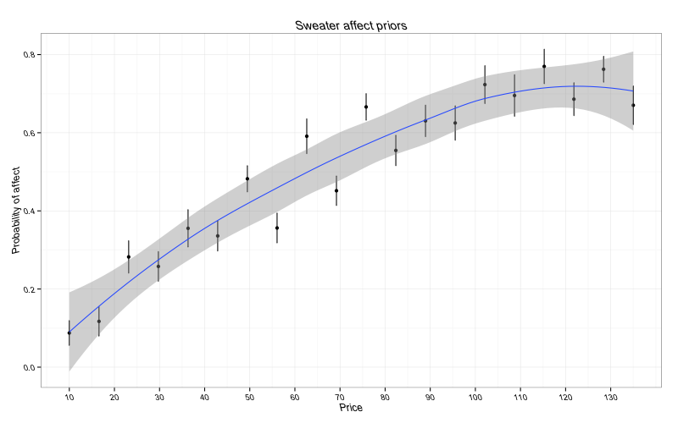

Slide 24
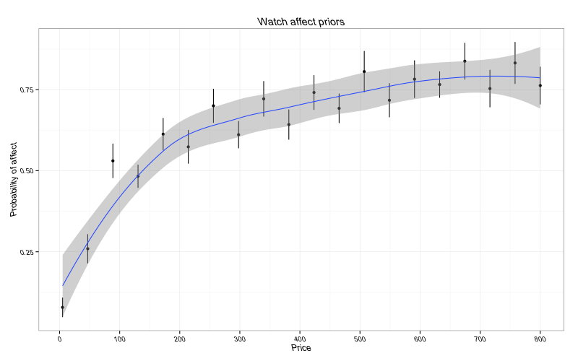

Slide 25
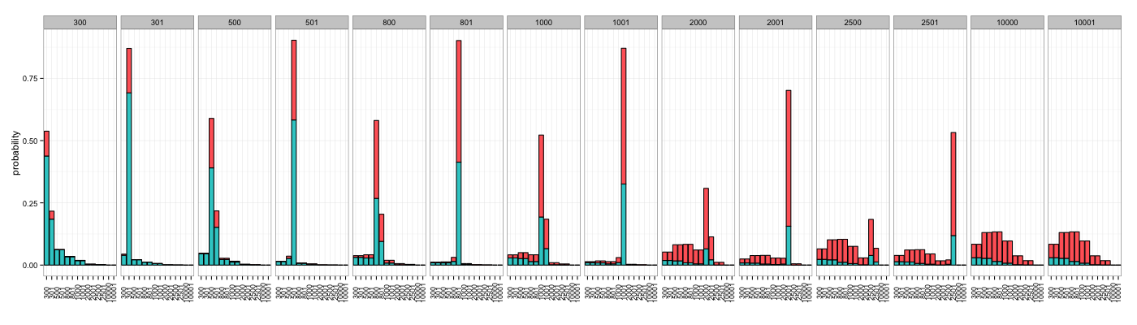
Model Prediction (Laptop)

Slide 26
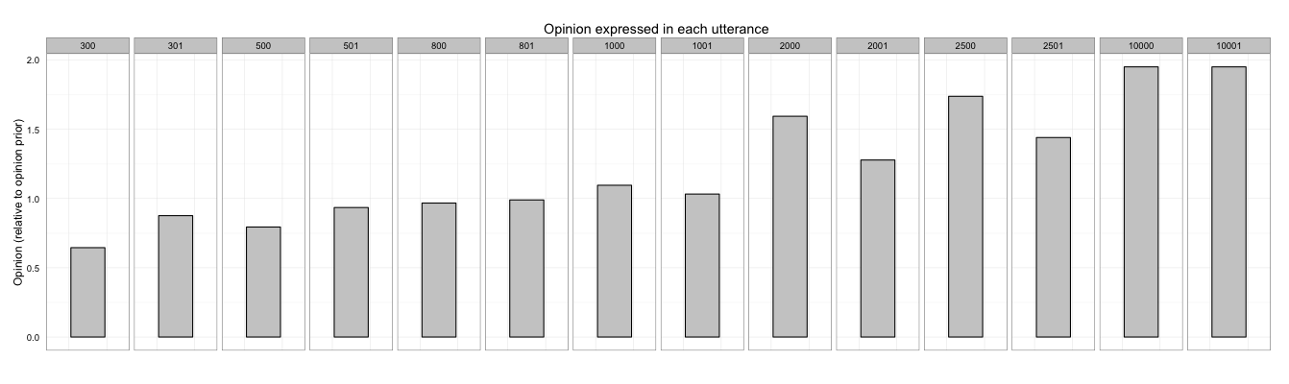
Model Prediction (Laptop)
Opinion values expressed in each utterance

Slide 27
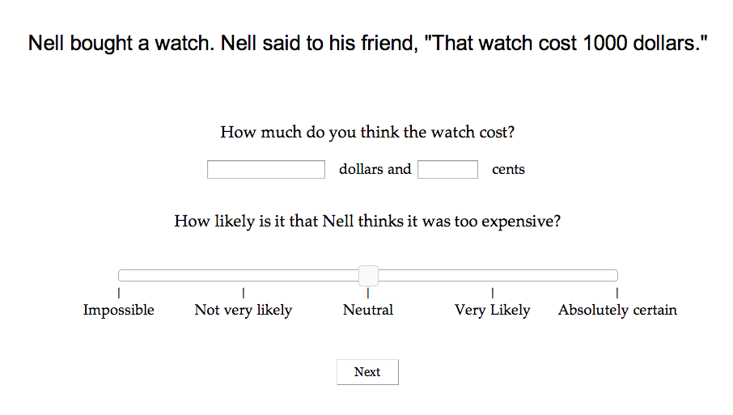
Experiment: Hyperbolic Interpretation

Slide 28
To be continued...
Thanks!
つづく

