Slide 1

Nonliteral language understanding for number words
Justine Kao
Frisem 2.21.2014
Notes:
Hi everyone, welcome to Frisem. My name is Justine Kao, and I am a 3rd year PhD student in Professor Noah Goodman’s Computation and Cognition Lab. Today I’m going to talk to you about my work on modeling nonliteral language understanding for number words.

Slide 2
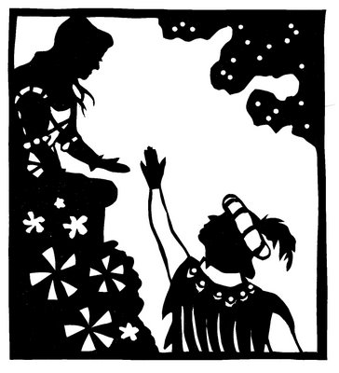
Nonliteral language
Notes:
Before we go into number words, I wanted to first show you a few examples of nonliteral language. Here is one that you probably had to analyze in high school, and so it should be familiar to most of you. In a classic scene in Romeo and Juliet, Romeo is about to find Juliet at her balcony. To profess his love for her, he utters these timeless words.

Slide 3
Nonliteral language
But soft! What light through yonder window breaks? It is the east, and Juliet is the sun.
Notes:
I won’t hazard a dramatic reading of this. I will instead focus on the last part of Romeo’s speech: Juliet is the sun. How does Juliet interpret this utterance?

Slide 4
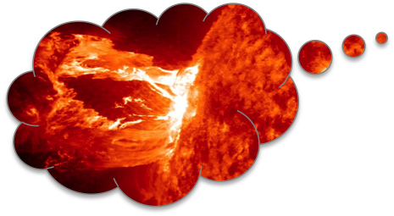
Nonliteral language
But soft! What light through yonder window breaks? It is the east, and Juliet is the sun.
He wants to tell me I am made of hot plasma.
Notes:
She could think, “Romeo wants to tell me I am made of hot plasma.” Not the most romantic message.

Slide 5
Nonliteral language
But soft! What light through yonder window breaks? It is the east, and Juliet is the sun.
He wants to tell me I am beautiful.
Notes:
Or she could think, “Romeo wants to tell me I am beautiful.” This is much more likely and is in fact the textbook interpretation of the metaphor.

Slide 6
Nonliteral language
But soft! What light through yonder window breaks? It is the east, and Juliet is the sun.
He wants to tell me I am hot.
Notes:
Or, of course, Juliet could simply infer that Romeo wants to tell her she is hot.
In both of the last two interpretations, Juliet needs to go beyond the literal meaning of the utterance to infer Romeo’s true message.

Slide 7

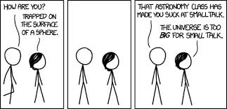
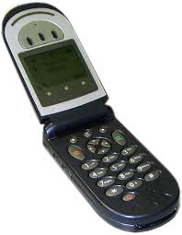
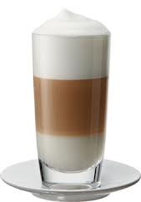
Nonliteral language in the wild
My phone is a hundred years old.
I told you a thousand times already.
A latte at that hipster place costs ten dollars.
Notes:
Nonliteral language isn’t something we encounter only in Shakespeare. We often hear a certain type of nonliteral language in everyday life without even thinking about it and interpret it effortlessly. Here is one example from a real-life rather scathing restaurant review on yelp. “Need I mention….” Here’s another one that you might have heard before from a parent or significant other. And a few others. While all of us have a clear mathematical understanding of the literal meanings of the numbers “a million”, “a hundred”, “a thousand””, and “10” etc, in all of these utterances, these literal meanings do not provide the correct interpretation. In fact, all of these sentences are false if taken literally. However, none of these sentences are considered lies. Instead, they are called hyperboles, a perfectly respectable subcategory of nonliteral language use. This will be the focus of my talk today.

Slide 8
Hyperbole
Rhetoric studies: “When the trope is exceedingly enlarged, or when the change of signiﬁcation is very high and lofty, or when in advancing or repressing one speaks much more than is precisely true, yea above all belief.” (Smith, 1657)
Has an affective dimension, is pragmatic in nature, and functions as a vertical-scale metaphor (Norrick, 1982)
Speakers often use hyperbole for emphasis, to evoke humor, or to express negative emotion (Roberts & Kreuz, 1994)
Successful interpretation hinges on common ground between speaker and listener and engagement in joint pretense (Clark, 1996; McCarthy & Carter, 2004; Gibb, 2000)
Notes:
The term hyperbole dates all the way back to Aristotle. In studies of rhetoric, hyperbole is defined as “when the trope is “ More recently, a linguist named Neal Norrick characterized hyperbole as having an affective dimension, being pragmatic in the nature of how it’s interpreted, and that it is a vertical-scale metaphor, meaning it is saying ‘‘more than necessary or justiﬁed’’ but not comparing one thing to a completely different thing like horizontal metaphors. An empirical study by psychologists looked at people’s motivations and purposes for using figurative language and found that people often use hyperbole to create emphasis, evoke humor, or express negative emotion. In most informal analyses of hyperbole, researchers have argued that successful hyperbole interpretation requires strong common ground between speaker and listener. It involves the listener entering into a “pact” with the speaker to accept extreme formulations and create a new layer of joint activity

Slide 9
Pragmatic halo
The use and interpretation of round and sharp numbers
Speakers utter round numbers to optimize relevance and achieve the same goal while minimizing effort (Van Der Henst et al., 2002)
Listeners interpret round numbers less precisely and sharp numbers more precisely (Lasersohn, 1999; Krifka, 2007; Bastiaanse, 2011)
Notes:
Another type of nonliteral use of numbers is a little less extreme, but still prevalent and important for our understanding of how number words are used in everyday language. This involves the different ways that people use and interpret round versus sharp numbers. Round numbers like 10 or 1000 tend to be numbers that are simpler, shorter to pronounce, and more frequent in the corpus. Sharp numbers like 11 or 1001 are longer and costlier to pronounce. Previous work has shown that speakers utter round numbers to optimize relevance and achieve the same goal while minimizing effort. Other work has shown that listeners interpret round numbers less precisely and sharp numbers more precisely. This phenomenon is called the “pragmatic halo.”

Slide 10
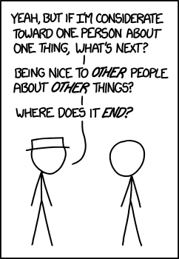
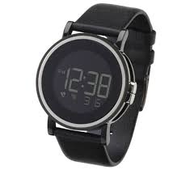
Pragmatic halo
The use and interpretation of round and sharp numbers
Speakers utter round numbers to optimize relevance and achieve the same goal while minimizing effort (Van Der Henst et al., 2002)
Listeners interpret round numbers less precisely and sharp numbers more precisely (Lasersohn, 1999; Krifka, 2007; Bastiaanse, 2011)
Twelve forty.
What time is it?
Notes:
As an example, consider the following dialogue. Andy asks, what time is it? And Bob replies, twelve forty. Even if the time is actually 12:38 and Bob knows it, he would not be lying. He is just using the number term loosely to achieve the same goal while minimizing effort. Also, Andy will not have interpreted Bob to mean 12:40 exactly, anyway, and will instead interpret it loosely. So this mutual understanding between the speaker and listener allows successful and efficient communication to take place.

Slide 11
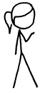
Interpreting utterances
How do people figure out what these utterances mean?
I waited ten minutes for a table.
Notes:
Let’s look at a few more examples of how different numeric expressions could be interpreted. Suppose Amy says to her friend Bill, “I waited 10 minutes for a table.”

Slide 12
Interpreting utterances
How do people figure out what these utterances mean?
I waited ten minutes for a table.
10 ± 3 minutes
Notes:
Bill thinks, she probably means roughly 10 minutes, perhaps 10+-3.

Slide 13
Interpreting utterances
How do people figure out what these utterances mean?
I waited eleven minutes for a table.
Notes:
Suppose now that Amy says “I waited eleven minutes for a table.”

Slide 14
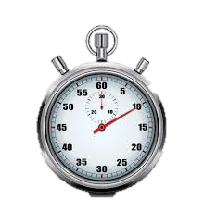
Interpreting utterances
How do people figure out what these utterances mean?
I waited eleven minutes for a table.
11 minutes
Notes:
Now Bill thinks, ok it’s probably exactly 11 minutes, and it’s important to Amy to tell me exactly how long she waited.

Slide 15
Interpreting utterances
How do people figure out what these utterances mean?
I waited a million years for a table.
Notes:
Suppose now that Amy says, “I waited a million years for a table.”

Slide 16
Interpreting utterances
How do people figure out what these utterances mean?
I waited a million years for a table.
> 10 minutes
< 1 million years
Notes:
Bill now thinks, well, it’s probably likely that she waited for longer than 10 minutes, but probably much shorter than a million years. Importantly, Amy is probably upset by how long she had to wait. These are all pretty sophisticated inferences that Bill has to make to successfully understand Amy’s utterance. How do we model that?

Slide 17
Communication as social reasoning
Rational Speech Act models (Frank & Goodman, 2012; Goodman & Stuhlmuller, 2013)
A speaker chooses an utterance that will effectively communicate her message to a listener
Notes:
A critical insight here is that communication requires reasoning about the other person. A lot of informal work has been done in linguistics and psychology suggesting that people communicate with the assumption that the other person is a rational and cooperative speaker. Professor Herb Clark is a great contributer to that body of work. More recently, researchers in our department such as professor noah goodman and mike frank have started to formalize these principles of communication using computational models. This type of model was first introduced as Rational Speech Act models in two important papers, one of which was published in science in 2012. The basic setup of the model assumes that given a message, a speaker chooses an utterance that will effectively communicate her message to a listener. This can be formalized with standard probabilistic tools and is captured in the following equation.

Slide 18
Communication as social reasoning
Rational Speech Act models (Frank & Goodman, 2012; Goodman & Stuhlmuller, 2013)
A speaker chooses an utterance that will effectively communicate her message to a listener
A pragmatic listener reasons about a speaker in order to infer the meaning of the utterance
Explains scalar implicature, Horn’s implicature, etc
Does not handle cases where the literal meaning of an utterance directly contradicts the intended meaning
Notes:
Given an utterance, a pragmatic listener will then reason about a speaker to infer its meaning. This is given by the following equation, which uses bayes rule to infer the meaning given an utterance. By modeling language understanding as recursive reasoning between speaker and listener, these models can explain a range of phenomena in pragmatics, such as scalar implicature, which is the tendency for listeners to infer that less specific utterances imply the negation of more specific utterances, and Horn’s implicatures, which is the tendency for listeners to assign more complex utterances to less likely meanings. However, this basic framework is not able to handle cases where the literal meaning of an utterance directly contradicts the intended meaning. As a result, the model cannot capture the effects of metaphor, hyperbole, and pragmatic halo that we described and know to be an important part of language use.

Slide 19
Extending to nonliteral language
Multiple communicative goals
Given a communicative goal, the speaker may wish to maximize informativeness for one kind of information (e.g. how she feels about the wait time) but not others (e.g. her exact wait time)
The listener reasons about multiple dimensions of information from a single utterance and jointly infers the speaker’s goal as well as the meaning
A statement that is literally false can be optimal as long as it conveys information along the target dimension
Notes:
To extend this model to explain nonliteral language, our insight was that a speaker may have multiple communicative goals for producing an utterance. Given a goal, the speaker may wish to maximize informativeness for one kind of information (such as how she feels about the wait time) but not others (e.g. her exact wait time). The listener reasons about multiple dimensions of information from a single utterance and jointly infers the speaker’s goal as well as the meaning of the utterance. Given this formulation, a statement that is literally false can be optimal as long as it conveys information along the target dimension. So a listener who reasons about the goals of the speaker can make sense of a statement that is false under its literal interpretation.

Slide 20
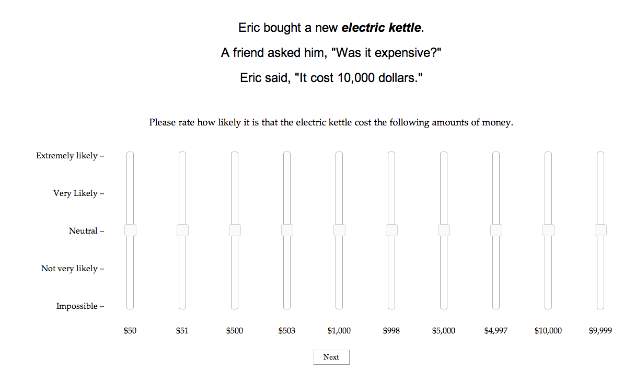
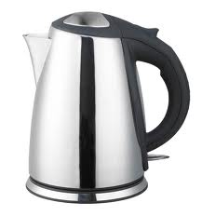
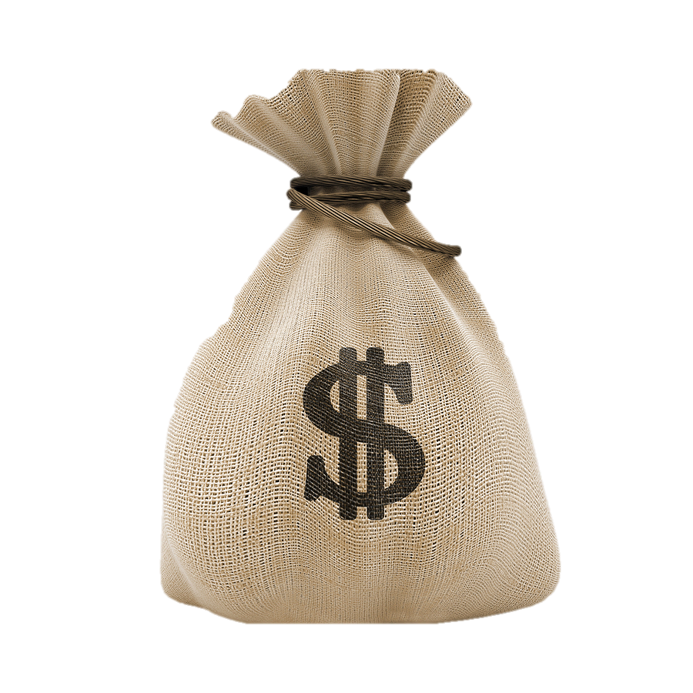
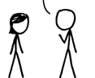
Understanding hyperbole
Notes:
Here we will model and examine the interpretation of number words in a domain of prices, where a person bought an item and tells his friend how much it cost.

Slide 21
Model
Speaker
Produces utterance given goal and model of the listener
Notes:
We start with a speaker who produces an utterance given her communicative goal and her understanding of the listener

Slide 22
Model
Speaker
Produces utterance given goal and model of the listener
Notes:
Mathematically, this can be written down as this equation, which I will go through in detail.

Slide 23
Model
Speaker
Produces utterance given goal and model of the listener
Communicative goal
Exact price
Approximate price
Affect
Notes:
The speaker produces an utterance given her communicative goal. The goal can be one of three things: to communicate the exact price, approximate price, or affect about the price, namely if she thinks it’s expensive.

Slide 24
Model
Speaker
Produces utterance given goal and model of the listener
Choose an utterance
“50” “51”
“500” “501”
“1000” “1001”
“5000” “5001”
“10001” “10001”
Notes:
The probability that a speaker chooses an utterance depends upon various considerations about that utterance.

Slide 25
Model
Speaker
Produces utterance given goal and model of the listener
I’m thinking about the listener.
Listener’s interpretation given utterance
It cost 50 dollars and the
speaker thinks it’s expensive.
Notes:
For each utterance, the speaker iterates through all possible interpretations that the listener may infer from the utterance. Here s is the price of the item, and a is the speaker’s feeling or affect about the price. A possible interpretation that the listener could have is that the kettle cost 50 dollars and the speaker thinks it’s expensive.

Slide 26
Model
Speaker
Produces utterance given goal and model of the listener
I want to communicate that I think it’s expensive. Did the listener correctly infer my affect?
Whether goal is satisfied by listener’s interpretation
Notes:
The speaker considers whether the listener’s interpretation satisfies her goal. For example, if she thinks it’s expensive and wants to communicate that, will the listener interpret that she thinks it’s expensive? If so, this value is 1, meaning the goal is satisfied and the information the listener inferred was relevant and accurate. If not, this value is 0, meaning the information the listener inferred was irrelevant or incorrect.

Slide 27
Model
Speaker
Produces utterance given goal and model of the listener
“Ten thousand” is easy to say.
“Nine thousand nine hundred and ninety nine” is not.
Cost of producing utterance
Notes:
Finally, because the speaker wants to communicate efficiently, she also considers her cost of producing an utterance. Some utterances like “10000” are easy to produce, while others like “9,999” are harder. All else being equal, if two utterances can equally likely allow the speaker to satisfy her goal, the speaker is more likely to choose the one that is shorter and easier to utter.

Slide 28
Model
Pragmatic listener
Incorporates prior knowledge to infer price and speaker’s affect given utterance
Notes:
Now we turn to the pragmatic listener, who needs to interpret an utterance. In our model, the listener incorporates prior knowledge to infer the price and the speaker’s affect given an utterance

Slide 29
Model
Pragmatic listener
Incorporates prior knowledge to infer price and speaker’s affect given utterance
Notes:
Mathematically, this can be written down as this.

Slide 30
Model
Pragmatic listener
Incorporates prior knowledge to infer price and speaker’s affect given utterance
Prior probability of price
A kettle is unlikely to cost $10000
A kettle is more likely to cost $50
Notes:
The listener considers the prior probability of a particular price. For example, how likely is it that a kettle costs $1000 vs $50 dollars? Note that this prior probability changes depending on the type of item. For example, a kettle is unlikely to cost $1000, but a laptop is likely to cost that amount. So this requires prior knowledge of the price distributions for different items.

Slide 31
Model
Pragmatic listener
Incorporates prior knowledge to infer price and speaker’s affect given utterance
Prior probability of affect given price
A speaker is very likely to feel that a $10000 kettle is too expensive
Notes:
The listener also considers the prior probability of someone having an affect given a price. For example, how likely it is that someone would think that a $10000 dollar kettle is too expensive?

Slide 32
Model
Pragmatic listener
Incorporates prior knowledge to infer price and speaker’s affect given utterance
The speaker is equally likely to want to communicate exact price, approximate price, and affect.
Prior probability of goal
Notes:
The listener also considers the prior probability of the speaker having a particular goal. This distribution can be shifted around based on the context of the conversation, but here in this experiment we set it as uniform, meaning the listener thinks it’s equally likely that the speaker will want to communicate the exact price, the approximate price, or her affect.

Slide 33
Model
Pragmatic listener
Incorporates prior knowledge to infer price and speaker’s affect given utterance
I’m thinking about the speaker.
Speaker’s probability of producing utterance given goal
Notes:
Finally, the pragmatic listener considers the speaker’s probability of producing an utterance given her goal. This part of the equation was defined in the speaker’s model described earlier.

Slide 34
Model
Pragmatic listener
Incorporates prior knowledge to infer price and speaker’s affect given utterance
Prior probability of price
Prior probability of affect given price
Notes:
Note that a prediction of the model is that tendency to interpret things hyperbolically or literally interacts with prior knowledge about prices and affect. To examine this interaction, we need to consider different price and affect distributions.

Slide 35
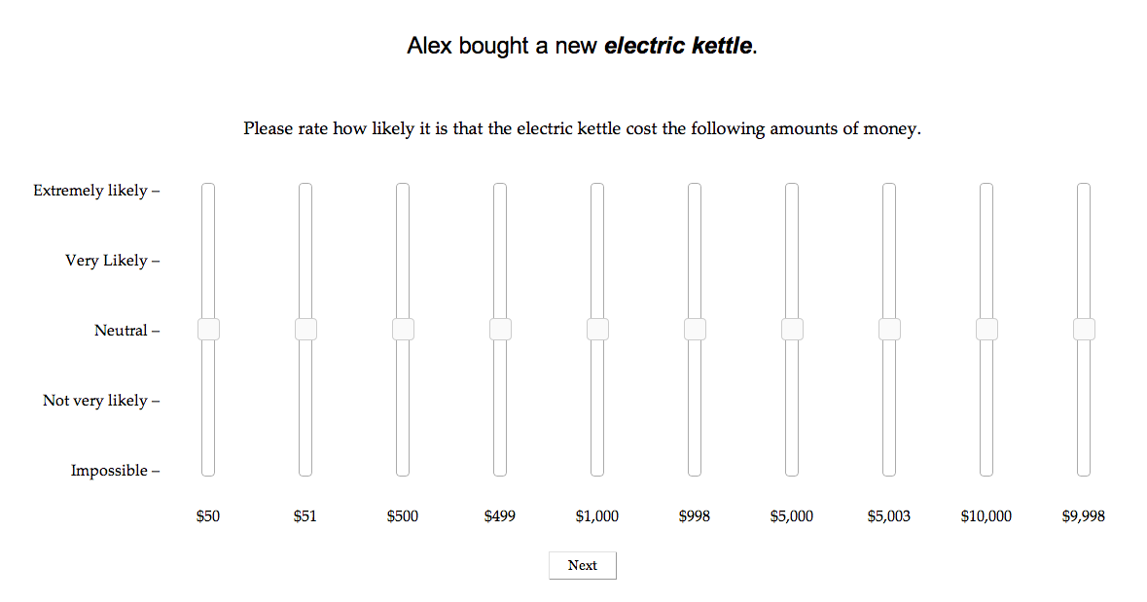
Price priors
30 participants
Notes:
We focused on three item types: electric kettles, laptops, and watches. To get their price priors, we asked 30 subjects on mTurk to rate how likely it is that certain items cost certain amounts of money. Participants read that a person bought an item, and then rate how likely it is that the item cost different amounts of money using slider bars. We normalized their ratings across each trial to sum up to 1.

Slide 36
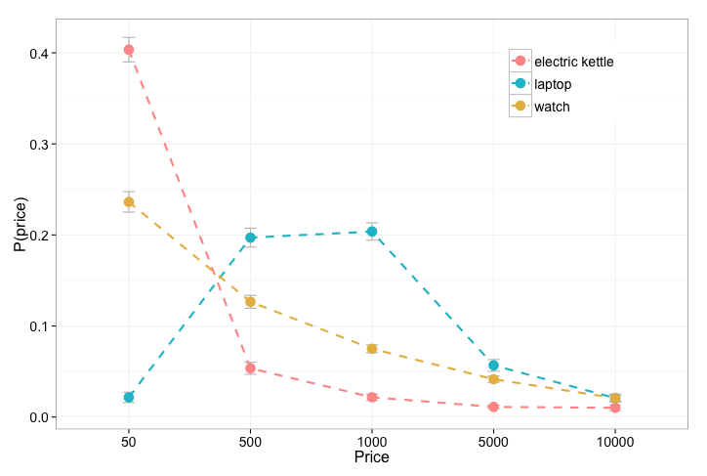
Price priors
30 participants
Notes:
Here are the price priors we got for the three types of items. You can see that electric kettles are very unlikely to cost more than 50 dollars, while laptops are most likely to cost 500 to 1000 dollars. Watches are likely to cost around 50 dollars, but there are also high-end watches that cost a lot more. So the three domains give us fairly different price priors.

Slide 37
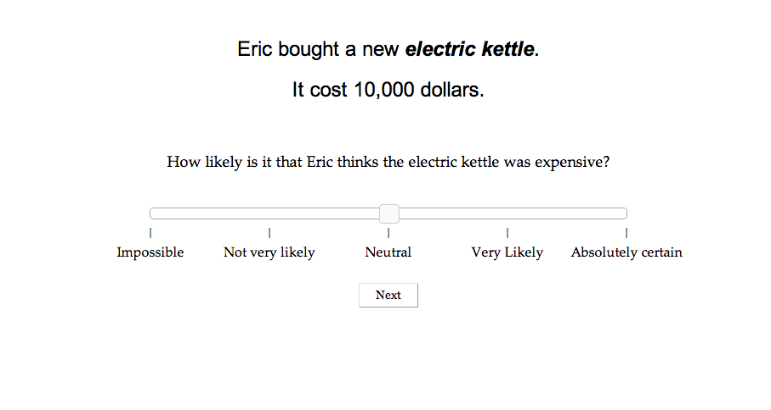
Affect priors
30 participants
Notes:
To elicit the affect priors, we asked 30 subjects on mechanical turk: if someone bought an item that costs a certain amount of money, how likely is it that a buyer would think it’s expensive? We also did this for the three types of items.

Slide 38
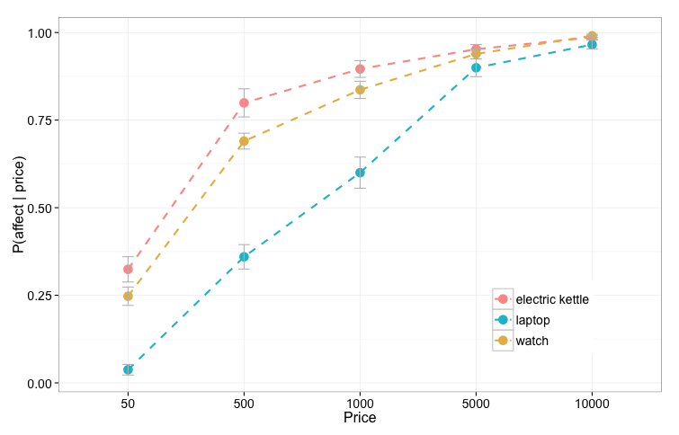
Affect priors
30 participants
Notes:
Here are the results. Generally, the higher the price, the more likely it is that the buyer would think it’s expensive, with slightly different slopes for the three items.

Slide 39
Hyperbole experiment
120 participants
Notes:
Finally, we conducted an experiment to elicit people’s interpretations of 30 numeric utterances—10 numeric utterances for each of the 3 item types. 120 participants read a dialogue between a speaker and his friend. Given the speaker’s utterance, the participant is asked to rate how likely it is that the item cost various amounts of money.

Slide 40
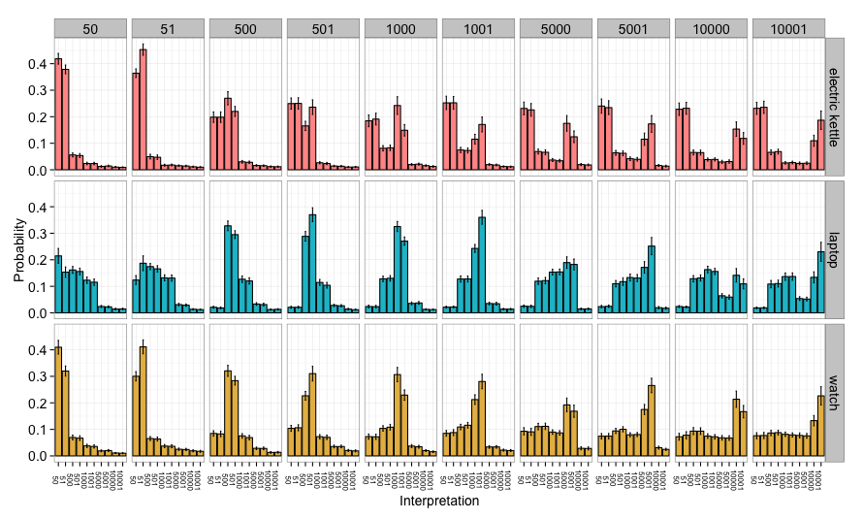
Results
120 participants
Notes:
Here are the results. Each column is an utterance, and each row is the item type. For each utterance in each item type, we get people’s interpretation distribution, where the x axis is the interpreted price, and the y axis the probability of that interpretation. We will focus on looking at this particular cell, which represents the interpretation distribution for the utterance: “The electric kettle cost 1000 dollars.”

Slide 41
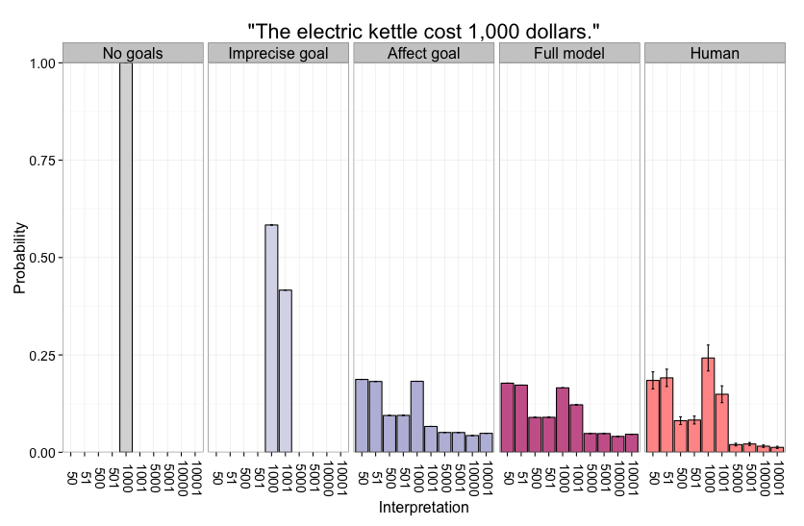
Results
Notes:
Here is again participants’ interpretation distribution for this utterance. We will show that our model uses reasoning about the speaker’s communicative goals to successfully capture humans’ interpretation of this utterance.

Slide 42
Results
Notes:
If the model does not consider the speaker’s communicative goals, it will interpret the utterance purely literally and think the kettle cost 1000 dollars with 100% certainty.

Slide 43
Results
Notes:
If the model considers the possibility that the speaker wants to communicate the price approximately, it will now think that it’s fairly likely the actual price was 1001 dollars. The intuition here is that if the kettle cost 1001 dollars and speaker wants to just communicate approximately, 1000 is a more reasonable thing to say because it is less costly to utter.

Slide 44
Results
Notes:
Now, If we let the model reason about a speaker who might have the goal of communicating the price exactly or communicating affect about the price, the model’s interpretation now places higher probability on “50” and “51”, which are more likely prices for kettles. The intuition here is that if the kettle cost 50 dollars and the speaker wants to say she thinks it’s expensive, “1000” dollars is a reasonable thing to say because it will satisfy her goal of communicating to the listener that she thinks it’s expensive.

Slide 45
Results
Notes:
Finally, with the full set of goals, we see that the model very closely matches humans’ interpretation of this utterance, with the full range of possibilities that humans consider: the utterance is meant to be hyperbolic, the utterance is meant to be exact, and the utterance is meant to be approximate.

Slide 46
Results
r = 0.97
Notes:
In fact, looking at the model’s predictions for all of the utterances that we considered, the correlation with human interpretations is 0.97. This correlation is consistent across item types and also across the different kinds of interpretation, such as exact, fuzzy, and hyperbolic. We now turn to examine how each part of the model is responsible for various patterns in the human data.

Slide 47
Results – hyperbole
Notes:
This graph examines hyperbolic interpretations given different utterances. The x axis is the utterance, and the y axis is the probability that the utterance is interpreted hyperbolically, in other words interpreted as being much less expensive than the literal meaning. Humans are more likely to interpret larger utterances as hyperbolic, and this interacts with the item types. Our model captures this general pattern. However, a model that uses a uniform price prior instead of the empirically derived priors was not able to distinguish among the item types. This confirms the hypothesis that people use their prior knowledge of an item’s price distribution to infer hyperbolic interpretations.

Slide 48
Results – pragmatic halo
Notes:
We now look at a part of the model that is responsible for the pragmatic halo effect. The x axis here is the utterance type, whether an utterance is a round number or a sharp number. The y axis is the bias for the utterance to be interpreted exactly rather than fuzzily. An example of a fuzzy interpretation is the utterance “1000” interpreted as “1001” or vice versa. We see that for humans, sharp utterances are significantly more likely to have a bias for exact interpretations, which is consistent with previous findings. Our full model also replicates this pattern. However, a model that uses a uniform utterance cost does not produce a distinction between round and sharp utterances. This suggests that people consider utterance costs and communicative efficiency when inferring exact versus fuzzy interpretations.

Slide 49
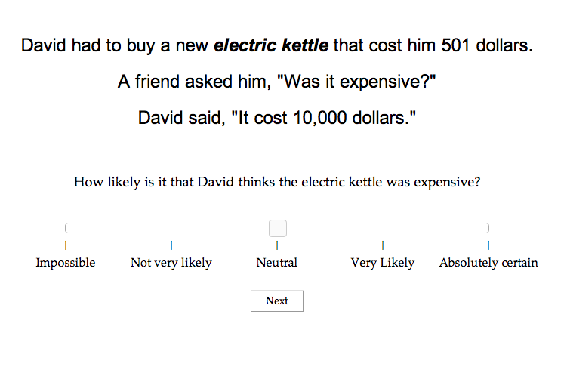
Affect experiment
160 participants
Notes:
Finally, we wanted to test the important intuition that hyperbole conveys additional affect. We conducted a separate experiment on 160 participants. In this experiment, participants are told the actual price of an item, and so they know when the speaker is being hyperbolic and when he is being literal. Participants are asked to rate how likely it is that the speaker thinks the item was expensive.

Slide 50
Results – affect
Notes:
This figure shows the probability of interpreting affect given different price states and utterances. Here the x axis is the actual price of the item, and the y axis is the probability that the speaker has an affect that it’s too expensive. The solid points indicate literal utterances. For example, the left-most yellow point indicates when a watch actually cost 50 dollars, and the speaker said it cost 50 dollars. The star-shaped points are when the utterance is hyperbolic. For example, the left-most yellow star indicates when a watch actually cost 50 dollars, but the speaker said it cost 500, 1000, 5000, or 10000 dollars. The human data shows two effects. First, higher actual price states are associated with higher probability of affect, which is not surprising. Second, and more interestingly, within the same actual price state, hyperbolic utterances are interpreted as conveying more affect than literal utterances. If someone buys a watch that cost 5000 dollars but says it cost 10000 dollars…. Both effects are replicated by the full model, but not by a model that uses a uniform affect prior. This shows that the rhetorical effect of hyperbole is driven in part by prior knowledge of affect associated with different prices.

Slide 51
Results – affect
r = 0.77
Notes:
Here is a scatter plot correlating the model predictions of speaker’s affect given different utterances and actual prices with human interpretations. The correlation is respectable, 0.77, suggesting that the model is able to successfully capture and predict the affective dimensions of hyperbole, although there are still systematic patterns in the residuals that we hope future work will help explain.

Slide 52
Discussion
Our model’s quantitative predictions closely match humans’ interpretations of hyperbole
Nonliteral number interpretation depends on reasoning about the speaker’s communicative goal, prior knowledge of the domain, and consideration of communicative efficiency
Future directions
What happens when the priors are not common knowledge?
Can we model sarcasm using similar principles?
Can we model other kinds of nonliteral language?
Notes:
In conclusion, our model’s quantitative predictions closely match humans’ interpretations of hyperbole. Also, our model and behavioral results show that nonliteral number interpretation depends on reasoning about the speaker’s communicative goal, prior knowledge about item under discussion, and consideration of communicative efficiency. Other questions we aim to answer in the future include, what happens when the priors are not common knowledge, and the listener is uncertain about what the prior distribution looks like? Can we model sarcasm using similar principles? Finally, can we model other kinds of nonliteral language? Regarding the last point, we are currently working on a model for metaphor understanding.

Slide 53
Ongoing work
But soft! What light through yonder window breaks? It is the east, and Juliet is the sun.
Notes:
Returning to the Juliet example,

Slide 54
Ongoing work
But soft! What light through yonder window breaks? It is the east, and Juliet is the sun.
What are features of the sun?
P(hot plasma | sun)
P(beautiful | sun)
Notes:
We can model metaphor interpretation in similar ways. Instead of the probability of affect given a price, the listener now considers the probability of a feature given a category. For example, what is the probability that the sun is made of hot plasma? What is the probability that the sun is beautiful?

Slide 55
Ongoing work
But soft! What light through yonder window breaks? It is the east, and Juliet is the sun.
What are features of me?
P(hot plasma | Juliet)
P(beautiful | Juliet)
Notes:
Also, what is the probability of Juliet being made of hot plasma, and the probability that Juliet is beautiful?

Slide 56
Ongoing work
But soft! What light through yonder window breaks? It is the east, and Juliet is the sun.
What might Romeo want to say about me?
P(topic = hot plasma)
P(topic = beautiful)
Notes:
What are Romeo’s possible communicative goals? Is he likely to want to talk about hot plasma? Or is he likely to want to talk about Juliet’s beauty?

Slide 57

Ongoing work
But soft! What light through yonder window breaks? It is the east, and Juliet is the sun.
Notes:
Using this information, the listener can infer the features of a metaphorical target.

Slide 58
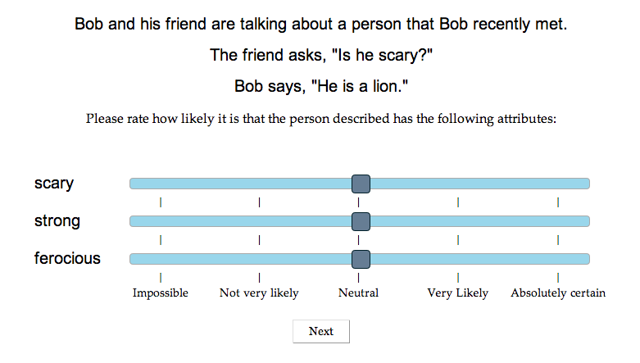
Ongoing work
Notes:
We used the following paradigm to examine people’s interpretation of a range of animal metaphors in context.

Slide 59
Ongoing work
Notes:
Our model achieved decent correlation with people’s interpretation of these metaphorical utterances. Work is still ongoing, but we believe it is quite promising and are excited to see where it goes.

Slide 60
Conclusion
Our framework advances the flexibility and richness of formal models of language understanding
Some day probabilistic models will explain everything.
Notes:
To conclude, I hope that the work I presented today suggests to you that our framework for computationally modeling nonliteral language advances the flexibility and richness of formal models of language understanding. I will end with the following statement, and leave it up to you to decide if it should be interpreted hyperbolically or not.

Slide 61
Thank you!
Collaborators:
Noah Goodman, Jean Wu, Leon Bergen
Funders:
National Science Foundation
Frisem 2.21.2014
Notes:
Thank you very much for your attention, and I’d be happy to answer any questions.

