Slide 1
Hyperbolically speaking:
A computational model of non-literal language understanding
Justine Kao
Jean Wu, Leon Bergen, Noah Goodman

Slide 2
Non-literal language
Romeo: “Juliet is the sun.”
Leon Bergen: “Halloween is my favorite day of the year.”
Disgruntled Yelp reviewer: “It took a million hours to get seated.”
How do people figure out what these sentences mean?

Slide 3
Pragmatics as recursive social reasoning
Starts with a listener who interprets utterances literally
Speaker chooses an utterance that will effectively communicate her intended message to the listener
Pragmatic listener then reasons about a speaker who reasons about the literal listener…and so on
But when is saying something that is literally false (not just underspecified) ever a good idea?

Slide 4
Communicative goals
The meaning of an utterance may have multiple dimensions
Different dimensions of the meaning may satisfy different communicative goals
Uncertainty about the speaker’s communicative goal allows interpretations that contradict the literal meaning of the utterance along some dimension

Slide 5
Precision goals
States: 99, 100, 101
P(S) -> uniform
Utterances: “99”, “100”, “101”
P(U) -> 0.2, 0.8, 0.2 (inverse costs)
Communicative goals: precise state, approximate state

Slide 6
Precision goals
States: 99, 100, 101
P(S) -> uniform
Utterances: “99”, “100”, “101”
P(U) -> 0.2, 0.8, 0.2 (inverse costs)
Communicative goals: precise state, approximate state
Pragmatic listener’s insight
If the price state is 99 or 101 and goal is approximate, “100” is a good thing to say -> “100” likely to mean 99 or 101
If the price state is 100, regardless of the goal, “99” and “101” are not good things to say -> “99” unlikely to mean 100

Slide 7
Affective goals
States: 10, 100, 10000
P(S) -> 0.7, 0.3, 0.01
Utterances: “10”, “100”, “10000”
P(U) -> uniform
Affect: with affect, no affect
P(Affect | S) -> 0.1, 0.5, 0.9
Communicative goals: price state only, price state + affective subtext, affective subtext only

Slide 8
Affective goals
States: 10, 100, 10000
P(S) -> 0.7, 0.3, 0.01
Utterances: “10”, “100”, “10000”
P(U) -> uniform
Affect: with affect, no affect
P(Affect | S) -> 0.1, 0.5, 0.9
Communicative goals: price state only, price state + affective subtext, affective subtext only
Pragmatic listeners’ insight:
The speaker reasons about a literal listener, who will hear “10000” and think P(A) = 0.9. If the speaker has affect and communicative goal involves affect, “10000” satisfies the speaker’s goal regardless of actual price state -> “10000” likely to mean 100 + affect

Slide 9
Full Hyperbole Model
The meaning of an utterance has two dimensions
Actual price state S
50, 51, 500, 501, 1000, 1001, 5000, 5001, 10000, 10001
Affective subtext A
With affect / no affect
A communicative goal has two dimensions
Actual price state
Communicate precise price state, approximate price state, or actual price state irrelevant
Affective subtext
Communicate affect, or affect irrelevant

Slide 10
Model effects

Slide 11
Model effects

Slide 12
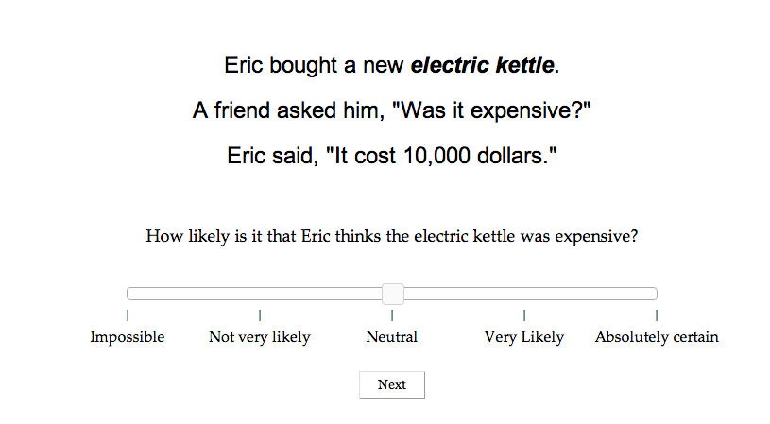
Experiment 1

Slide 13
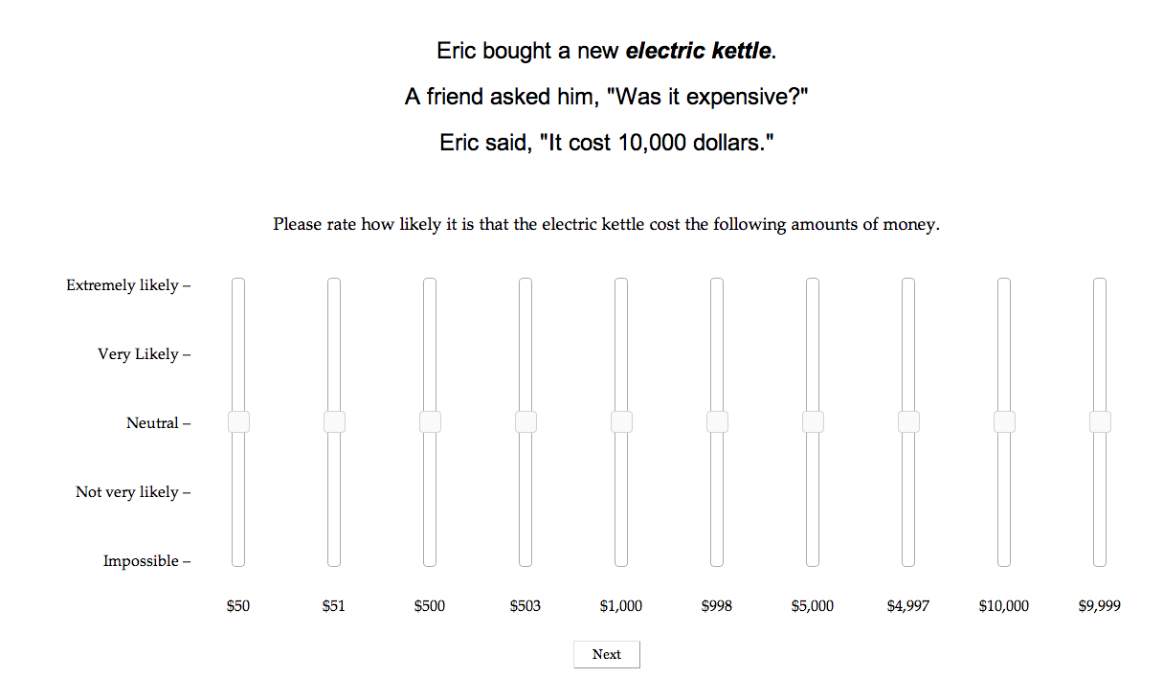
Experiment 1

Slide 14
Comparison with humans

Slide 15
Comparison with humans

Slide 16
Model Comparison

Slide 17
Model Comparison

Slide 18
Model Comparison

Slide 19
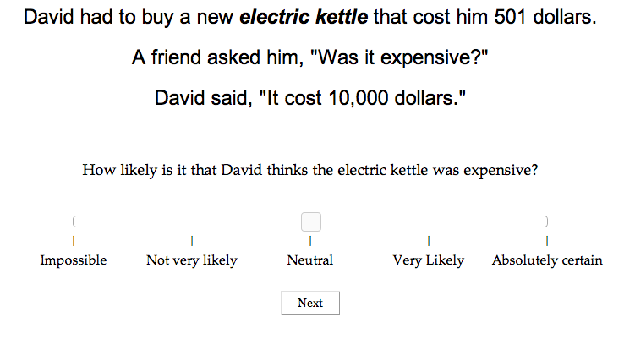
Experiment 2

Slide 20
Model Comparison

Slide 21
Since probabilistic models can explain everything…

Slide 22
Metaphor Interpretation
“X is a Y” metaphors
“Juliet is the sun.”
“My lawyer is a shark.”
“John is a lion.”

Slide 23
“John is a lion.”
Prior knowledge about John
P(John is a human) = 0.9999999
P(John is a lion) = 0.0000001
Potential features of John
John is male, John is skinny, John is fierce, John is brave….
Prior knowledge about features given categories
P(male| human) = 0.5
P(male | lion) = 0.5
P(skinny | human) = 0.5
P(skinny | lion) = 0.5
P(fierce | human) = 0.5
P(fierce | lion) = 0.9
P(brave | human) = 0.5
P(brave | lion) = 0.9

Slide 24
“John is a lion.”
Is John human?
Is John male?
Is John skinny?
Is John fierce?
Is John brave?

Slide 25
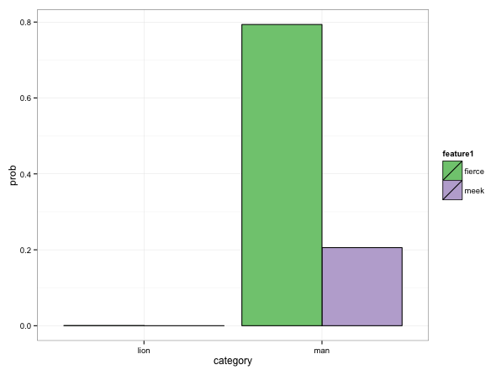
“John is a lion.”
Is John human?
Is John male?
Is John skinny?
Is John fierce?
Is John brave?

Slide 26
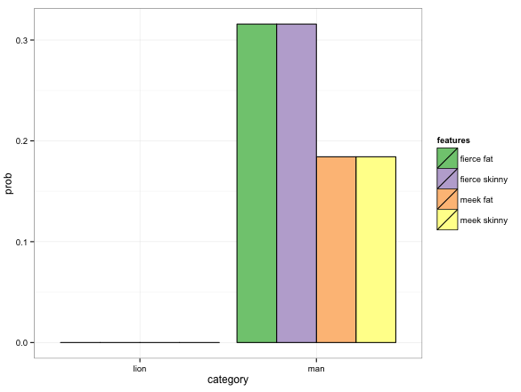
“John is a lion.”
Is John human?
Is John male?
Is John skinny?
Is John fierce?
Is John brave?

Slide 27
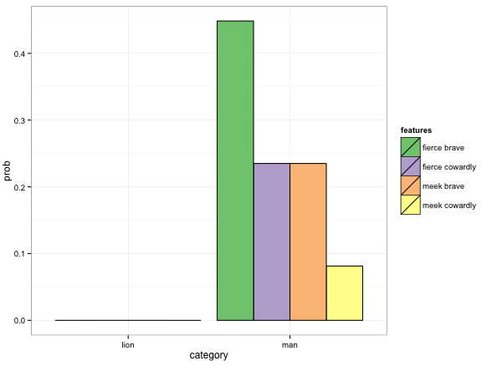
“John is a lion.”
Is John human?
Is John male?
Is John skinny?
Is John fierce?
Is John brave?
Saying “John is a lion” is more efficient than saying “John is fierce and brave.”

Slide 28
Potential Experiments

Slide 29





Metaphors in artificial domains
Feps
Wugs

Slide 30
Metaphors in artificial domains
“Let me introduce you to Mark. Mark is a Wug.
Which one is Mark?”

Slide 31
Metaphors in artificial domains
“Let me introduce you to Mark. Mark is a Wug.
Which one is Mark?”

Slide 32
Metaphors in artificial domains
“Let me introduce you to John. John is a Wug.
Which one is John?”

Slide 33
Metaphors in artificial domains
“Let me introduce you to John. John is a Wug.
Which one is John?”

Slide 34
Metaphors in the wild
Given a “X is a Y” metaphor, empirically measure salient features and priors
“What are lions like?”
“How likely is it that a man is fierce?”
“How likely is it that a man has a tail?”
Set up QUD and ask for metaphor interpretation
A: “Is John fierce?” B: “John is a lion.”

Slide 35
Ultimately…
Predict metaphoric interpretations
Predict metaphor aptness

