Slide 1
Halo, Hyperbole, and the Pragmatic Interpretation of Numbers
Justine Kao
Jean Wu, Leon Bergen, Noah Goodman

Slide 2
Numbers in the real world
1000 + 3 = 1003
1003 > 1000
“She has 1000 dollars in her account.”
“She has 1003 dollars in her account.”
“He has 1000 friends on Facebook.”
“He has 1003 friends on Facebook.”
“It’s 1000 degrees outside.”
“It’s 1003 degrees outside.”
“That bag costs 1000 dollars.”
“That bag costs 1003 dollars.”

Slide 3
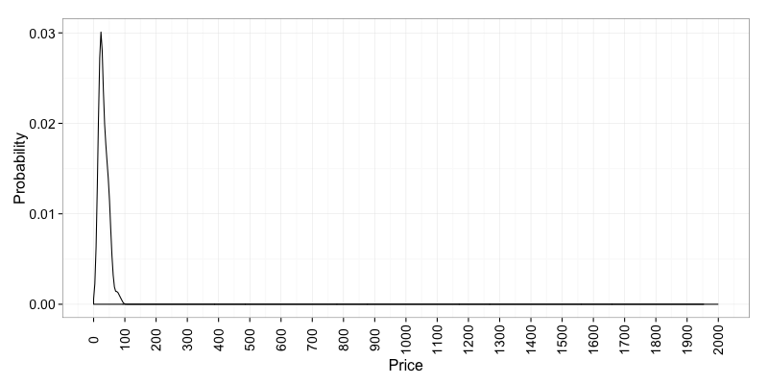
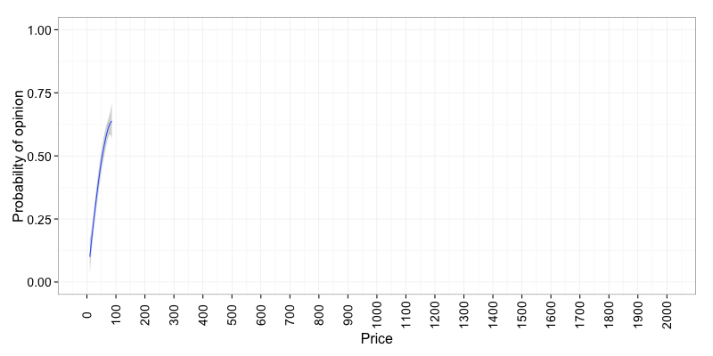
Kettles
Price Prior

Slide 4
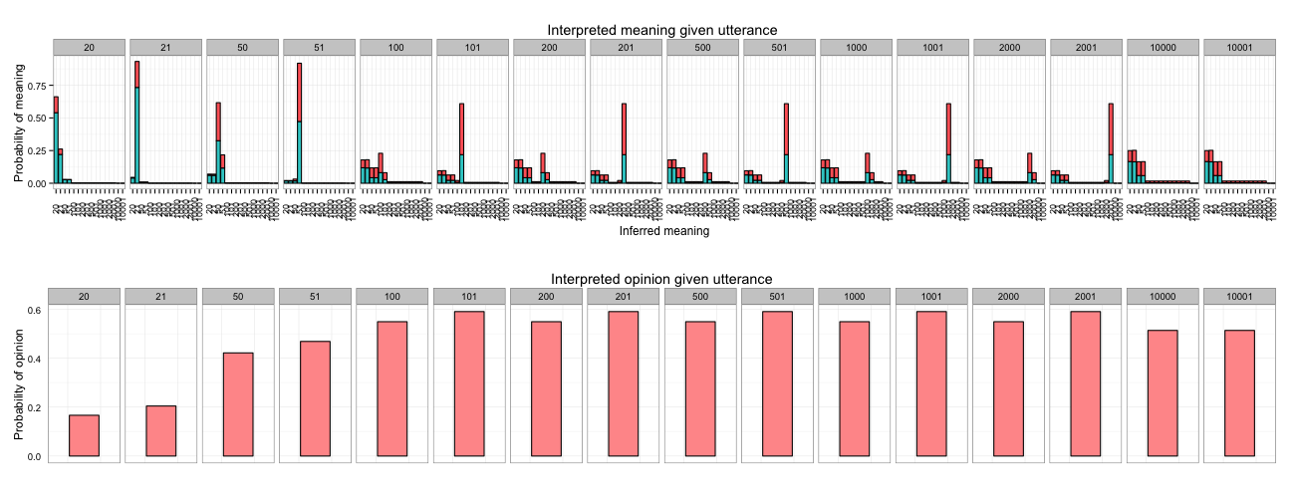
Kettles
Model

Slide 5
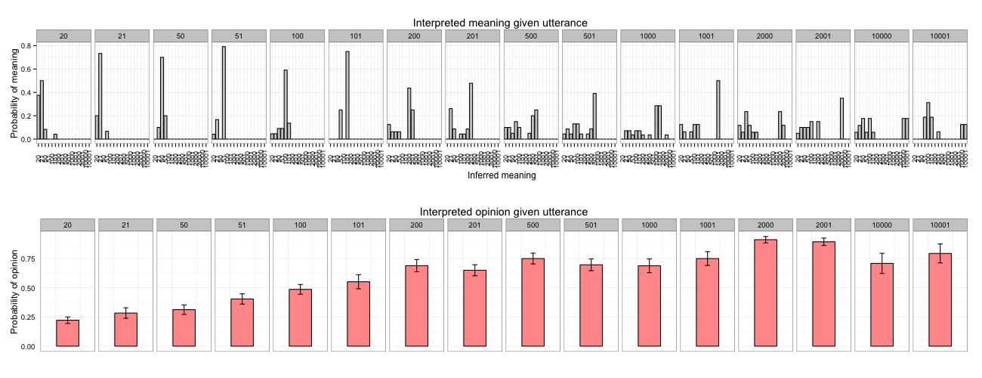
Kettles
Model
Kettles
Humans

Slide 6
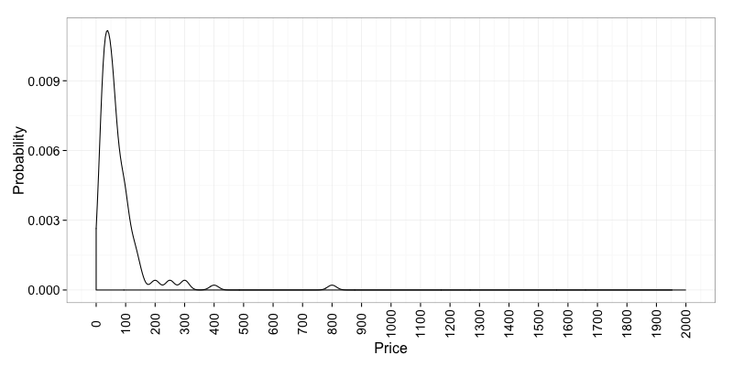
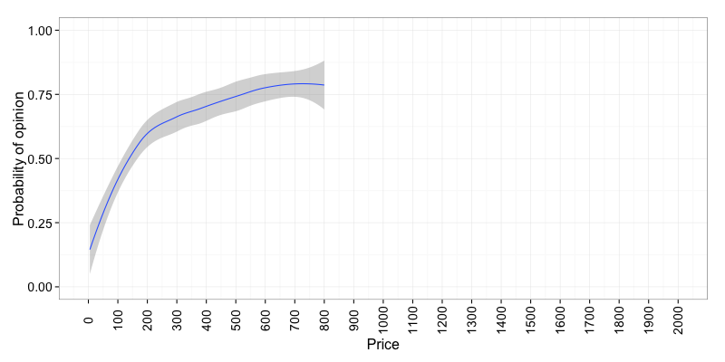
Watches
Price Prior
Watches
Affect Prior

Slide 7
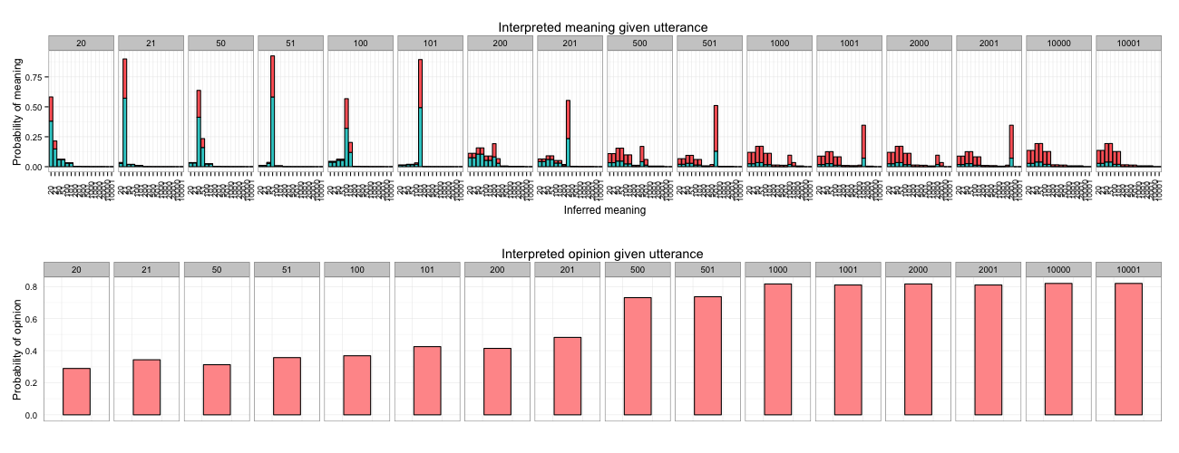
Watches
Model
Watches
Humans

Slide 8
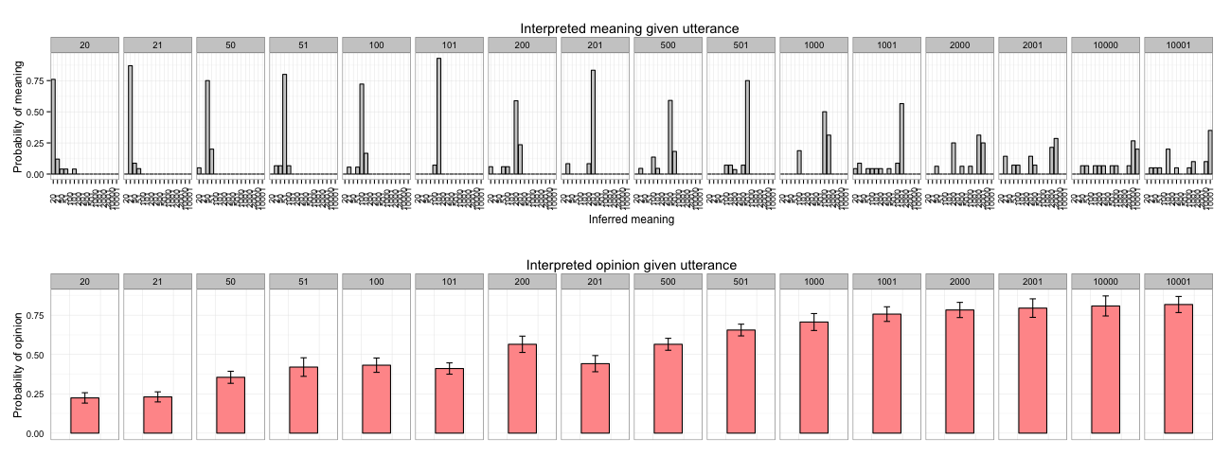
Watches
Model
Watches
Humans

Slide 9
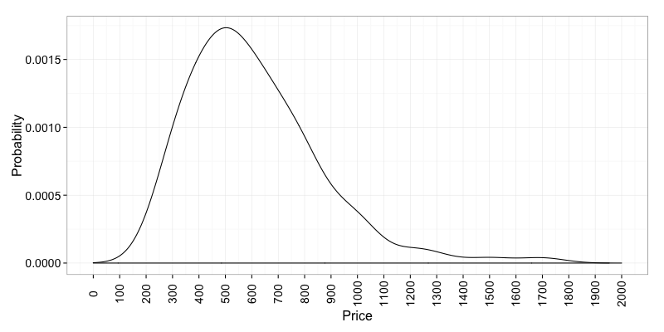
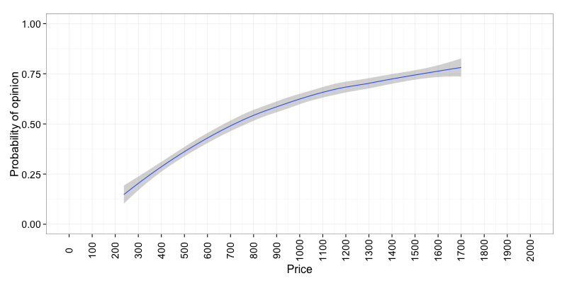
Laptops
Price Prior
Laptops
Opinion Prior

Slide 10
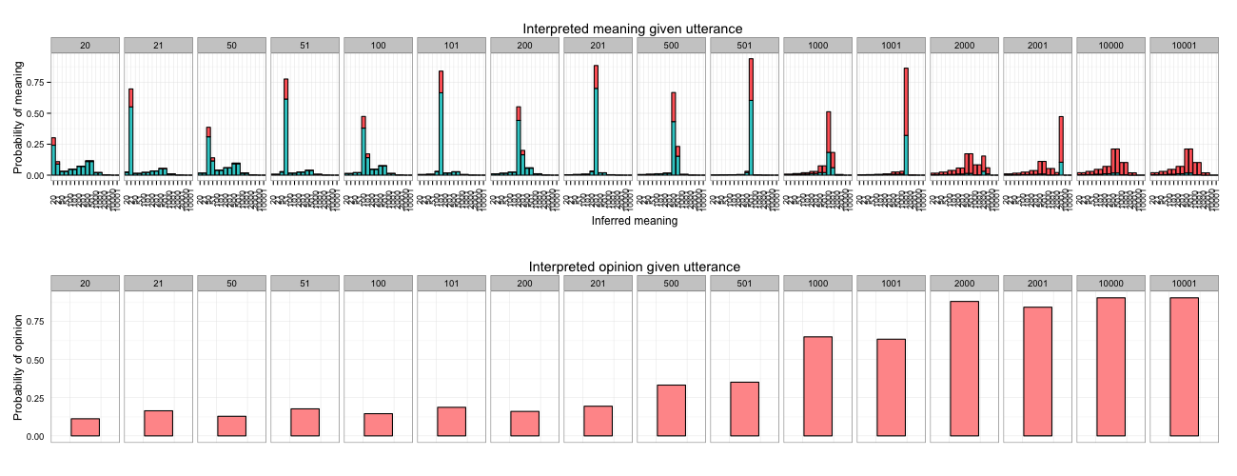
Laptops
Model

Slide 11
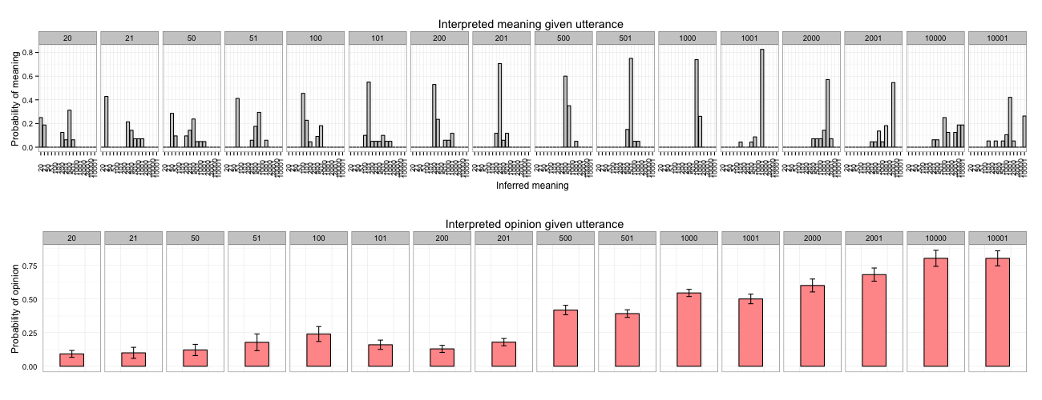
Laptops
Model
Laptops
Humans

