Slide 1
Halo, Hyperbole, and the Pragmatic Interpretation of Numbers
Justine Kao
Jean Wu, Leon Bergen, Noah Goodman
CoCoLab meeting
May 21, 2013
Notes:
Today I’m going to talk about Halo, Hyperbole, and the pragmatic interpretation of numbers. This is work with Jean Wu, Leon Bergen, and Noah. This work is still ongoing, and we just got some interesting results that we would love your feedback on in terms of how to best present and visualize them.

Slide 2
Numbers in the real world
10000 - 2 = 9998
10000 > 9998
“Bob has 10000 dollars in his bank account.”
“Bob has 9998 dollars in his bank account.”
“A latte from that place costs 10000 dollars.”
“A latte from that place costs 9998 dollars.”
“That girl just bought a bag that costs 10000 dollars.”
“That girl just bought a bag that costs 9998 dollars.”
Notes:
Usually when we think about numbers, we think we mean something very specific. Numbers, of all words, should have pretty clear and precise literal meanings. They obey certain clearly defined rules, and their meanings relate to each other in specific ways. For example, 10000 – 2 = 9998. It is clear that 10000 is greater than 9998, and that 10000 is different from 9998.
However, what if I said to you, “Bob has 10000 dollars in his bank account.” Then you find out that Bob actually has 9998 dollars in his bank account. Would you think I was being disingenuous? What if I said to you, “Bob has 9998 dollars in his bank account,” and then you find out he has 10000 dollars?
Now what if I said to you, referring to some hipster coffee shop in San Francisco: “A latte from that place costs 10000 dollars.” How much do you think a latte costs?
What if I said, “A latte from that place costs 9998 dollars.”
What about a more ambiguous case? Suppose I said to you, “That girl just bought a bag that costs 10000 dollars.” How much do you think the bag cost?
What if I said, “That girl just bought a bag that costs 9998 dollars”?
Suppose you find out that the bag actually cost 4329.89, with tax. Would you think I was lying? What do you think I was trying to tell you when I said her bag cost 10000 dollars?
When interpreting these number words, we don’t always just rely on our knowledge of the precise mathematical quantities that these numbers are supposed to refer to. We use a lot of our commonsense knowledge about the domains in question. We also think about the communicative intent of the speaker as well as certain ways that a rational communicator would use language if he or she wanted to be efficient.

Slide 3
Linguistic phenomena
Pragmatic Halo (Lasersohn, 1999; Krifka, 2007; Bastiaanse, 2011)
Tendency toward imprecise interpretations of simple number expressions
Tendency toward precise interpretations of complex number expressions
“Bob has 10000 dollars in his bank account.”
“Bob has 9998 dollars in his bank account.”
Notes:
These intuitions about number expressions have been studied before in linguistics and psychology. One well-studied phenomenon is how people use numbers loosely, referred to as pragmatic halo. Generally, “round” numbers, which also tend to be numbers that are simpler, shorter to pronounce, more frequent in the corpus, are interpreted more imprecisely than “sharp” or complex numbers. Note that there are different degrees of roundness. For example, compared to 9997.99, 9998 is rounder.
Krifka \cite{krifka2007approximate} described how this pragmatic halo effect can be explained under the assumption that speakers prefer number expressions that are shorter and less costly to utter. Listeners will then favor approximate interpretations of round numbers even if there is no general bias for approximate interpretations. Bastiaanse \cite{bastiaanse2011rationality} further argued that interpreting round numbers as approximate is a rational choice, as can be formalized via game theory.

Slide 4
Linguistic phenomena
Hyperbole (McCarthy & Carter, 2004; Gibb, 2000; Mora, 2003)
Expresses interpersonal meaning beyond the literal meaning of the statement
Successful interpretation of hyperbolic expressions hinges on the listener’s ability to infer the speaker’s intentions
“A latte from that place costs 10000 dollars.”
“That girl just bought a bag that costs 10000 dollars.”
Notes:
A separate phenomena we’re interested in and that interacts with pragmatic halo is hyperbole. Corpus studies have shown that hyperbole is very prevalent in everyday language. It is often used to express interpersonal meaning beyond the literal meaning of the statement. Hyperbole use is especially common among friends, and it also involves the listener entering into a “pact” with the speaker to accept extreme formulations, impossible worlds, and/or apparent counterfactuality.

Slide 5
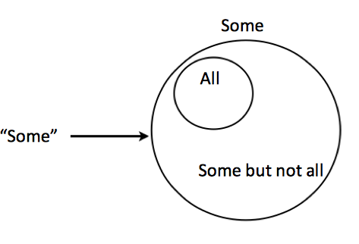
Pragmatic reasoning
Allows us to go beyond the literal meaning of an utterance in a highly productive and systematic way
The lexicon forms the basis of pragmatic reasoning according to traditional accounts: it determines the set of alternative utterances available to the speaker.
“Some of the students passed the test.”
Speaker didn’t say “all” ➡ Not all of the students passed
Slide from Leon Bergen
Notes:
We think that both these phenomena related to numeric interpretation can be modeled under the framework of pragmatic reasoning.
Pragmatic reasoning allows us to go beyond the literal meaning of an utterance in a highly productive and systematic way.
The lexicon…
In this example of scalar implicature, the lexicon tells us that the literal meaning of some is this set, which includes all. We need to pragmatic reasoning step to get the inference that the intended meaning is “some but not all.”

Slide 6
Pragmatic reasoning
Recursive social models
Starts with a listener who interprets utterances literally
Speaker chooses an utterance that will effectively communicate her intended message to the listener
Listener then reasons about the intent of this speaker
Explains pragmatic phenomena
Scalar implicature (Goodman & Stuhlmuller, 2013)
Notes:
These recursive social models have this structure. It starts with…
Explains pragmatic phenomena like scalar implicature.

Slide 7
Pragmatic reasoning
Lexical uncertainty
The speaker and listener do not know the literal meaning of each utterance in advance, i.e. they have uncertainty about the lexicon.
They coordinate on an efficient lexicon while performing pragmatic inference.
Explains more pragmatic phenomena
Interpretation of gradable adjectives (e.g. tall, full) (Lassiter & Goodman, 2013)
Speciﬁcity implicatures and Horn implicatures (Bergen, Goodman & Levy, 2012)
Notes:
These models have been extended to include lexical uncertainty. This is in cases when the speaker and listener do not know the literal meaning of each utterance in advance. They have uncertainty about the lexicon itself and not just the intended meaning, and they coordinate on an efficient lexicon while performing pragmatic inference. Incorporating lexical uncertainty explains even more pragmatic phenomena, such as….

Slide 8
Pragmatic interpretation of numbers
Numbers have literal meanings. However, there is uncertainty about the precision of those meanings
Does 10000 mean 10000, or 10000 +- 3?
Some numbers are less costly to utter than others
Try saying “9998” and “10000”
There is common knowledge about the distribution over number meanings in specific domains
A used car is likely to cost $10000 dollars; a bag is less likely.
Notes:
Our model of hyperbole builds upon these models.
We incorporate lexical uncertainty about the precision of numeric meanings.
We incorporate the cost of uttering these numbers, which the speaker considers when choosing the most efficient utterances to communicate her meaning.
We also have common ground: shared knowledge about the distribution over number meanings in specific domains, or the prior.

Slide 9
Pragmatic interpretation of numbers
There is common knowledge about the sentiment associated with different number meanings
A person is likely to find a $1000 bag expensive, and less likely to find a $1000 car expensive
There is uncertainty over a speaker’s communicative goals
To convey objective information about the world (that bag cost $1398), or subjective evaluation/sentiment (that bag is expensive), or both
Notes:
In addition to the basic components of a recursive social model, our model has an additional dimension of sentiment and opinion that the speaker wants to express with her utterance. Since hyperbole and other non-literal uses of language often serve the purpose of expressing interpersonal information, we want to be able to model that kind of information.
So in addition to a prior about distributions of numeric meanings, we also have priors about the sentiment associated with different number meanings.
Since the speaker now has the ability to express both objective information (the numeric meaning) about the world and their sentiment, our model has uncertainty about a speaker’s communicative goals.

Slide 10
Pragmatic interpretation of numbers
People talk about prices a lot and have good priors on them
Notes:
To test out our model, we decided to focus on numeric expressions in the price domain.

Slide 11
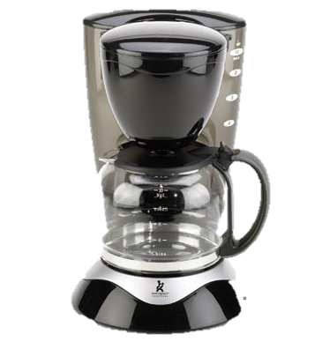
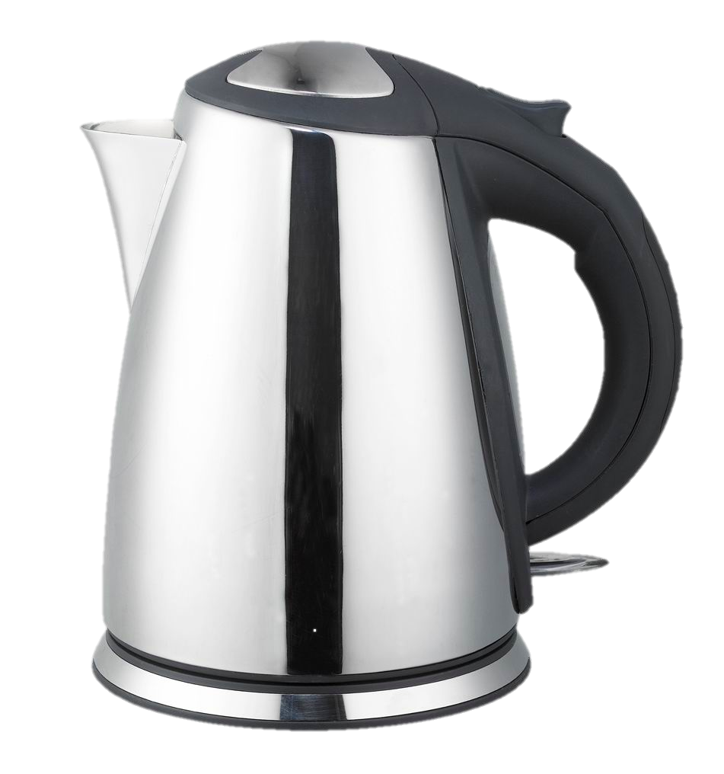
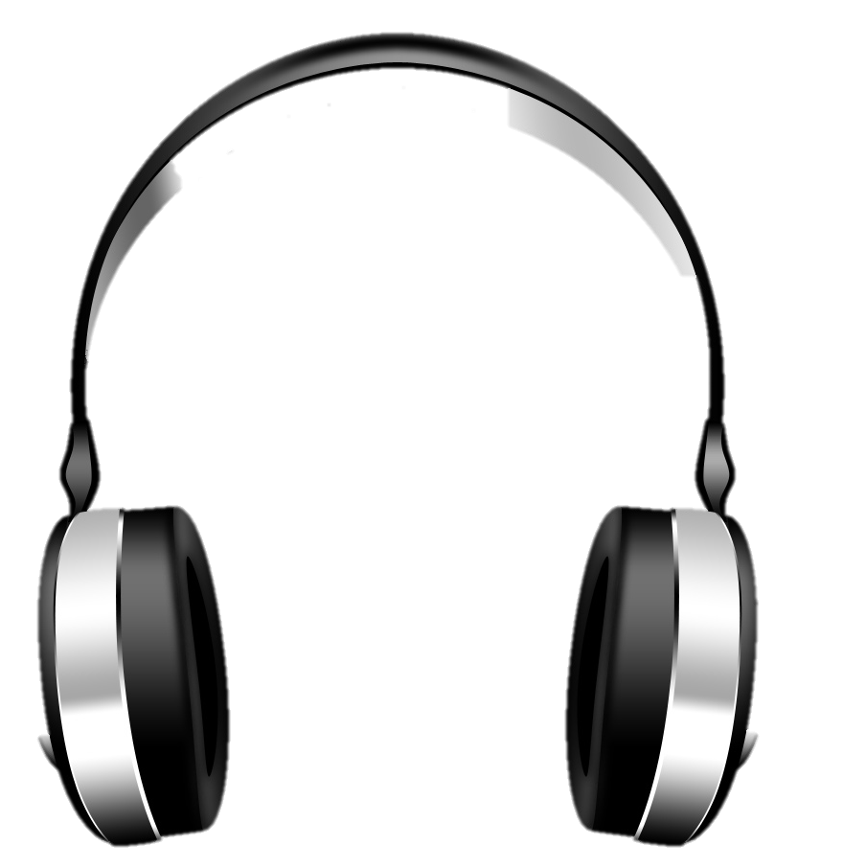
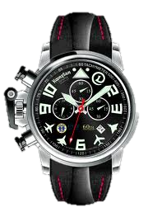
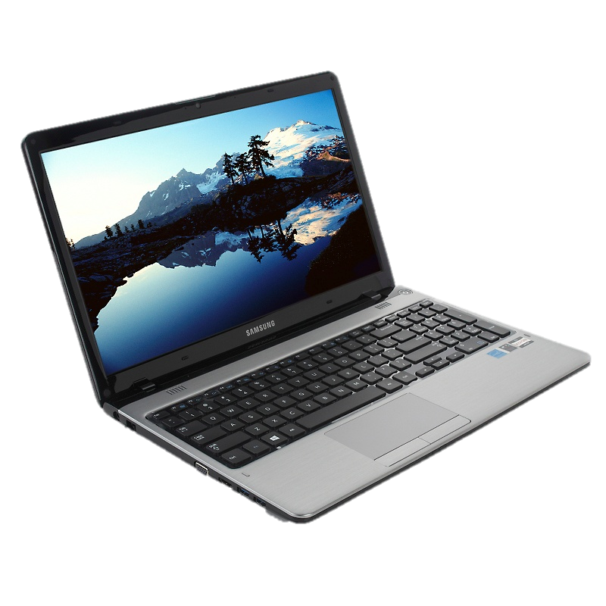
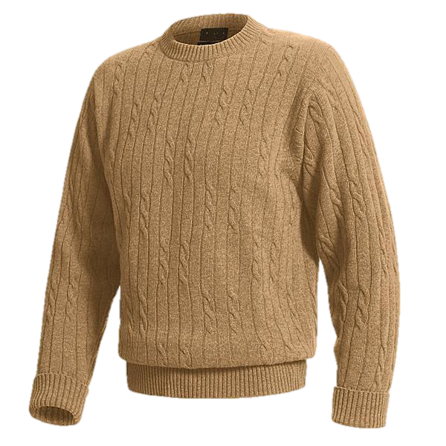
Pragmatic interpretation of numbers
People talk about prices a lot and have good priors on them
6 everyday items with varying price distributions
Notes:
We chose these items also because it’s easy to find price priors for these items on the web.

Slide 12
Price priors
100 subjects on Mechanical Turk
For each of the 6 items, guess its price

Slide 13
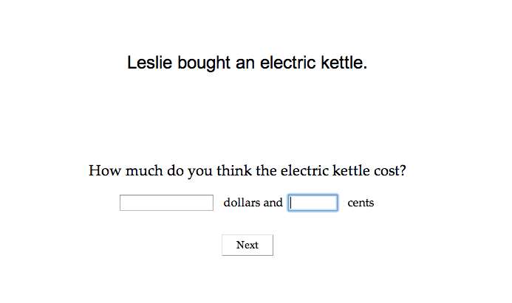
Price priors

Slide 14
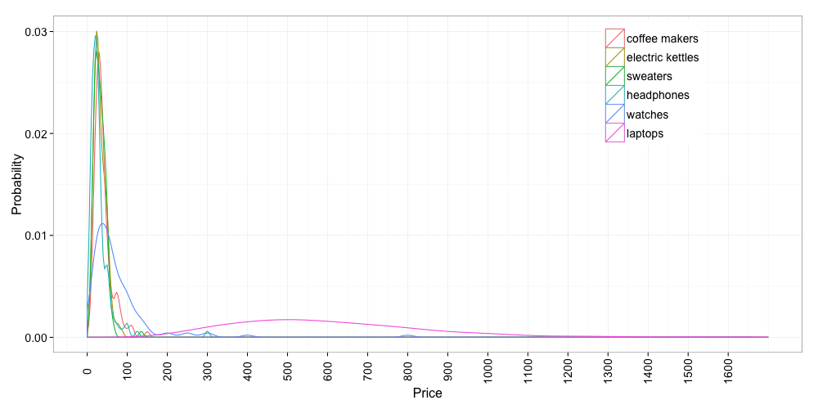
Price priors

Slide 15
Opinion priors
30 subjects on Mechanical Turk
Given the price of a particular item, estimate the chances that the buyer thinks it’s too expensive

Slide 16
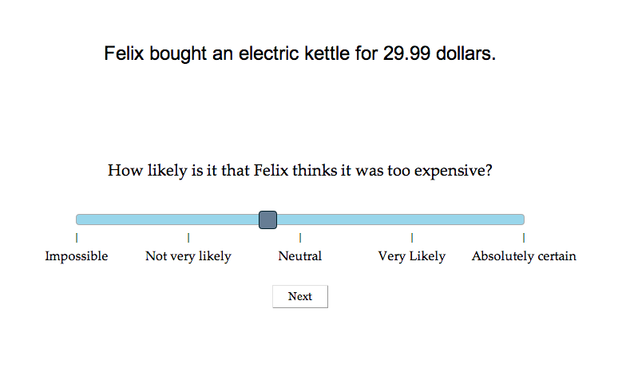
Opinion priors

Slide 17
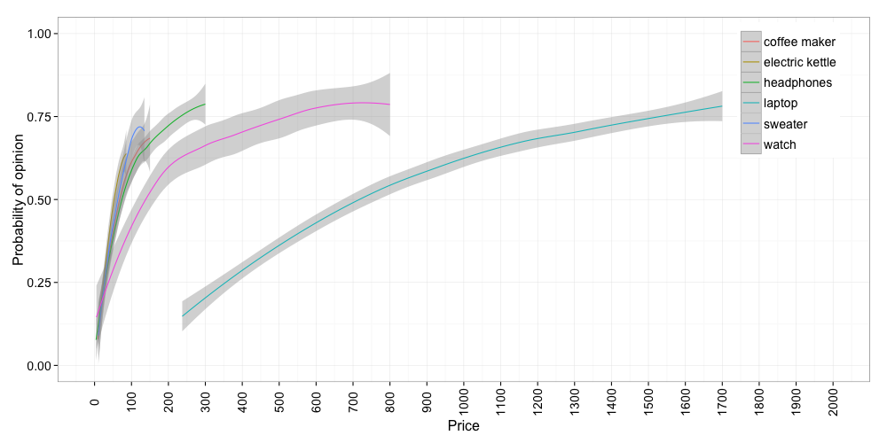
Opinion priors

Slide 18
Interpretation of utterances
60 subjects on Mechanical Turk
Given the buyer’s utterance about the price of a particular item, guess how much it actually cost and estimate chances that the buyer thinks it’s too expensive

Slide 19
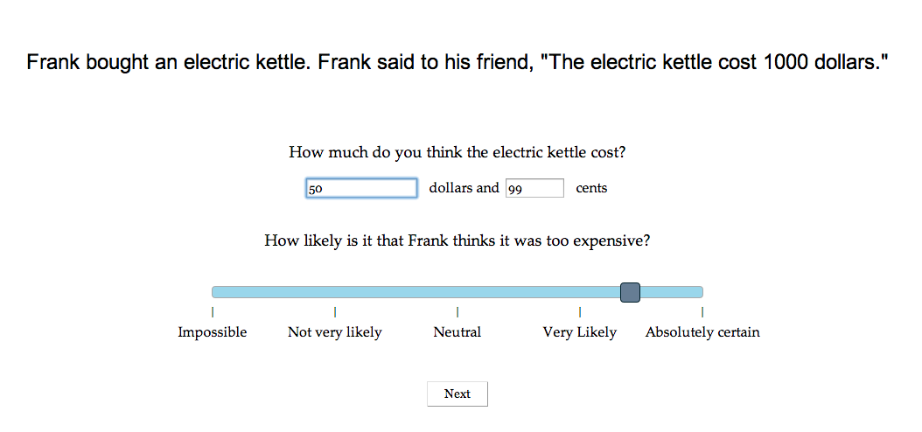
Interpretation of utterances

Slide 20
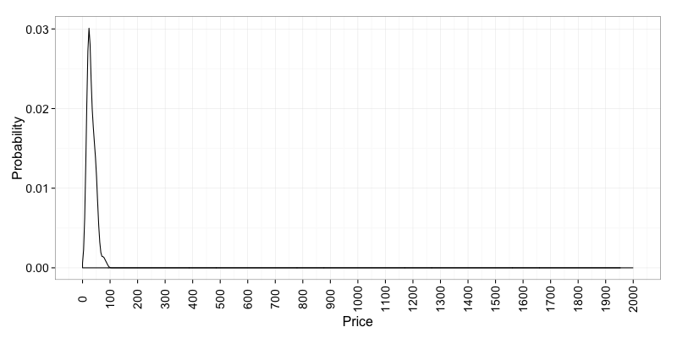
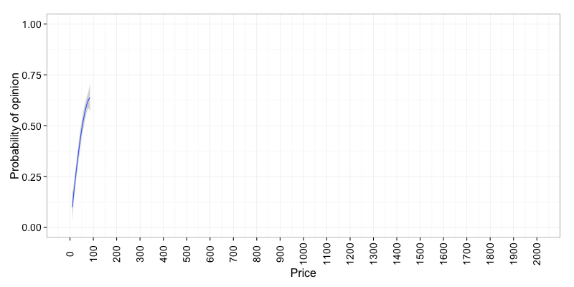
Kettles
Price Prior
Kettles
Opinion Prior

Slide 21
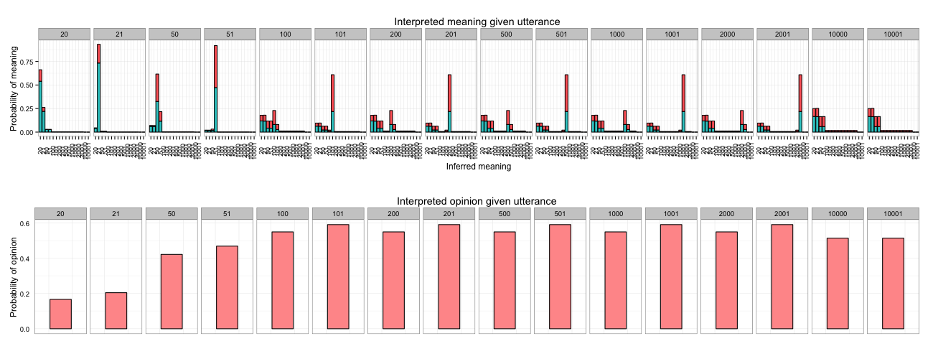
Kettles
Model

Slide 22
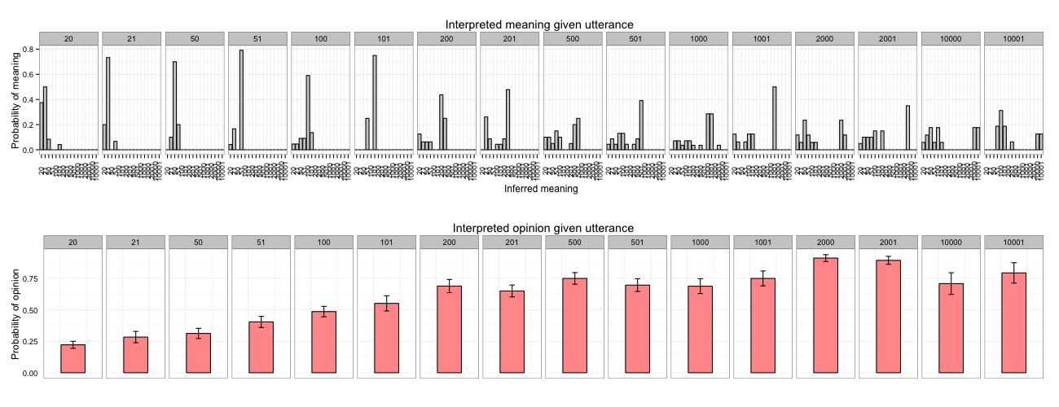
Kettles
Model
Kettles
Humans

Slide 23
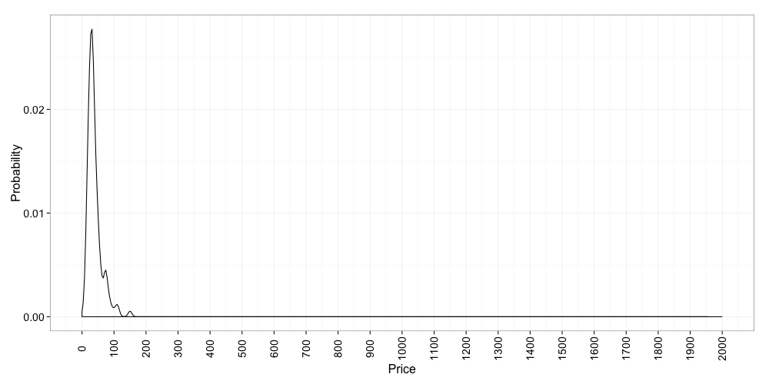
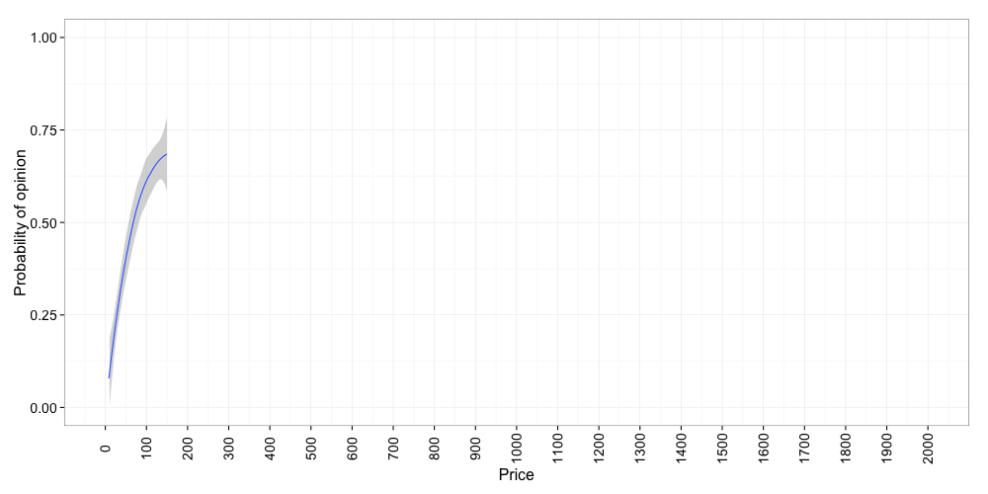
Coffee Makers
Price Prior
Coffee Makers
Opinion Prior

Slide 24
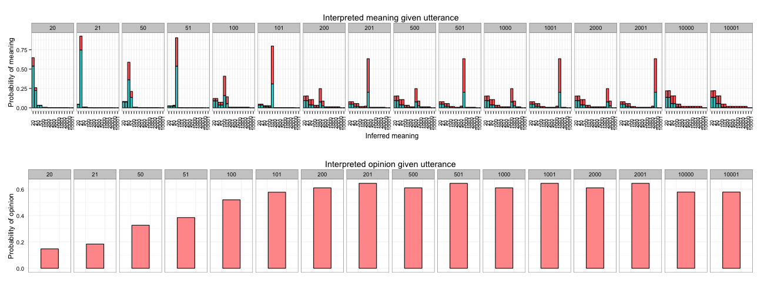
Coffee Makers
Model

Slide 25
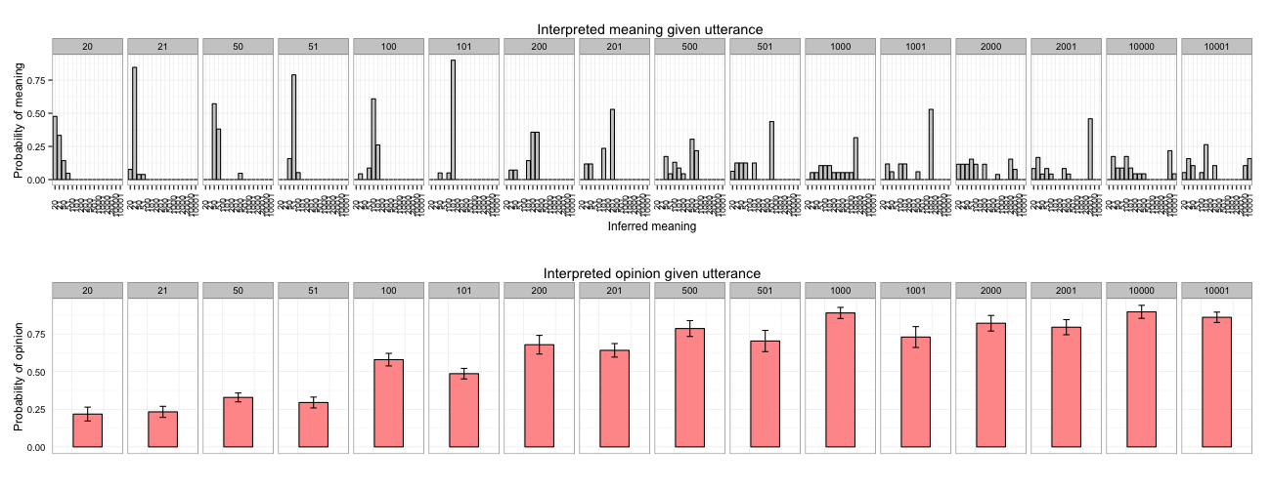
Coffee Makers
Model
Coffee Makers
Humans

Slide 26
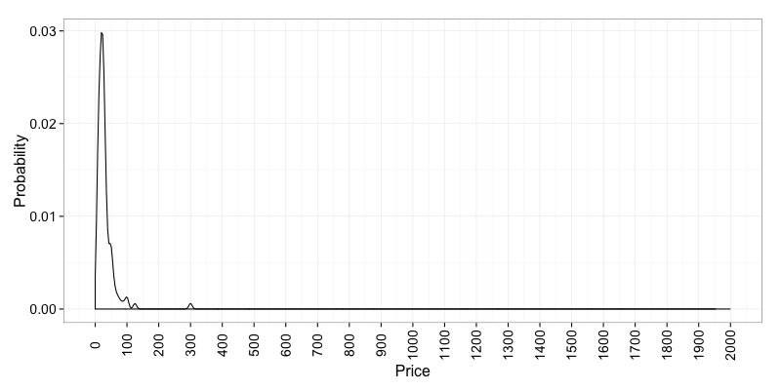
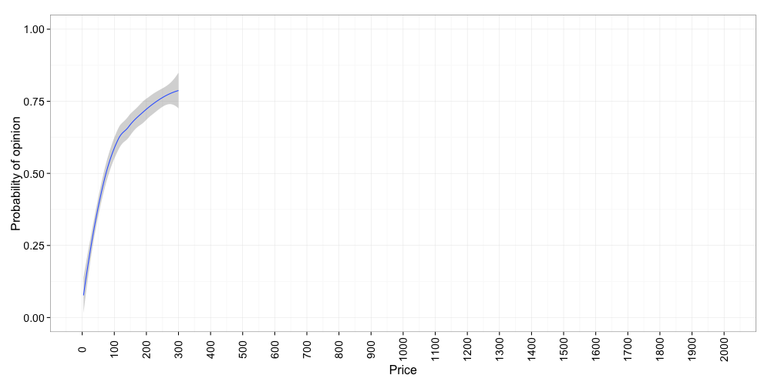
Headphones
Price Prior
Headphones
Opinion Prior

Slide 27
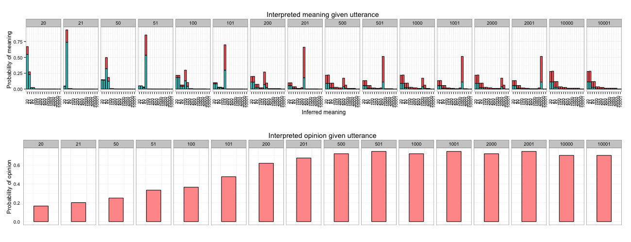
Headphones
Model
Headphones
Humans

Slide 28
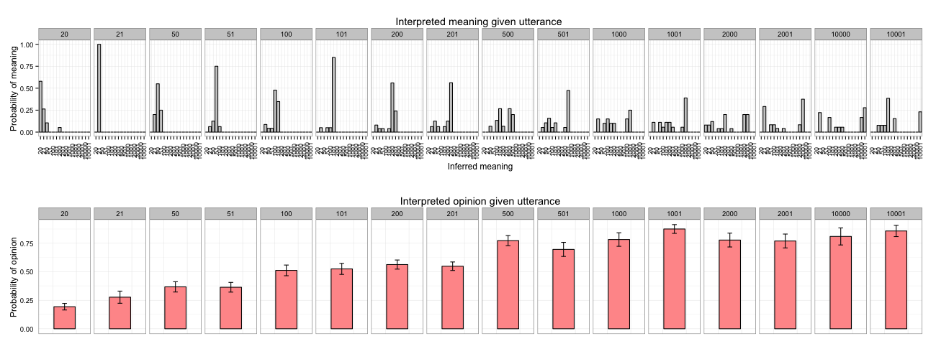
Headphones
Model
Headphones
Humans

Slide 29

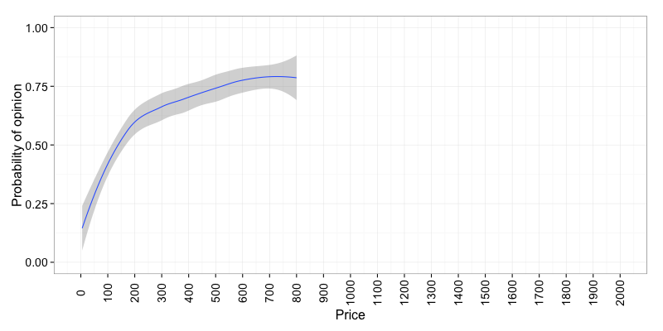
Watches
Price Prior
Watches
Opinion Prior

Slide 30
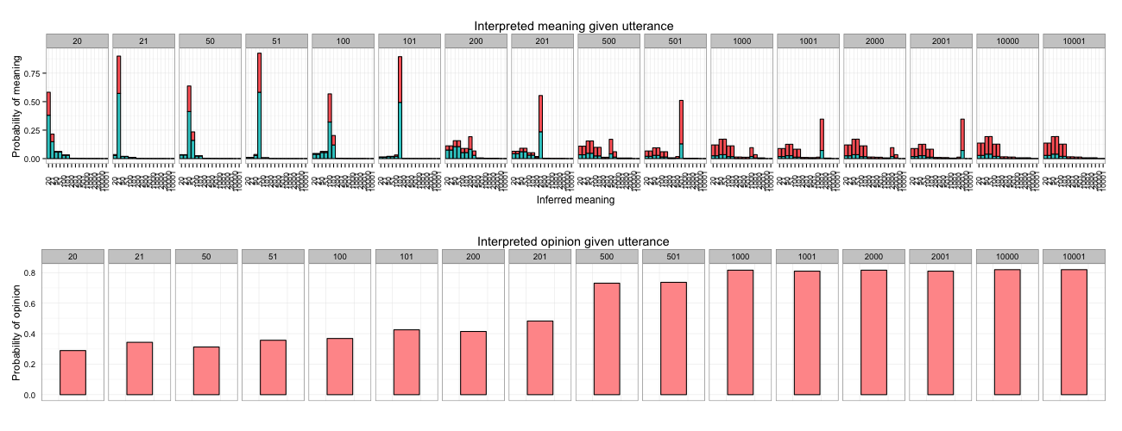
Watches
Model
Watches
Humans

Slide 31
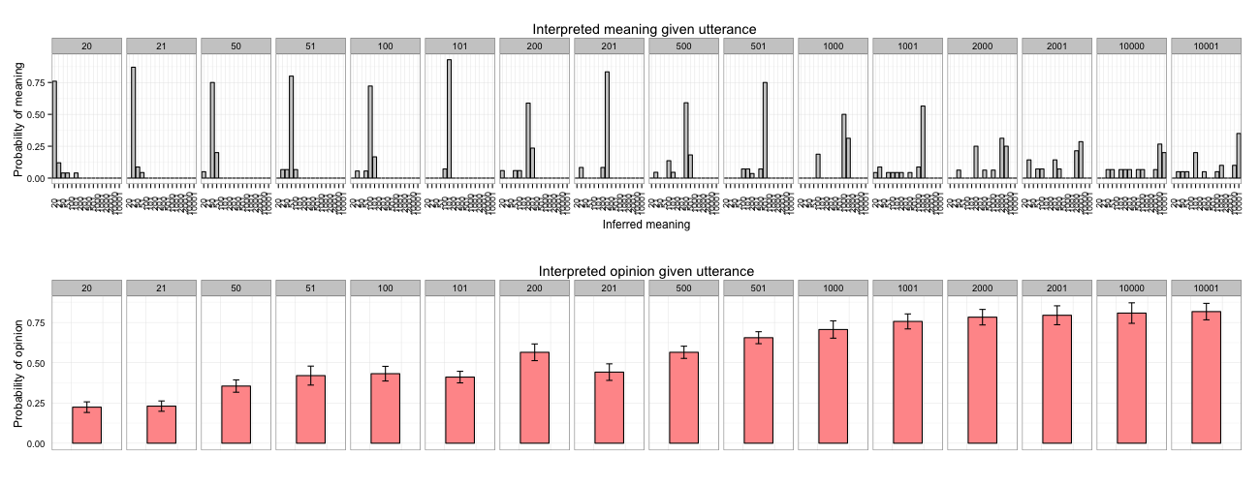
Watches
Model
Watches
Humans

Slide 32

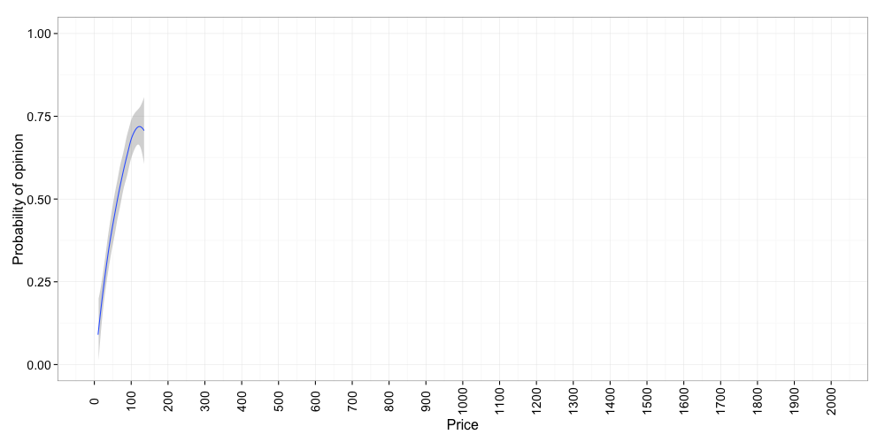
Sweaters
Price Prior
Sweaters
Opinion Prior

Slide 33
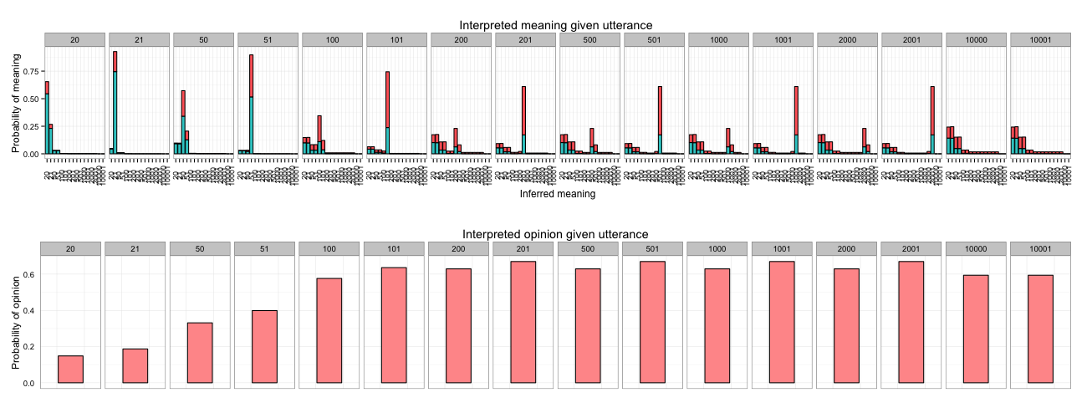
Sweaters
Model
Sweaters
Humans

Slide 34
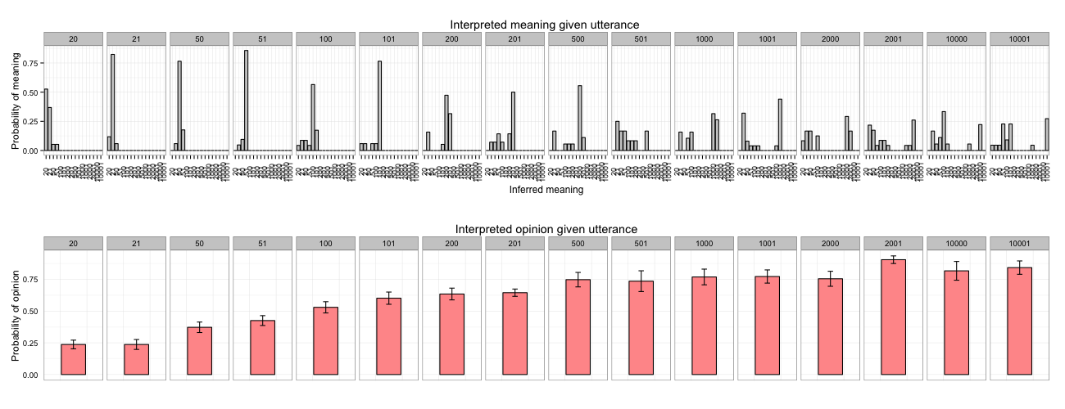
Sweaters
Model
Sweaters
Humans

Slide 35
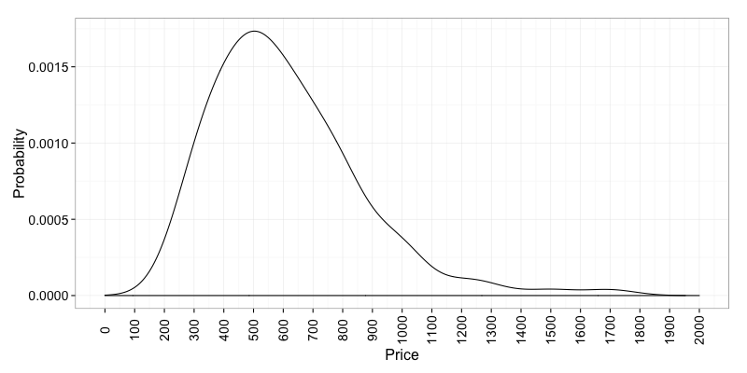
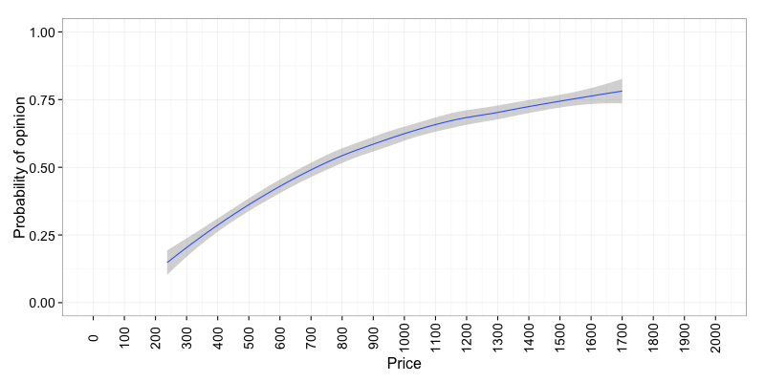
Laptops
Price Prior
Laptops
Opinion Prior

Slide 36
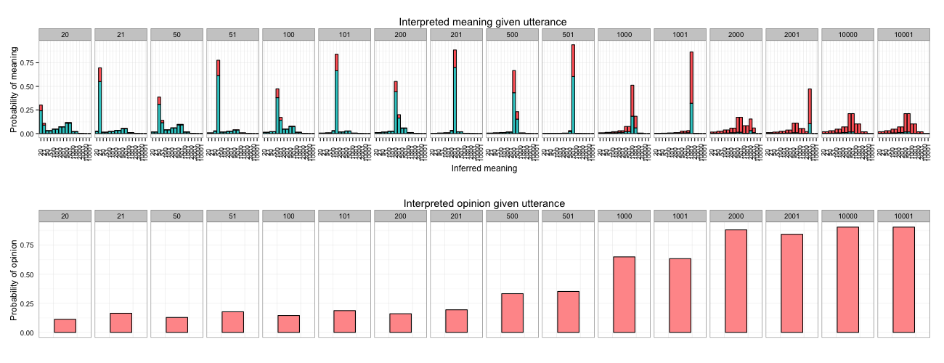
Laptops
Model

Slide 37
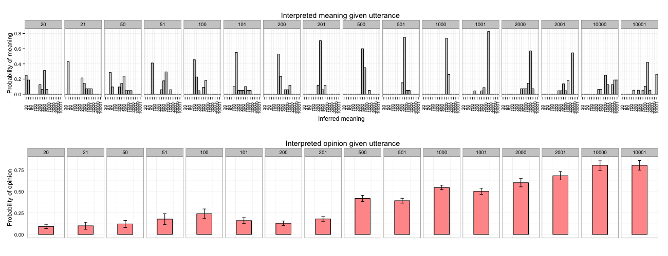
Laptops
Model
Laptops
Humans

Slide 38
Next steps and quandaries…
Numerical meanings are continuous, but we are currently binning them into discrete integers
Other ways to visualize halo/hyperbole/sentiment effects?
Quantitative measures of model fit
Sarcasm?
Snarkiness?
A million other possibilities…

