Slide 1
SECTION ONE

Slide 2

PARLIAMENT WEB SCRAPING
Motivation
Public Accountability
Policy Formulation and Review
Balance and Check
Objectives
Summarize common topics from COS debates that took place within the 13th parliament
Identify MPs who asked questions frequently about each topic

Slide 3
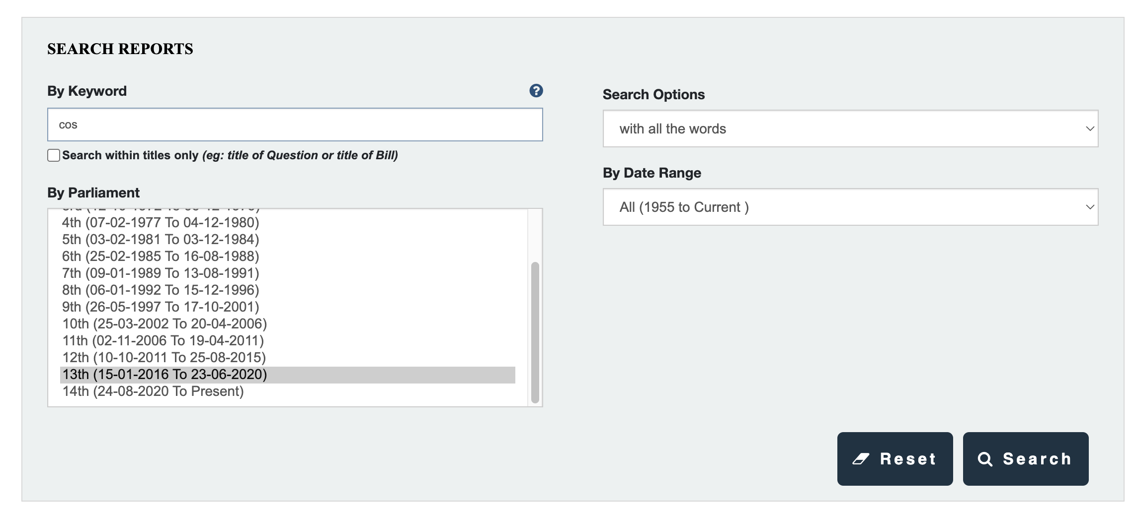
AUTOMATE SEARCHING
1. Get search box and fill it up
3. Find “Search” and click
2. Select the 13th parliament

Slide 4
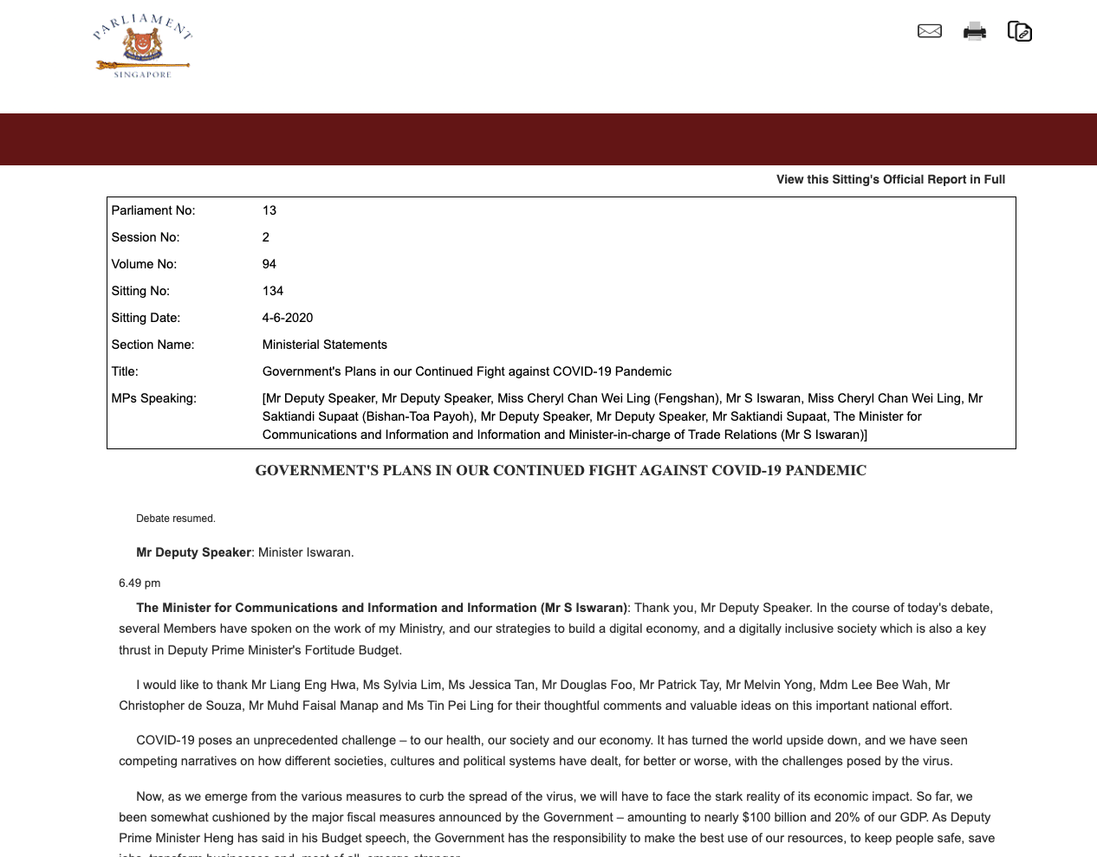
SCRAPE INDIVIDUAL SEARCH ITEMS
Scrape first 10 pages of data
Each page has ~20 items
Last page has only 2 items
Individual data scraped
- Section Name
- Title
- MPs Speaking
- Text

Slide 5
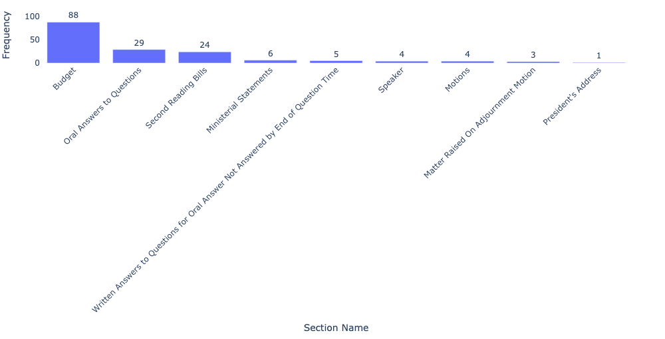
DISTRIBUTION OF SECTION NAMES
“Budget” was most widely discussed among Section Names
Only Section Names which are related to Questions and Answers will be considered for identifying MPs who asked questions frequently about each topic

Slide 6
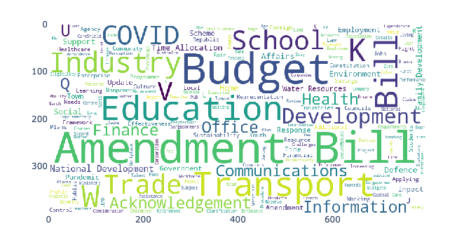
WORD CLOUD FOR TITLES
Word cloud plotted based on frequency at which words occur in Title
Excluded stopwords such as “in”, “debate”, “minister” which occur frequently but do not carry much information
Some common topics being discussed are related to “Budget”, “Transport”, “Education”, “Amendment”, “COVID”

Slide 7
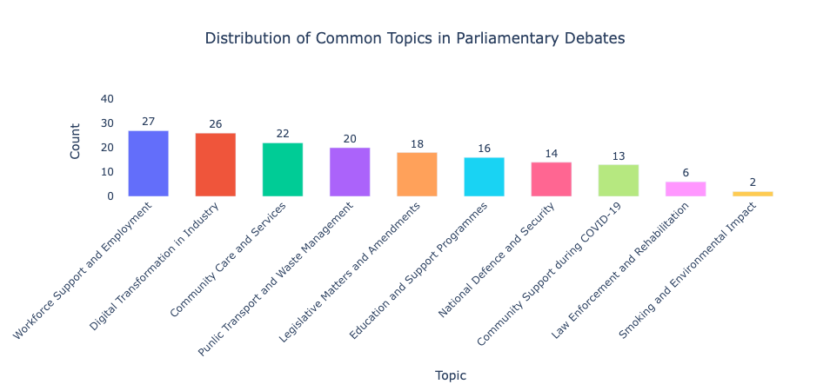
TOPIC MODELLING FOR TEXT
Latent Dirichlet Allocation
Identifies patterns of word usage that correspond to different themes or topics
Groups documents into a predefined number of clusters (topics) even without explicit labels
Topics identified based on their top 10 most frequent keywords

Slide 8
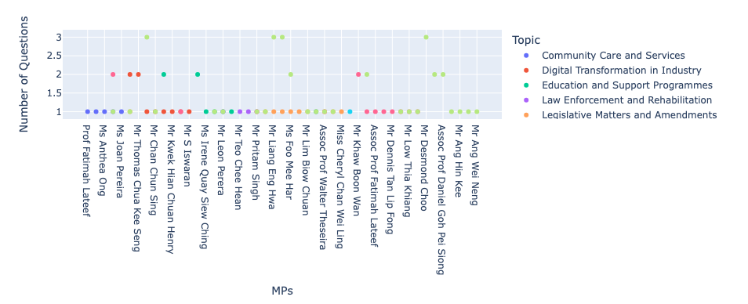
MPS WHO ASKED QUESTIONS
Interactive plot - can hover over each dot to view: Topic, MP, Number of Questions
Most MPs asked 1 question, and 10 MPs asked 2 questions
Most questions asked for Workforce Support and Employment, with 4 MPs asking 3 questions: Mr Liang Eng Hwa, Mr Patrick Tay Teck Guan, Mr Desmond Choo, Mr Lim Swee Say

Slide 9
THANK YOU!

