Slide 1
Campus Conquest
Final Presentation
Gruppe 8
Michael Sailer, Paul Preißner, Jonas Mayer,
Benedict Drechsler, Jean Paul Vieira Filho, Julian Frattini
[IN 0036] Praktikum Social Gaming

Slide 2
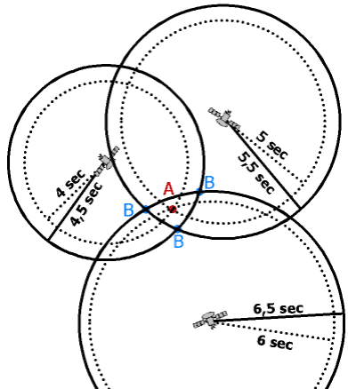
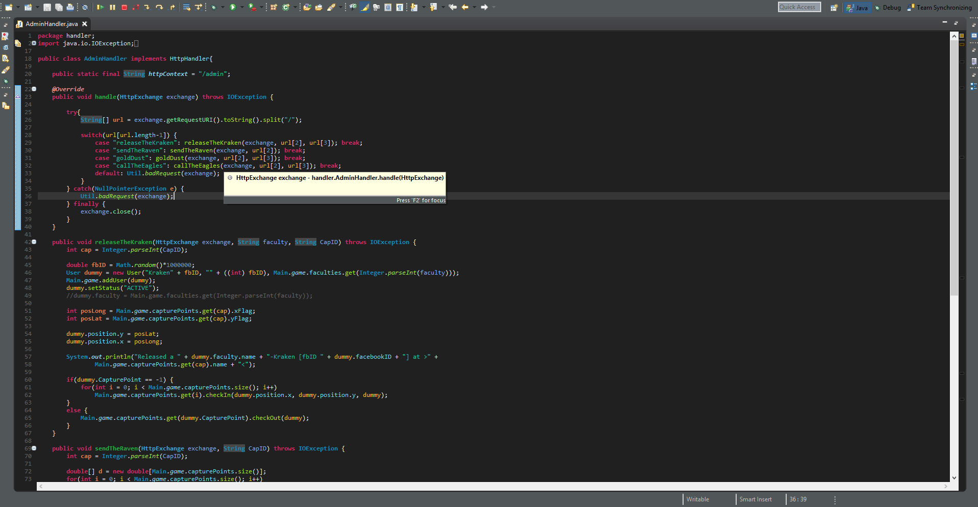
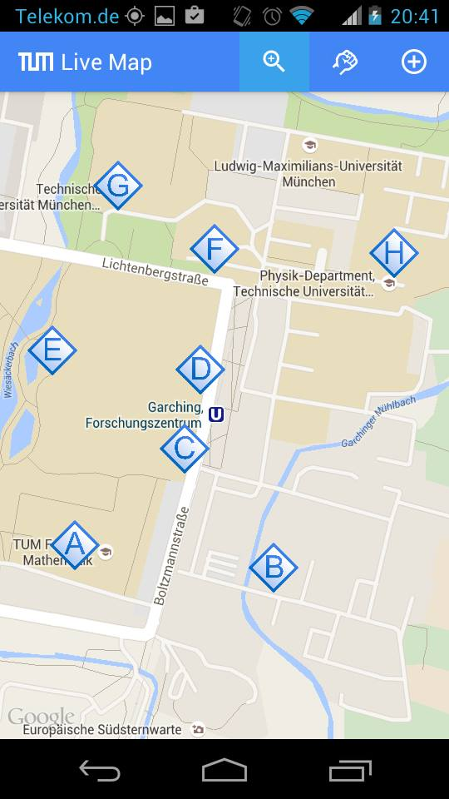

Main Game Loop
Game Logic
Game Data
Client-side
Server-side
HTTP
Simulation Data
Statistics and Social Context Data

Slide 3
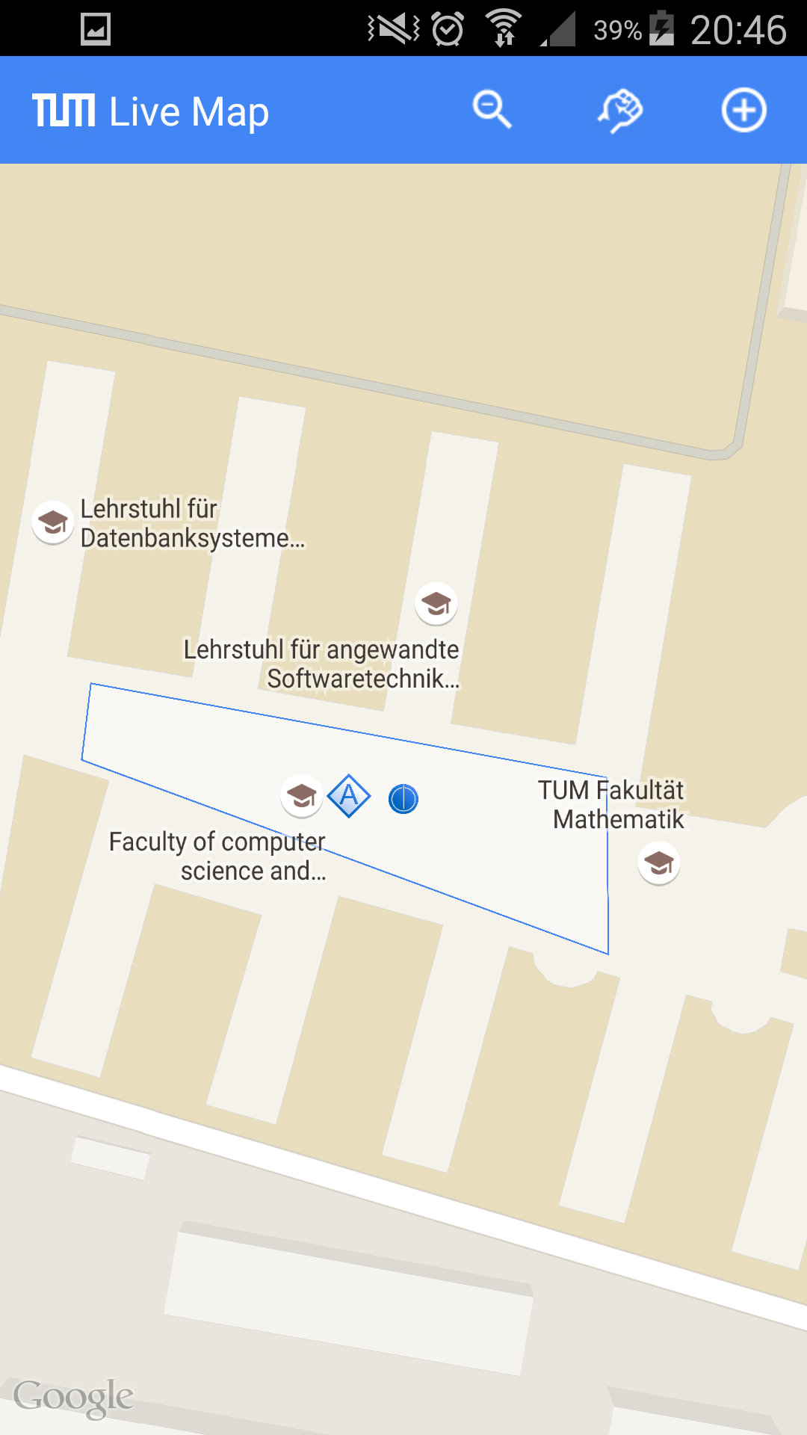
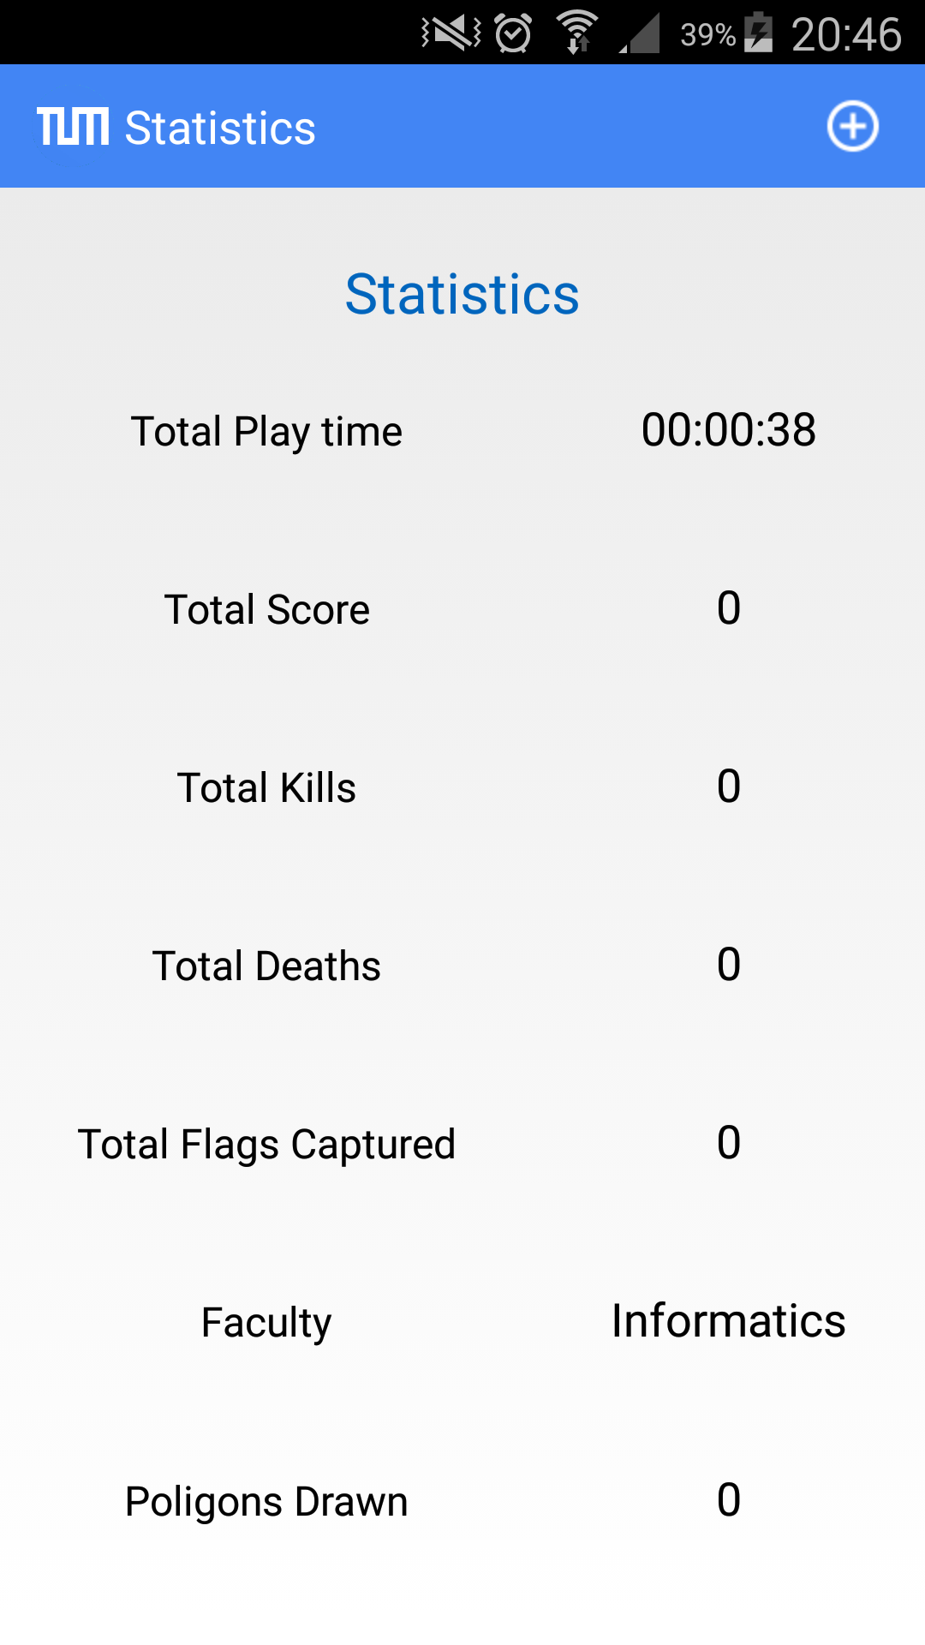
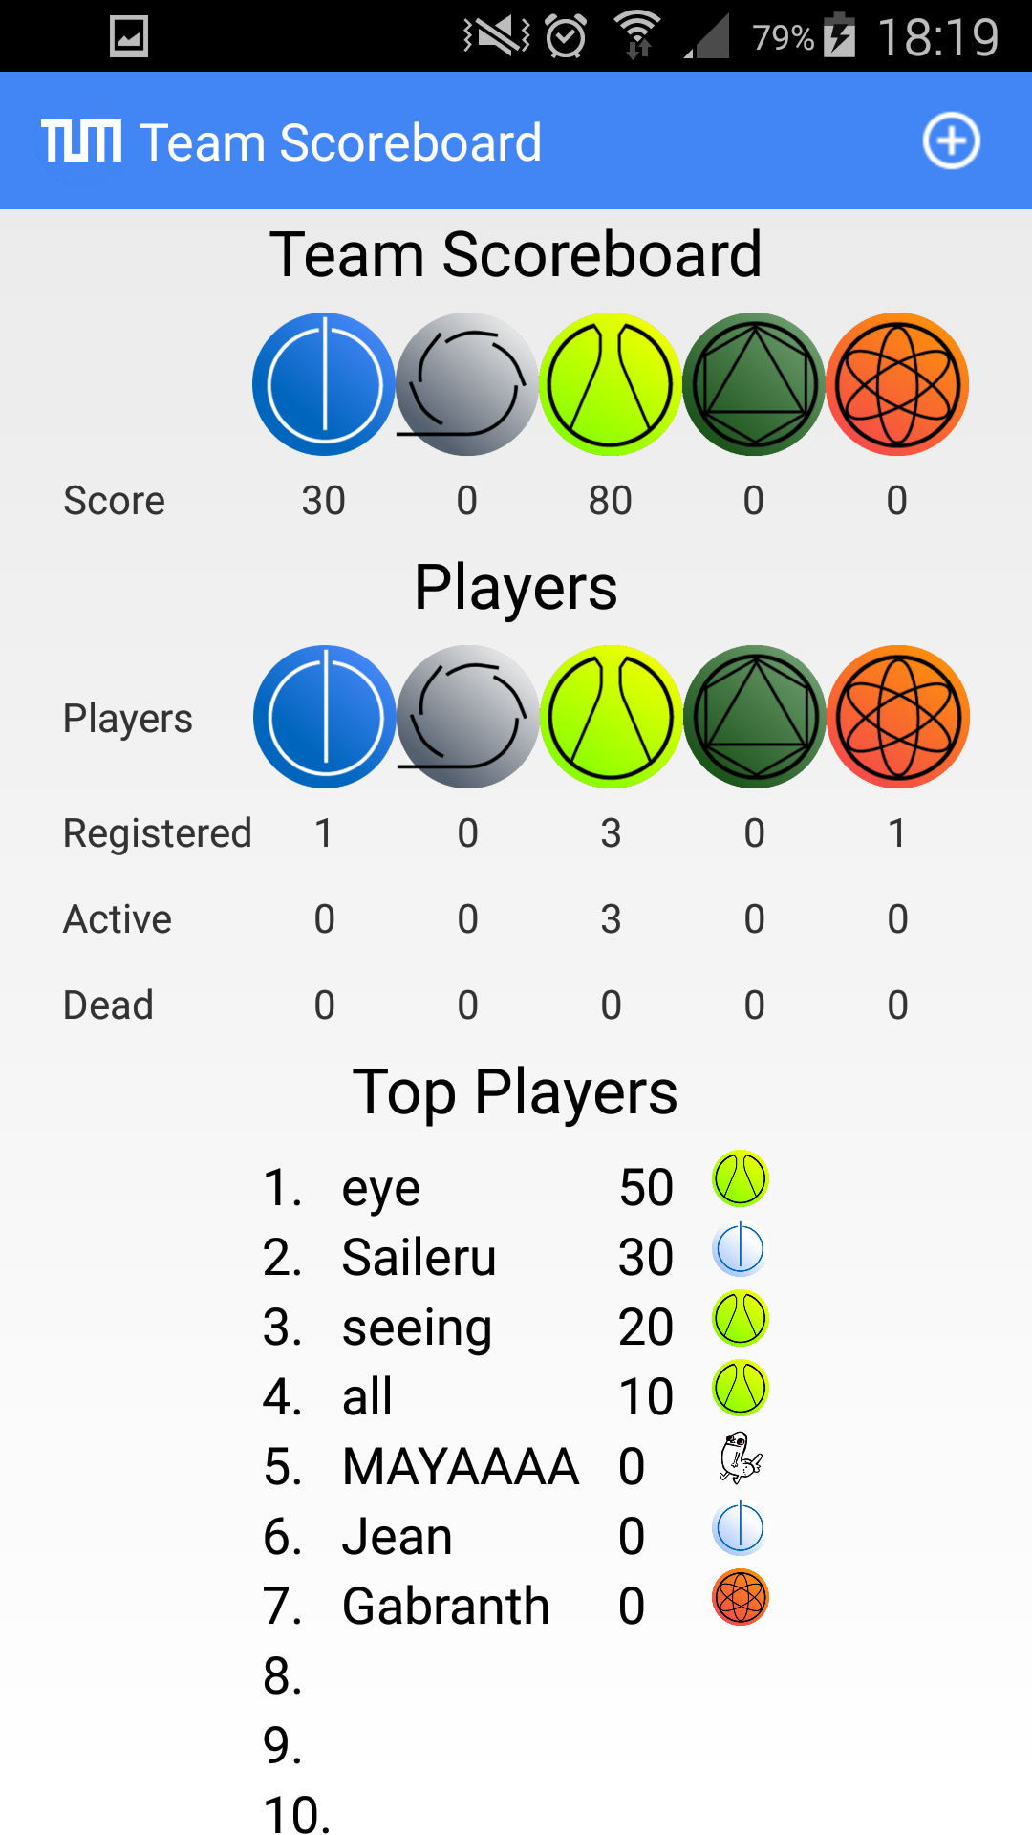
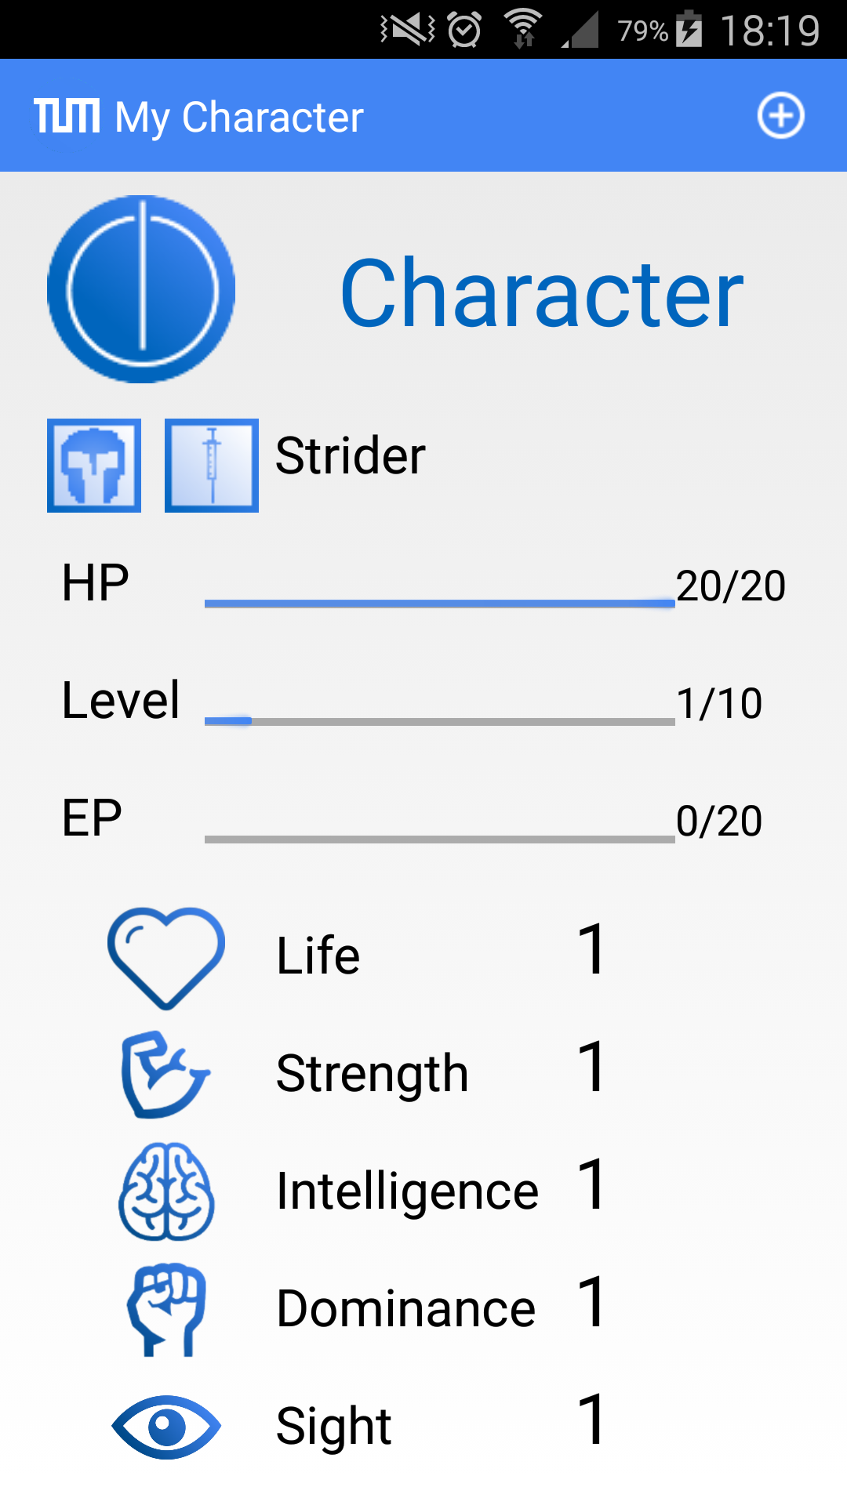
Main Game Loop
Game Data
Statistics and Social Context Data:
  Player Score/Deaths/Kills
  Faculty Scoreboard
  Game Statistics
  Single event data
Simulation Data:
  Users' GPS coordinates
  Users' status (HP, Energy, isAttacking)
  Capture Points' status
  Attack meshes

Slide 4
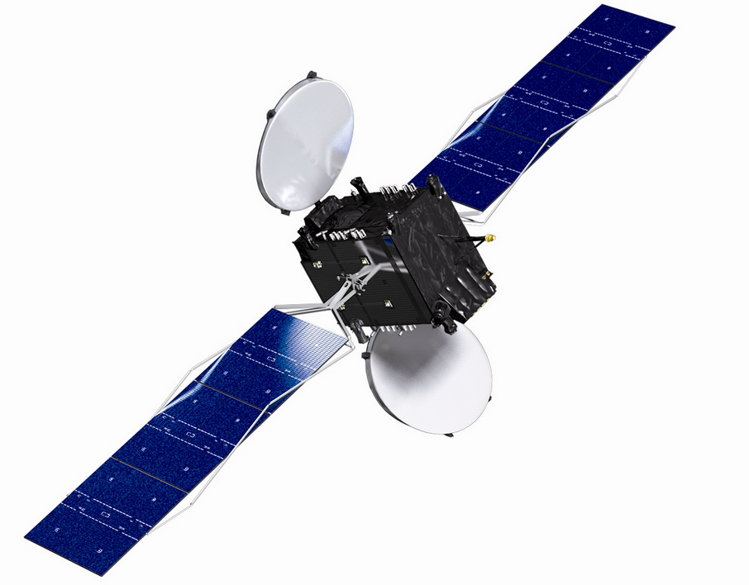
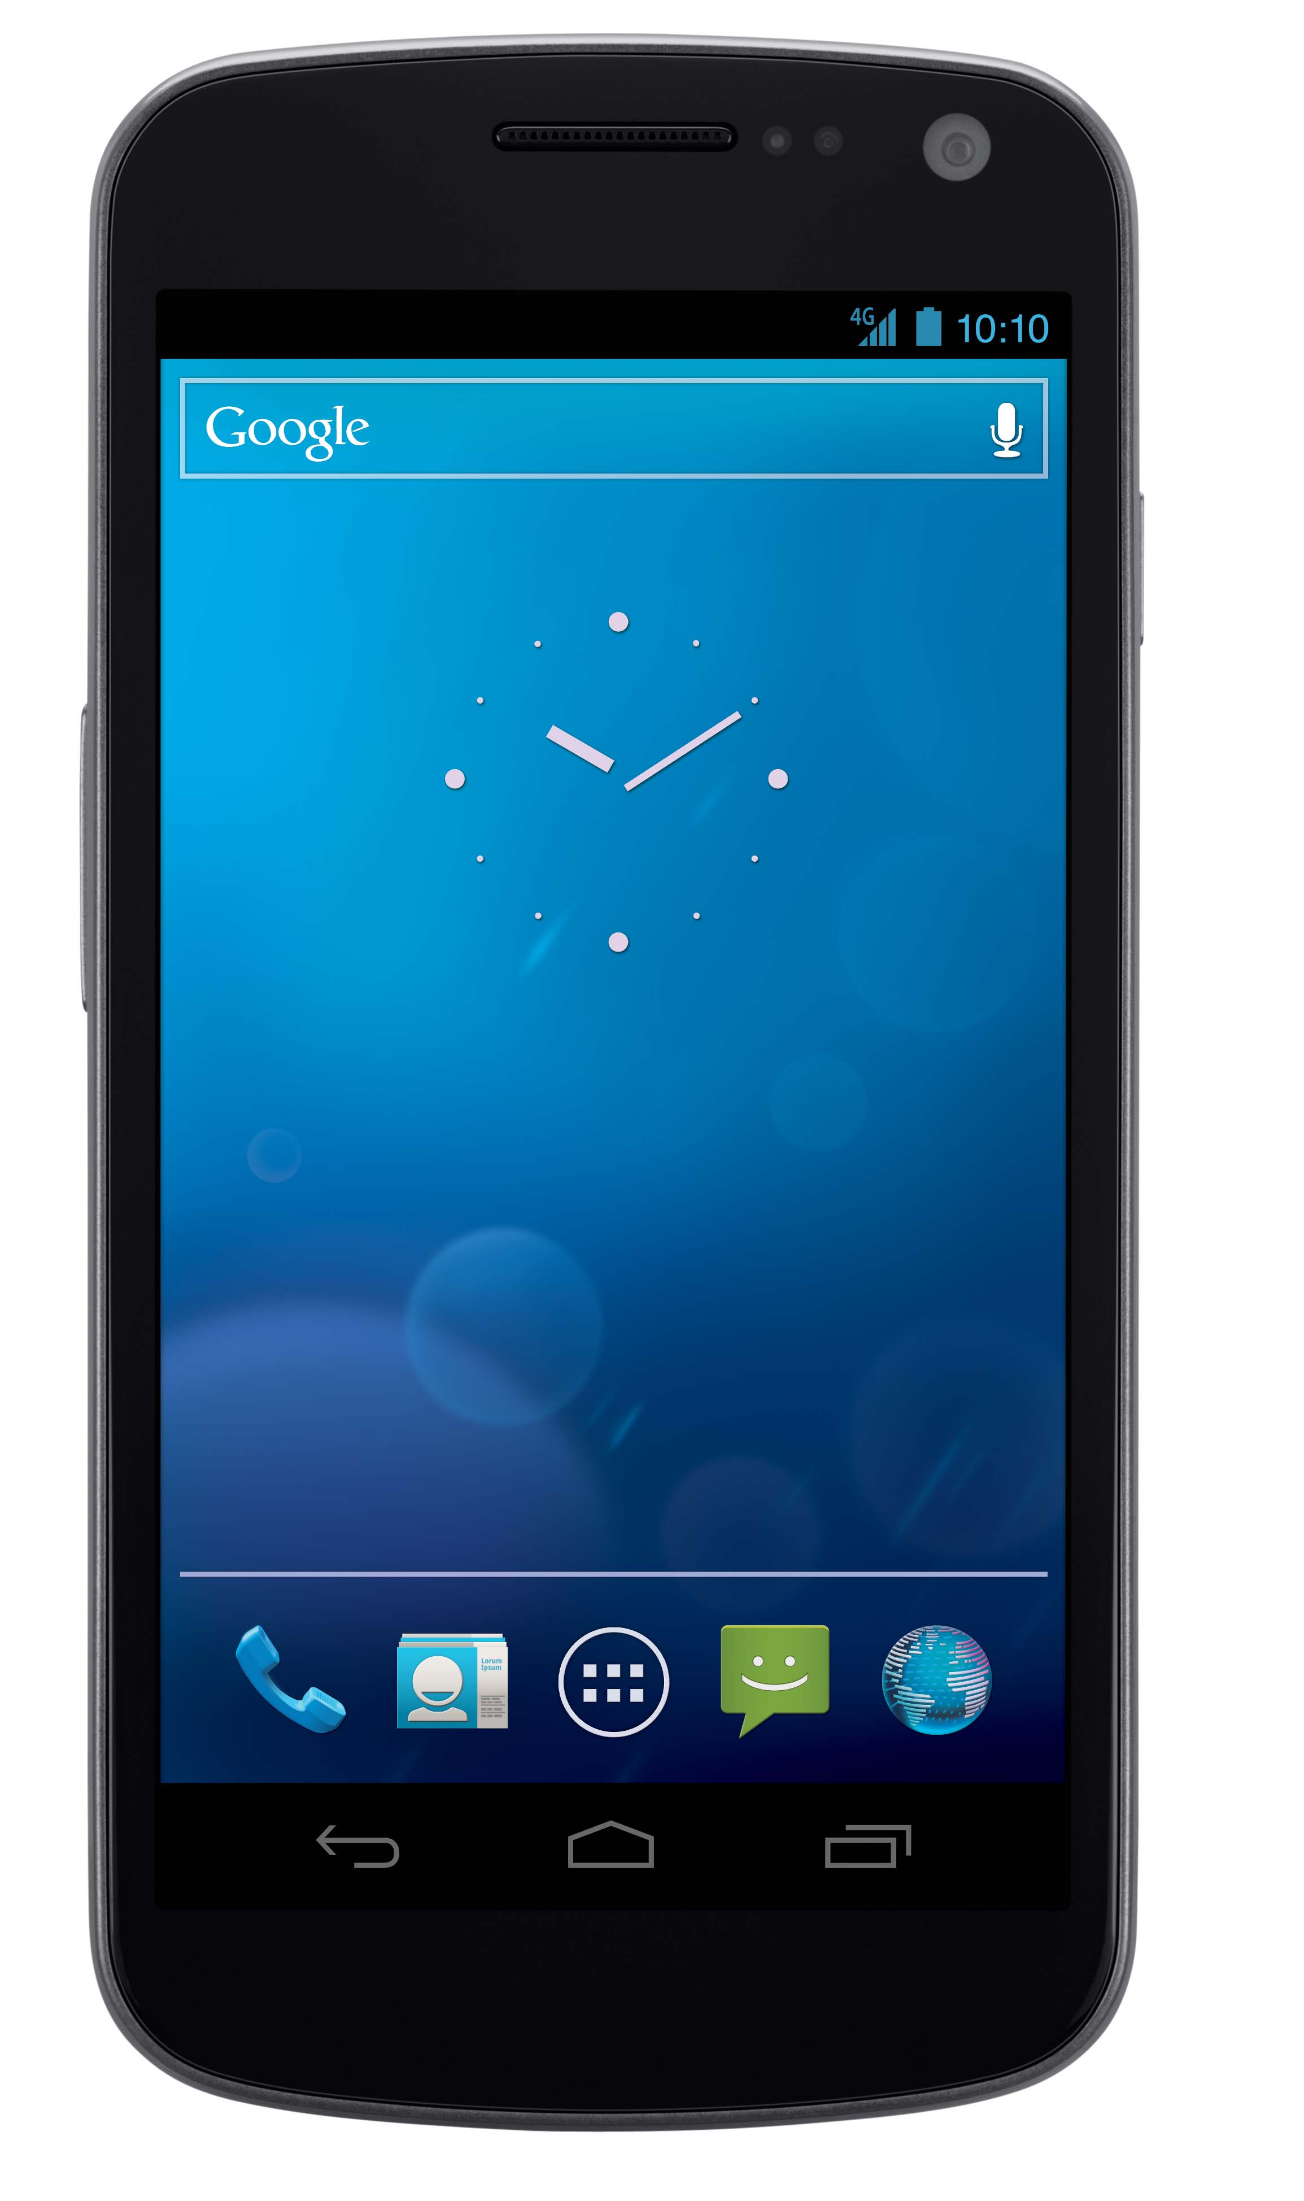

Main Game Loop
Game Logic
Simulation data flow:
  Clients gather GPS data and send it to the server via HTTP Post
  Server receives GPS data from all clients and use it to simulate one “step” of the game.
  Clients request the updated game in a specific frequency via HTTP Request
  This information is processed and displayed to the user on the client
GPS Data
Time
GPS Data
Simulation
Game Data

Slide 5
Main Game Loop
Game Logic
Statistics and Social Context
  A client sends randomly, when the user wants to see this data, a HTTP Request to the server.
  The server packs all the data on a JSON Object and sends it back to the specific client.
  The client then processes the information and display it back to the user
Request
Time
Build packet
SSC Data

