Slide 1
Obstacles and Problems
in the
Development Process
Play-Framework
Flag Conquering Process
HTTP-Requests

Slide 2

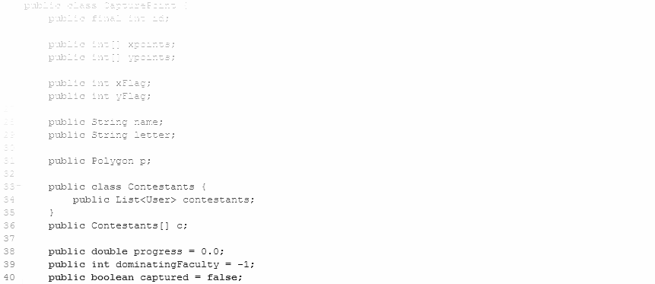
Framework
What the Play Framework offers:
lightweight, stateless, web-friendly architecture
  run on request
  hot-code reload
  requires http-Requests
  requires data bank
What we need:
continuous game world simulation
efficient support of multiple clients
fast responsiveness
continuously running server
Solution:
We‘re writing our own server from scratch

Slide 3
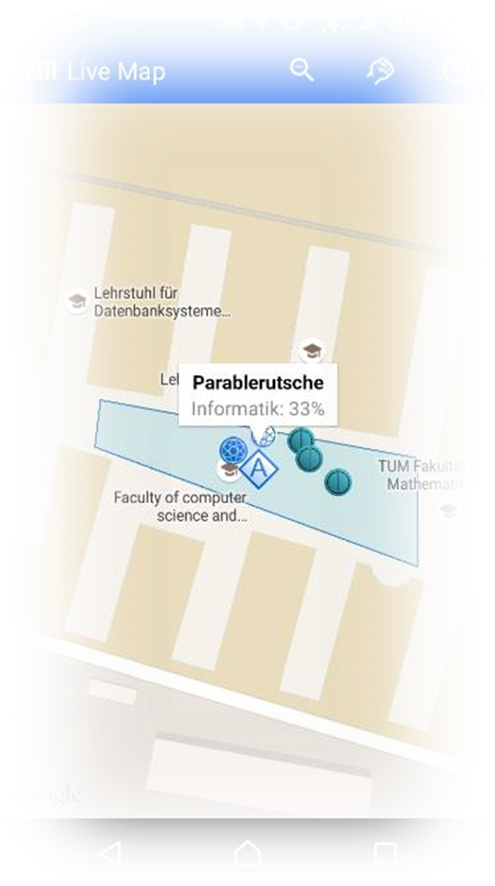
Flag Capturing Process
Problem:
Transfer the known 1:1 concept in a 1:n or n:n context
multiple D.O.F for solutions
Created one of the most controversial discussions in our team
Different concepts:
  mixed multi faculty capturing
  destroy with everyone - capture with team
  Dominant faculty capture
Our Solution:
Most numerically dominant faculty starts destroying and capturing the point

Slide 4
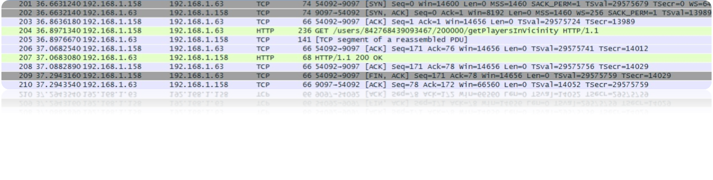
HTTP-Requests
Goal:
low latency, high precision networking for best user experience
Problem:
http-Request rather slow
10 messages needed to transport 1 packet of data
Ok and Necessary for Play Framework
performance bottleneck in our current game
Possible solution:
Sockets or simply anything but http-Request

