Slide 1


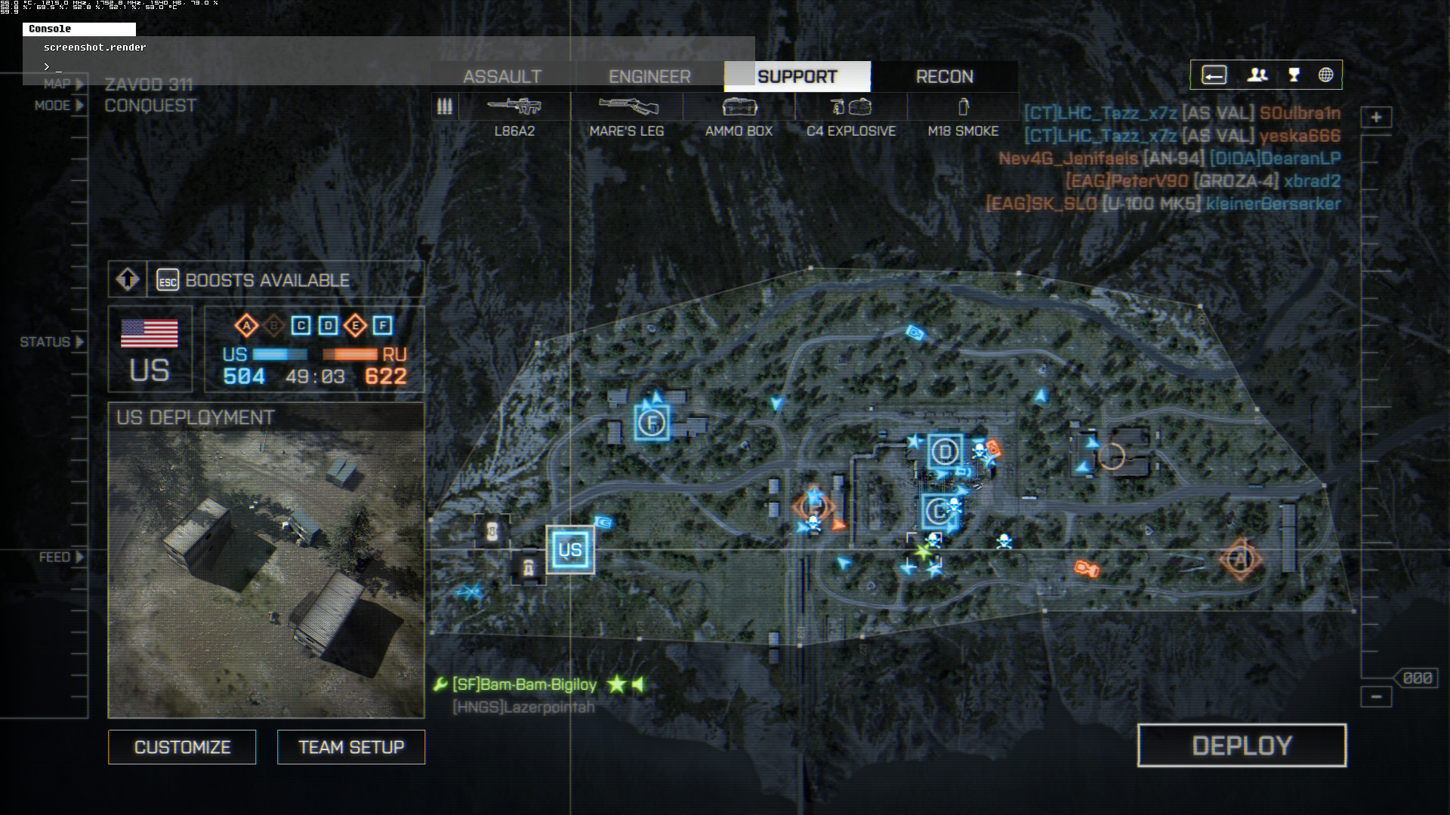
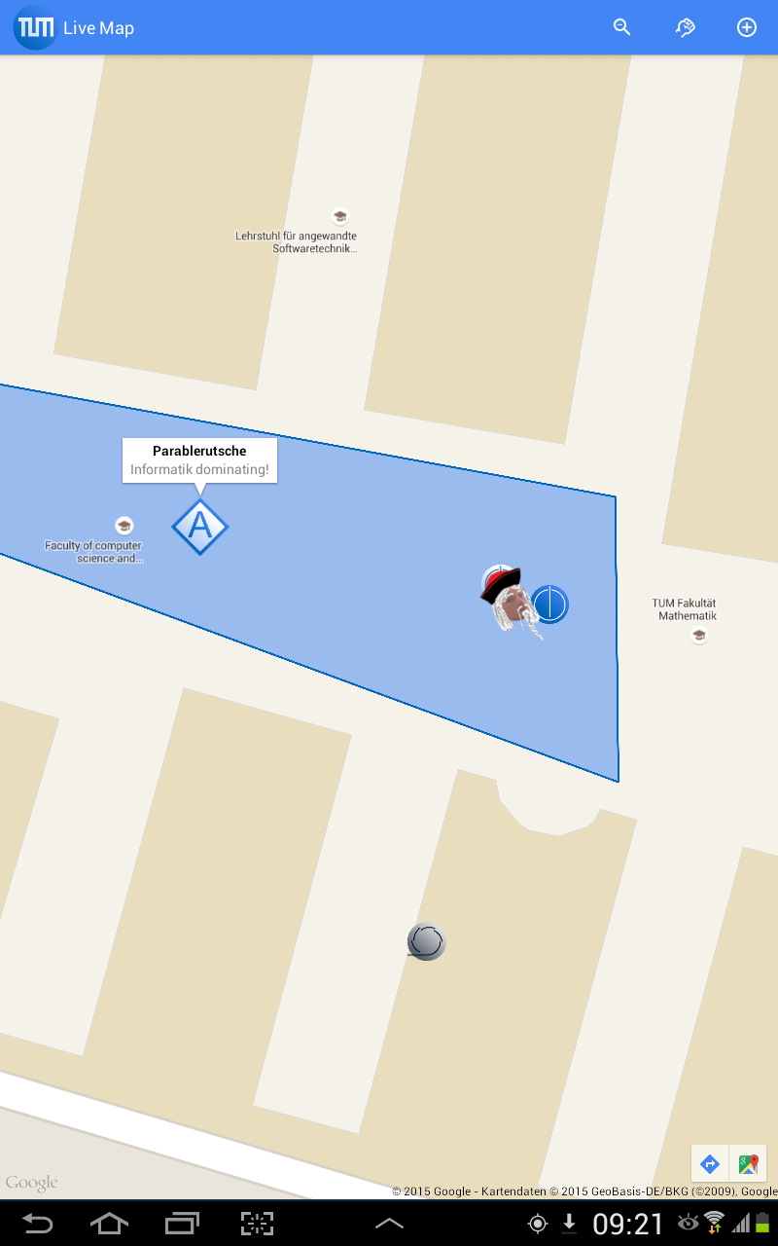
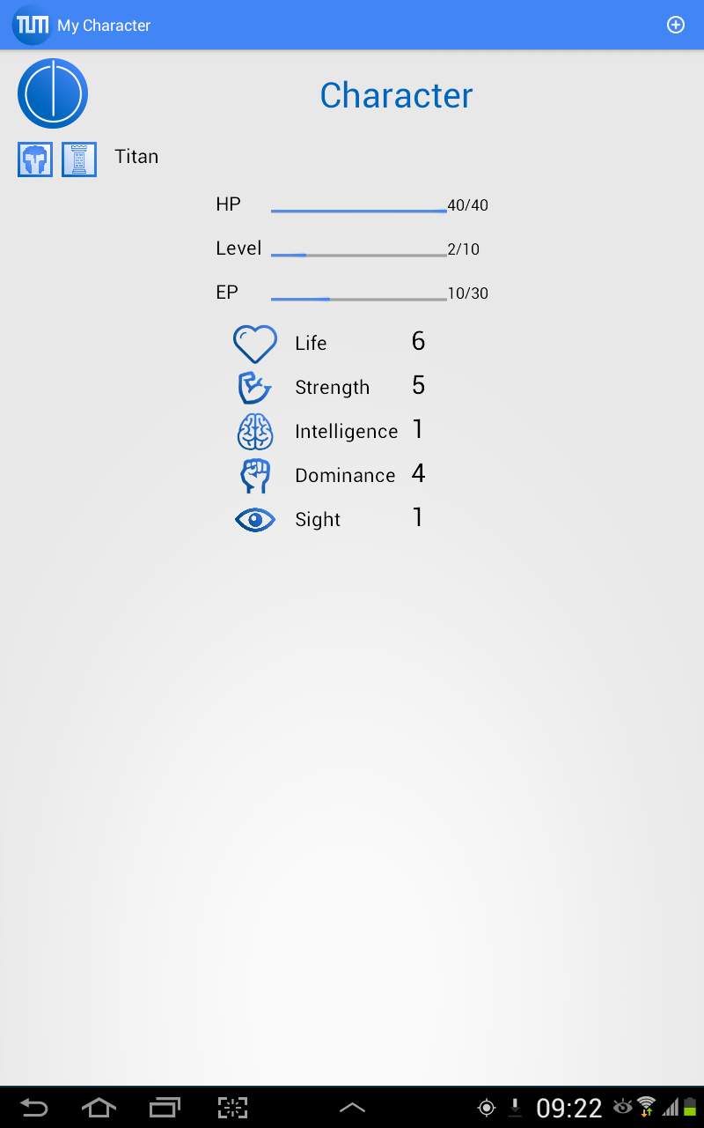

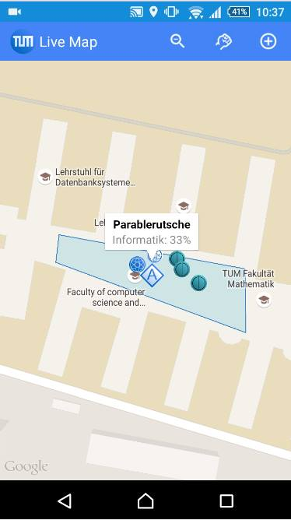
“Best strategy game 2015!” - IGN 9.7/10
“Amazingly good! A must have for your android device!” - Larry Page
Dominate the campus with your friends and other faculty members!
Gain experience and level up to become the ultimate conqueror!
Receive feedback about you and your faculty to improve tactics!
And much more...

