Slide 1
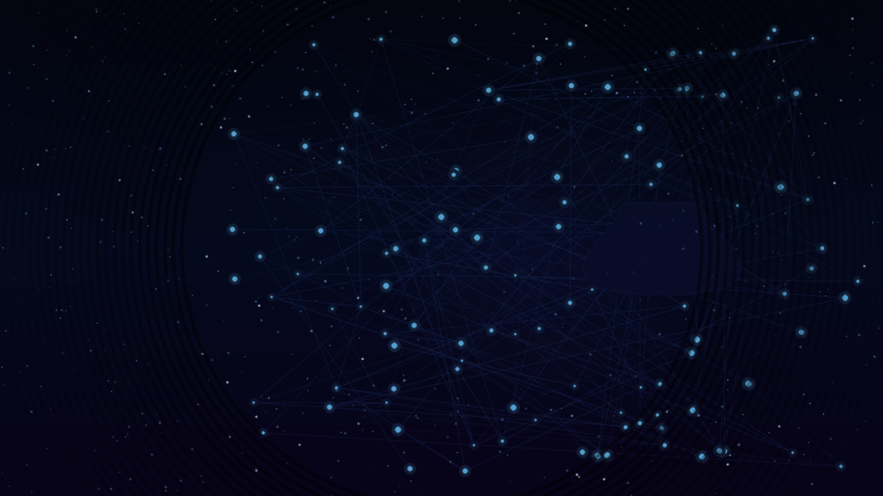
AI
My Journey into AI
Seeing is believing (or is it?)
Jean • Director of R&D IT (Data, Analytics & AI) • April 2026
AstraZeneca | Confidential

Slide 2

1
Early Days
Late 2025
🔍 Search Tool
💡
Started using ChatGPT purely as a search replacement
📄 Summarization
Lightbulb Moment
Began summarizing documents, articles and long content
Realising the immense learning power now unlocked through AI — this wasn't just a tool, it was a paradigm shift.
✍️ Content Generation
First content generation — including maths homework for the kids!
💻 Code Generation
Leveraged GenAI capabilities for software development
👨‍👩‍👧‍👦 Family Access
Ensured the whole family had access to Grok
My Journey into AI | Slide 1

Slide 3
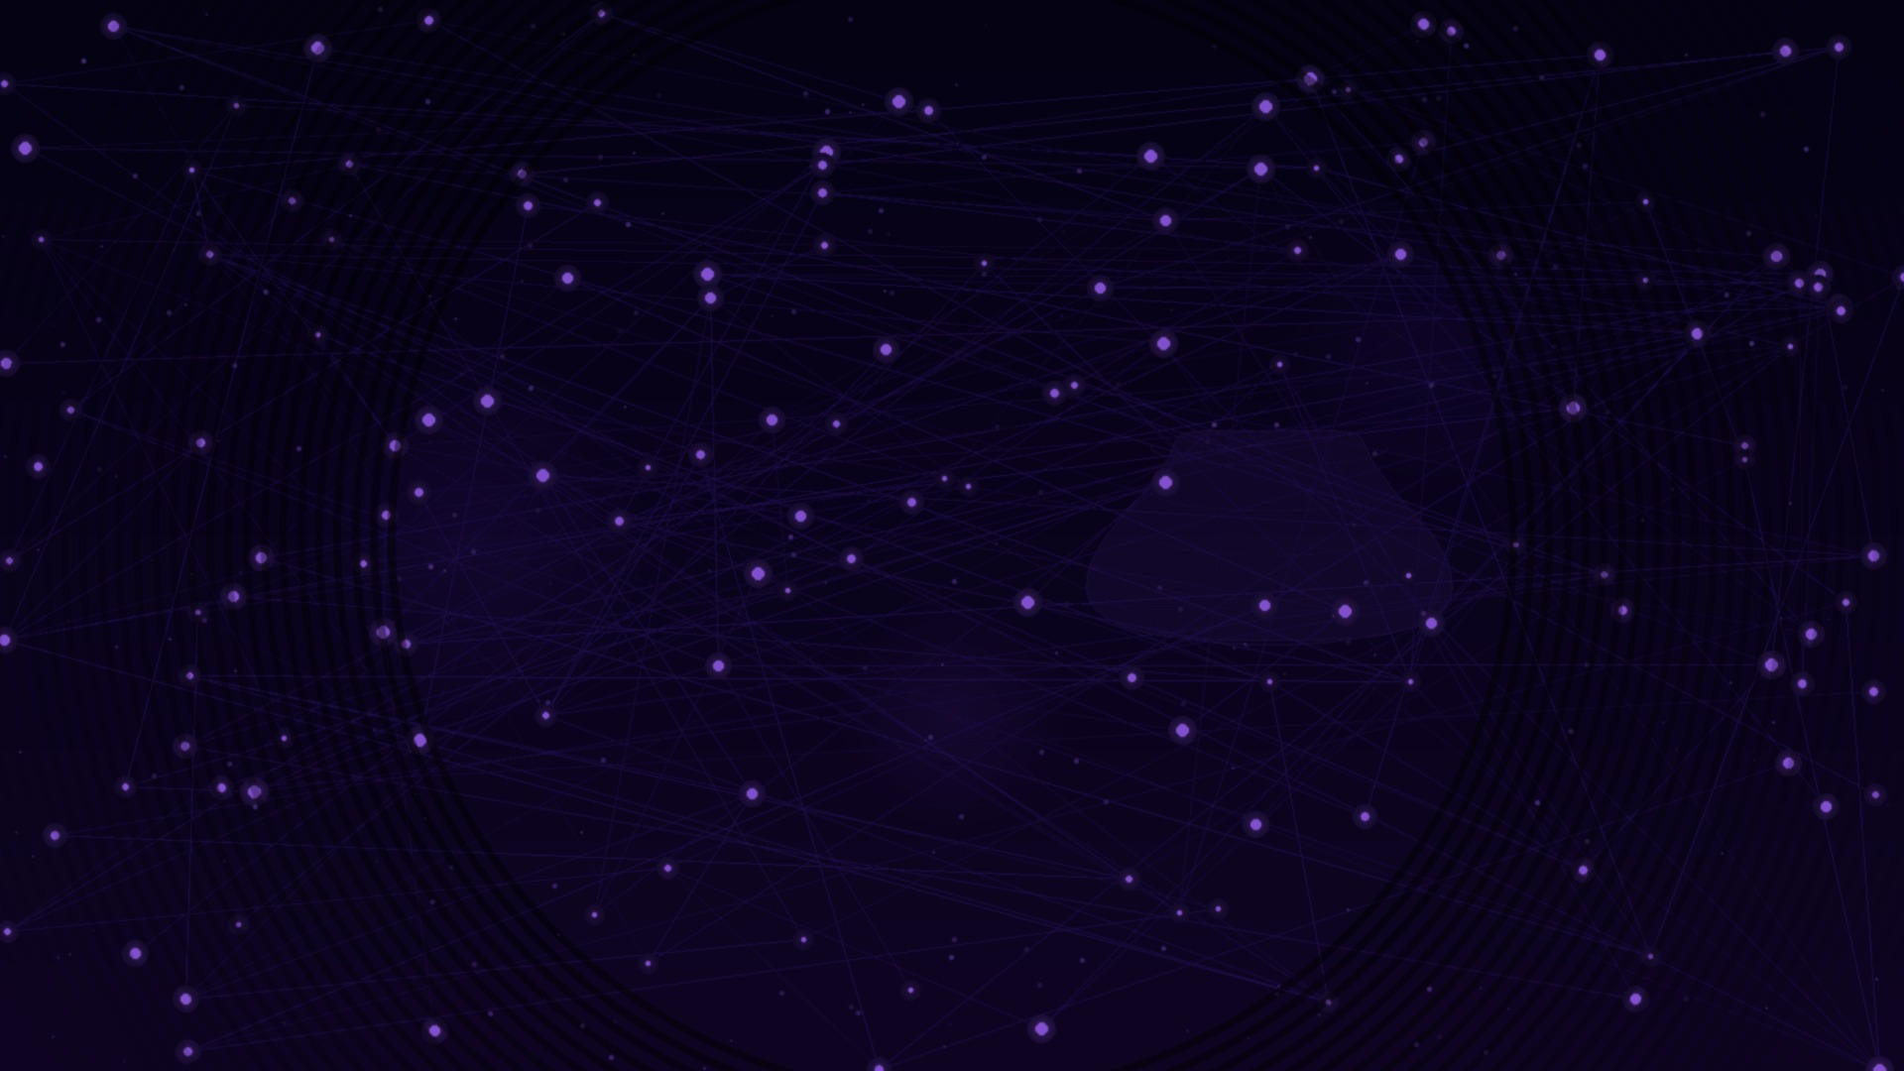
2
Early 2026
Testing & Evaluation
TOOLS EVALUATED
Microsoft
Google
Anthropic
OpenAI
› GitHub Copilot
› Gemini
› Claude Code
› Codex
MODEL EVALUATION FINDINGS
🔭 Discovered Opus
💡 Discovered OpenClaw
• Long-running complex tasks • High-quality code output • Frontier reasoning capabilities
LIGHTBULB MOMENT — Configured and deployed
in an Azure VM for real-world experimentation
My Journey into AI | Slide 2

Slide 4

3
April 2026
The Present
🌀 Analysis Paralysis
🦾 OpenClaw Deep Dive
Too many tools, too many choices — the paradox of abundance in AI:
Moving from experimentation to real-world application:
⚡ Hermes
1
Researching OpenClaw capabilities & architecture
⚡ Perplexity
Getting OpenClaw to perform real-world tasks autonomously
2
⚡ PaperClip
3
Pushing the boundaries of agentic AI workflows
My Journey into AI | Slide 3

Slide 5

4
How Agentic AI Works
[ Diagram: How the Agentic Model Works ]
Insert your agentic workflow diagram here — e.g. Plan → Tools → Execute → Observe → Reflect loop
My Journey into AI | Slide 4

Slide 6

5
OpenClaw Overview
[ Add your OpenClaw description here — e.g. OpenClaw is an open-source autonomous AI agent framework that enables complex multi-step task execution using tool calling, memory, and planning. ]
[ OpenClaw Architecture / Component Diagram ]
Insert diagram showing OpenClaw components: Agent Core, Tool Registry, Memory Module, Planner, Executor, etc.
My Journey into AI | Slide 5

Slide 7
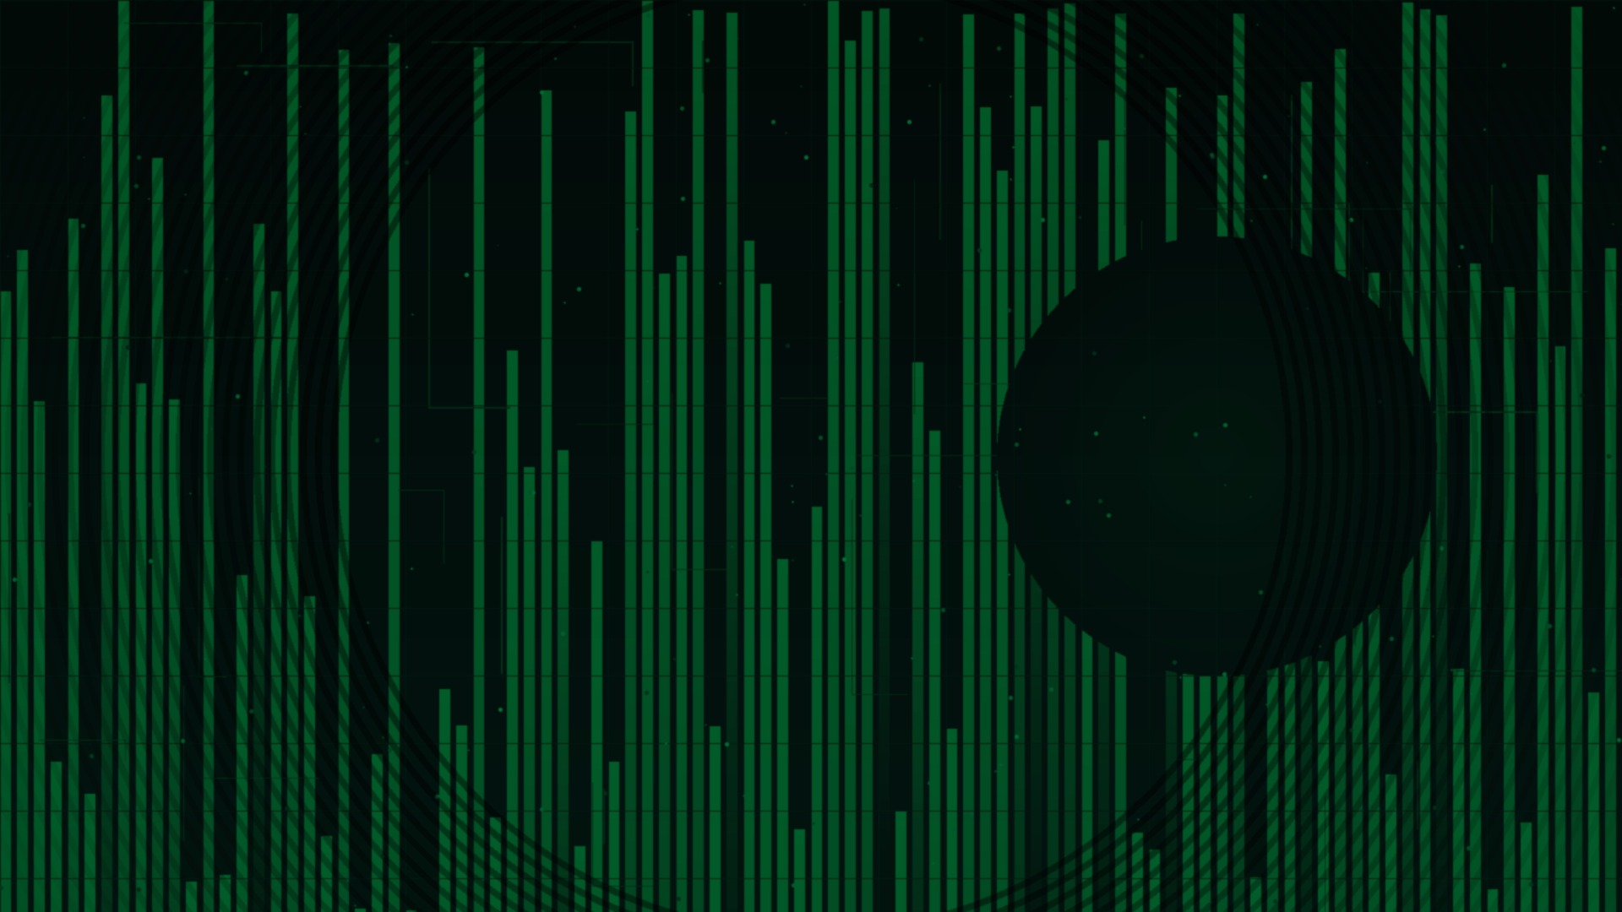
6
Setting Up OpenClaw
01
Provision Azure VM
Create an Azure Virtual Machine (Ubuntu 22.04 LTS recommended). Minimum: 4 vCPU, 16GB RAM. Open ports 22 (SSH) and 8080 (web UI).
02
Install Prerequisites
Install Docker, Node.js 18+, and Git. Run: sudo apt-get update && sudo apt-get install -y docker.io nodejs npm git
03
Clone OpenClaw
Run: git clone https://github.com/openclaw/openclaw.git && cd openclaw && npm install
04
Configure API Keys
Copy .env.example to .env. Add your model provider API keys (Anthropic, OpenAI, etc.) and configure tool permissions.
05
Launch & Access
Run: npm start — then navigate to http://[your-vm-ip]:8080 in your browser to access the OpenClaw dashboard.
My Journey into AI | Slide 6

Slide 8
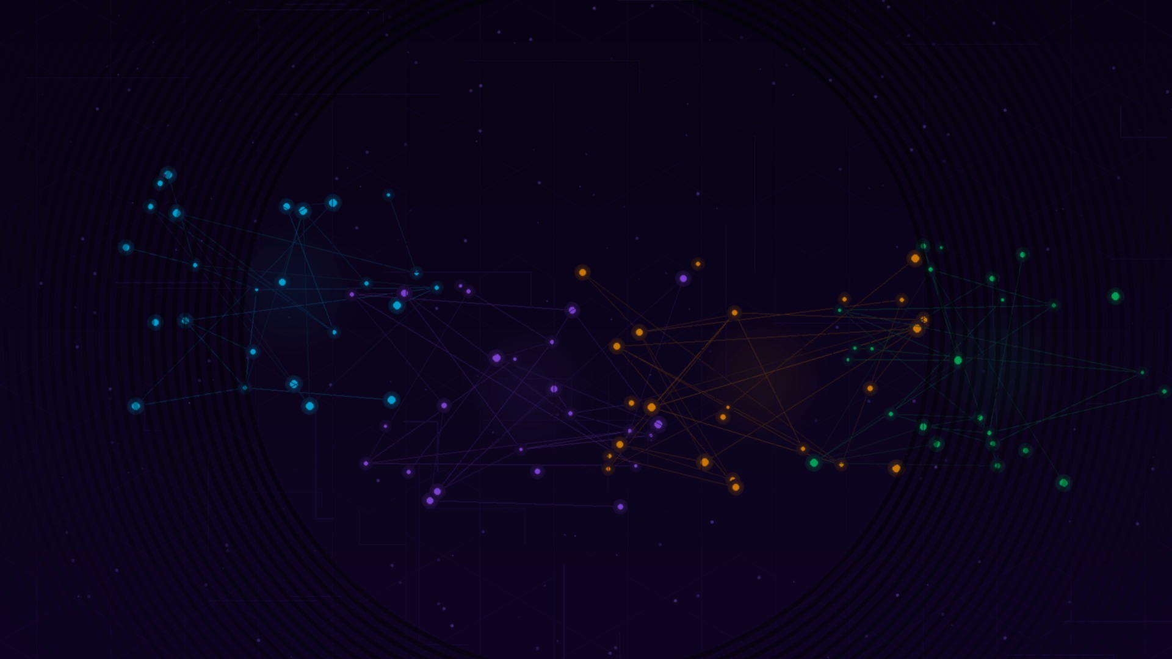
7
AI Model Licensing & Access
Provider / Model | Licence Type | Where to Get Access | API Key?
Anthropic (Claude) | Proprietary / SaaS | console.anthropic.com | ✅ Paid
OpenAI (GPT series) | Proprietary / SaaS | platform.openai.com | ✅ Paid
Google Gemini (closed) | Proprietary / SaaS | aistudio.google.com | ✅ Free + Paid
Google Gemma 4 (open) | Apache 2.0 | Hugging Face / AI Studio | ✅ Self-host/API
Meta Llama 4 | Custom Meta Licence | llama.meta.com / Hugging Face | ✅ Via 3rd party
Mistral (open models) | Apache 2.0 | mistral.ai / Hugging Face | ✅ Free / Self-host
Mistral (commercial) | Proprietary / SaaS | console.mistral.ai | ✅ Paid
DeepSeek (V3, R1) | MIT | platform.deepseek.com / HF | ✅ Cheap + Self-host
xAI Grok | Proprietary / SaaS | console.x.ai | ✅ Paid
Amazon Bedrock (aggregator) | SaaS / per-model terms | aws.amazon.com/bedrock | ✅ AWS key
Hugging Face (aggregator) | Varies per model | huggingface.co | ✅ Free + Paid
My Journey into AI | Slide 7 | Note: OpenAI key does NOT give access to Claude — separate accounts required

