Slide 1
The Thought Bottleneck
From search tool to agentic AI
Jean Hibbert · 2026

Slide 2
Early Days
Late 2025
• AI as a search tool — precise, instant answers
• Summarisation at scale
• Structured data extraction from unstructured text
• Content generation — from blog posts to maths problems for the kids
• Code generation — first taste of LLM-assisted development
• Rolled out Grok across the family
• Learning accelerator: AI as a personal tutor

Slide 3
Expanding the Toolkit
Early 2026
• Systematic evaluation across providers
– Microsoft — GitHub Copilot
– Google — Gemini
– Anthropic — Claude Code
– OpenAI — Codex
• Discovered Claude Opus: long-running tasks, acceptable quality code
• Discovered OpenClaw — deployed to Azure VM

Slide 4
The AI Landscape
Model Provider Overview
Aggregators
Access models from many providers via a single API
▸ TogetherAI
▸ OpenRouter
[ AI Provider Mind Map ]
▸ Azure OpenAI
▸ Amazon Bedrock
⚠ Licensing Minefield
Commercial vs research licences vary widely across providers and models.

Slide 5
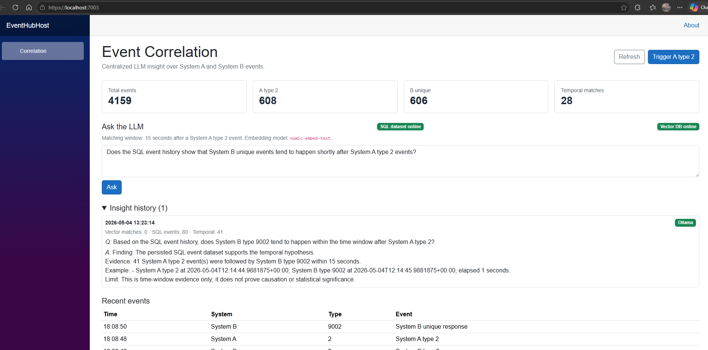
LLM-Enhanced AIOps Event Correlation
Agentic architecture: correlating events across distributed systems using LLMs + RAG
System A ──────────┐
▼
System B ──── [Message Broker / NServiceBus / Event Hubs]
│
▼
[Stream Processor / Flink / Stream Analytics]
(normalise · deduplicate · window · pre-filter)
│
┌────────┴────────┐
▼ ▼
[Time-Series DB] [Vector DB]
(raw storage) (embeddings + RAG)
│ │
└────────┬────────┘
▼
[LLM Correlation Engine]
(windowed prompt + RAG context injection)
│
┌──────────┼──────────┐
▼ ▼ ▼
[Alerts] [Dashboard] [API / DB]

Slide 6
Why Vector Database?
Agentic architecture: correlating events across distributed systems using LLMs + RAG
What a Vector Database Actually Does
A vector database stores embeddings — dense numerical representations of meaning. When you embed an event batch like:
"SystemA: database connection pool exhausted, 47 timeout errors. SystemB: API gateway 503s, response times >8s"
...it becomes a point in high-dimensional space. Events with similar meaning cluster near each other in that space, regardless of the exact words used.
So when a new event batch arrives, you embed it and ask: "what historical event batches are geometrically closest to this one?" — and you get back the most semantically relevant past episodes, even if they used different error codes, different systems, or happened months ago.

Slide 7
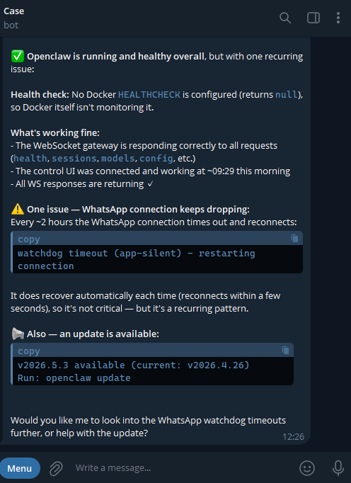
Exploration in the Deep End
April 2026
• Analysis paralysis — too many tools, too many choices
– Hermes, Perplexity, PaperClip, Obsidian vault, Lance Db
– Agentic architectures — orchestrator / advisor patterns
• Real-world OpenClaw experimentation
– Moving beyond demos to genuine productivity tasks
– Hermes agent: auto-fixing OpenClaw upgrade breakages

Slide 8
Getting Started
OpenClaw on Docker · Azure VM
Hermes — Self-Healing Upgrades
1. Provision Ubuntu 22.04 VM on Azure
1. Install Hermes via OpenClaw plugin
2. Install Docker + Docker Compose
2. Configure as an advisor/orchestrator agent
3. Pull the OpenClaw Docker image
3. Set upgrade watch on OpenClaw service
4. Configure openclaw.json (model keys, channels, workspace)
4. Hermes detects breaking changes post-upgrade
5. docker compose up -d
5. Auto-generates and applies fixes
6. Connect WhatsApp / Telegram channel
6. Reports back with change summary

Slide 9
OpenClaw Overview
OpenClaw is a self-hosted AI gateway and agent platform — connecting LLMs to your life, your tools, and your data without sending everything to the cloud.
🔌 Multi-provider
🧠 Long-term memory
📱 Any channel
Anthropic, OpenAI, Google, xAI, Mistral…
Semantic search across sessions + Obsidian vault
WhatsApp, Telegram, Discord, Signal…
🤖 Agentic skills
🔒 Self-hosted
🛠 Extensible
Scheduled tasks, tools, sub-agents
Your data stays on your infrastructure
Plugin architecture, custom skills
The power of OpenClaw: your AI, your rules, your infrastructure.

