Slide 1

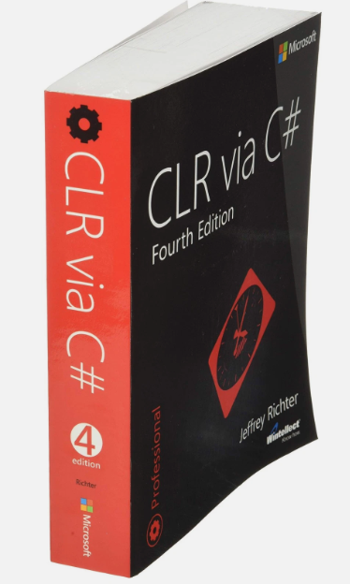
Tips and Tricks for C# code performance optimization
Goals:
How to look under the hood
How to avoid unnecessary heap allocations
Learn a few tricks and gains some insights
“Just remember it’s not a bible…”

Slide 2
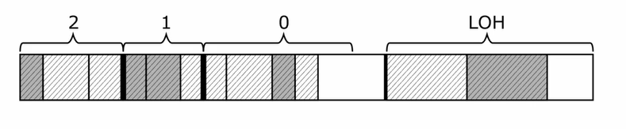
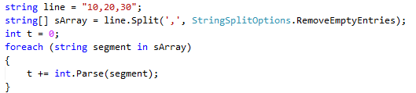
Generational garbage collector
  Stages
    Mark
    Plan
    Compact? (survival rate more than 90%) => Sweep (free memory)
    Relocate
line
Ref
10,20,30
sArray
Ref
10
20
30
Stack
Heap
t
60
segment
Ref
10
20
30

Slide 3

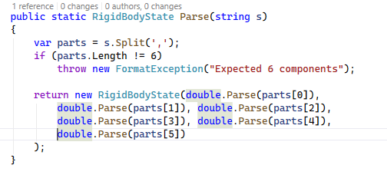
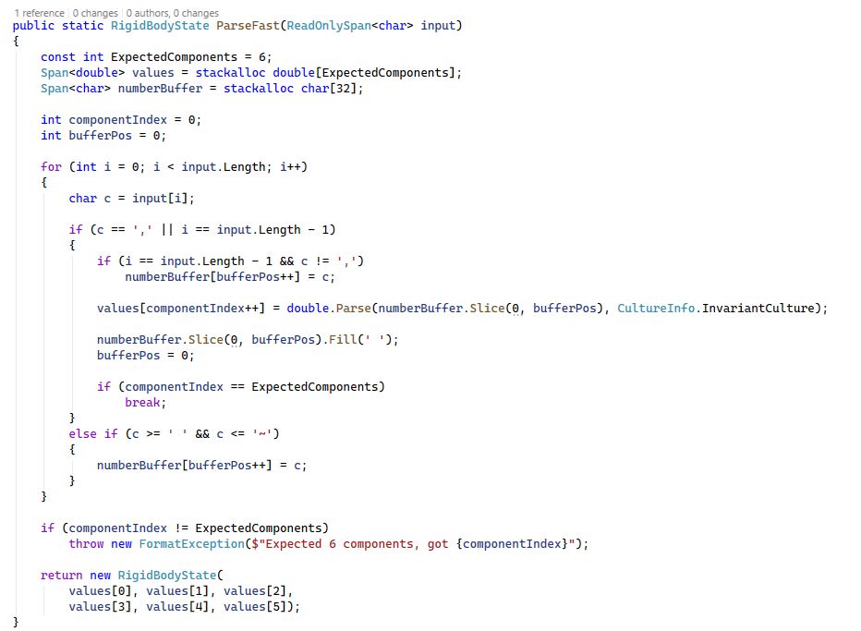
Fast code is ugly code
Maintainability
Performance
Only on Hot Path when performance required

Slide 4

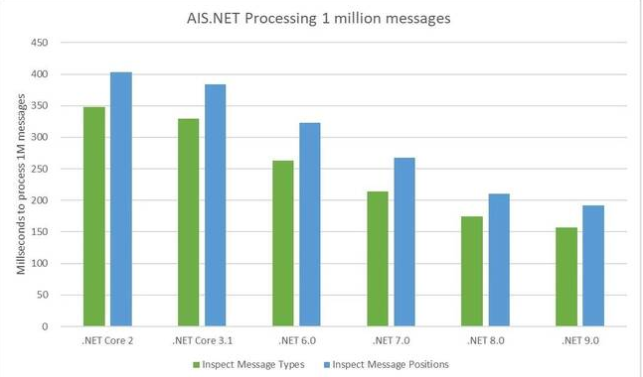
PRIMARY GOAL: REDUCE HEAP ALLOCATIONS
General advice
  Ensure all your code is testable
    Dependency injection -> tests
  Understand your tools and settings (e.g. Zlinq, Span etc)
  Benchmark before optimizations
    Measure before & after
  Use the Result Pattern
    Only throw exceptions in extreme situations!
  Don’t parallelize unnecessarily
  Read the documentation
    Stephen Toub’s blog posts
      Tiered compilation
      Frozen dictionary
      …
  Best optimisations are DB/IO/Architecture
    Micro-optimisations are the exception
    Be careful micro-optimisation is addictive
  Understand your tools
    ILSpy
    SharpLab.io
    VS Performance Profiler
    Dotnet-counters
  Update Dot Net Core Runtime when possible
    Use Span, FronzenDictionary etc.

Slide 5
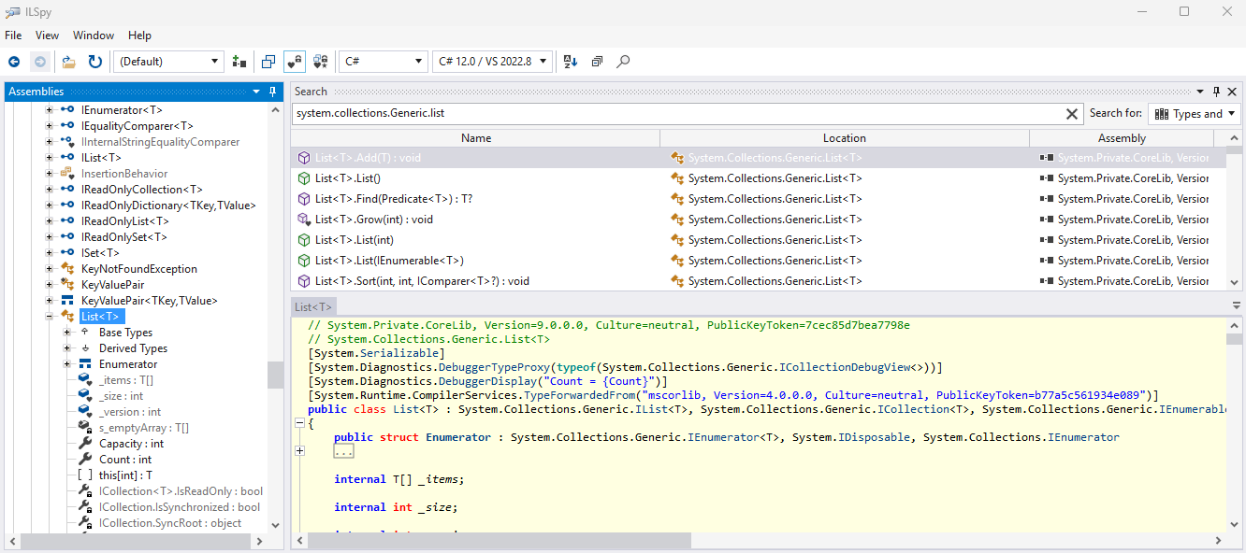
IL Spy (Visual Studio Extension)

Slide 6
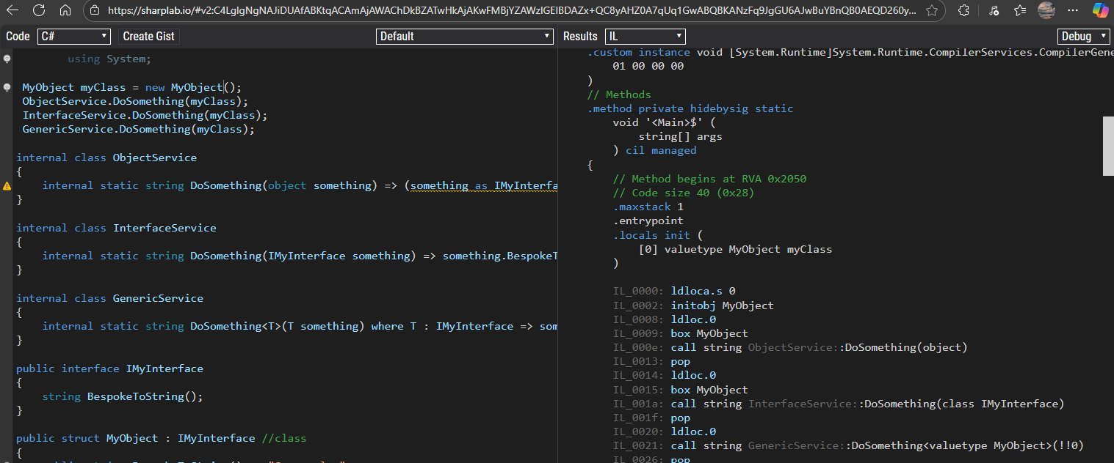
SharpLab.io

Slide 7
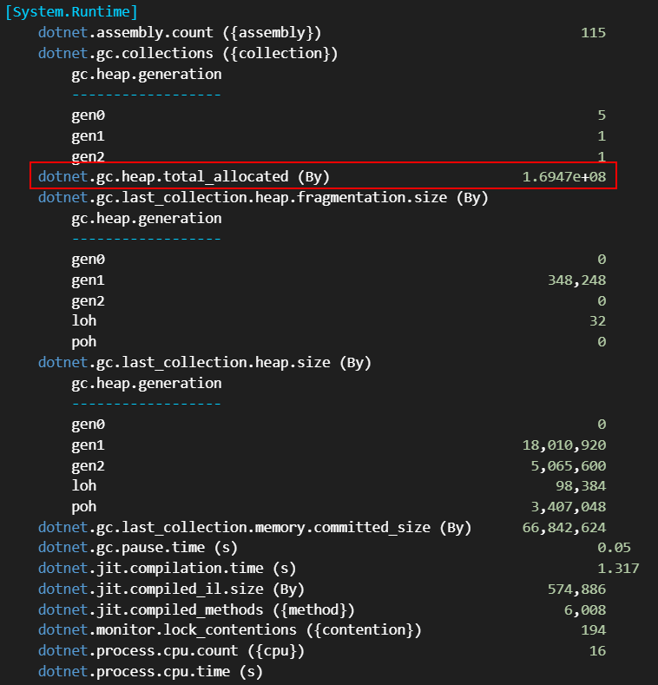
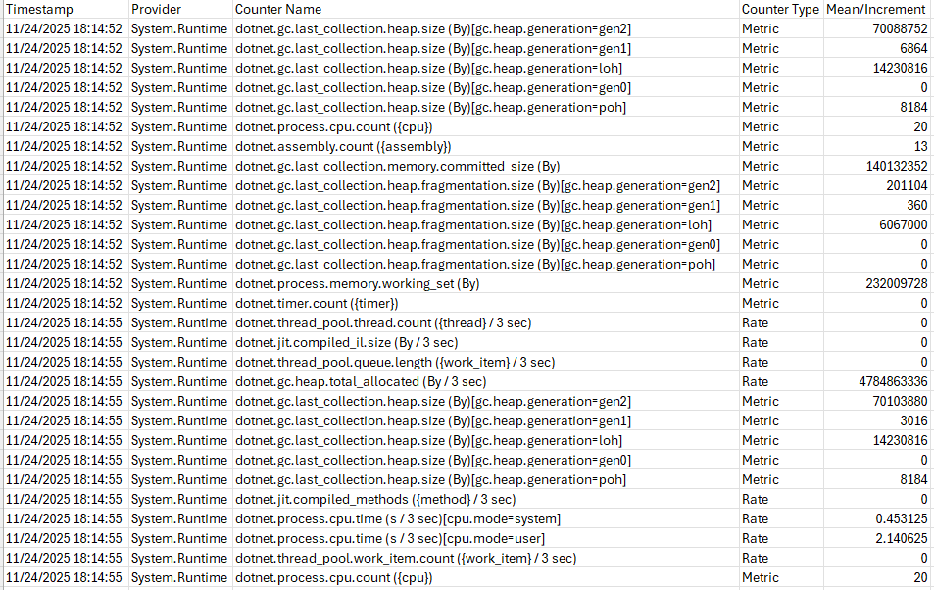
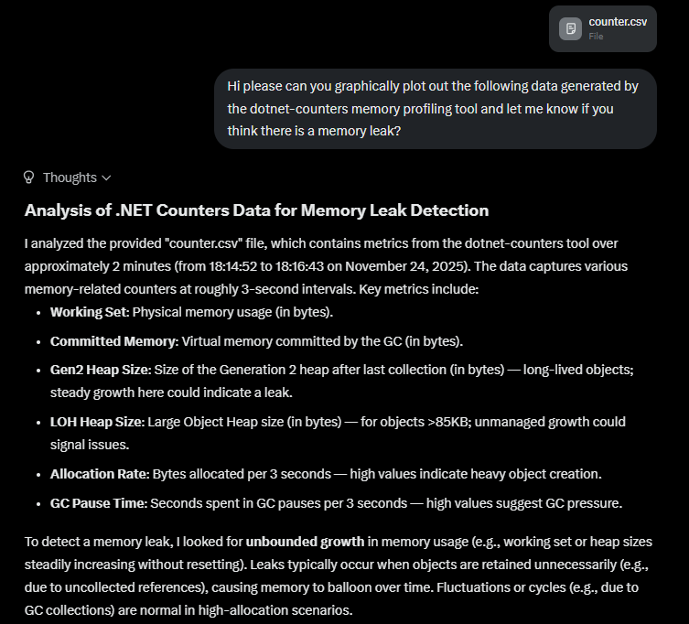
dotnet-counters
dotnet-counters diagnostic tool - .NET CLI - .NET | Microsoft Learn

Slide 8
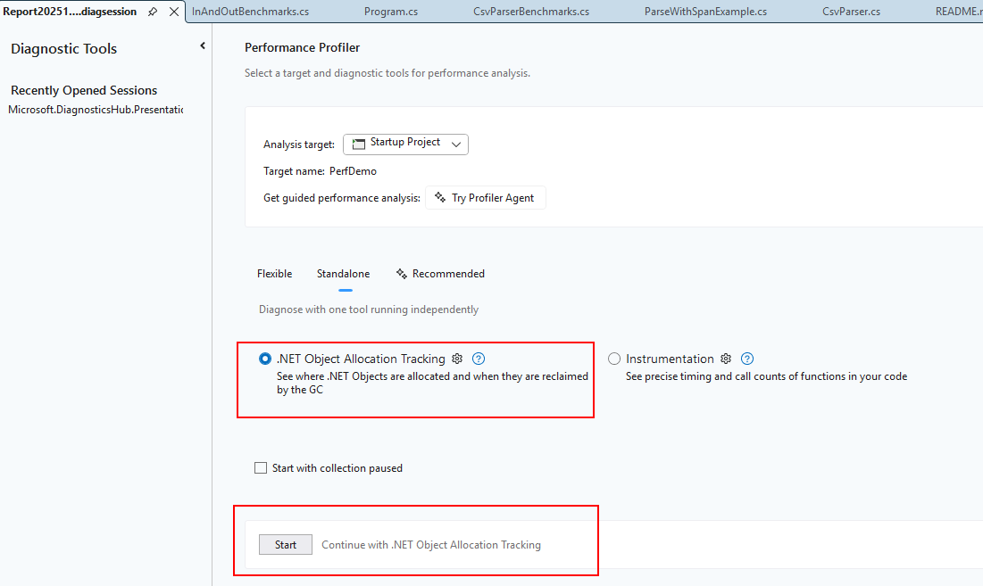
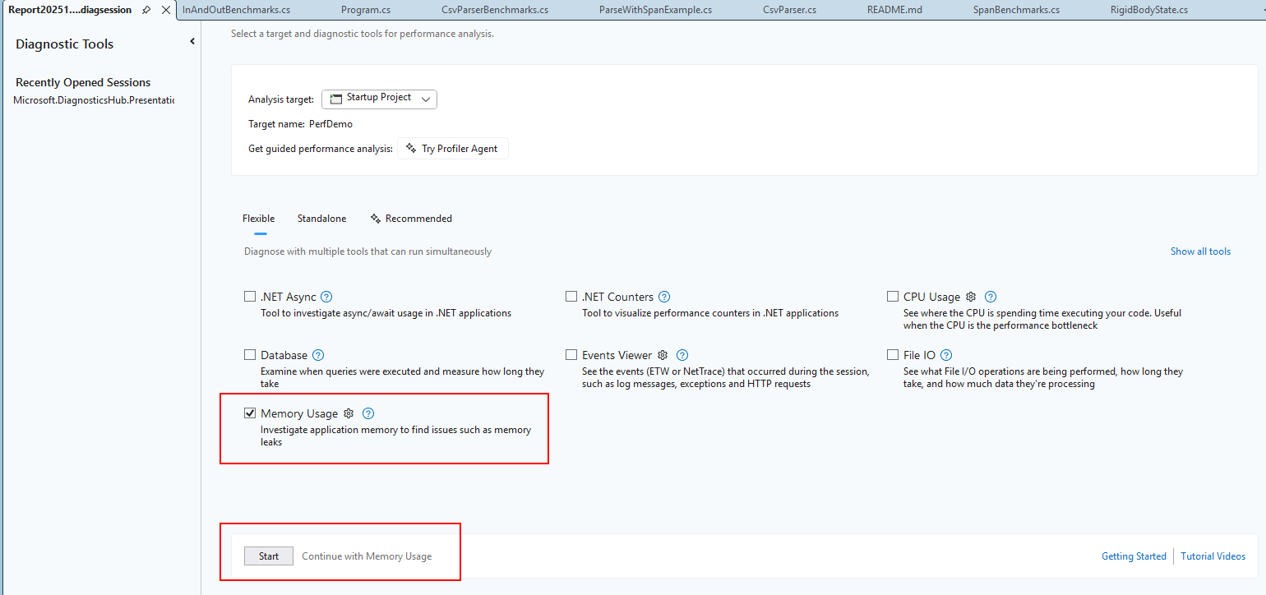
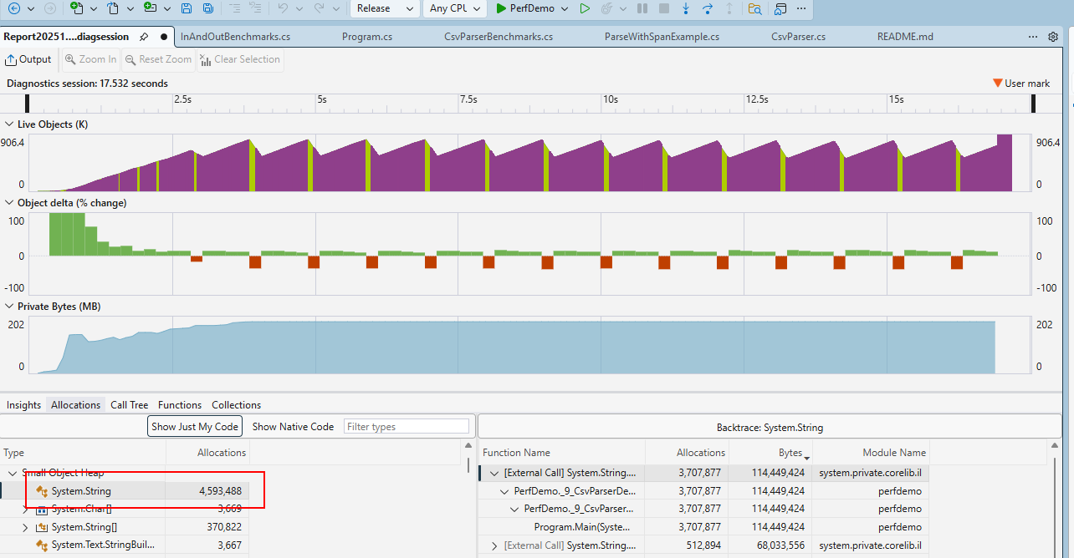
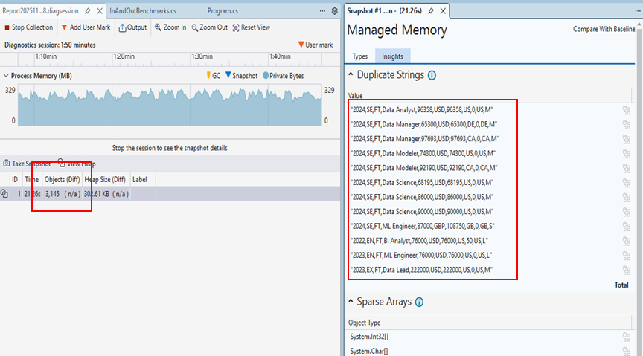
Visual Studio Profiler

Slide 9
Demo
Result Pattern
Fast way to add/update dictionaries
Fast iteration benchmarks
Zlinq
Frozen Dictionary
Ref struct
Casting
How Generics affect performance
  Boxing
  GenericList
  Service
  CallpathElimination
    CallpathFactory
Span
CSV Parser
In and out keywords with ref struct

Slide 10
Resources
  CLR via C#4 by Jeffrey Richter
  Stephen Toub (Partner Software Engineer)
    Performance Improvements in .NET 7 - .NET Blog
    Performance Improvements in .NET 8 - .NET Blog
    Performance Improvements in .NET 9 - .NET Blog
  #122 Matt Warren, How the .NET Runtime Has Changed | no dogma podcast
  Writing High-Performance .NET Code – Ben Watson
  High Performance .NET: Recipes and Thoughts for .NET 8, 9, and C# 12, 13 - Armen Melkumyan
  Zlinq
  https://github.com/Cysharp/ZLinq
  https://www.nuget.org/packages/ZLinq

