Slide 1
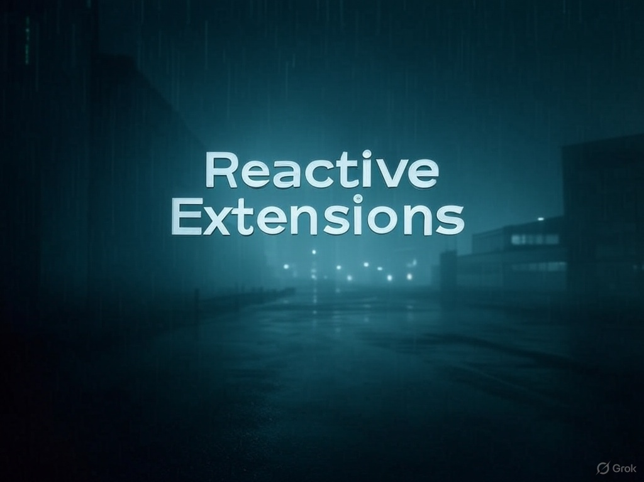
“You have been down that road with EventHandlers,
and you know where it leads…”

Slide 2
What is Reactive Extensions?
A better way to handle asynchronous event streams through the use of IObserver and IObservable
A set of extension methods for querying the asynchronous data stream using Linq
A way of parameterizing concurrency with schedulers
IObservable<T>
IEnumerable<T>
( T –> ()) –> ()
( T <- ()) <- ()
IObserver<T>
IEnumerator<T>

Slide 3
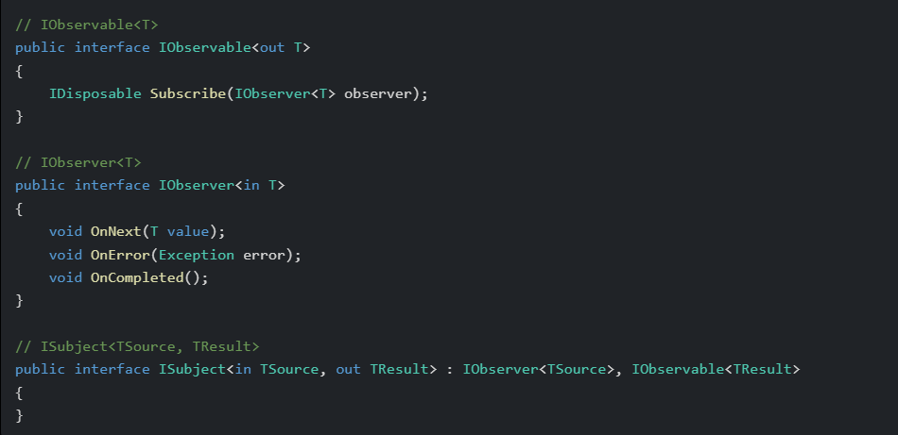

Slide 4
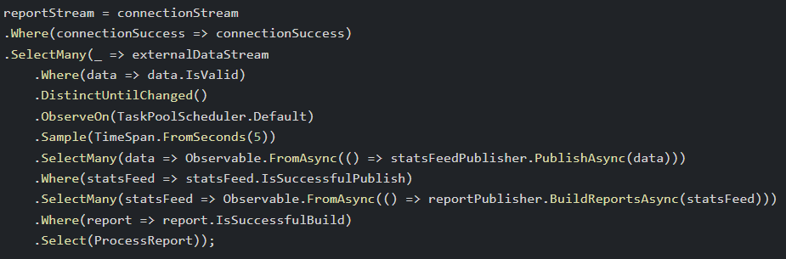
Concepts and Features
Hot and Cold Observables (Streams)
Multicasting behaviour with multiple subscribers
Rx is testable using TestSchedulers
Pipelines are an advanced way to use Rx
Supported in many languages

Slide 5
Declare EventHandler<int> handler = null; | Declare ISubject<int> stream = new Subject<int>();
Subscribe handler += (sender, e) => { if (e % 2 == 0) Console.WriteLine(e); }; | Subscribe IDisposable subscription = stream .Where(x => x % 2 == 0) .Subscribe(Console.WriteLine);
Publish handler.Invoke(null, 1); | Publish numberStream.OnNext(1);

Slide 6
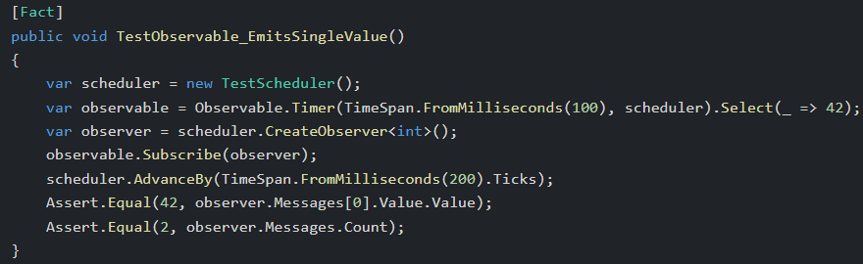
Advantages…
Streams can be used as first class citizens in your application code
Streams of data can be aggregated and filtered with Linq, code is more compositional
Unsubscribing from a stream using IDisposable is “cleaner” than -= eventhandler
Bridging into Async/Await world is seamless
Ability to handle stream completion and errors within event stream processor (IObserver<T>)
Parameterization of concurrency with schedulers

Slide 7
Events vs Observables
LinqPad UI
Swagger UI
Currency Pair
Strategy
Trade Execution API
FX Pricer
Equity Pricer

Slide 8
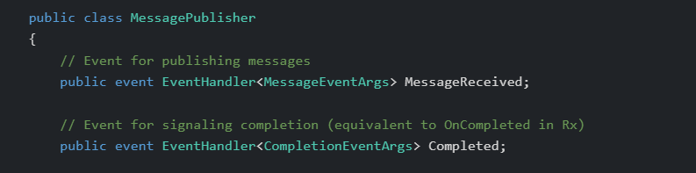
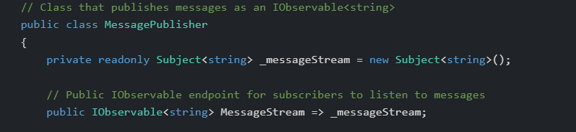
Best use cases:
Stateful thick clients or stateful browser applications
WPF, Winforms, Blazor Client, Angular, React
Backend stateful systems that handle incoming asynchronous data streams
(Systems which process incoming data streams (event handlers) from external API’s)

Slide 9
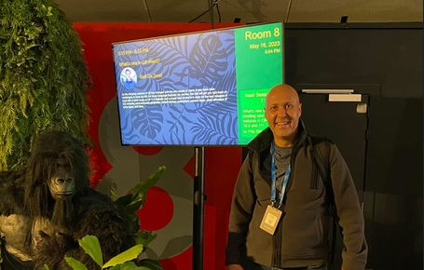
Resources
Creators
https://github.com/dotnet/reactive
https://github.com/reactivex
https://github.com/ReactiveX/RxJava
https://introtorx.com/
https://reactiveui.net/
https://rxmarbles.com/
Bart De Smet
Erik Meijer
Maintainer
Ian Griffiths

