Slide 1
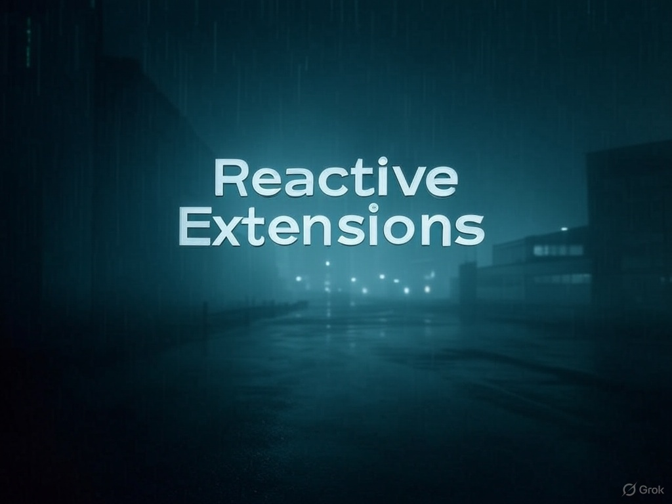
“You have been down that road with events handlers,
and you know where it leads…”

Slide 2
What is Reactive Extensions?
A better way to handle asynchronous event streams through
the use of IObservers and IObservables
A set of extension methods for querying the asynchronous data stream using Linq
A way of parameterizing concurrency with schedulers
Main advantageous?
Streams can be used as first class citizens in your application code
Streams of data can be aggregated and filtered with Linq
Unsubscribing from a stream using IDisposable is cleaner than -= eventhandler

Slide 3
Declare EventHandler<int> handler = null; | Declare ISubject<int> stream = new Subject<int>();
Subscribe handler += (sender, e) => { if (e % 2 == 0) Console.WriteLine(e); }; | Subscribe IDisposable subscription = stream .Where(x => x % 2 == 0) .Subscribe(Console.WriteLine);
Publish handler.Invoke(null, 1); | Publish numberStream.OnNext(1);

Slide 4
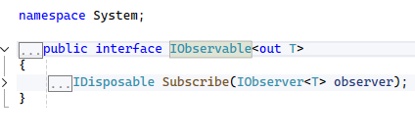
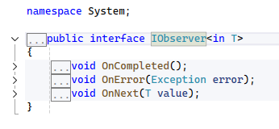


Slide 5
Best use cases?
Stateful thick clients or stateful browser applications
WPF, Winforms, Blazor Client, Angular, React
Backend stateful systems that handle incoming asynchronous data streams
Systems which process incoming data streams (event handlers) from external API’s

Slide 6
Other features & behaviors to note
Bridging into Async/Await world is seamless
Hot and Cold Observables (Streams)
Multicasting with streams
Multiple ways to create an observable stream
Rx is testable using TestSchedulers
Pipelines are an advanced way to use Rx
Resources
https://github.com/dotnet/reactive

