Slide 1
GenTract
A CONTACT TRACING MOBILE APPLICATION
USING QR CODE
Jewel Mae P. Capariño
Paul Ian M. Masendo
Jeanne Nicole M. Punzalan

Slide 2
Agenda
01
INTRODUCTION
02
BACKGROUND OF THE PROBLEM
03
OVERVIEW OF THE CURRENT STATE OF TECHNOLOGY
04
OBJECTIVES OF STUDY
05
SCOPE AND LIMITATIONS

Slide 3
INTRODUCTION

Slide 4
COVID-2019 Test
Confirmed Cases
An individual who had a confirmatory viral test performed by way of a throat swab, nose swab or saliva test and that specimen tested positive for COVID-19
Interpretation Of Result
Probable Cases
Who has been tested for COVID-19 but the results are inconclusive.
Suspect Cases
When there is a history of close or household contact with a laboratory confirmed COVID-19 case during the seven days prior to onset of symptoms
What is Covid-19?
Coronavirus disease (COVID-19) is an infectious disease caused by a newly discovered coronavirus. Most people infected with the COVID-19 virus will experience mild to moderate respiratory illness and recover without requiring special treatment. Older people, and those with underlying medical problems like cardiovascular disease, diabetes, chronic respiratory disease, and cancer are more likely to develop serious illness.

Slide 5
Contact Tracing
What is contact tracing?
Importance of Contact Tracing
A process of finding out who has recently been in close contact with a person infected with a covid-19 and reaching out to those people to let them know they may have been exposed and guide them on what to do next. In some cases, that may include self-isolating to prevent further spread.
To interrupt ongoing transmission and reduce the spread of infection, To alert close contacts to the possibility of infection and offer preventive counseling or care. This is the identification, listing, and follow-up of persons who may been close contact with a confirmed COVID-19 case

Slide 6
BACKGROUND OF THE PROBLEM
COVID-19 Virus
This time of pandemic, they promoted less physical contact that's why cashless transaction as mode of payment is more accessible like GCash, Paymaya, etc. But the process of contact tracing is too expose because it didn't lessen the physical contact, because they need to interview people one by one in every establishment where the virus was exposed.

Slide 7
OVERVIEW OF THE CURRENT STATE OF THE TECHNOLOGY
In the Philippines, you need to fill-up your information in a piece of paper every establishment that you will enter. This process has too many flaws and too much contact to itself.

Slide 8
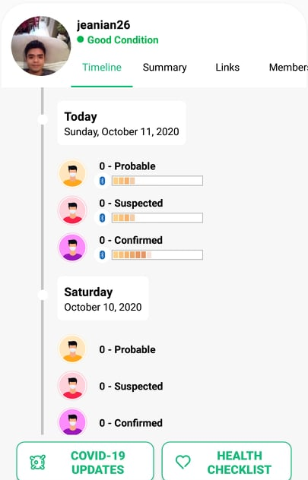

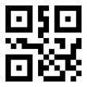
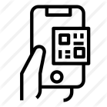

GenTract
GenTract is a contract tracing mobile application using QR code
A module that will serve as a health checklist
A module that will generate a QR code.
A module that will enable establishments and/or users to scan another user QR code.
A module that will notify users that they had been in contact with an individual who had been a confirmed COVID-19 case.

Slide 9
SCOPE
User Account Module
QR Code Scanning module
Notification Module
Establishments Module
Desktop app or LGUs Module

Slide 10

GenTract
COVID-19
LIMITATIONS
Mobile Application for android user will only be provided.
The GenTract app is only intended
for the City of Gen. Trias.
The Researchers will test it only in a limited number and small area.

Slide 11
THANK YOU
God bless and Stay Healthy!

