Slide 1
Overall Scorecard - Nancy
Amazon is attributed in Revenue and Overall Spend
🟡 - Mid 🔴 - Bad 🟢 - Good
Overall | L30D | L7D | Yesterday | Good Target | Better Target | Best Target
Revenue | $6,166,661 🟢 | $1,505,745 🟢 | $219,733.8 🟢 | $200,000 | $200,000 | $300,000
Overall Spend | $3,008,127 | $700,347 | $100,795 | $93,023 | $80,000 | $120,000
Overall ROAS | 2.05 🔴 | 2.15 🟢 | 2.18 🟢 | 2.15 | 2.5 | 2.5
NC-ROAS | 1.82 | 1.88 | 1.95 | 1.89 | 2.20 | 2.20
NC-CAC | $44.14 | $42.71 | $40.65 | $45 | $45 | $45
EBIT | $637,170 🔴 | $189,287 🟢 | $29,135 🟢 | $24,060 | $35,000 | $60,200
EBIT % | 10.33% | 12.57% | 13.26% | 12.03% | 17.50% | 20.07%
Meta Spend % | 81% | 78% | 78% | 75% | 75% | 75%
Meta Spend | $2,430,758 | $548,489 | $78,595 | $70,000 | $60,000 | $90,000
Meta ROAS | 1.68 🔴 | 1.74 🔴 | 1.82 🟢 | 1.8 | 2.1 | 2.1
Repeat % | 11% | 12% | 10% | 12% | 12% | 12%
L30D ROAS increased compared to last week; ROAS on shorter windows hold stills within target and has visible improvement with Meta Roas
Notes:
SLIDE 1 — OVERALL SCORECARD (NANCY): This is the top-line health check across three windows (Last 30 Days, Last 7 Days, Yesterday) benchmarked against Good/Better/Best targets. Revenue is solid in absolute terms (L30D $6.17M, L7D $1.51M, Yesterday $219.7K, all flagged yellow = meeting “Good” but short of “Best”). The core concern is efficiency: Overall ROAS is red at the L30D level (2.05 vs 2.15 target) but improves on shorter windows (L7D 2.15, Yesterday 2.18), signaling recent optimization is working. New-customer economics are healthy — NC-CAC ($44.14/$42.71/$40.65) is at or under the $45 ceiling and trending down, while NC-ROAS (1.82–1.95) sits just below the 2.20 goal. Profitability is the weak spot: L30D EBIT is red ($637K, 10.33% margin vs 12.03% target) though it recovers to 12.57% (L7D) and 13.26% (Yesterday). Meta dominates spend at ~78–81% (above the 75% target), and Meta ROAS is red on the longer windows (1.68 L30D, 1.74 L7D) but recovering to yellow Yesterday (1.82). Repeat purchase rate (~10–12%) is roughly on target. ANALYSIS: The account is revenue-stable but margin-pressured, with over-reliance on Meta whose ROAS is the main drag. The consistent improvement from L30D > L7D > Yesterday across ROAS, EBIT and CAC is the key positive — recent changes are pulling efficiency upward. Priorities: lift Meta ROAS toward 2.1, diversify spend away from the 78%+ Meta concentration, and push EBIT margin back above target. Note: Amazon is included in Revenue and Overall Spend.

Slide 2
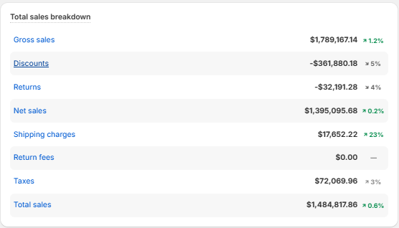

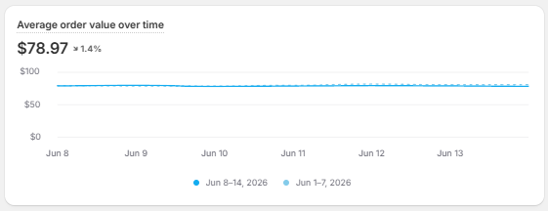
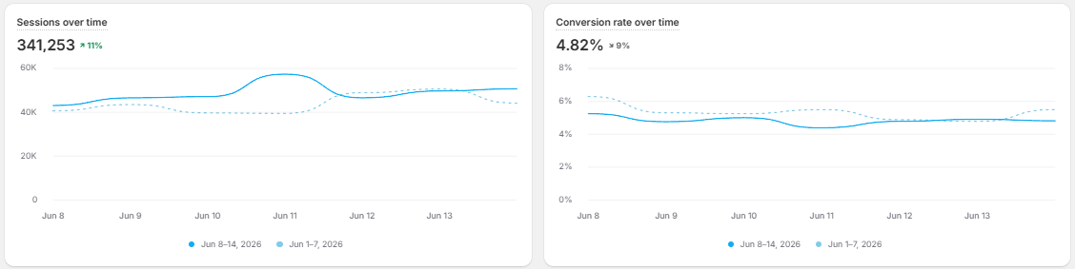
Shopify Data - June 8-14 vs. June 1-7
Returning customer rate mostly from Avo and Berri attributed to Klaviyo emails
Notes:
SLIDE 2 — SHOPIFY DATA, STORE OVERVIEW (June 8–14 vs. June 1–7): Week-over-week DTC storefront health. Gross sales $1,789,167 (+1.2%), but heavy deductions follow: discounts -$361,880 (+5%) and returns -$32,191 (+4%), leaving net sales $1,395,096 (+0.2%). After shipping charges (+$17,652, +23%) and taxes ($72,069, +3%), total sales land at $1,484,818 (+0.6%). Engagement metrics are the bright spot: sessions 341,253 (+11%) and conversion rate 4.82% (+9%), so more traffic AND better conversion drove the week. AOV is essentially flat at $78.97 (+1.4%) and returning-customer rate is 12.45% (+9%). ANALYSIS: Top-line is roughly flat week-over-week despite strong traffic/CVR gains because rising discounts (+5%) and a 23% jump in shipping charges are eating the upside — margin leakage, not demand, is the issue. The +11% sessions and +9% conversion lift confirm acquisition and on-site experience are improving; protecting net sales now depends on reining in discounting and shipping cost. Healthy returning-customer growth (+9%) supports LTV.

Slide 3
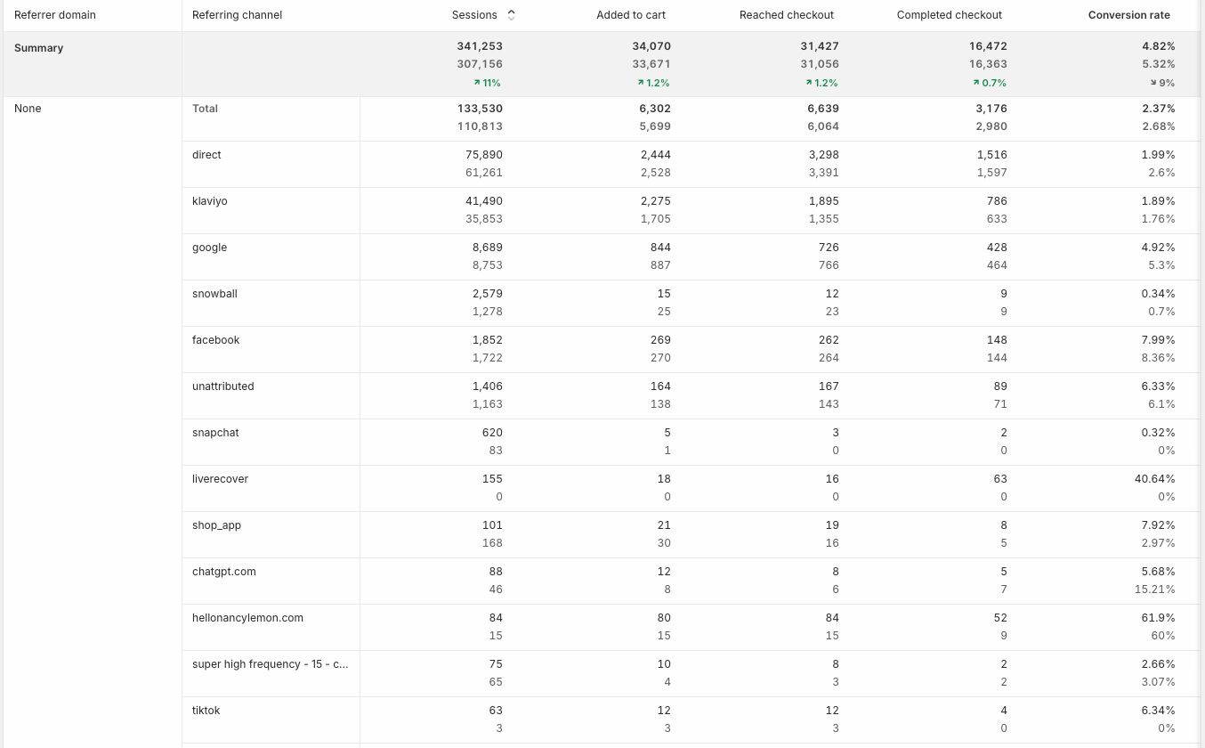
Shopify Data - June 8-14 vs. June 1-7 (Increase in sessions)

Slide 4
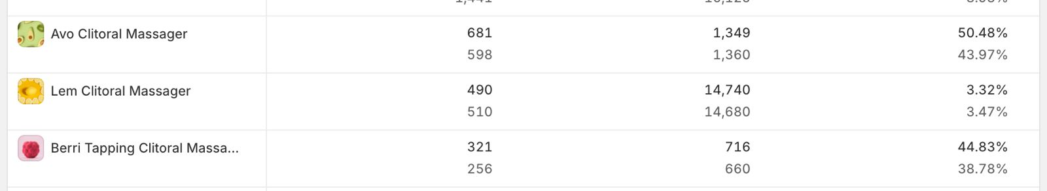
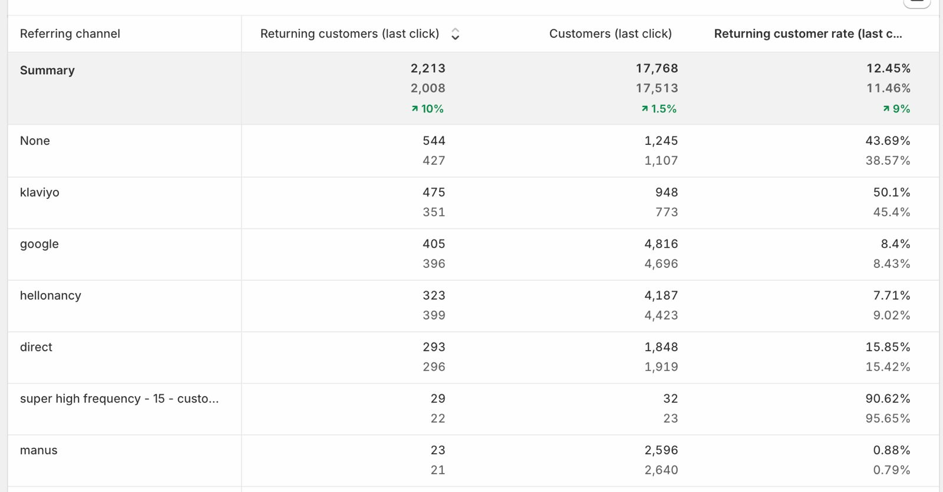
Shopify Data - June 8-14 vs. June 1-7 (Returning customer) rate

Slide 5
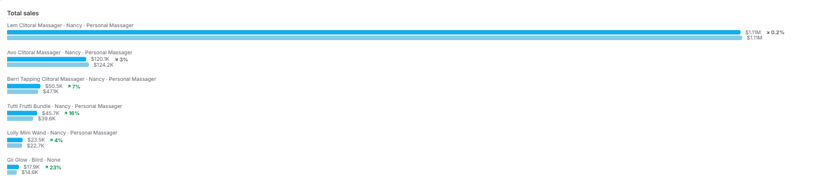
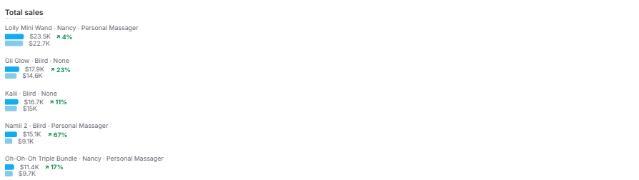
Shopify Data - June 8-14 vs. June 1-7
Bird products notable sales increased
Notes:
SLIDE 3 — SHOPIFY DATA, SALES BY PRODUCT (June 8–14 vs. June 1–7): Product-level revenue breakdown. The hero SKU is the Lem Clitoral Massager at ~$1.17M (+0.2%) — it alone is the overwhelming majority of revenue and is essentially flat week-over-week. Everything else is a long tail: Avo Clitoral Massager $120.9K (-3%), Berri Tapping Clitoral Massager $50.5K (-7%), Tutti Frutti Bundle $45.7K (+16%), Lolly Mini Wand $23.5K (+4%), Oil Glow $17.9K (+23%), Kali $16.7K (+11%), Nami 2 $15.1K (+67%), and Oh-Oh-Oh Triple Bundle $11.4K (+17%). ANALYSIS: Severe revenue concentration risk — a single SKU (Lem) carries the business while the #2 and #3 products are declining (-3% and -7%). The encouraging signal is in the emerging products: Nami 2 (+67%), Oil Glow (+23%), Tutti Frutti Bundle (+16%) and Oh-Oh-Oh Bundle (+17%) are growing fast off small bases, suggesting bundles and newer items are gaining traction. Strategic priority: keep defending the Lem flagship while scaling the fast-growing small SKUs and bundles to reduce single-product dependency.

Slide 6
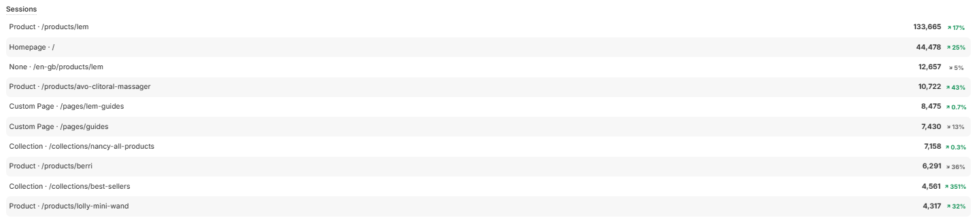
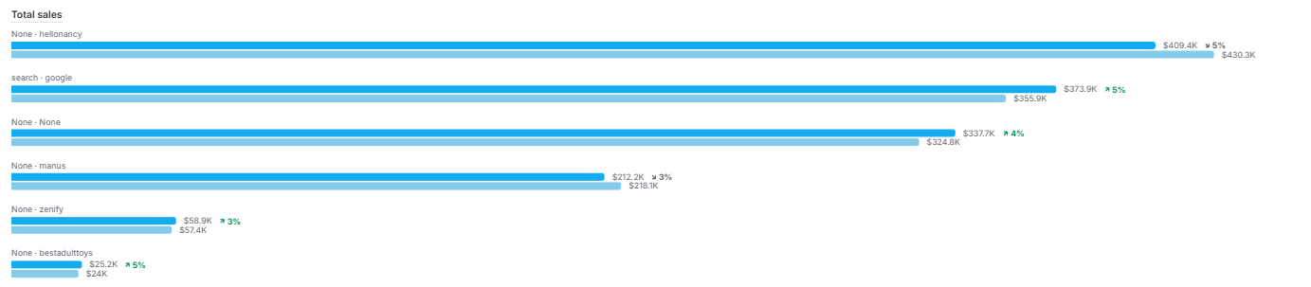
Shopify Data - June 8-14 vs. June 1-7
Notes:
SLIDE 4 — SHOPIFY DATA, SESSIONS & SALES BY SOURCE (June 8–14 vs. June 1–7): Two views. TOP (Sessions by landing page): the Lem product page dominates traffic at 133,665 (+17%), followed by Homepage 44,478 (+25%), /en-gb Lem page 12,657 (+5%), Avo product page 10,722 (+43%), Lem guides 8,475 (+0.7%), guides 7,430 (+13%), nancy-all-products collection 7,158 (+0.3%), Berri page 6,291 (+38%), best-sellers collection 4,561 (+351%), and Lolly Mini Wand 4,317 (+33%). BOTTOM (Total sales by source/medium): hellonancy (direct) $409.4K (+5%), google search $373.9K (+5%), none/none $332.7K (+4%), manus $212.2K (+3%), zenify $58.9K (+3%), and feelstuff/toys $25.2K (+5%). ANALYSIS: Traffic mirrors revenue — the Lem PDP is the single biggest entry point and is still growing (+17%), reinforcing the flagship concentration seen on Slide 3. Standout growth: best-sellers collection (+351%), Avo PDP (+43%), Berri (+38%) and Lolly (+33%) show merchandising/collection pages and secondary products are gaining visibility. On the sales side, direct + Google together drive the largest share, indicating strong brand/organic demand alongside paid; emerging landing-page domains (zenify, feelnancy/manus, unlock) confirm the multi-LP testing strategy is contributing measurable revenue.

Slide 7
Status by Channel
Snapchat
3 active campaigns $900 - Total daily Budget Active Campaigns 🟢
TikTok
3 active campaigns
$800 - Total daily budget
Active Campaigns 🟢
Twitter / X
Campaign already set up last week, but delivery status is halted
No Campaign 🔴
Reddit
1 active campaign $100 daily budget
Active Campaign🟢
Notes:
SLIDE 5 — STATUS BY CHANNEL: Quick at-a-glance status of the emerging/diversification paid channels (outside Meta). Snapchat: 3 active campaigns, $900 total daily budget — green/active. TikTok: 3 active campaigns, $800 total daily budget — green/active. Twitter/X: no campaign — red/inactive. Reddit: 1 active campaign, $100 daily budget — green/active. ANALYSIS: Three of four diversification channels are live (Snapchat, TikTok, Reddit) with combined daily budget of ~$1,800, a deliberate push to reduce the ~78% Meta concentration flagged on Slide 1. Twitter/X is the only gap (red) and is the obvious next activation. Budget weighting favors Snapchat and TikTok, with Reddit being tested at a small $100/day toe-hold. This slide sets up the per-channel deep dives that follow (Snapchat, TikTok, Reddit).

Slide 8
Snapchat Ads Performance (7D click, none view )
Overall Metrics of Snapchat Ads
Metric | T | Y | L7D
Spend | $205.85 | $900 | $5,676.23
Revenue | $345.14 | $1,444.96 | $6,387.99
ROAS | 1.68 | 1.61 | 1.13
Purchase | 2 | 15 | 74
Metrics per Campaign
Campaign | Spend (L7D) | T (Roas) | Y (Roas) | L7D (Roas)
1 | $2,699.69 | 3.27 | 1 | 1.07
2 | $2,099.90 | 0 | 2.45 | 1.28
3 | $599.97 | 0 | 1.54 | 0.9
Campaign 1 - Nancy Ad Account 1_Website_US,UK,CA,AU_Lem Winners UGC Videos_05June26
Budget: $400/daily | Target: US,UK,CA,AU | Creatives: UGC videos | LP: unlock.hellonancy.com/lem
Campaign 2 - Nancy Ad Account 1_Zenify_US,UK,CA,AU_Lem Winners UGC Videos_08June26
Budget: $300/daily | Target: US,UK, AU, CA | Creatives: UGC Videos | LP: zenify.com
Campaign 3 - 2026 Catalog campaign_12Jun26
Budget: $200/daily | Target: US | Creatives: UGC Videos and static | LP: hellonancy.com
Snapchat roas increasing gradually compare to last week, campaigns for monitoring
Action plan: monitor and optimize campaigns, add more videos (rejection rate increases)
Notes:
SLIDE 6 — SNAPCHAT ADS PERFORMANCE (7D click, no view): Top metrics across Today (T) / Yesterday (Y) / Last 7 Days (L7D). Spend: T $205.85, Y $900, L7D $5,676.23. Revenue: T $345.14, Y $1,444.96, L7D $6,387.99. ROAS: T 1.68, Y 1.61, L7D 1.13. Purchases: T 2, Y 15, L7D 74. Per-campaign (L7D spend / ROAS trend T-Y-L7D): C1 Lem Winners UGC ($400/day, US/UK/CA/AU) $2,699.69, ROAS 3.27>1.07>1.54; C2 Zenify Winners UGC ($300/day, US/UK/AU/CA, LP zenify.com) $2,099.90, ROAS 1.0>2.45>0.9; C3 2026 Catalog ($200/day, US, UGC+static, LP hellonancy.com) $599.97, ROAS 0>1.28>(building). ANALYSIS: Snapchat is the weakest of the active diversification channels — L7D ROAS of 1.13 is well below the account’s ~2.0+ blended target and the channel is currently unprofitable at scale. However recent days are improving (Today 1.68 vs L7D 1.13), and the Zenify campaign shows promise. Stated action plan: monitor/optimize and add more video creative because the ad rejection rate is rising (a Snapchat-specific creative-approval bottleneck). Verdict: keep as a small test, fix creative rejections, and don’t scale spend until L7D ROAS clears target.

Slide 9
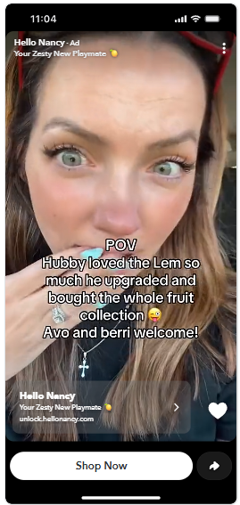
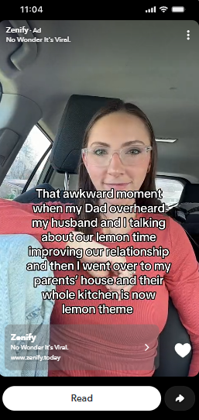
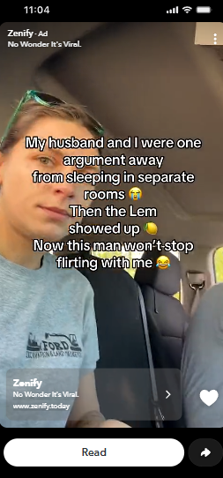
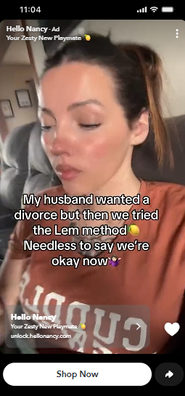
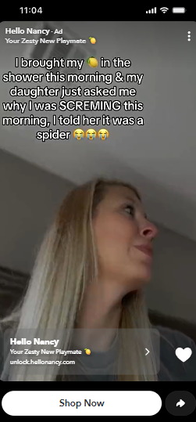
Top 5 Creatives - Snapchat (L7D Spend - 7d click,none view)
Top 1
Top 2
Top 3
Top 4
Top 5
Spend: $493.91 Purchase: 9 Roas: 1.47
Spend: $298.61 Purchase: 8 Roas: 2.25
Spend: $515.02 Purchase: 7 Roas: 1.24
Spend: $213.69 Purchase: 5 Roas: 1.97
Spend: $439.36 Purchase: 5 Roas: 1.01
Notes:
SLIDE 7 — TOP 5 CREATIVES, SNAPCHAT (L7D spend, 7d click none view): Best-spending ads ranked. Top 1: spend $493.91, 9 purchases, ROAS 1.47. Top 2: $298.61, 8 purchases, ROAS 2.25. Top 3: $658.03, 8 purchases, ROAS 1.0. Top 4: $515.02, 7 purchases, ROAS 1.24. Top 5: $213.69, 5 purchases, ROAS 1.97. ANALYSIS: Creative efficiency is inconsistent and explains the weak channel-level 1.13 ROAS from Slide 6. The two efficient winners are Top 2 (2.25) and Top 5 (1.97), yet they receive the least spend ($298 and $213) — a budget-allocation mismatch. Meanwhile Top 3 absorbs the most spend ($658) at break-even ROAS 1.0, and Top 1/Top 4 are sub-1.5. ACTION: reallocate budget toward the Top 2 and Top 5 creative styles, pause or refresh Top 3, and feed more video variants into the pipeline (consistent with the rising-rejection note on Slide 6). The spread shows winning creative exists on Snapchat — the problem is concentration of budget on the wrong ads.

Slide 10
Tiktok Ads Performance (7D click, none view )
Overall Metrics of Tiktok Ads
Metric | T | Y | L7D
Spend | $404.64 | $868.79 | $4,558.14
ROAS | 0.52 🔴 | 2.73 🟡 | 2.50 🟡
Purchase | 1 | 28 | 138
Metrics per Campaign
Campaign | Spend (L7D) | T (Roas) | Y (Roas) | L7D (Roas)
1 | $1,484.65 | 0 | 2.19 | 2.25
2 | $1,877.82 | 0.92 | 3.68 | 3.53
3 | $1,195.67 | 0.46 | 2.36 | 1.92
Campaign 1 - ktkbcbtkipa_adv_feelnancy_US_spark ads_30May26
Budget: $200/daily | Target: US | Creatives: Spark Ads | LP: feelnancy.com
Campaign 2 - ktkbcbtkipa_adv_feelnancy_UK,US,CA,AU_spark ads_05June26
Budget: $300/daily | Target: US,UK, AU, CA | Creatives: Spark ads | LP: feelnancy.com
Campaign 3 - PCE4ZK_adv_website unlock_US,UK,AU,CA,SG,IR,NZ,FR,BE,NL,SE_spark ads_11June26
Budget: $300/daily | Target: Top 11 countries | Creatives: 50 spark ads | LP: unlock.hellonancy.com/lem
Tiktok L7d roas is promising, limited delivery due to some ads getting disapproved
Action plan: scale campaigns
Notes:
SLIDE 8 — TIKTOK ADS PERFORMANCE (7D click, no view): Top metrics T/Y/L7D. Spend: T $404.64, Y $868.79, L7D $4,558.14. ROAS: T 0.52 (red), Y 2.73 (yellow), L7D 2.50 (yellow). Purchases: T 1, Y 28, L7D 138. Per-campaign (L7D spend / ROAS trend T-Y-L7D): C1 feelnancy US Spark Ads ($200/day) $1,484.65, ROAS 0>2.25>1.92; C2 feelnancy UK/US/CA/AU Spark Ads ($300/day) $1,877.82, ROAS 0.92>3.53>2.19; C3 website-unlock top-11-countries, 50 Spark Ads ($300/day, LP unlock.hellonancy.com/lem) $1,195.67, ROAS 0.46>2.36>3.68. ANALYSIS: TikTok is the strongest diversification channel — L7D ROAS 2.50 beats the blended target and Yesterday hit 2.73. Today’s 0.52 is not a red flag; it reflects same-day attribution lag (only 1 purchase recorded so far), a normal pattern in a 7-day-click window. The new multi-country unlock campaign (C3) is the breakout, already at 3.68 ROAS even on a different landing page, proving Spark Ads + broad geo targeting scales. Stated action plan: scale campaigns — well justified. This is the channel to lean into for Meta diversification.

Slide 11
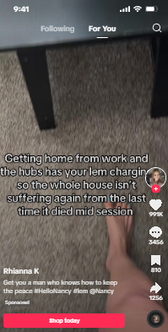
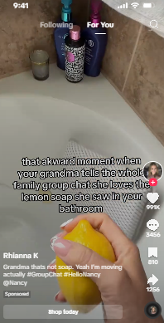
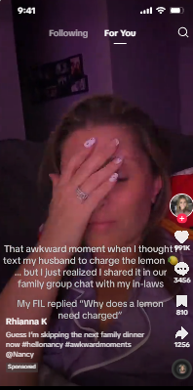
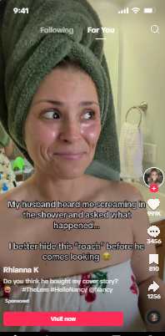
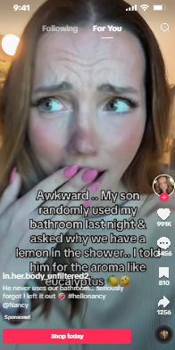
Top 5 Creatives - Tiktok (L7D Spend - 7d click, 1 day view)
Top 1
Top 2
Top 3
Top 4
Top 5
Spend: $217.61 Purchase: 45 Roas: 17.74
Spend: $286.90 Purchase: 36 Roas: 12.01
Spend: $183.64 Purchase: 28 Roas: 13.20
Spend: $306.73 Purchase: 28 Roas: 7.89
Spend: $223.24 Purchase: 25 Roas: 10.23
Notes:
SLIDE 9 — TOP 5 CREATIVES, TIKTOK (L7D spend, 7d click 1 day view): The winners. Top 1: spend $306.73, 28 purchases, ROAS 7.89. Top 2: $286.90, 36 purchases, ROAS 12.01. Top 3: $183.64, 28 purchases, ROAS 13.20. Top 4: $217.61, 45 purchases, ROAS 17.74. Top 5: $223.24, 25 purchases, ROAS 10.23. ANALYSIS: TikTok creative is dramatically outperforming every other channel — ROAS ranges from ~8x to nearly 18x at the ad level (vs Snapchat’s 1.0–2.25 on Slide 7). Top 4 is the standout at 17.74 ROAS with 45 purchases on just $217 spend. Note the difference vs the channel-level 2.50 ROAS on Slide 8: these are the best individual ads on a 1-day-view window, so they look richer than the blended 7d-click-only number — but the gap still confirms enormous headroom. ACTION: these are clear scaling candidates; increase budget on the Top 4/Top 3 creative styles and produce more variants in the same format. This slide is the strongest single piece of evidence for the “scale TikTok” recommendation.

Slide 12
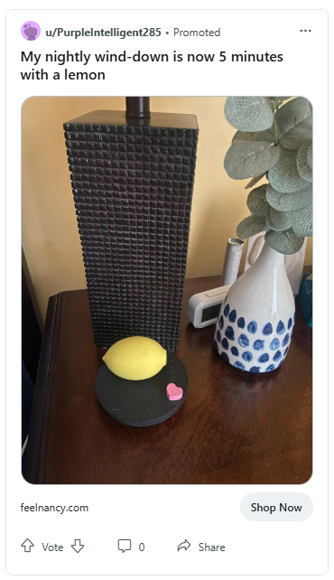
Reddit Ads Performance (7D click, 1 day view )
Overall Metrics of Reddit Ads
Metric | T | Y | L7D
Spend | $95.91 | $98.04 | $705.89
Revenue | $141.75 | $277.44 | $2,698.18
ROAS | 1.48 | 2.83 🟢 | 2.70 🟢
Purchases | 5 | 7 | 71
Campaign 1 - Hello Nancy_Feelnancy_US/UK/CA/AU_Loox Lem Assets_03Jun26
Budget: $100/daily | Target: US | Creatives: loox review statics | LP: feelnancy.com
Late data attribution, will scale and create new campaign
Notes:
SLIDE 10 — REDDIT ADS PERFORMANCE (7D click, 1 day view): Top metrics T/Y/L7D. Spend: T $95.91, Y $98.04, L7D $705.89. Revenue: T $141.75, Y $277.44, L7D $2,698.18. ROAS: T 1.48, Y 2.83 (green), L7D 2.70 (green). Purchases: T 5, Y 7, L7D 71. Single campaign: Hello Nancy / Feelnancy US/UK/CA/AU, Loox review statics ($100/day, target US, LP feelnancy.com). ANALYSIS: Reddit is the most efficient diversification channel on a profitability basis — L7D ROAS 2.70 and Yesterday 2.83 are both green and beat target, achieved with a tiny $100/day budget and review-style static creative (Loox). The 71 L7D purchases on ~$706 spend is strong. The team flags late/inconsistent data attribution (typical of low-volume Reddit), but the signal is clearly positive. ACTION: scale spend and launch a new campaign — well supported. Reddit + TikTok are the two channels worth pressing on; both are profitable and under-funded relative to their returns.

Slide 13
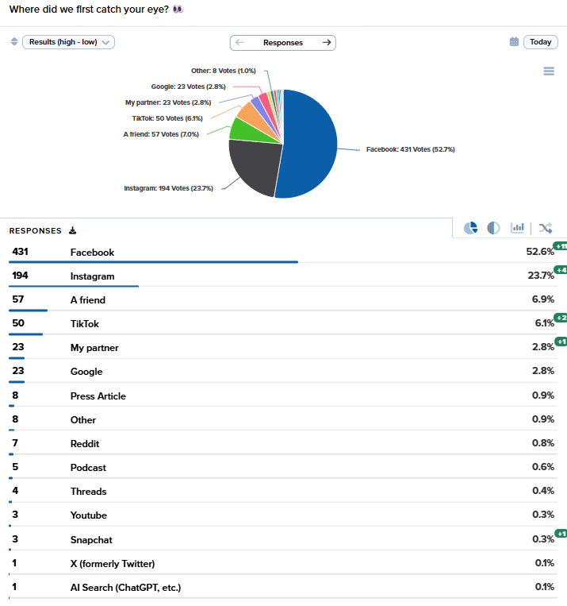
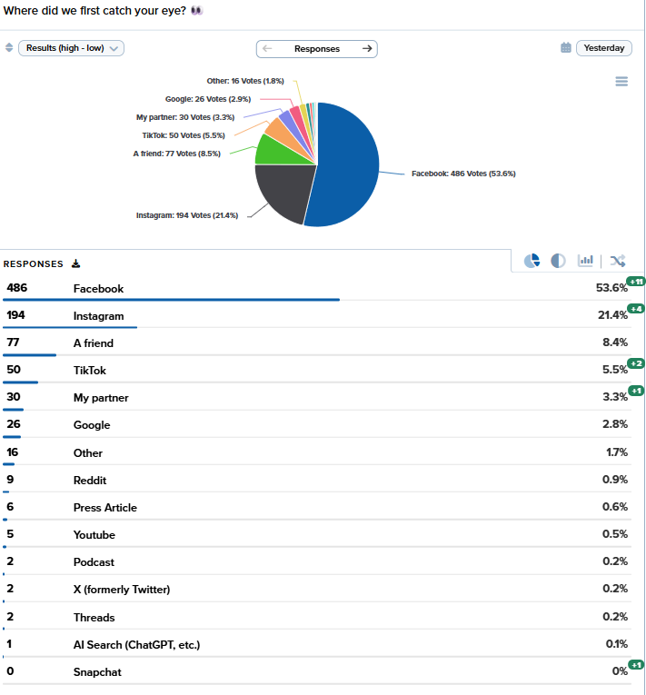
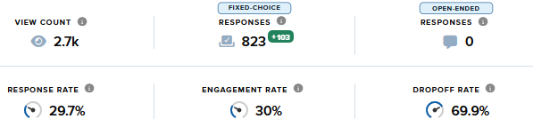
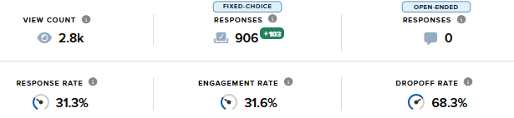
Zigpoll Data (L7d data, Yesterday, Today)
Post-purchase attribution survey dominated by Meta, response rate average of 30.5% for Y,T
Notes:
SUMMARY: Post-purchase attribution survey is dominated by Facebook at 57.8% (4,320 votes) and Instagram at 19.7% (1,408), so Meta accounts for ~77% of how customers say they discovered the brand. Word of mouth is meaningful - A friend 7.9% (564) plus My partner 3.3% (238) - while TikTok self-reports just 4.9% (352) and Google 2.3% (164). Notably, Snapchat and AI Search register 0%, suggesting Snapchat brand recall is near zero despite active ad spend.
SLIDE 11 ANALYSIS \u2014 ZIGPOLL “WHERE DID YOU FIRST CATCH OUR EYE?” (L7D vs. Yesterday): This is self-reported / post-purchase attribution, distinct from platform-reported ROAS. L7D panel (831 responses): Facebook 431 (52.6%), Instagram 194 (23.7%), A friend 57 (6.9%), TikTok 50 (6.8%), My partner 23 (2.8%), Google 23 (2.8%), with Reddit/Press/Podcast/YouTube/Snapchat/X all under 1%. Yesterday panel (~906 responses): Facebook 486 (53.6%), Instagram 194 (25.6%), A friend 77 (8.4%), TikTok 50 (5.5%), My partner 30 (3.3%), Google 26 (2.8%). KEY INSIGHT: Meta (FB+IG) accounts for ~76\u201379% of how customers say they discovered the brand \u2014 explaining and justifying the high Meta spend share from Slide 1. Word-of-mouth is significant (A friend + My partner \u2248 10%+), a strong organic/brand signal. Notably Snapchat and AI Search self-report near 0% despite active ad spend, meaning Snapchat is driving little brand recall \u2014 reinforcing the cautious Snapchat stance from Slides 6\u20137. Response/engagement rates are healthy (~30%).

Slide 14
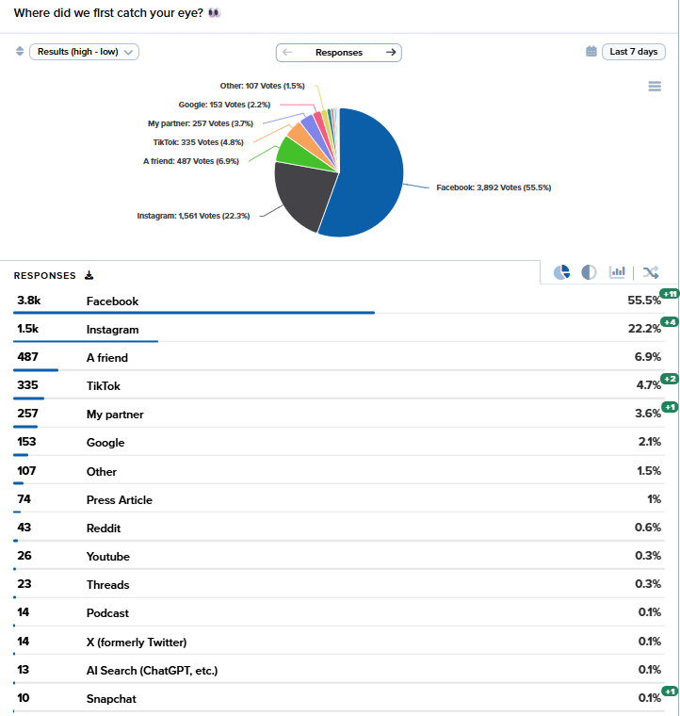
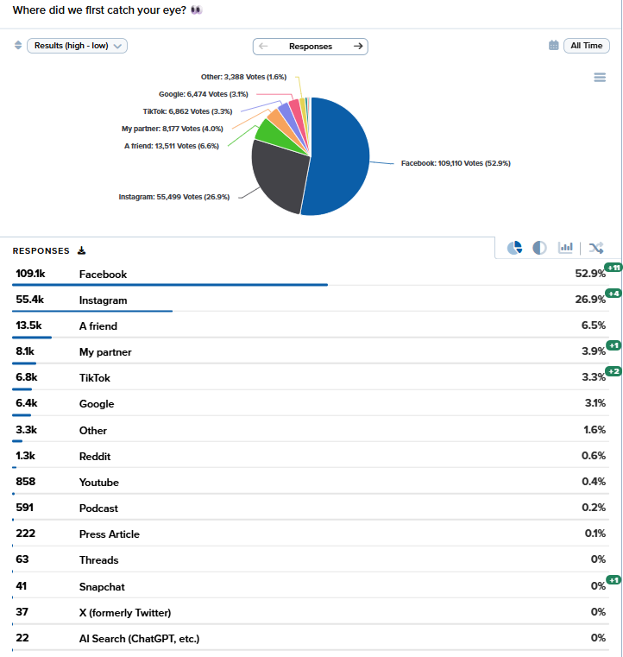
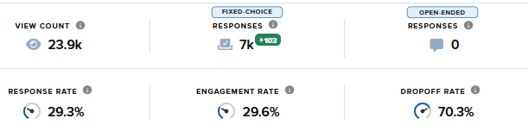
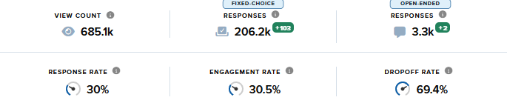
Zigpoll Data (L7d data, Yesterday, Today)
Post-purchase attribution survey dominated by Meta, response rate average of 30% for L7D, Lifetime. Tiktok responses emerging L7D.
Notes:
SUMMARY: Post-purchase attribution survey is dominated by Facebook at 57.8% (4,320 votes) and Instagram at 19.7% (1,408), so Meta accounts for ~77% of how customers say they discovered the brand. Word of mouth is meaningful - A friend 7.9% (564) plus My partner 3.3% (238) - while TikTok self-reports just 4.9% (352) and Google 2.3% (164). Notably, Snapchat and AI Search register 0%, suggesting Snapchat brand recall is near zero despite active ad spend.
SLIDE 12 ANALYSIS — ZIGPOLL ATTRIBUTION (Last 7 Days vs. All Time): Same discovery question on longer windows. Last 7 Days panel (~7k responses): Facebook 3.8k (55.5%), Instagram 1.5k (22.2%), A friend 487 (6.9%), TikTok 335 (4.7%), My partner 257 (3.6%), Google 153 (2.1%). All Time panel (~206k responses): Facebook 109.5k (52.9%), Instagram 55.4k (26.9%), A friend 13.5k (6.5%), My partner 8.5k (3.9%), TikTok 6.8k (3.3%), Google 6.4k (3.1%). KEY INSIGHT: The pattern is remarkably stable across all time horizons — Meta (FB+IG) consistently drives ~76–80% of self-reported discovery, confirming the brand was built on Meta and that this is structural, not a short-term spike. Instagram’s share rises on the All-Time window (26.9% vs ~22% recent), suggesting IG was historically even more important. TikTok’s share is small in self-reported attribution (3–5%) even though its ad ROAS is excellent (Slides 8–9) — a classic case of an upper/mid-funnel channel that converts well but isn’t yet a top-of-mind brand-discovery source. STRATEGIC TAKEAWAY: Meta remains the brand-awareness engine, but the channel-diversification effort (TikTok/Reddit) is additive incremental revenue that won’t show up strongly in this discovery poll yet.

Slide 15
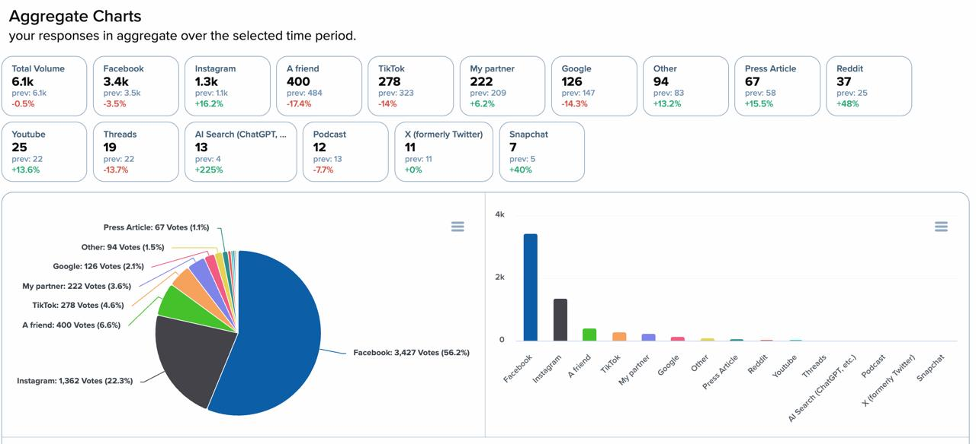
Zigpoll Data (L7d data, Yesterday, Today)
L7D data vs. Previous period
Notes:
SUMMARY: Post-purchase attribution survey is dominated by Facebook at 57.8% (4,320 votes) and Instagram at 19.7% (1,408), so Meta accounts for ~77% of how customers say they discovered the brand. Word of mouth is meaningful - A friend 7.9% (564) plus My partner 3.3% (238) - while TikTok self-reports just 4.9% (352) and Google 2.3% (164). Notably, Snapchat and AI Search register 0%, suggesting Snapchat brand recall is near zero despite active ad spend.
SLIDE 12 ANALYSIS — ZIGPOLL ATTRIBUTION (Last 7 Days vs. All Time): Same discovery question on longer windows. Last 7 Days panel (~7k responses): Facebook 3.8k (55.5%), Instagram 1.5k (22.2%), A friend 487 (6.9%), TikTok 335 (4.7%), My partner 257 (3.6%), Google 153 (2.1%). All Time panel (~206k responses): Facebook 109.5k (52.9%), Instagram 55.4k (26.9%), A friend 13.5k (6.5%), My partner 8.5k (3.9%), TikTok 6.8k (3.3%), Google 6.4k (3.1%). KEY INSIGHT: The pattern is remarkably stable across all time horizons — Meta (FB+IG) consistently drives ~76–80% of self-reported discovery, confirming the brand was built on Meta and that this is structural, not a short-term spike. Instagram’s share rises on the All-Time window (26.9% vs ~22% recent), suggesting IG was historically even more important. TikTok’s share is small in self-reported attribution (3–5%) even though its ad ROAS is excellent (Slides 8–9) — a classic case of an upper/mid-funnel channel that converts well but isn’t yet a top-of-mind brand-discovery source. STRATEGIC TAKEAWAY: Meta remains the brand-awareness engine, but the channel-diversification effort (TikTok/Reddit) is additive incremental revenue that won’t show up strongly in this discovery poll yet.

Slide 16
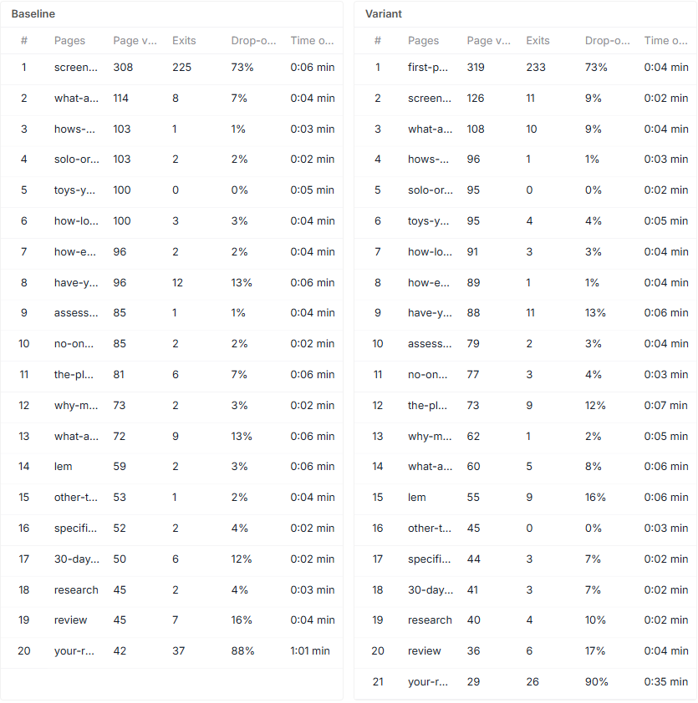
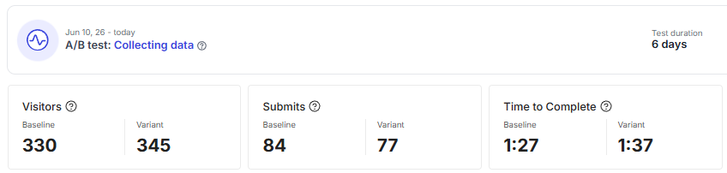
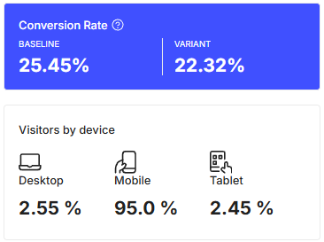
Heyflow Campaign (L7d Data)
Overall Metrics of Heyflow Campaign
Metric | T | Y | L7D
Spend | $316.11 | $1,126.67 | $5,694.35
Revenue | $566.59 | $1,603.91 | $9,274.10
ROAS | 1.79 | 1.42 | 1.63
Purchase | 1 | 3 | 15
Campaign 1 - Nancy Ad Account 1_Website_US,UK,CA,AU_Lem Winners UGC Videos_05June26
Budget: HKD1000/daily | Target: Top 15 | Creatives: winner statics | LP: heyflowquiz.com
A/B Test different first page. Flow of questions still the same. The baseline first page is outperforming new variant.
Meta campaign improving with good roas, no changes on Meta campaign side.
Notes:
SLIDE 13 — HEYFLOW CAMPAIGN (L7D Data): Performance of the Heyflow quiz funnel . Top metrics T/Y/L7D — Spend: $316.11 / $1,126.67 / $5,694.35; Revenue: $566.59 / $1,603.91 / $9,274.10; ROAS: 1.79 / 1.42 / 1.63; Purchases: 1 / 3 / 15. Campaign 1: Nancy Ad Account 1 Website US/UK/CA/AU Lem Winners UGC, budget HKD1000/day, target top 15, winner statics, LP heyflowquiz.com. A/B TEST RESULTS: Baseline conversion 25.45% vs Variant 22.32% — the baseline (control) first page is outperforming the new variant. Device mix is overwhelmingly mobile: Desktop 2.55%, Mobile 95.0%, Tablet 2.45%. ANALYSIS: The Heyflow quiz funnel is marginally profitable (L7D ROAS 1.63, below the ~2.0 target) — similar to broader Snapchat economics. The headline learning is the A/B test: the variant first page LOST (22.32% vs 25.45%), so the current control should be kept and a new variant designed. Because traffic is ~95% mobile, all funnel optimization must be mobile-first. Stated next step: A/B test a different first page while keeping the question flow the same — the right iterative approach given the inconclusive/negative variant result.

Slide 17



TSL ABO Campaign (L7d Data)
Overall Metrics of TSL Campaign
Winners (L7D)
Metric | T | Y | L7D
Spend | $2,147.25 | $3,193.53 | $17,664.38
Revenue | $4,578.36 | $4,335 | $22,853.18
ROAS | 2.13 | 1.36 | 1.29
Purchase | 8 | 7 | 38
I am 66. I am divorced.
I have been divorced for nine years and separated for two before that. I have no interest in another relationship.
L7D: $3,967.57 | ROAS: 1.30
I am Camila. I am 56. I have been single by choice since I was 42.
I have been telling women in their fifties the same thing for fifteen years, and almost none of them listen until they have been on five bad dates or sat through one bad anniversary.
L7D: $3,900.95 | ROAS: 1.32
My daughter is 28. She got divorced six months ago, after two years of marriage to a man who was, in the end, not who he advertised himself as.
She moved back into a small apartment three blocks from mine.
L7D: $3,900.95 | ROAS: 1.32
Campaign 1 - Hello-Momo-9_Manus Nancy Lem_Top 15 Countries_Liven style ads_ABO_3June26
Budget: HKD2,423.08/daily | Target: Top 15 | Creatives: liven style ads | LP: nancylem.com
Performance improving.
Notes:
SLIDE 13 — HEYFLOW CAMPAIGN (L7D Data): Performance of the Heyflow quiz funnel . Top metrics T/Y/L7D — Spend: $316.11 / $1,126.67 / $5,694.35; Revenue: $566.59 / $1,603.91 / $9,274.10; ROAS: 1.79 / 1.42 / 1.63; Purchases: 1 / 3 / 15. Campaign 1: Nancy Ad Account 1 Website US/UK/CA/AU Lem Winners UGC, budget HKD1000/day, target top 15, winner statics, LP heyflowquiz.com. A/B TEST RESULTS: Baseline conversion 25.45% vs Variant 22.32% — the baseline (control) first page is outperforming the new variant. Device mix is overwhelmingly mobile: Desktop 2.55%, Mobile 95.0%, Tablet 2.45%. ANALYSIS: The Heyflow quiz funnel is marginally profitable (L7D ROAS 1.63, below the ~2.0 target) — similar to broader Snapchat economics. The headline learning is the A/B test: the variant first page LOST (22.32% vs 25.45%), so the current control should be kept and a new variant designed. Because traffic is ~95% mobile, all funnel optimization must be mobile-first. Stated next step: A/B test a different first page while keeping the question flow the same — the right iterative approach given the inconclusive/negative variant result. The single most replicable insight across all three: they convert the product's biggest weakness — shame and embarrassment — into the entire emotional payload. Most products hide their objection. These build the whole ad on top of it, so that buying becomes an act of self-respect rather than a guilty indulgence. That inversion is the trick worth stealing.

Slide 18
Game Plan by Channel — What’s Done / Findings / Next Step
Channel | What’s Done | Findings | Next Step
Snapchat 🟢 ($900/day budget) | Launched catalog campaign | Hitting a lot of rejected ads Campaign directing to Zenify started to perform well Snapchat sessions increases | Create new ad accounts Monitor campaigns and performance/ kill underperforming ads
TikTok 🟢 ($800/day budget) | Launched new campaign targeting 11 countries, and directing to unlock.hellonancy.com | Campaigns are performing well using spark ads even on different landing page. | Scale campaigns gradually and see if roas holds
Twitter / X 🔴 | Setup done (campaign not live yet) | Blocker: delivery status halted | Look for someone in Twitter who run ads and learn from them To launch the campaign this week
Reddit 🟢 ($100/daily) | Campaign launched (monitoring) | Inconsistent data from the campaign but good roas | Monitor, scale and launch new campaign Create new campaign targeting more countries
Notes:
SLIDE 14 — GAME PLAN BY CHANNEL (Done / Findings / Next Step): Action-plan matrix for the diversification channels. SNAPCHAT (green, $900/day): Done — launched catalog campaign. Findings — hitting many rejected ads, but the Zenify-directed campaign started performing well and Snapchat sessions are increasing. Next — create new ad accounts, monitor and kill underperforming ads. TIKTOK (green, $800/day): Done — launched new campaign targeting 11 countries directing to unlock.hellonancy.com. Findings — campaigns performing well with Spark Ads even on a different landing page. Next — scale gradually and watch if ROAS holds. TWITTER/X (red): Done — setup in progress, not live. Findings — blocker is a pixel issue. Next — fix pixel, then launch. REDDIT (green, $100/day): Done — campaign launched (monitoring). Findings — inconsistent data but good ROAS. Next — monitor, scale, launch new campaign. ANALYSIS: A clear, channel-by-channel execution plan that ties directly to the data slides. TikTok and Reddit get “scale” (both profitable); Snapchat gets “fix and prune” (creative rejections + weak ROAS); Twitter/X is blocked on a technical pixel fix. The plan is appropriately matched to each channel’s performance — lean into winners, repair laggards, unblock the dormant channel.

Slide 19
Game Plan for Nancy — What’s Done / Findings / Next Step
 | What’s Done | Findings | Next Step
Nancy | Launched Localized Zenify ABO campaign Launched campaign on Tiktok and Snapchat | Sales from L7D holds within target, L30D Roas increased Improvement on target Meta roas Tiktok ads holds with good ROAS Snapchat Roas increased vs. L7D Juicy Blanket sales decrease | Monitor and optimize other paid channels Create a new whitelisting campaign (this week target) Launch Pride Campaign (target today) Start optimising Google
Notes:
SLIDE 15 — GAME PLAN FOR NANCY (Done / Findings / Next Step): The overall account wrap-up. DONE: launched a localized Zenify ABO campaign; launched campaigns on TikTok and Snapchat. FINDINGS: L7D sales hold within target and L30D ROAS increased; improvement on target Meta ROAS; TikTok holds with good ROAS; Snapchat ROAS increased vs L7D; the one negative — Juicy Blanket sales are decreasing. NEXT STEPS: monitor and optimize the other paid channels; create a new whitelisting (creator/influencer) campaign; launch a Pride campaign; optimize the active Juicy Blanket campaign. ANALYSIS: This is the executive summary that closes the loop on Slide 1. The narrative is broadly positive — efficiency is recovering (L30D ROAS up, Meta ROAS improving), TikTok is a confirmed winner, and Snapchat is trending the right way despite weak absolute ROAS. The main soft spot called out is the Juicy Blanket product decline, which gets a dedicated optimization action. Forward strategy blends defense (optimize Meta + Juicy Blanket) with growth bets (whitelisting/influencer, seasonal Pride campaign, scaling TikTok/Reddit). Overall: stable-and-improving account with a clear, well-prioritized roadmap.

