Slide 1
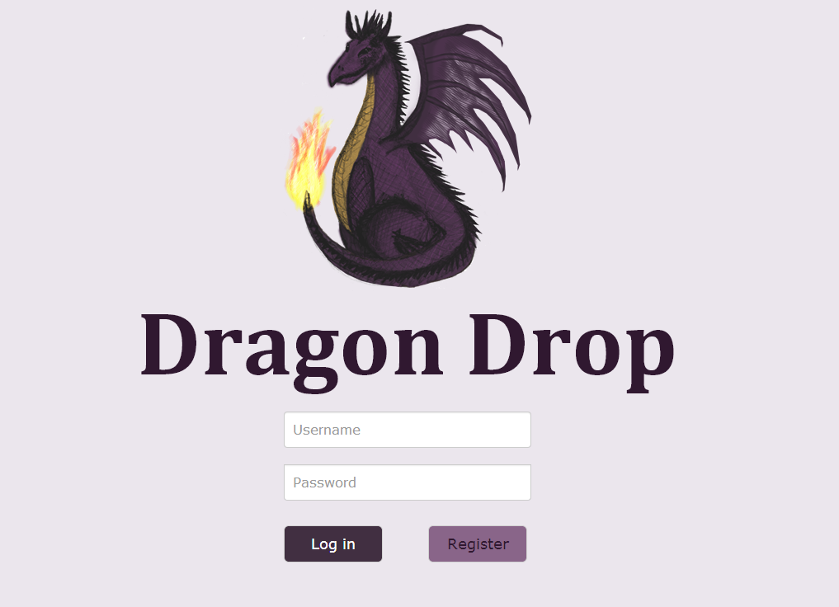
Jean Power, Martyna Maroń, James Trimble, Gözel Shakeri, Ruoyang Wen

Slide 2
Stand-Out Features
Saving bookmarks by drag and drop to folders.
2. Ranking filter applied to results to increase suitability of response:
Prioritisation of bookmarks within folders.
Instances of the site within bookmarks.
Overall site preferences.
3. Intuitive, uncomplicated interface - folder structure, drag and drop to store/organise bookmarks/folders
4. DRAGONS!

Slide 3
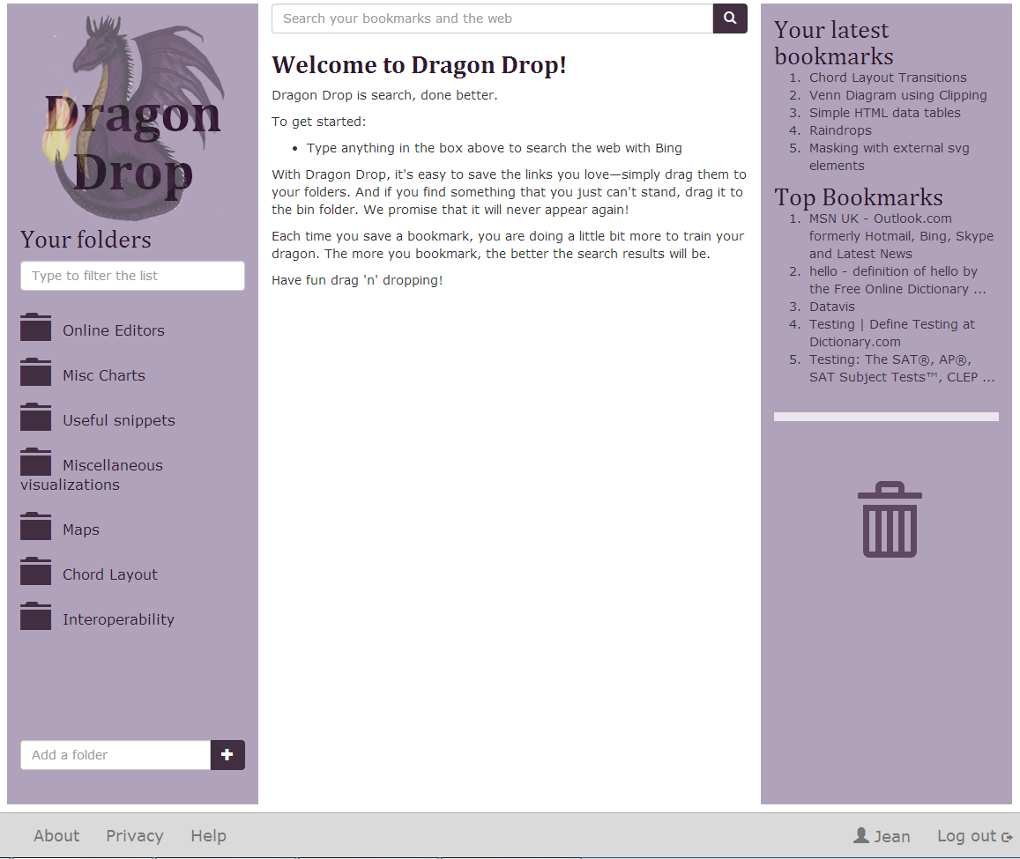
User Page
2
6
Username, logout
Logo
Folder area
Search results - empty on startup
About, Privacy and Help links
Search bar
Add folder
Bin Folder
Latest bookmarks added and top bookmarks from all users
4
9
3
8
7
5
1

Slide 4
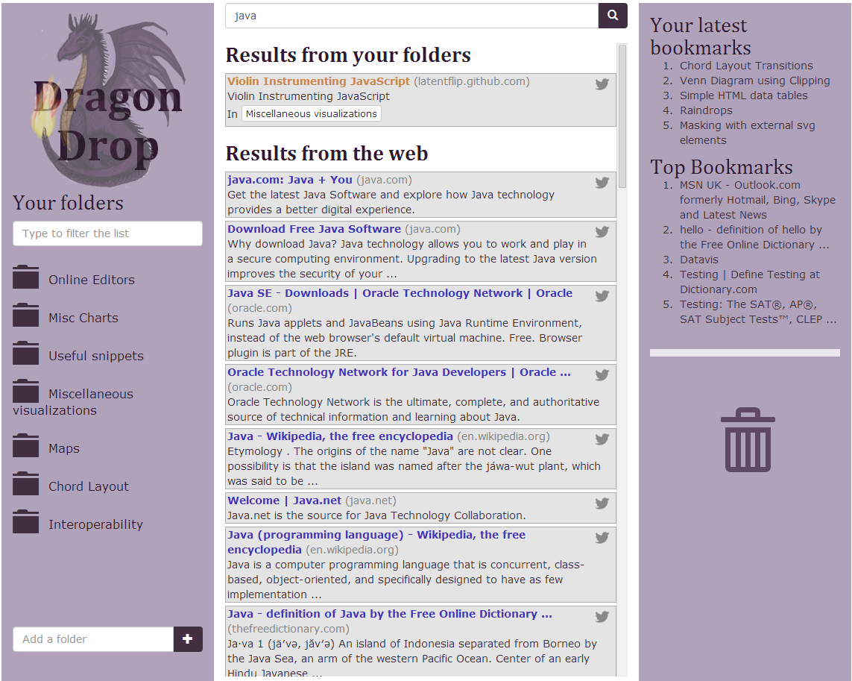
General Search Results
1
Results from folders, ranked.
Results from the web, ignoring anything in the bin.
Tweet the URL, via DragonDrop
2
3

Slide 5
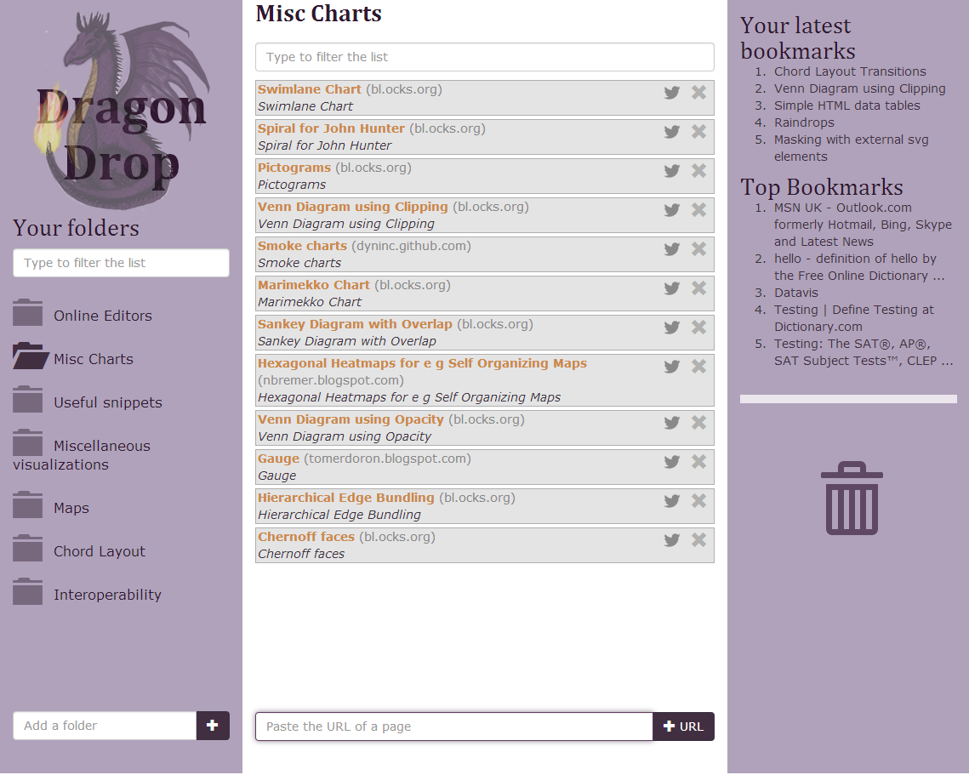
Folder Page
2
Open folder
Search results from folder
Add bookmark manually
1
3

Slide 6
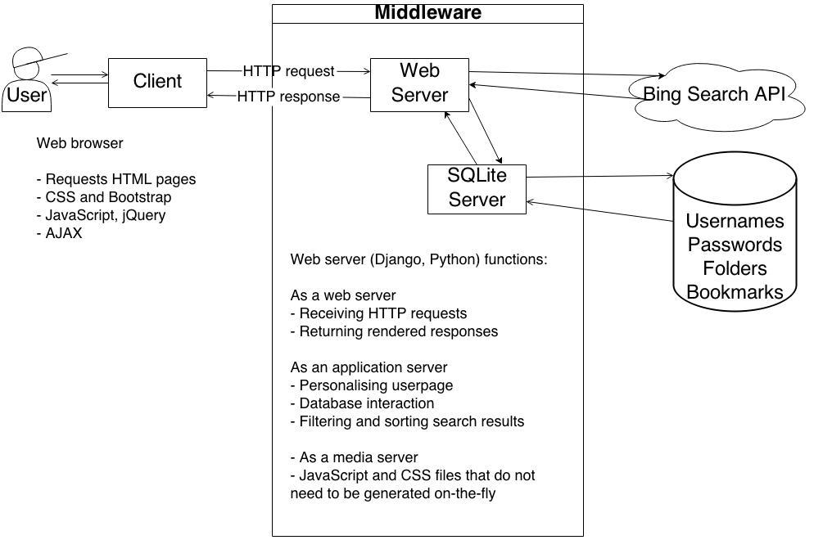
System Architecture

Slide 7
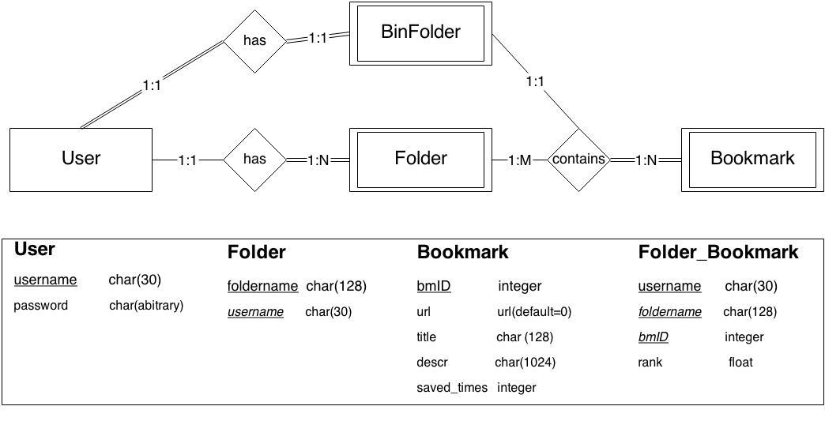
ER Diagram

Slide 8
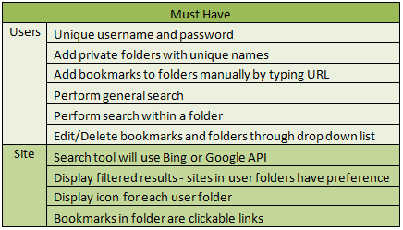
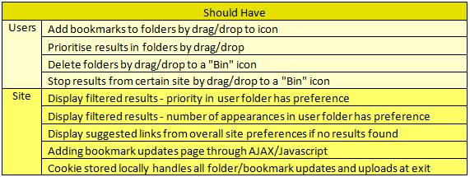
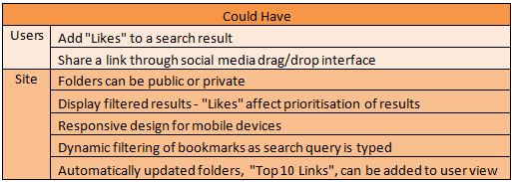
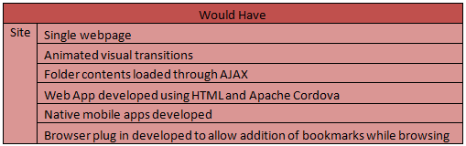
Specifications

Slide 9
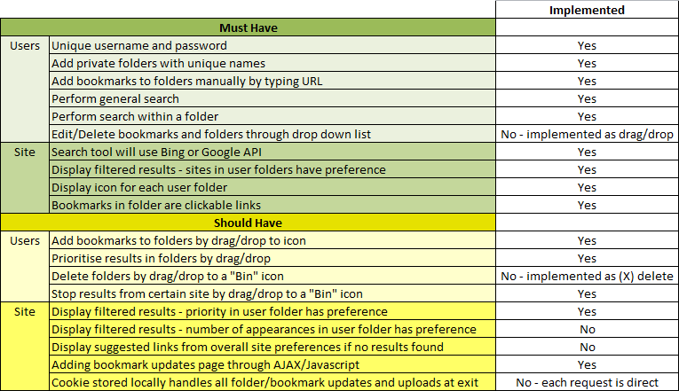
Checklist of implementation

Slide 10
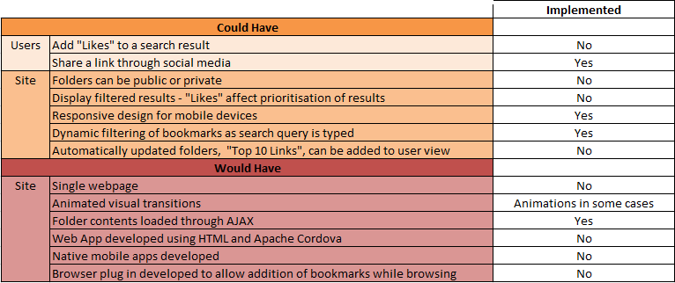
Checklist of implementation

Slide 11
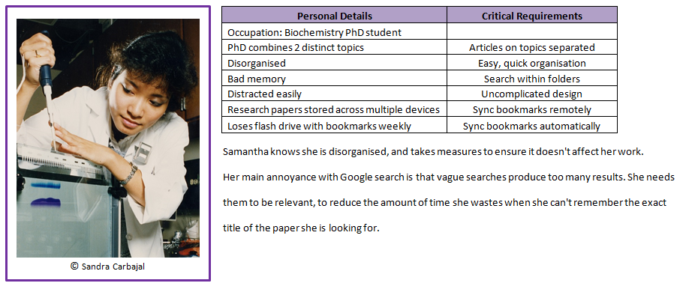
Samantha Jenkins, age 24

Slide 12
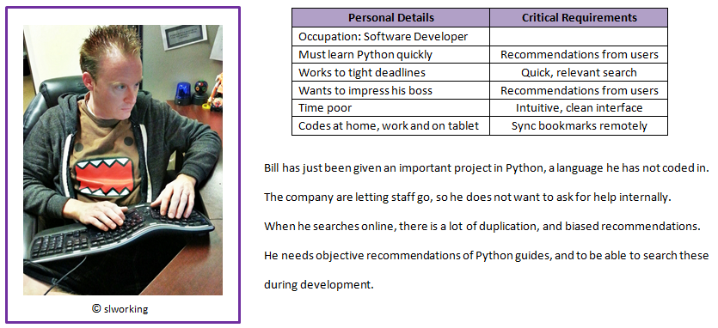
Bill Talin, age 34

Slide 13
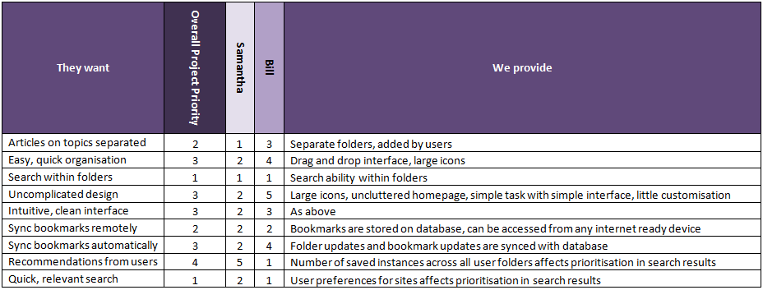
User needs matrix

Slide 14
URLs
Homepage - http://dragondrop.pythonanywhere.com/
User page - http://dragondrop.pythonanywhere.com/userpage
Folder page - http://dragondrop.pythonanywhere.com/<folder name>
example - http://dragondrop.pythonanywhere.com/Misc_Charts/
Other pages:
http://dragondrop.pythonanywhere.com/register/
http://dragondrop.pythonanywhere.com/about/
http://dragondrop.pythonanywhere.com/help/
http://dragondrop.pythonanywhere.com/privacy/

Slide 15
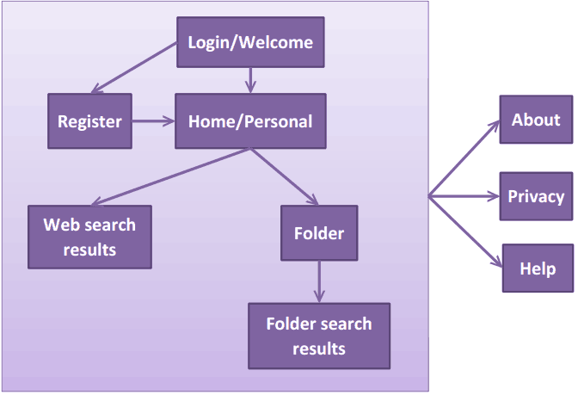
Site Map

