Slide 1

Research for the award of the Doctor of Philosophy Degree (PhD) in Management of Agroecosystems and Environment.
Faculty of Agriculture, University of Nairobi
Thesis: Climate change impacts on maize-based agroecosystems in Kikuyu Sub-County, Kenya.
by: Jean-Marie V. Minani
Supervisors:
Prof. Richard N. Onwonga, Prof. Walter Leal Filho, Prof. Charles K. K. Gachene

Slide 2

Outlines
INTRODUCTION
2. LITERATURE REVIEW
3. MATERIAL AND METHODS
4. RESULTS
5. DISCUSSIONS
6. CONCLUSIONS

Slide 3
1.Introduction
1.1. Background:
effects of climate change on food /maize production
Global context:
Regional context:
National context:

Slide 4
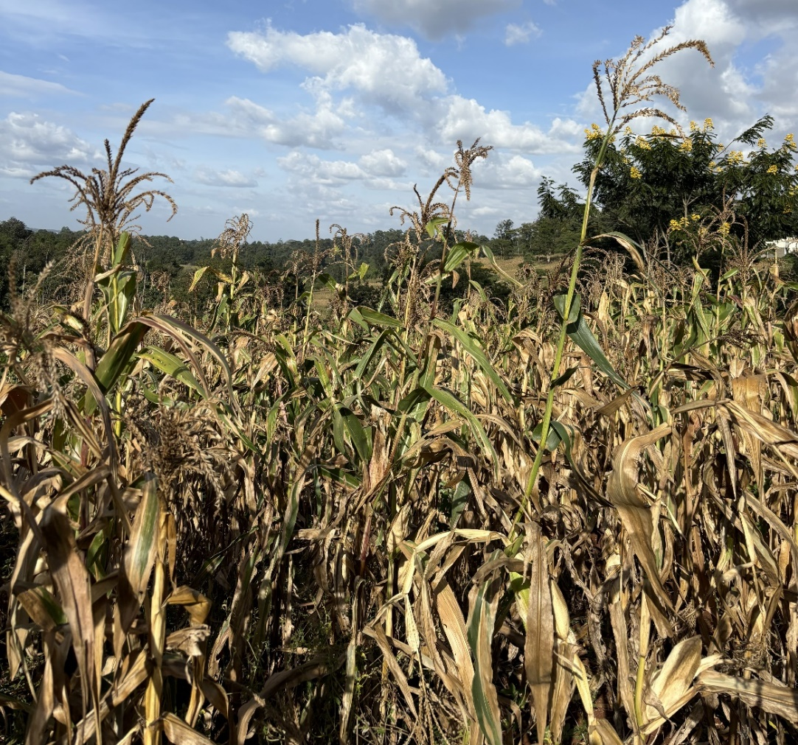
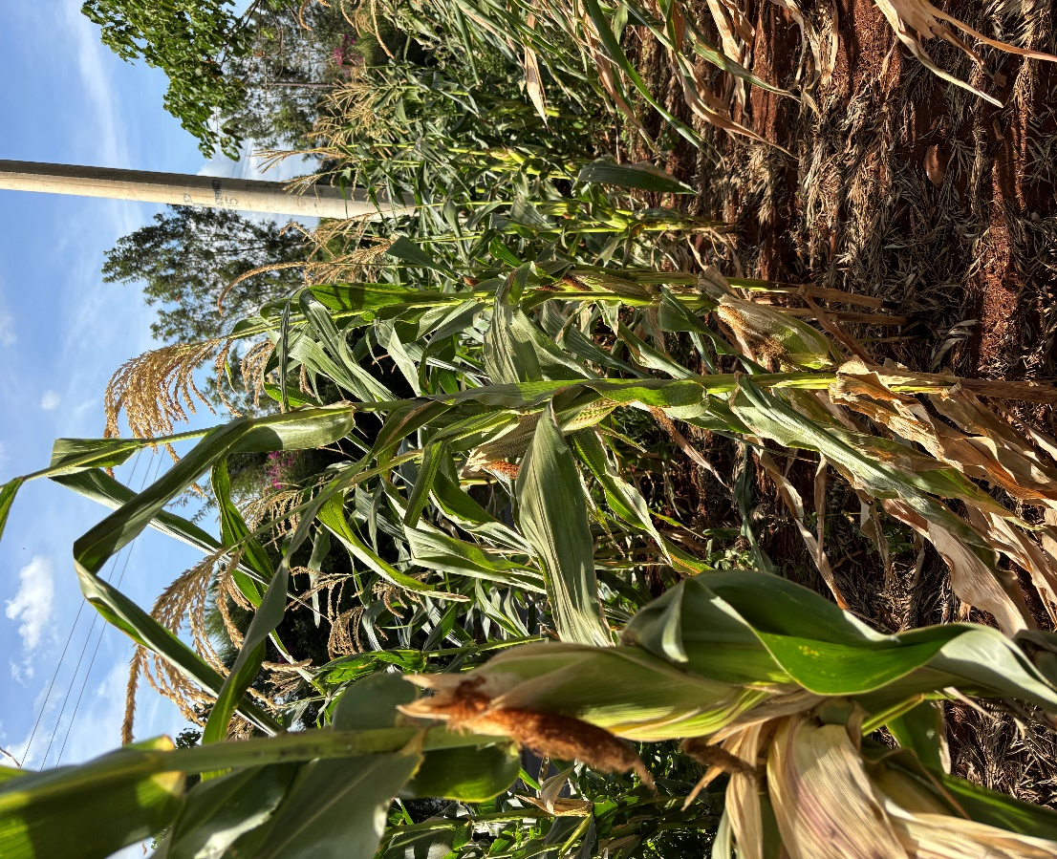
Maize (Zea mays) is a staple crop consumed by more than 90% of households in urban and rural areas in Kenya (KNBS, 2024)

Slide 5
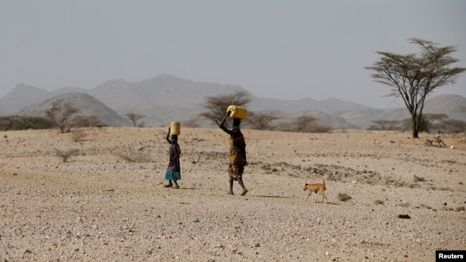
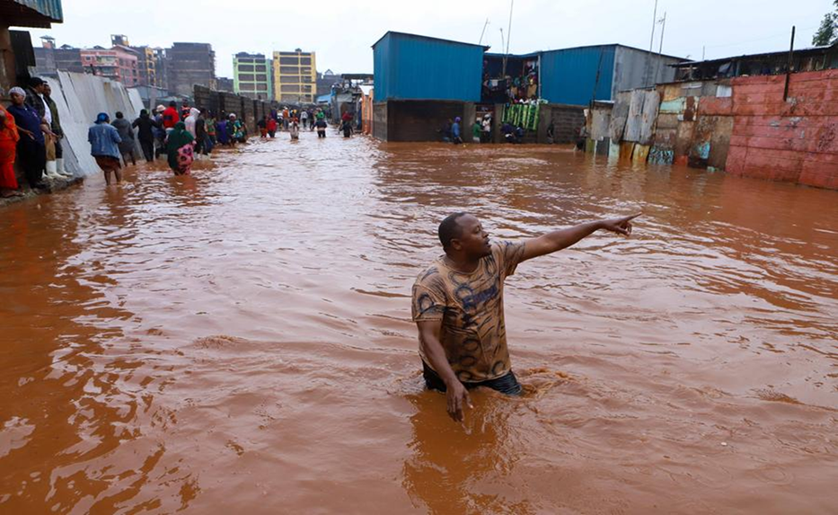
Climate change severely impacts agricultural production, threatens food security in Kenya
Kenya is highly vulnerable to droughts and flooding:
In 2022, Kenya has experienced severe droughts in the Arid and Semi-Arid Lands (ASALs).
April 2024 heavy rains caused devastating floods that affected Nairobi city, the Makueni, the West Pokot, and the Machakos counties: over 200 deaths and displaced hundreds of thousands of people

Slide 6
1.Introduction…
1.2. Problem statement
severe droughts
devastating floods
food security threatened
Identified gaps
The Geographic gap:
lack of assessment of climate change impacts on maize-based agroecosystems in Kiambu County, and Kikuyu Sub-County in particular.
The Technological gap:
failure of past research to utilize modern computational tools (GIS/Machine Learning) in this specific area

Slide 7
1.Introduction…
1.3. Research objectives
the overall objective :
4 specific objectives:
1.4. Hypotheses :
-
-
-
-

Slide 8
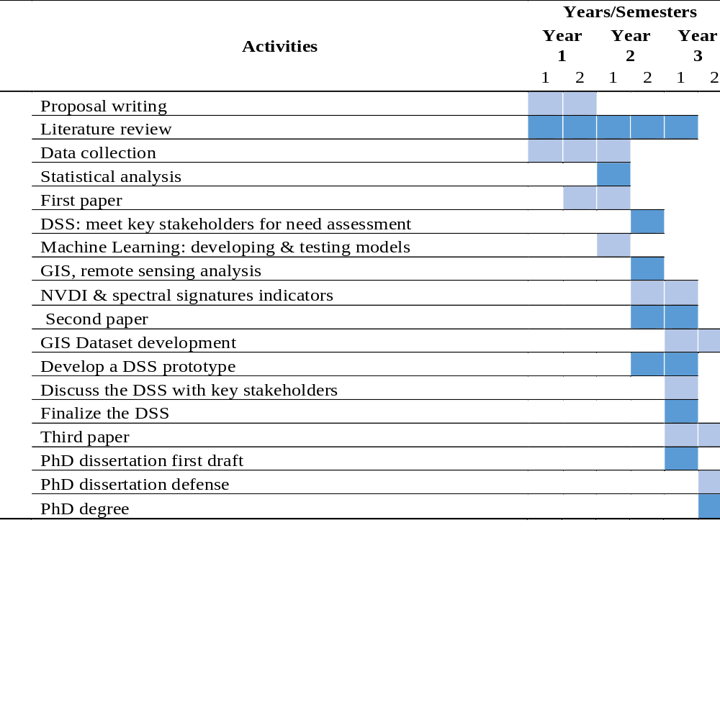
Work plan

Slide 9
2.Literature review
An overview of previous studies
Grigorieva (2023)
Rafique (2023)
Kipkulei, Bellingrath-Kimura, et al., 2025
Ocwa et al. (2023)
Li & Tian (2024)
Kipkulei, Boitt, et al., 2025
Kumar et al., 2021; Ma, X., Li, L., & Wu, Y., 2025
Kazemi Garajeh, M., Salmani, B., Zare Naghadehi, S. et al. (2023)
Mahlayeye, Darvishzadeh, and Nelson (2024)

Slide 10
2.Literature review ….
Mwangi et al.(2020)
Tufail et al (2025)
Li et al.(2022)
Alamanos, A., Rolston, A., & Papaioannou, G. (2021)
Adaptation: Policies and strategies towards climate change adaptation and mitigation in Kenya

Slide 11
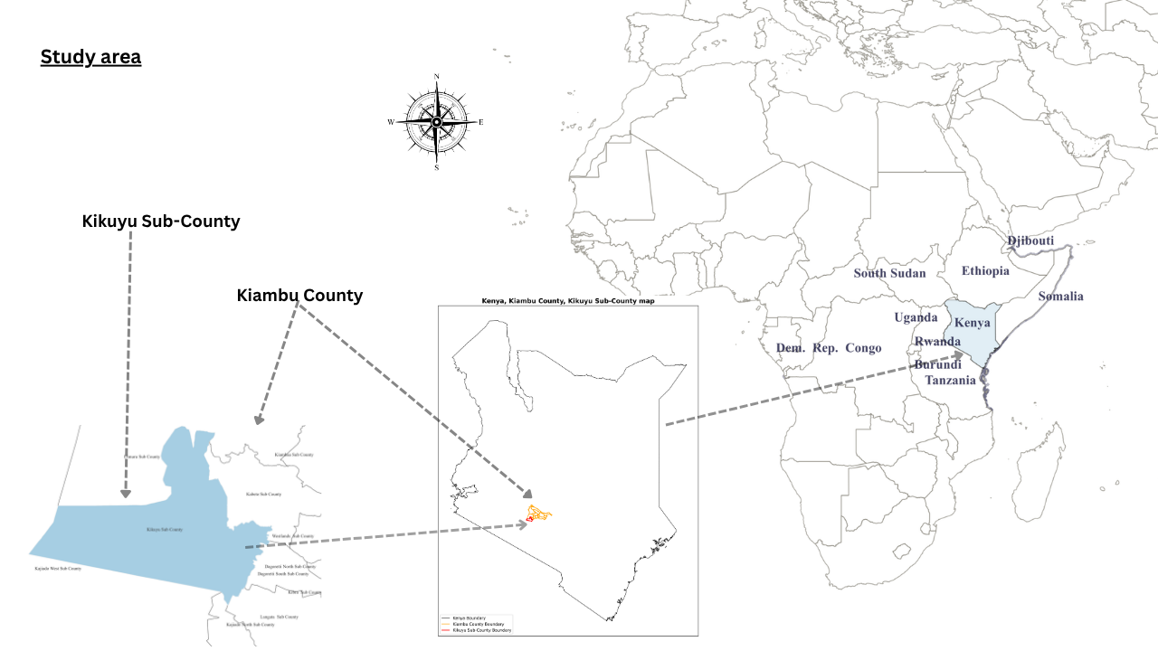
3.Material and methods
Study area Kikuyu Sub-County

Slide 12
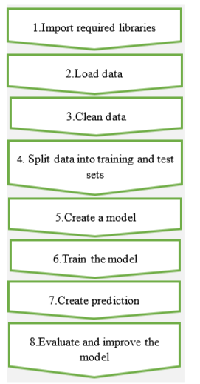
3.Material and methods ….
Data collection and acquisition
FAOSTAT database
NASA POWER Data
USGS Earth Explorer
Kikuyu Sub-County: Farmer Quesionnaire,
Decision-makers questionnaire, Kobotoolbox
Data Screening, cleaning, and processing
Applying Machine Learning techniques

Slide 13
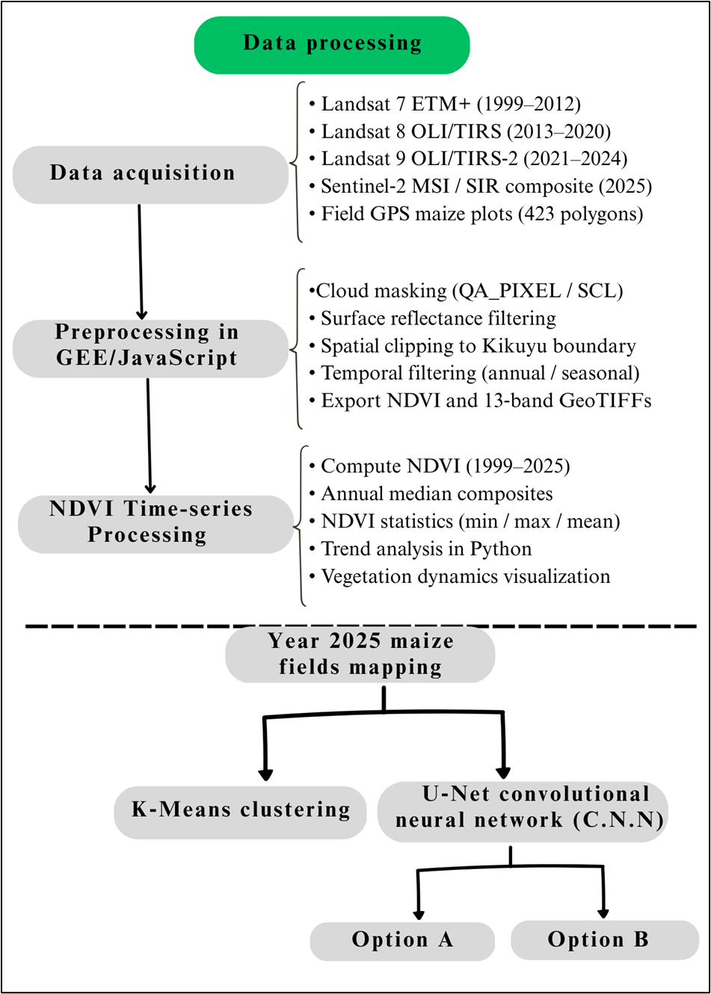
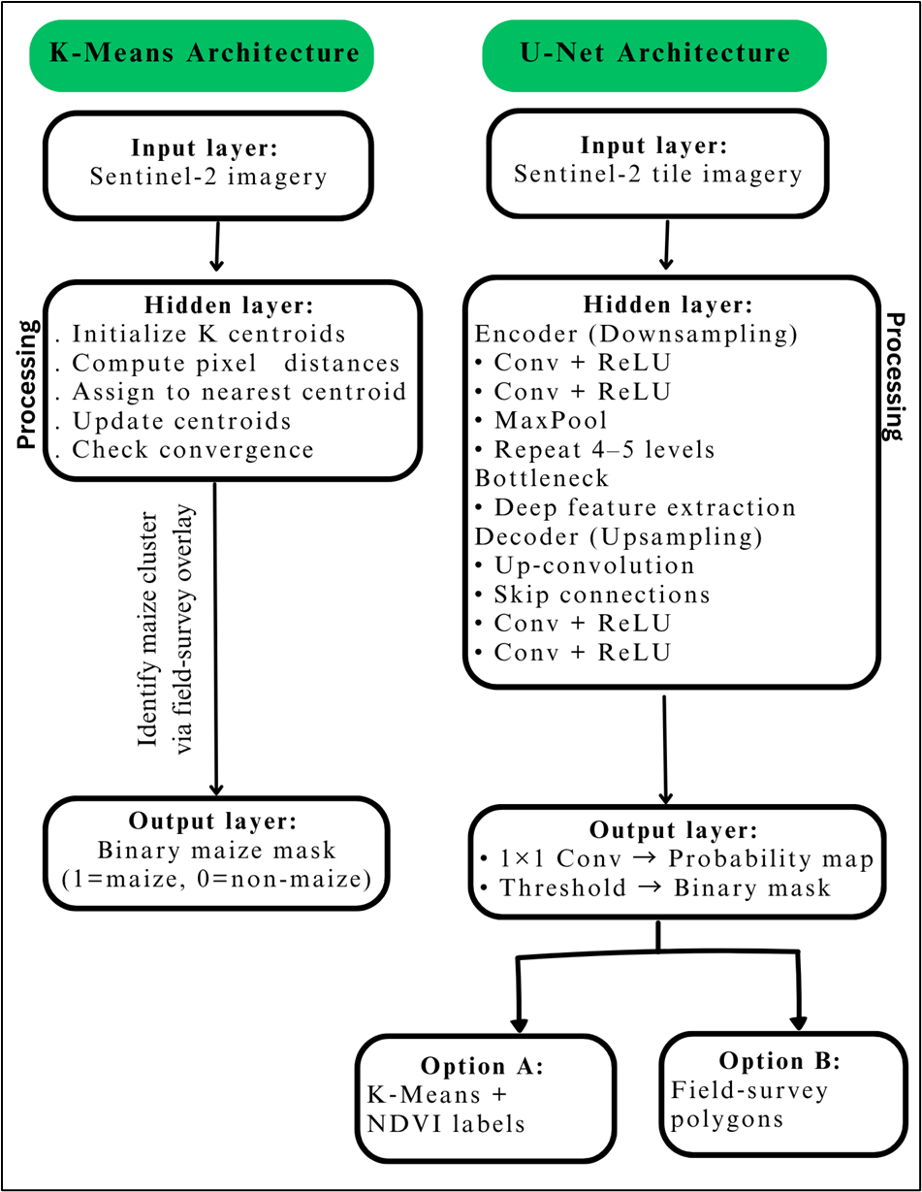
3.Material and methods ….
Remote sensing and GIS, NVDI and spectral signatures

Slide 14
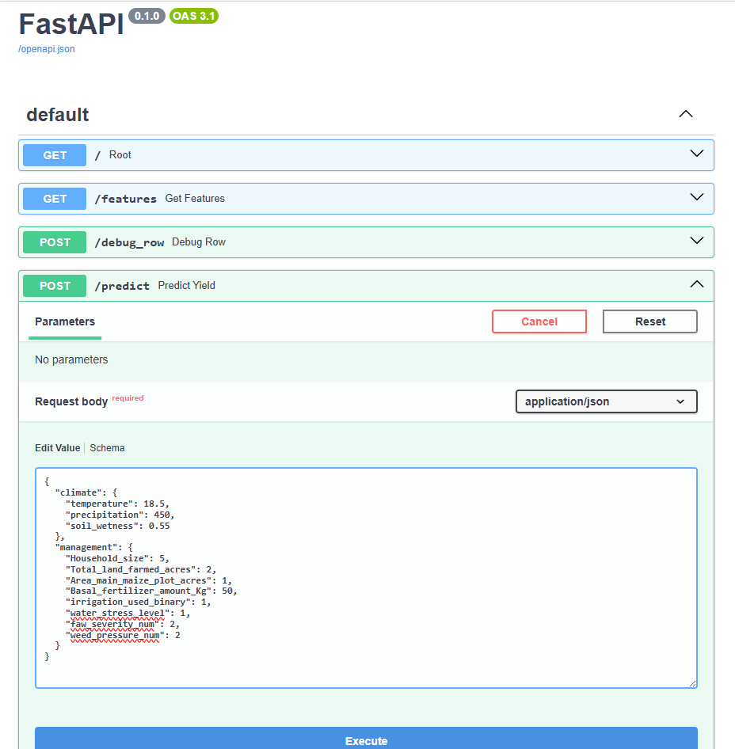
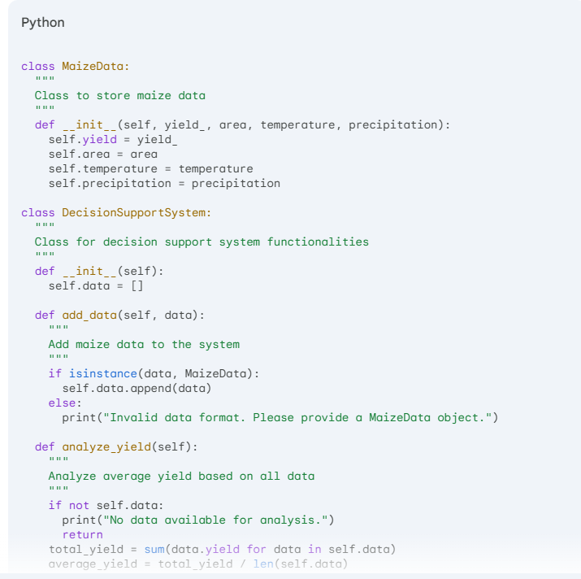
3.Material and methods ….
5-Decision support System (DSS)

Slide 15
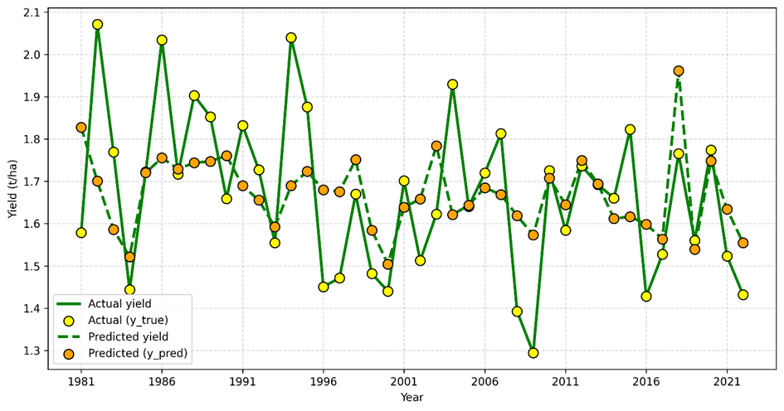
Results & Discussion
Linear climate sensitivities and scenario projections for maize agroecosystems in Kikuyu Sub-County, Kenya (1981-2022):
Metric Two-Predictor Three-Predictor
R² 0.2278 0.2323
Adjusted R² 0.1882 0.1717
RMSE (t/ha) 0.1615 0.1611
MAE (t/ha) 0.1279 0.1280
SE (t/ha) 0.1635 0.1671
Model performance

Slide 16
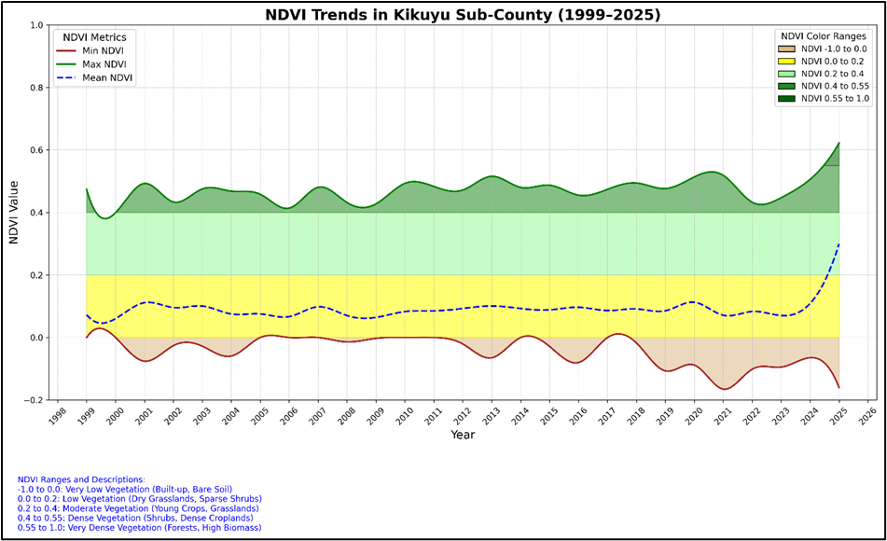
Results & Discussion…
Integrating Landsat‑derived NDVI and Sentinel‑2 imagery for vegetation dynamics assessment and maize field mapping in Kikuyu Sub-County, Kenya using K‑Means clustering and U‑Net):
NDVI time-series 1999-2025 in Kikuyu Sub County

Slide 17
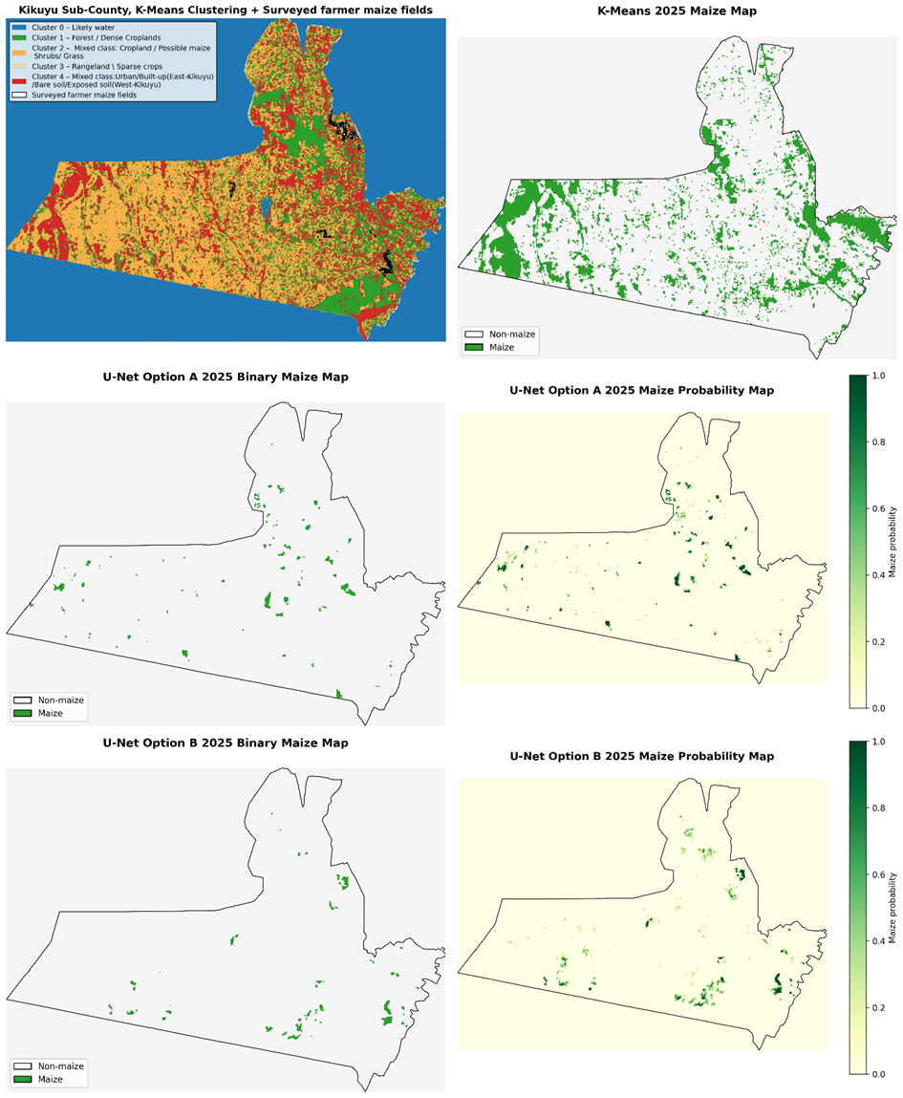
Results & Discussion …
Integrating Landsat‑derived NDVI and Sentinel‑2 imagery for vegetation dynamics assessment and maize field mapping in Kikuyu Sub-County, Kenya using K‑Means clustering and U‑Net):
Comparison of
K-Means and U-Net (Option A and B) maize-mapping results for Kikuyu Sub-County in 2025

Slide 18
Results & Discussion …
Integrating Landsat‑derived NDVI and Sentinel‑2 imagery for vegetation dynamics assessment and maize field mapping in Kikuyu Sub-County, Kenya using K‑Means clustering and U‑Net):
Approach | supervision | IoU | F1-score | Precision | Recall | Accuracy
K-Means | Unsupervised | 0.013 | 0.025 | 0.013 | 0.451 | 0.913
U-Net Option A | Supervised, trained with proxy labels | 0.397 | 0.568 | 0.607 | 0.533 | 0.976
U-Net Option B | Supervised, trained with field survey data | 0.403 | 0.574 | 0.540 | 0.613 | 0.955
Evaluation metrics for the three approaches

Slide 19
Conclusions
23% of maize yield variance were explained by OLS regression models: we trained climate variables (T, P, GWETTOP)
77% are driven by non-climatic factors such as soil health, pest pressure, and management practices
We trained ML models: Random Forest, Gradient Boosting, LightGBM, and XGBoost on farm-level management, inputs, pest pressure, and technology adoption features
We employed a multi-sensor remote sensing approach to map maize distribution, integrating long-term Landsat NDVI trends with high-resolution Sentinel-2 imagery.
27-year NDVI time-series for Kikuyu Sub-County
Mapping maize distribution for the growing season
Unsupervised K-Means clustering
Supervised U-Net deep learning models
Study limitations and future research direction

Slide 20

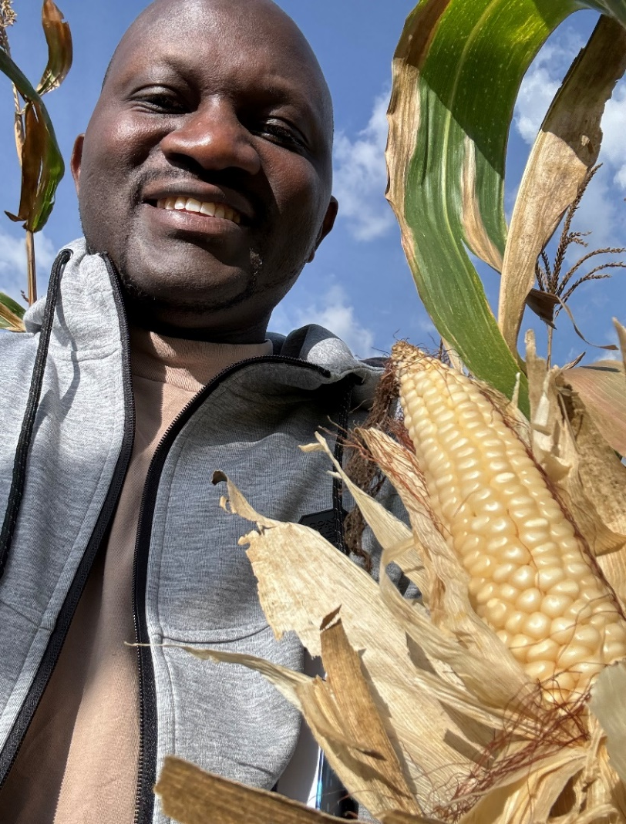

Thank you, Asante sana, Murakoze, Merci

