Slide 1
Scope Studio
Oscilloscope data analysis that never leaves your machine
deterministic NumPy math · local AI routing · tokamak current-driver campaign demo

Slide 2
One click, five deterministic steps
1
Load & calibrate instrument preamble parsed; sensor presets convert V to A
design rule
the AI never computes numbers - it routes to tools and explains their output
2
Zero baselines pre-trigger mean removed - both monitors start at 0 A
3
Stats & anomaly scan peak / mean / RMS; spikes, clipping, drift, module imbalance
4
Saturation estimate censored two-slope fit where the busbar exceeds its limit
5
RLC reconstruction physics fit through the gap, consistent with BOTH sensors

Slide 3
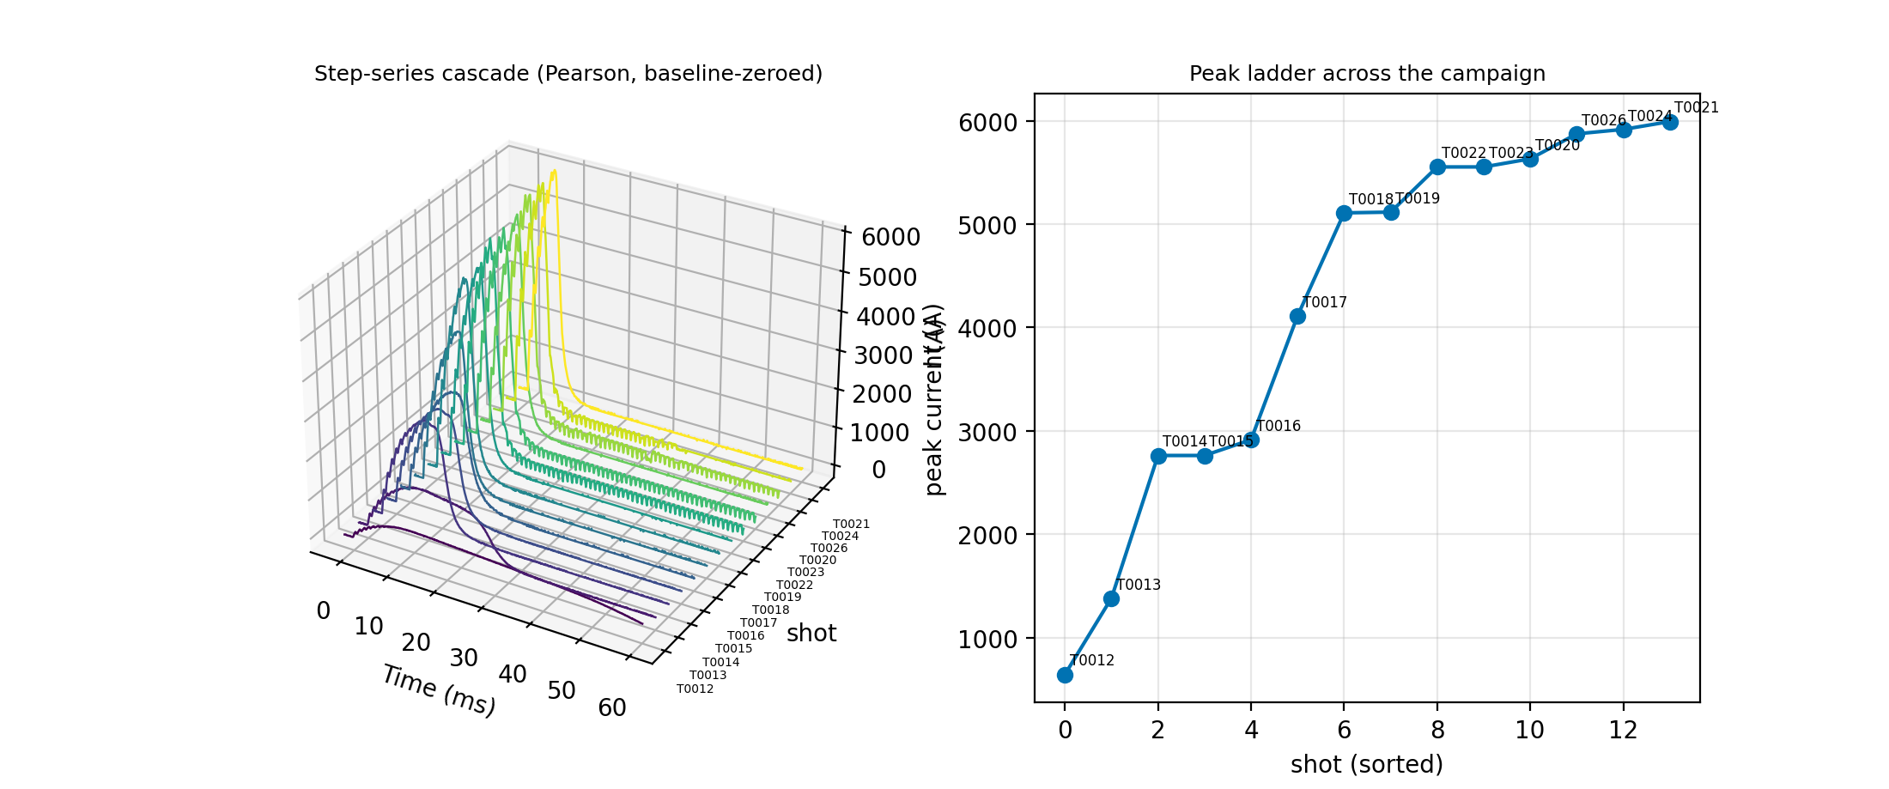
Real campaign: 14-shot step series, one view
Pearson current, baseline-zeroed, trigger-aligned; shots sorted by setpoint (646 A to 5 991 A). Constant discharge charge across the ladder validated the calibration.

Slide 4
Verified against ground truth
0.3%
0.6%
6.6 kA nameplate vs measured Pearson peak (6 620 A)
reconstructed peak error with the busbar saturated across the entire pulse top
0.3%
9/9 vs 0/9
max error of the 5-40 ms gap reconstruction, consistent with both sensors
model benchmark separates faithful readers from arithmetic guessers - why NumPy computes

Slide 5
Your data never leaves your machine
No cloud, no telemetry the only network call is to a local model server on localhost
Raw waveforms never reach the AI only derived statistics text; formula engine is AST-sandboxed
Every change logged a development log records what changed, why, and how it was verified
Next: charging-voltage waterfalls on the GPU renderer · batch shot journals · packaged app

