Slide 1
Tweets Analysis
Marion et Jeanne
M2 DS2E

Slide 2
DATASET DESCRIPTION
The dataset consists of tweets published by various newspapers that focus on the subject of 4th industrial revolution technologies (AI, Robot, VR, 5g, IoT). The dataset covers the period from 2007 to 2019.
⇒ 3000 tweets from 6 countries ( Spain , Italia, Germany, France, Netherland and England)
id: Unique identifier for each tweet
created at: Time at which the tweet was posted
text: The actual content of the tweet
author.id: Unique identifier for each user
public metrics.like count: Number of likes
public metrics.retweet count: Number of retweets
label: Country code ISO-2

Slide 3
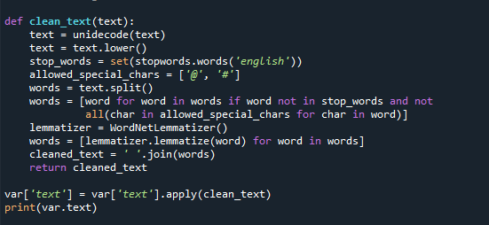
CLEANING

Slide 4
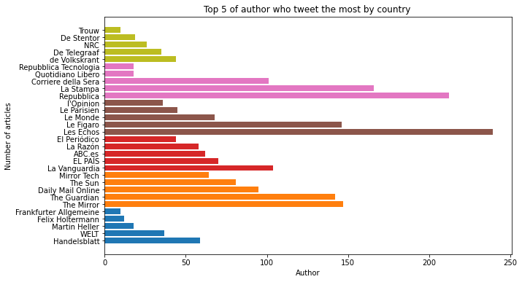
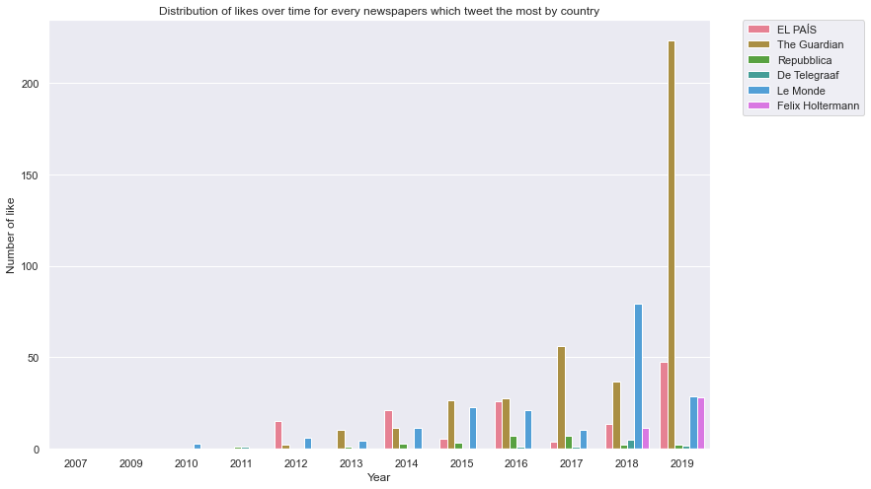
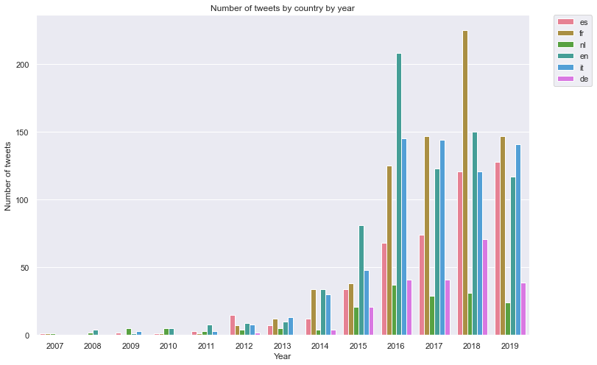
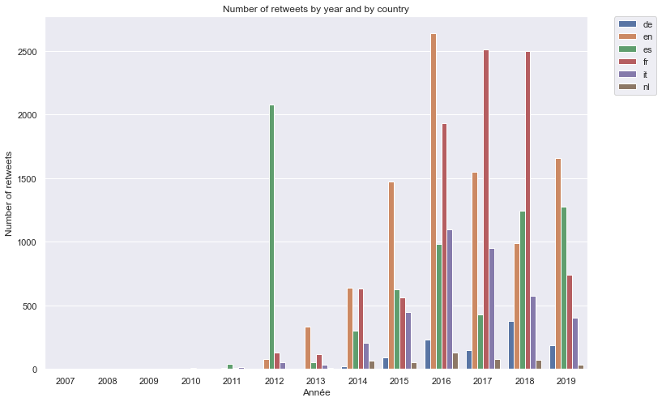
DATA EXPLORATION

Slide 5
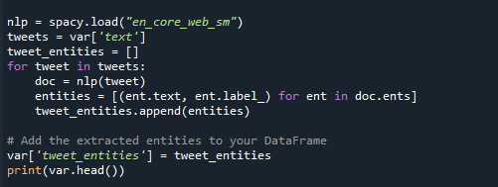
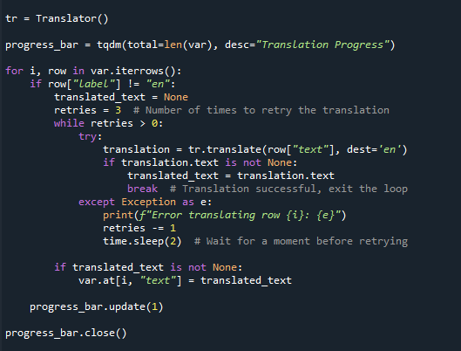
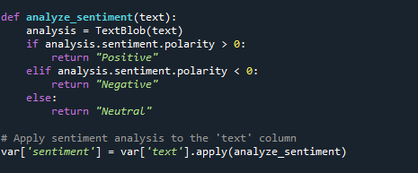
DATA ANALYSIS AND TRANSLATION

Slide 6
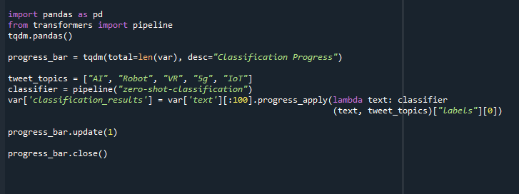
ZERO-SHOT CLASSIFICATION

Slide 7
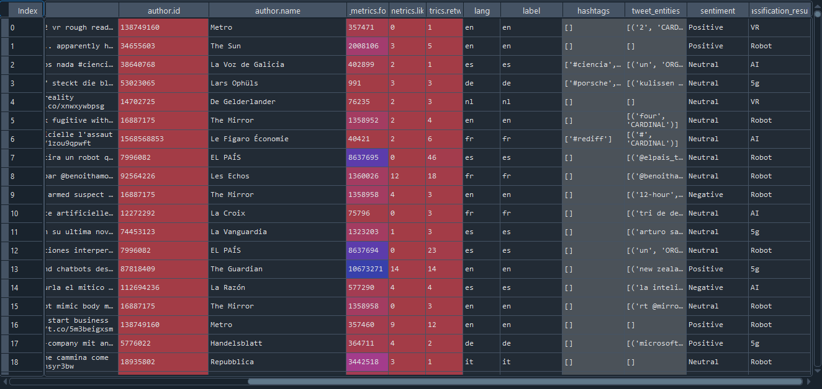

Slide 8
Thank you all for your attention !

