Slide 1
How to import Drias files!
par David Metivier

Slide 2


Slide 3
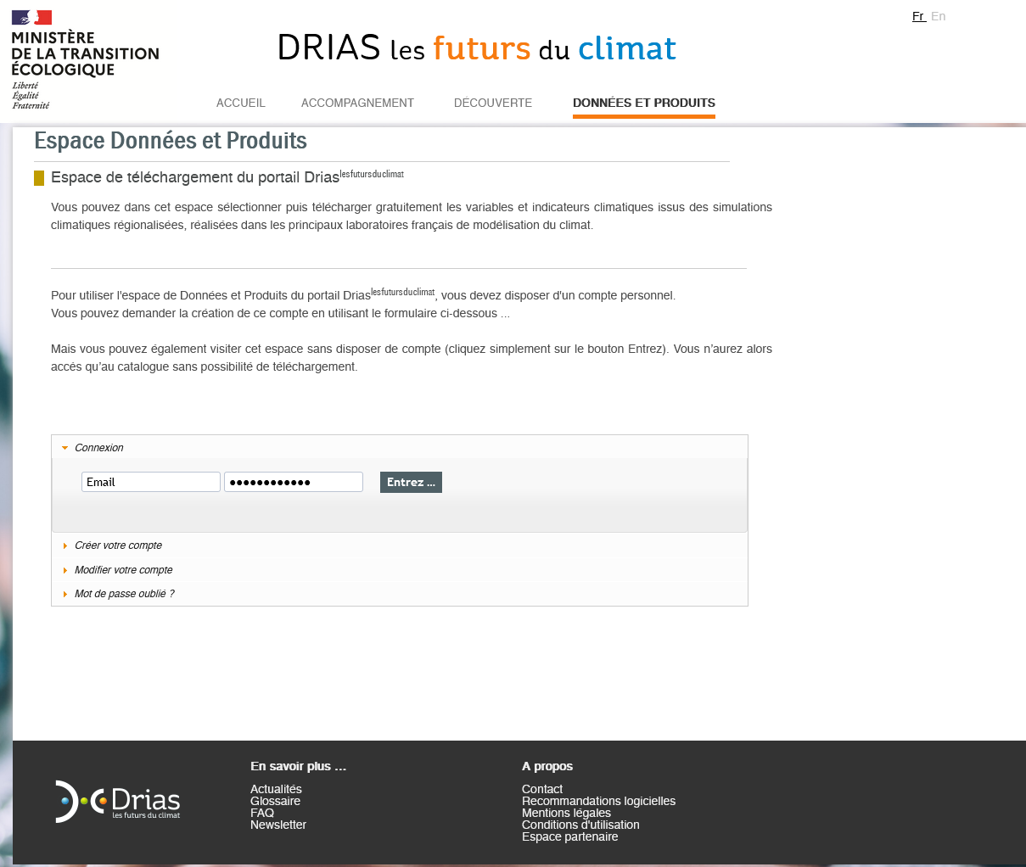
Create account with university email
Then login

Slide 4
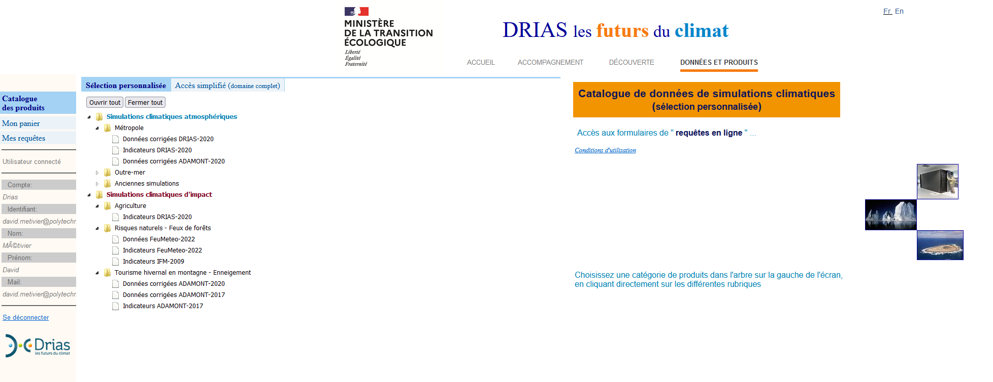

Slide 5
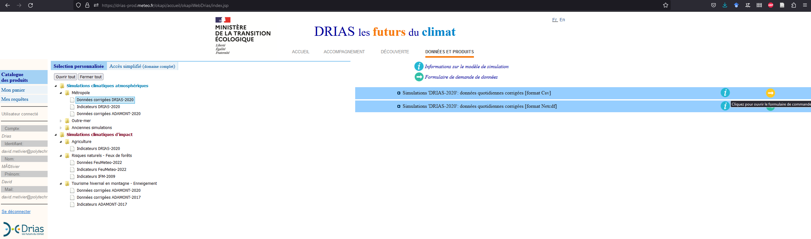

Slide 6
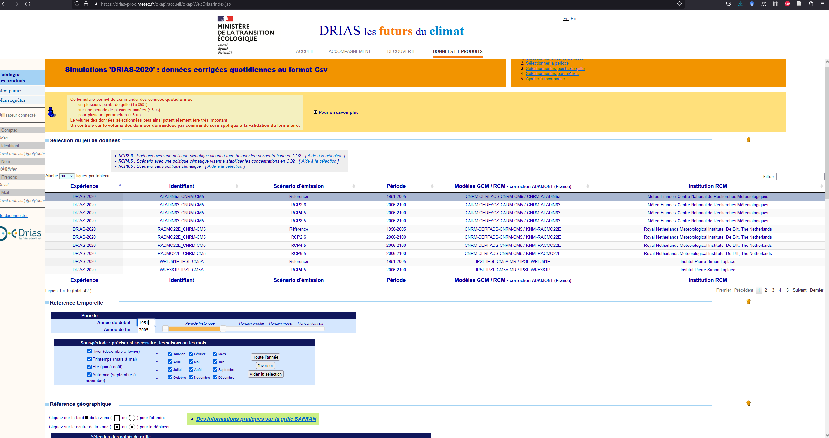
Aladin is MeteoFrance, compare it with another reference one ex: WRF…
Reference is over historical data
(if you have time, you can try different RCP)

Slide 7
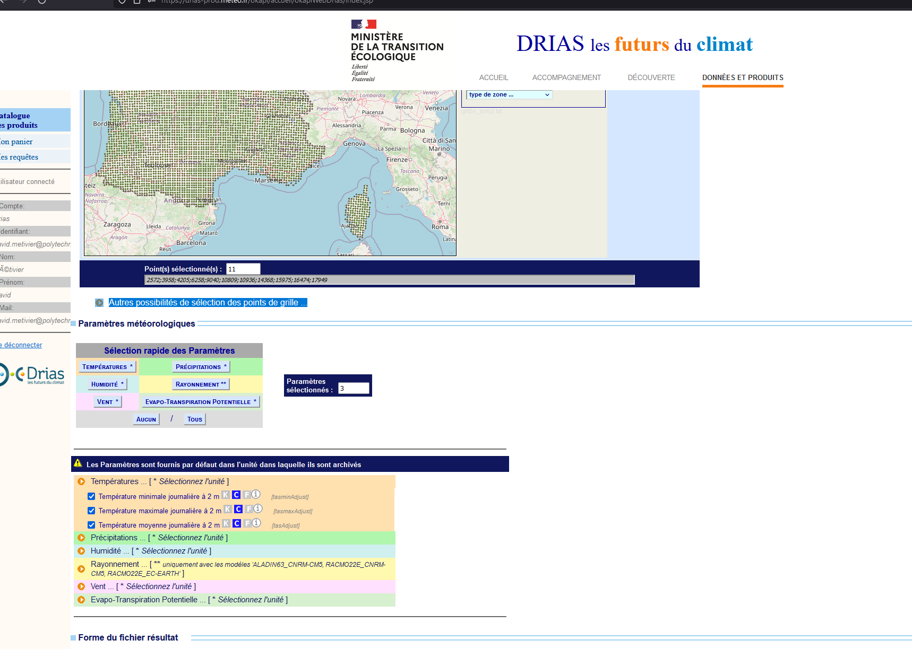

Slide 8
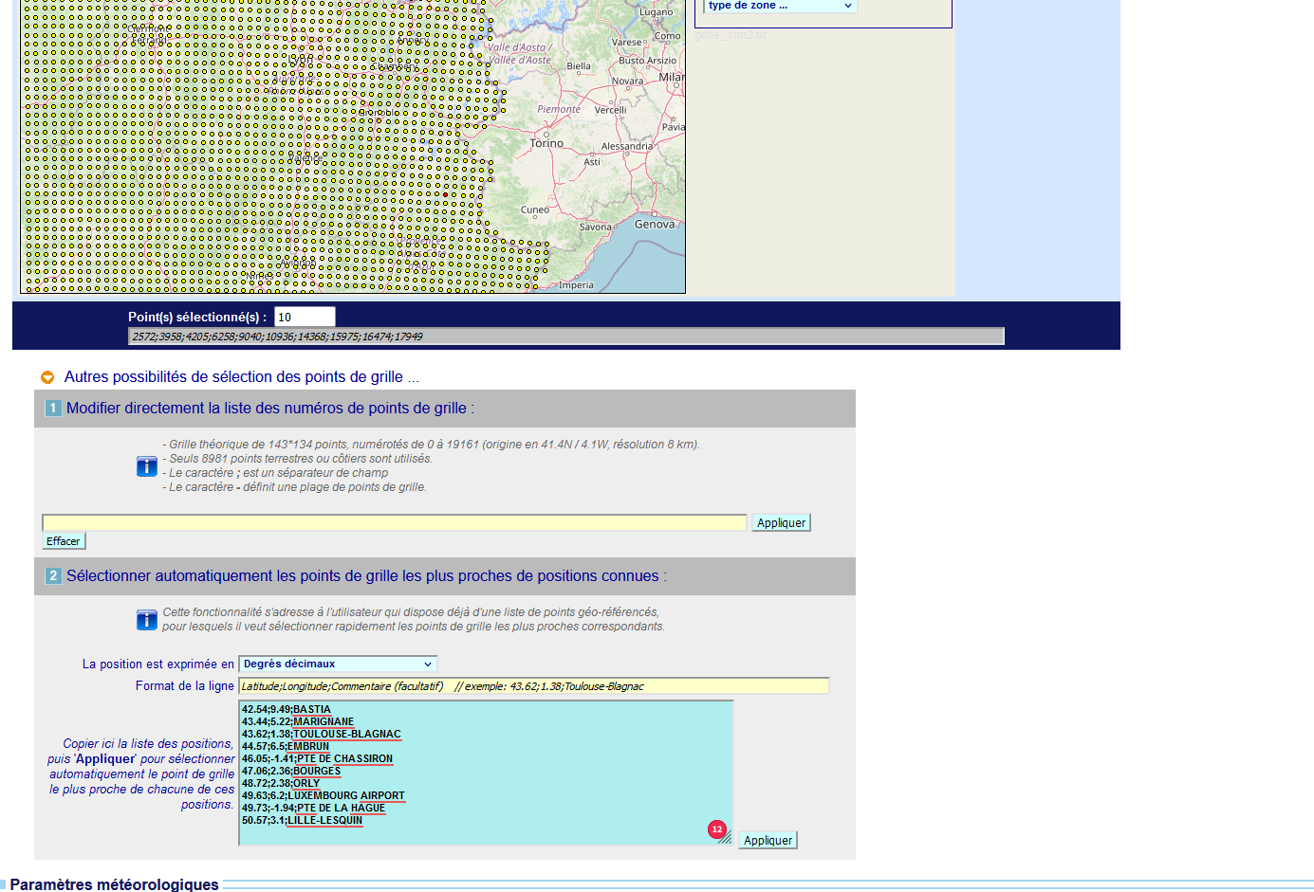
Add GPS of station you want then do apply

Slide 9
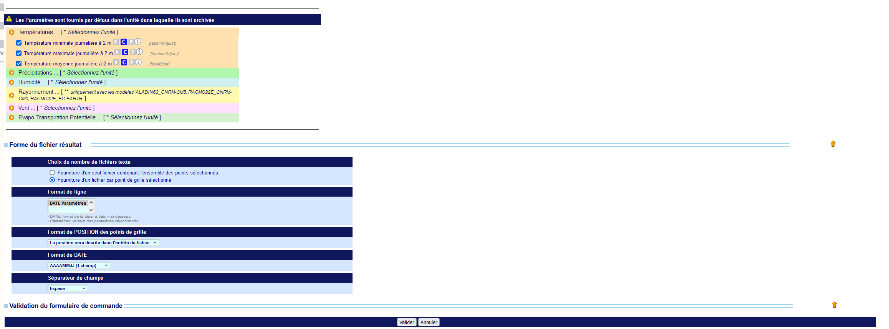
These settings are good I think
Then validate
You have to wait a bit before downloading on the next page

Slide 10
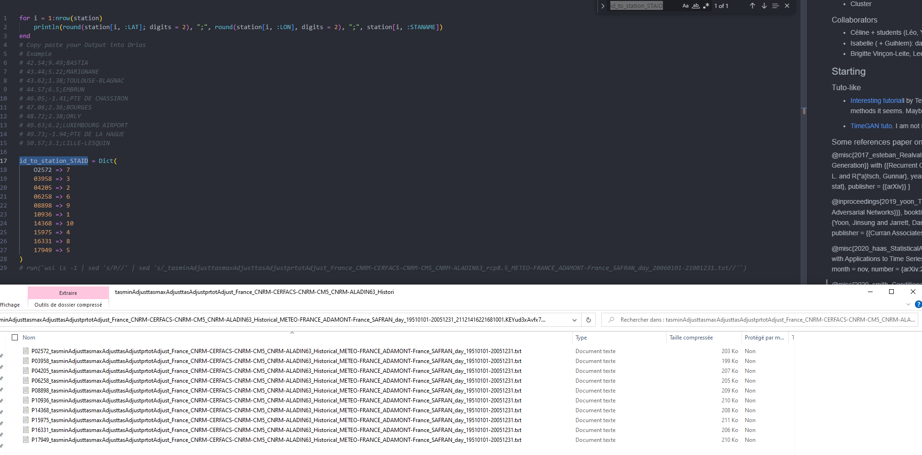
Files are given a id PXXXX. Here you need to match it to the STAID of the station you care about (kind of manually)

