Slide 1

MoMo
Your New Saving Tips
Developed by:
Jeannie Liu
Bonnie Ly

Slide 2

Contents
. Target audience
. Problem solved
. Comparison
. Demo
. Frameworks / Services
. Product design circle

Slide 3
Target audience
WHO?
WHY?

Slide 4
Problem solved!
But how?

Slide 5




Problem solved
Keep a record of past expense.
Keep a reminder for future payment.
A sense of emergency:
See how many days left for payment.
Get notified.
Better control from Macro & Micro perspective:
Monthly / weekly expenses.
Set budget.

Slide 6
Comparison
What is different?
What is similar?

Slide 7
Demo
Notes:
Features:
Add new record (choose a date in the calendar, the date in the record will match as well, but you can change it if you want)
We can add the amount, choose the category, choose the date and add note, of course you can make it blank so the record will be set to all default values
When leaving the record screen, the calendar in home screen will display the date we just added
Go out to check for notification (within 5 seconds after adding a record for tomorrow)
The footer will show the total amount of the records on that date
Edit record
Delete record (ask for confirmation)
The records are sorted by the most recently
The number of events will show the number of records (if > 3, just show 3)
The red event means it’s less than 3 days to pay
The future expense will have the countdown function (from today) to help users have a sense of emergency
The statistic page has budget, spent amount and daily average (explain each)
You can switch to weekly budget or monthly budget (explain each)
The progress will show how much you spend, whether it exceeds the limitation or the budget or not
It will change the colour accordingly
Explain the charts

Slide 8
Business model
Free Model

Slide 9
Frameworks & services

Slide 10
Firebase
. Synchronizes data between devices in real-time.
. Easy to save and retrieve data.
. Simple data query.
. No need to setup any server.
. Secure authentication.
. Create unique ID function.

Slide 11
FSCALENDAR
. Fully customizable calendar library.
. Many supports and related questions from others.
. Many useful and cool functions.
. Easy to use.

Slide 12
charts
. Fully customizable chart library.
. 8 different chart types.
. Scaling on both axes.
. Divide data to categories.
. Detail for single point.
. Multi-color decoration.

Slide 13
Product design circle

Slide 14


Brain storming
Discussion
Research on similar products
An expense record application
Notes:
We have made a research for many existing apps, discuss what they have and what they don’t have
Why:
Couldn’t keep and remind future pay,
No sense of emergency
No statistics for data

Slide 15
Functions

Slide 16
Functions
.Show records for expense list and to pay list.
.Show records by FSCalendar
. Add / Edit / Remove records
. Show days left for future expenses
. Notify the almost-due expenses
. Set weekly / monthly budget
. Visualize the spending
. Show spending data by charts

Slide 17
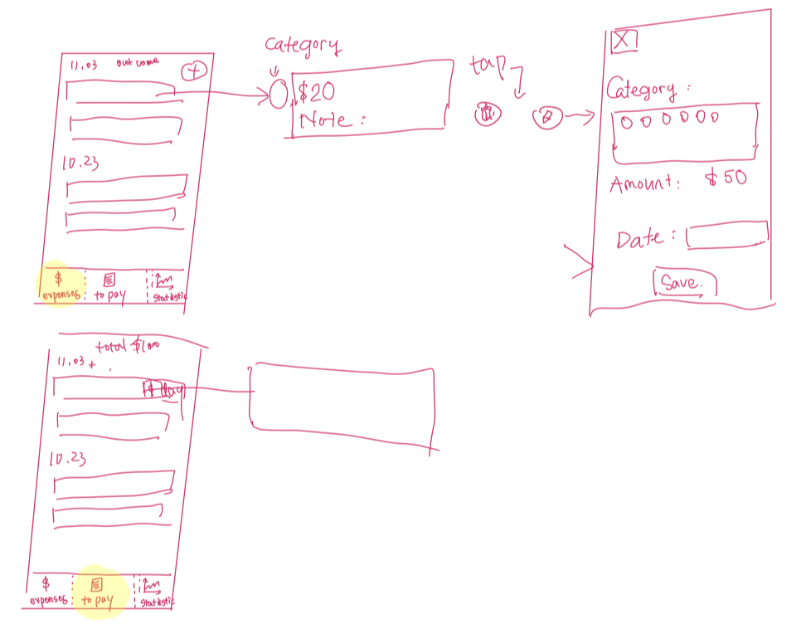
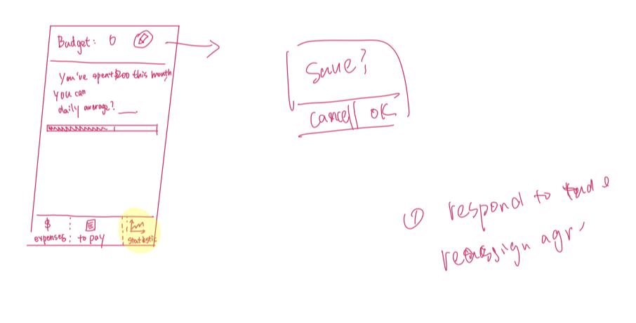
paper design

Slide 18
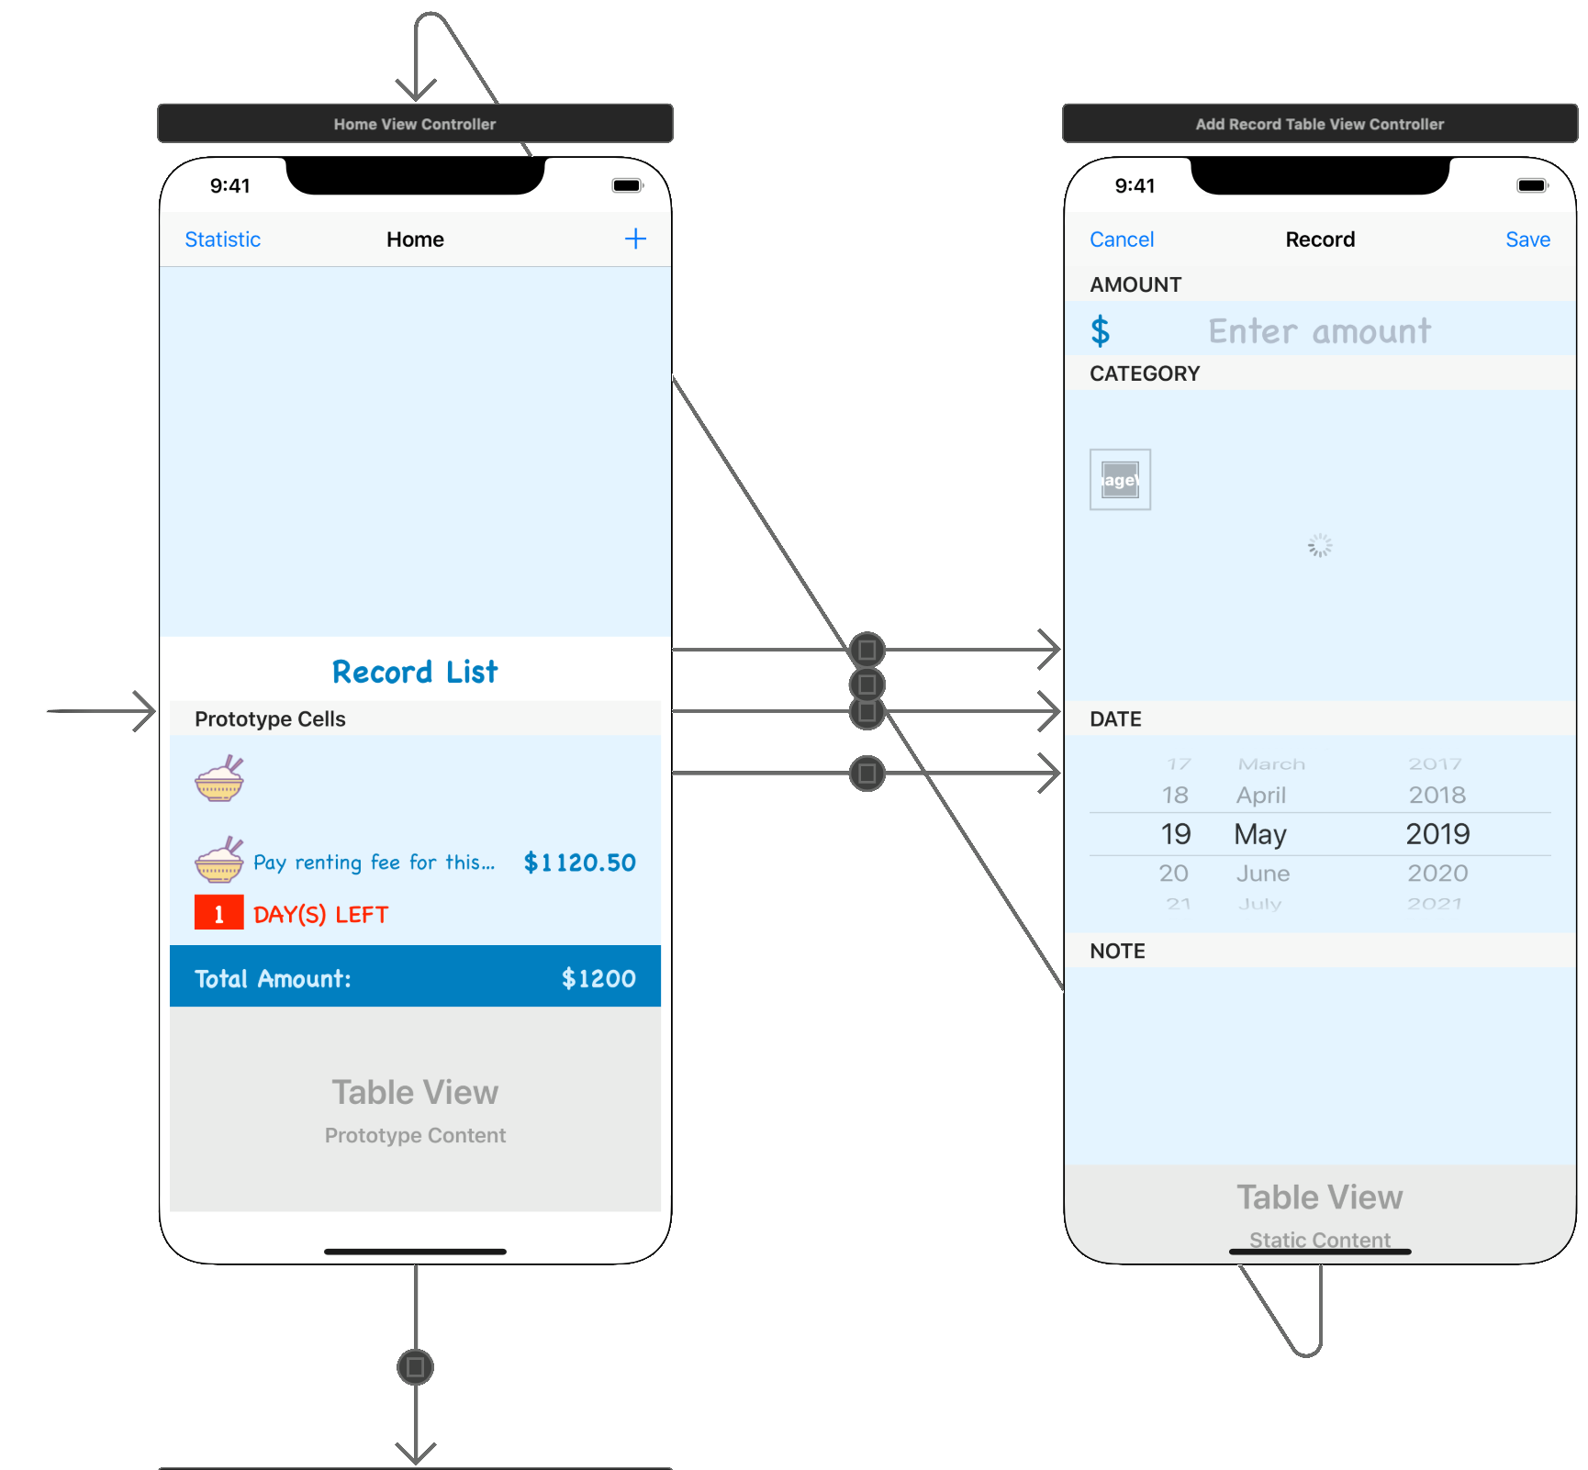
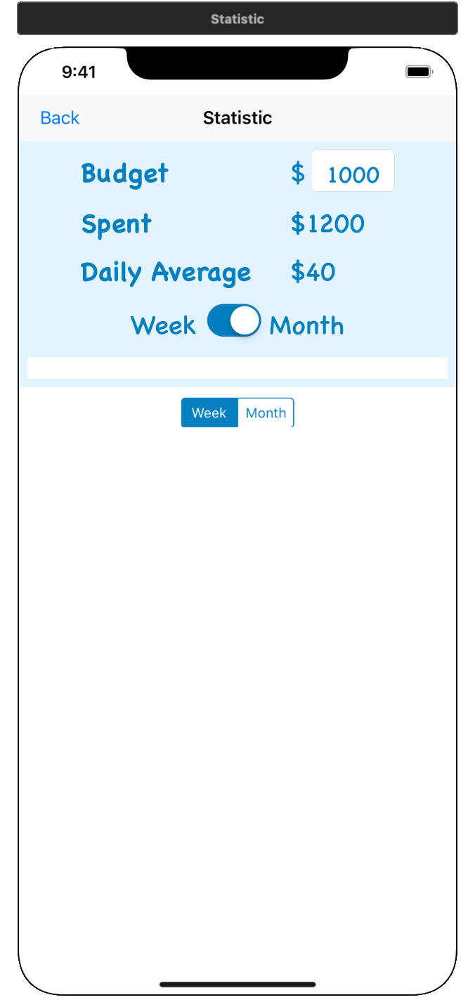
Storyboard design

Slide 19
Researches
How to:
display calendar
store and retrieve data
use the asynchronous data
send notification
show the statistic
visualize the spending

Slide 20
PROTOTYPE
. Make up the data
. Hard code the data
. Only non-functional views

Slide 21





Peer review
User is confused with the front page
Add footer for total amount of expenses
Confused with days, should be like "N days left"
Don't know the swipe-to-delete function
Graph should show a budget line
Notes:
Here I would like to thank Miga from another team for offering some very constructive opinions on the prototype. So that we could make improvement in our app.

Slide 22
Testing
Coding style:
. Make the function as short as possible
. Keep consistence
. Descriptive comments and variable names
. No hard-coded string
. Naming convention (Camel case, Pascal case)
Notes:
Why:
Couldn’t keep and remind future pay,
No sense of emergency
No statistics for data

Slide 23
Testing
Functionality and Look:
. Popup for expense details
. Limitation line in the charts
Notes:
Why:
Couldn’t keep and remind future pay,
No sense of emergency
No statistics for data

Slide 24
Testing
. Coding style
. Functionality and appearance
Notes:
Why:
Couldn’t keep and remind future pay,
No sense of emergency
No statistics for data

Slide 25
Question
&
answer

Slide 26
Thanks for listening!

