Slide 1
Date-a-Scientist
MACHINE LEARNING FUNDAMENTALS
JEAN PAOLO SAUL
2018-NOV-15
CODECADEMY

Slide 2
Table of Contents
Exploration of the Dataset
  Zodiac sign distribution
  Offspring/No-offspring distribution
Questions to Answer
Augmenting the Dataset
Regression Approaches
Classification Approaches
Conclusions/Next steps
CODECADEMY

Slide 3
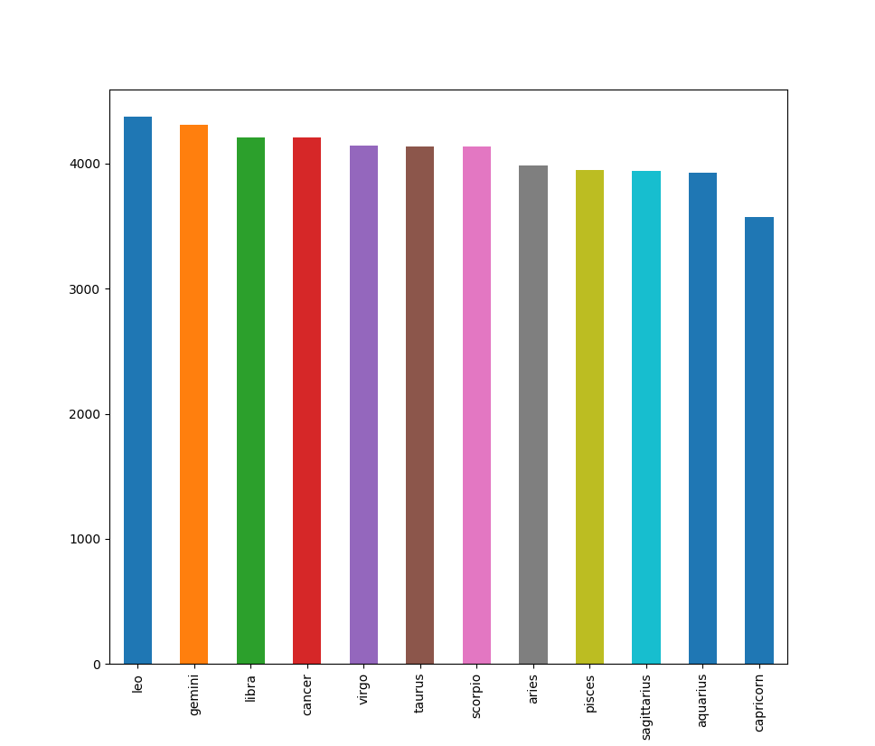
Exploring The Dataset
Zodiac Sign Histogram
  Signs look well distributed
  Had to remove NaNs

Slide 4
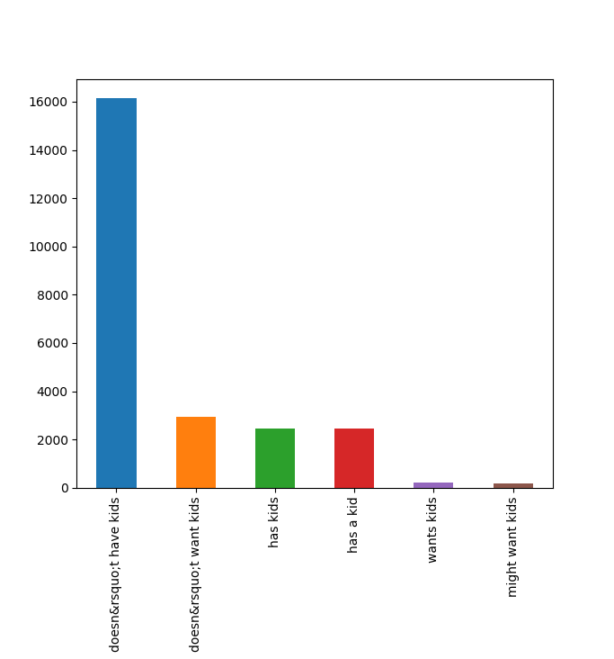
Exploring The Dataset
Offspring Histogram
  Highly skewed to individuals who do not have children
  Had to remove NaNs

Slide 5
Questions to Answer
Can we determine the income of an individual using their essay length, height, and/or ethnicity?
Can we determine the gender of an individual using the words of all their essays?
CODECADEMY

Slide 6
Augmenting the Dataset
We followed the guide to add a column for all concatenated essays
  We replaced NaNs with blanks
  We joined essays with a space
  We kept the letter case
We added an extra column for essay length
We simplified ethnicity into its first split by comma, and converted the values to numeric
We normalized our numeric data to control distribute their weights
CODECADEMY

Slide 7
Regression: Income through ???
Features to use
  Essay length - NaNs removed, normalized
  Height - NaNs removed, normalized
  Ethinicity - mapped to numeric codes, NaNs removed
Using multiple linear regression
  All of the features together returned < 1% accuracy, disappointing
Using simple linear regression
  All of the features individually returned < 1% accuracy, disappointing
CODECADEMY

Slide 8
Regression: Income through ???
All of the features returned < 1% accuracy
  Double checked by replacing the feature to “income” and the result was 100%
  It looks like we cannot correlate height, essay lengths, or ethnicity to income
  Ethnicity is likely a bad feature for regression since its not continuous but categorical
CODECADEMY

Slide 9
Classification: Gender via essays
Features to use
  Concatenated essays, Nans removed
Using Naïve-Bayes (n-gram range = (1,1))
  80% accuracy
  Training time around 1min
Using Support Vector Classifier (rbf, gamma = 0.1)
  74% accuracy
  Training time around 6 mins
Both used word counts and ease of setup was the same. Several ranges, gammas and C parameters where used and those shown above got the highest scores

Slide 10
Classification: Gender via essays
Accuracy, precision and recall
  Naïve-Bayes was more accurate than SVM at 80% versus 74%, and much faster at training, when trying to determine the gender from essays
  Precision, recall, and F1 score all had the same identical values for both classifications
counter = CountVectorizer()
counter.fit(df.all_essays)
X_train, X_test, y_train, y_test = train_test_split(df.all_essays, df.sex)
train_counts = counter.transform(X_train)
test_counts = counter.transform(X_test)
classifier = SVC(kernel = 'rbf', gamma = 0.1)
classifier.fit(train_counts, y_train)
predict_test = classifier.predict(test_counts)
print(classifier.score(test_counts, y_test))
print(accuracy_score(predict_test, y_test))
print(recall_score(predict_test, y_test, average=‘micro’))
print(precision_score(predict_test, y_test, average=‘micro’))
print(f1_score(predict_test, y_test, average=‘micro’))

Slide 11
Conclusions and Next Steps
We can predict gender by a person’s essay with 80% accuracy
Of the three features we tried: height, essay length, ethnicity; none were able to predict income via regression
There are not a lot of features we can use that are continuous, as a final test, we used age, and its accuracy was also bad
Sklearn’s machine learning tools are quite standardized and easy to use
CODECADEMY

