Slide 1
Syracuse University School of Information Studies Master of Science Applied Data Science
Portfolio Milestone| Jean Paul Uwimana|518472486|March 14, 2021
https://github.com/jeanpauluwimana/MSADS_Portfolio

Slide 2
Introduction
The Applied Data Science program at Syracuse University provides students with an in-depth understanding of the key technologies in data and business analytics: data collection, data mining, machine learning, visualization techniques, predictive analytics, and statistics.
The program supplies students with the technical skills to practice problem analysis and decision-making abilities to begin leading data-driven solutions in organizations across industries upon graduation

Slide 3
DS Program Learning Objectives
Describe a broad overview of the major practice areas in data science
Collect and organize data
Identify patterns in data via visualization, statistical analysis, and data mining
Develop alternative strategies based on the data
Develop a plan of action to implement the business decisions derived from the analyses.
Demonstrate communication skills regarding data and its analysis for relevant professionals in their organization.
Synthesize the ethical dimension of data science practice

Slide 4
Program Highlights
IST 659: Data Administration Concepts and Database Management
IST 719: Information Visualization
IST 772: Quantitative Reasoning
IST 707: Data Analytics
IST 736: Text Mining

Slide 5



IST 659: Data Administration Concepts and Database Mgmt.
Task Management Database

Slide 6
IST 659: Data Administration Concept and Database Mgmt.
Task Management Database application designed to collect and store information to answer various questions such as the following:
What’s the task status?
Not started
In-progress
Completed
How many tasks completed on any given day?
Which tasks aren’t assigned to an analyst?
Who is working what?

Slide 7
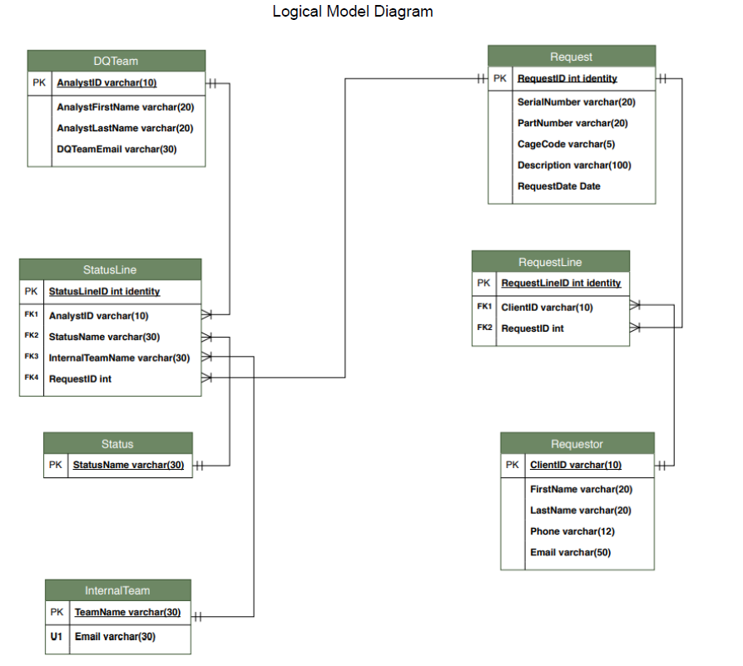
IST 659: Data Administration Concepts and Database Mgmt. Logical Model

Slide 8
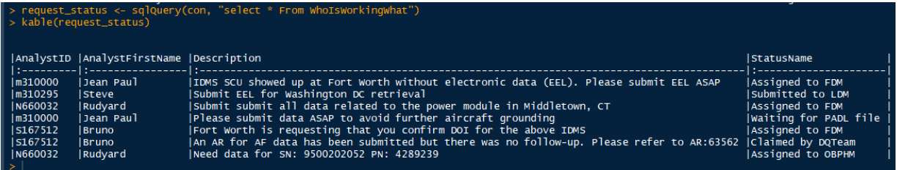
IST 659: Data Administration Concepts and Database Mgmt. Reporting and UI

Slide 9

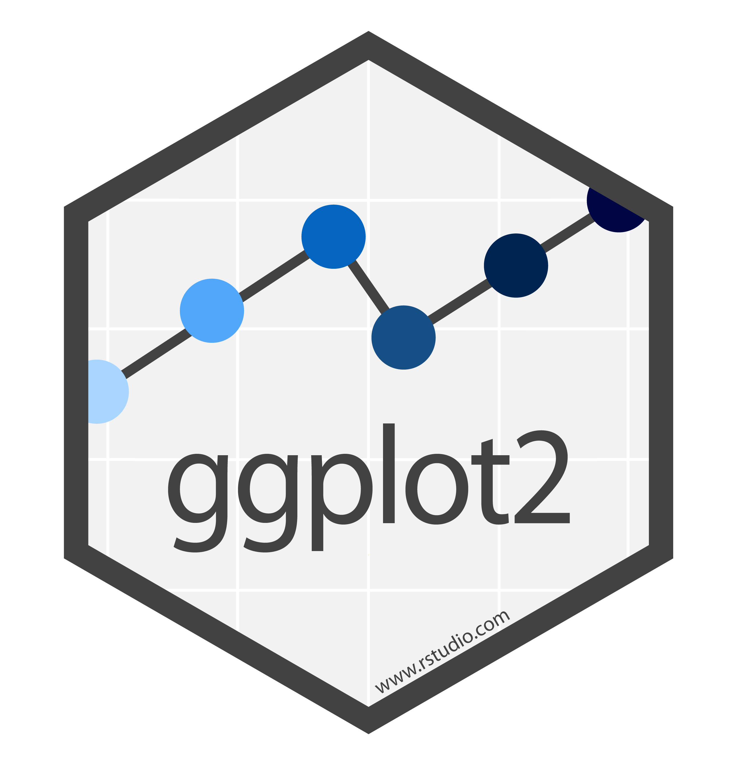
IST 719: Information Visualization
Poster

Slide 10
IST 719: Information Visualization Introduction
Data acquisition, analysis, visualization and presentation of information through various techniques.
Collected US demographics data
Computed diversity score and explored relationships between income and diversity
Explored states with the highest percentage of Native American population
Explored Poverty Rate across all 50 states

Slide 11
IST 719: Information Visualization Analysis
Observed data from all 50 states showed that richest states tend to be more diverse. No linear relationship between diversity and income, however
Observed data showed the top 5 culturally diverse states: HI, CA, NV, TX, MD
States with highest percentage of Native American population: AK, SD, NM, MT, OK

Slide 12
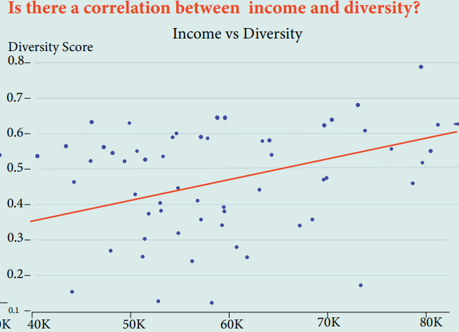
IST 719: Information Visualization Visualization

Slide 13
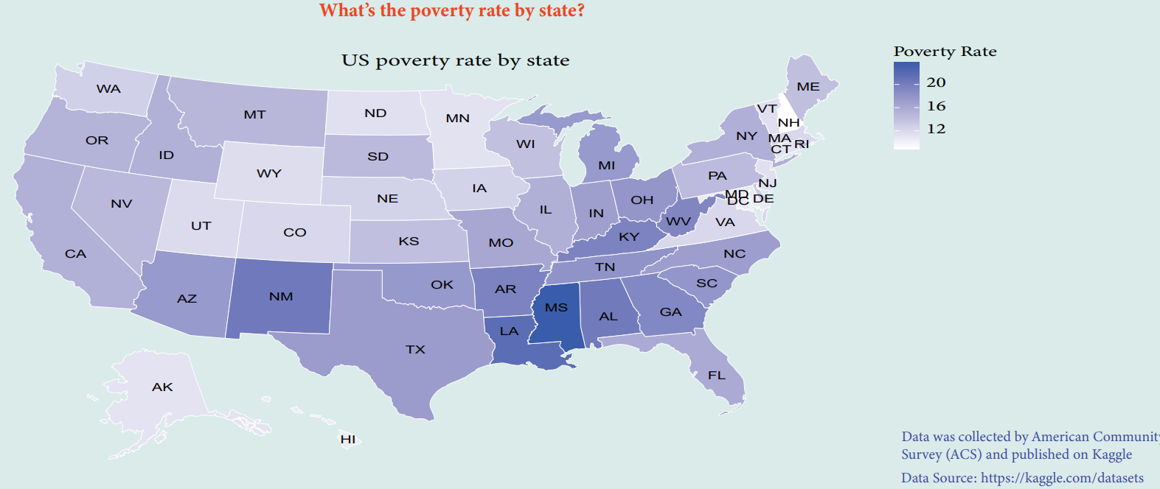
IST 719: Information Visualization Visualization – contd

Slide 14
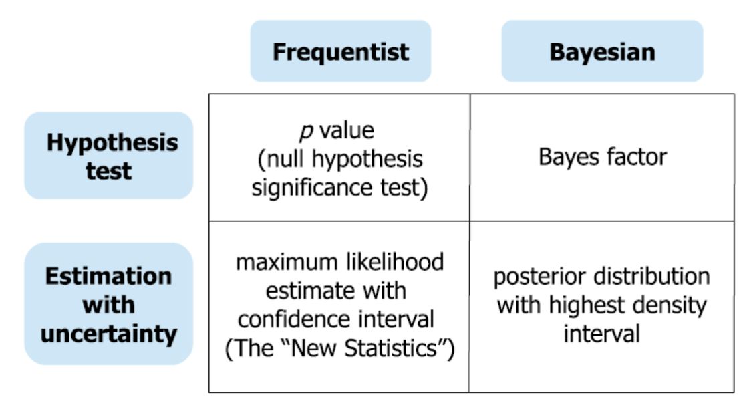
IST 772: Quantitative Reasoning
Vaccination Volatility Rate
Hep-B
Measles
Polio
DTP1
Influenza

Slide 15
IST 772: Quantitative Reasoning
Explore the vaccination volatility rates in the US between 1980 and 2017 for the five most common vaccines: Hep-B, Measles, Polio, DTP1, Influenza
Bayesian vs frequentist methods to answer questions such as:
Whether there’s a credible difference in vaccination reporting proportions between private and public schools
Whether CA’s vaccination rates were better than US’
Which variables could predict the percentage of enrolled students with up-to-date vaccination

Slide 16
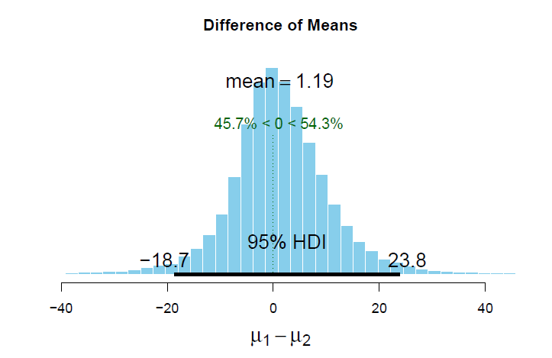
IST 772: Quantitative Reasoning Findings using Bayesian method
California vs US vaccination rates
No credible difference in means in vaccination rates for California and the US

Slide 17
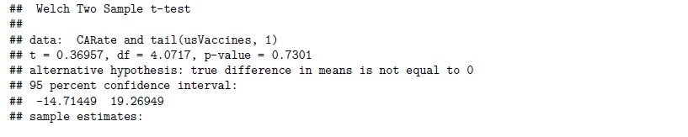
IST 772: Quantitative Reasoning Findings using Frequentist method
California vs US vaccination rates
No credible difference in means in vaccination rates for California and the US was observed

Slide 18
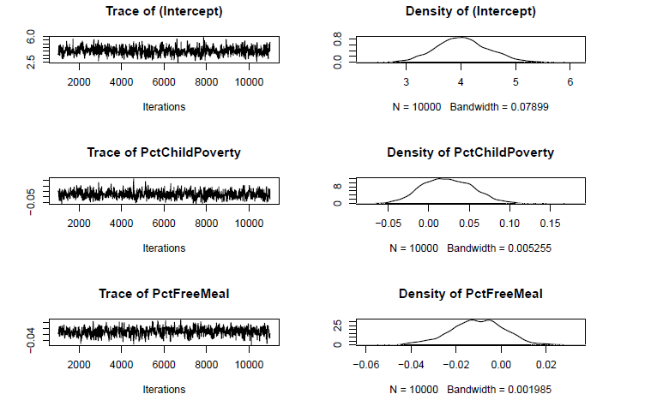
IST 772: Quantitative Reasoning Findings of predictive variables for reporting completion
Significant variables:
PctChildPoverty
PctFreeMeal
PctFamilyPoverty
Enrolled
TotalSchools

Slide 19
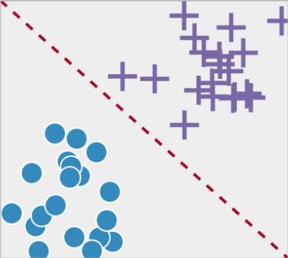

IST 707: Data Analytics
Heart Disease Classification

Slide 20
IST 707: Data Analytics
Dataset from Kaggle: 13 features + dependent variable
Final project leveraged supervised machine learning technique to predict the presence or absence of heart disease in a patient
Naïve Bayes, Weka’s J48, Random Forest, and SVM

Slide 21
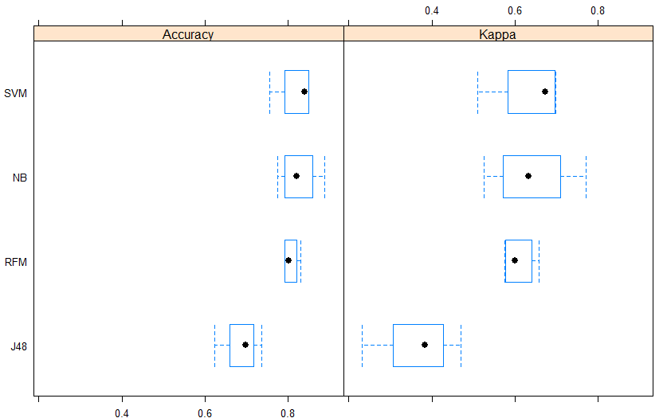
IST 707: Data Analytics Model Performance Evaluation
Model Performance Comparison
SVM: accuracy 85%, Kappa: 70%
70% Kappa score is considered substantial agreement among the raters according to National Library of Medicine¹
Weka’s J48 performed worst – accuracy: 70%, Kappa: below 40%
¹https://bit.ly/3q5Saps

Slide 22

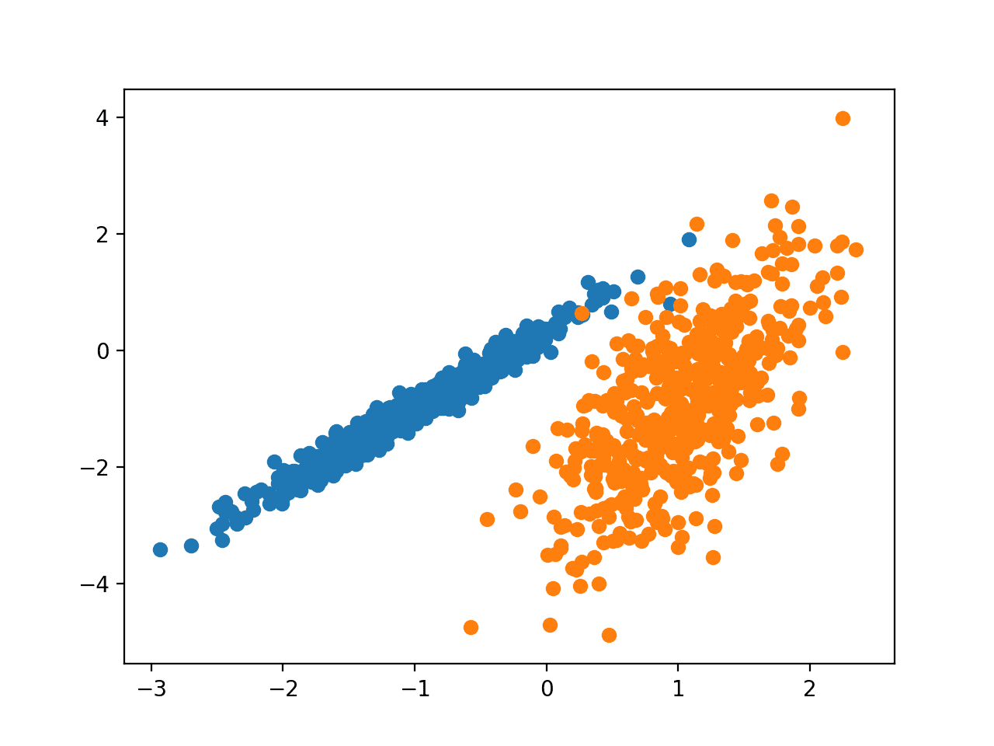

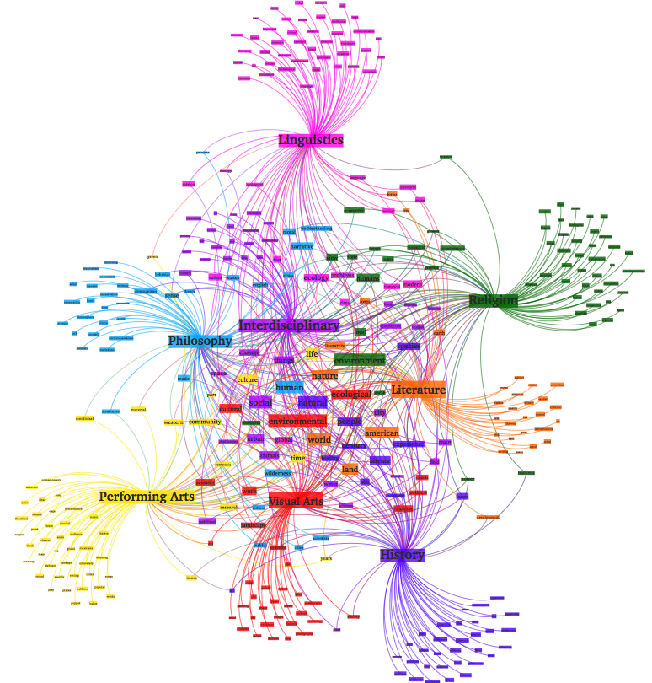
IST 736: Text Mining
Predicting presidential candidate party affiliation, ultimate success, and Topic Modeling

Slide 23
IST 736: Text Mining
Unstructured data for knowledge discovery
Classification
Clustering
Topic Modeling
Final project employed all the above techniques and consisted of analyzing presidential candidate’s nomination Acceptance Speech to identify:
Candidate party affiliation based on their speech
Whether their campaign ultimately succeeded
Which topics can be derived from the speech

Slide 24
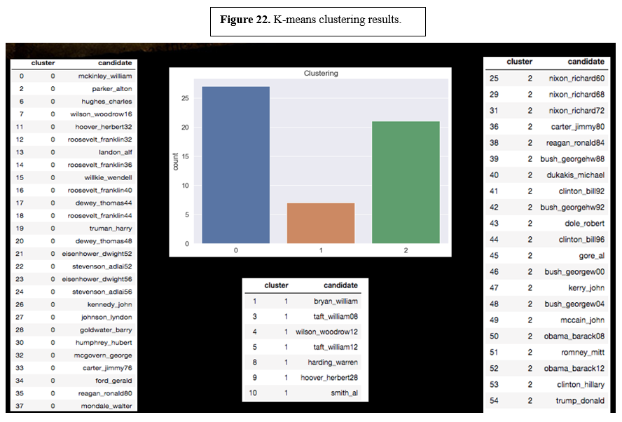
IST 736: Text Mining Model results
K-means clustering results
3 clusters were identified
Results showed that speech clustering was more dependent on temporal factors than political affiliation, winners and losers and economic status

Slide 25
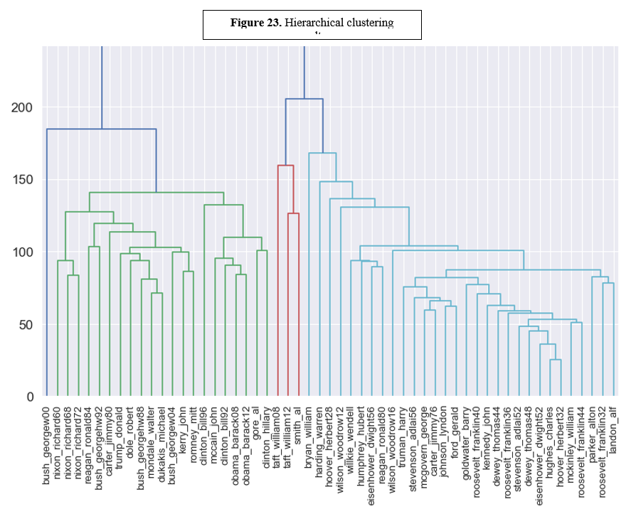
IST 736: Text Mining Model results
Hierarchical Clustering results
4 clusters were identified
4th cluster only contains one presidential candidate
Again, results showed that speech clustering was more dependent on temporal factors than political affiliation, winners and losers and economic status

Slide 26
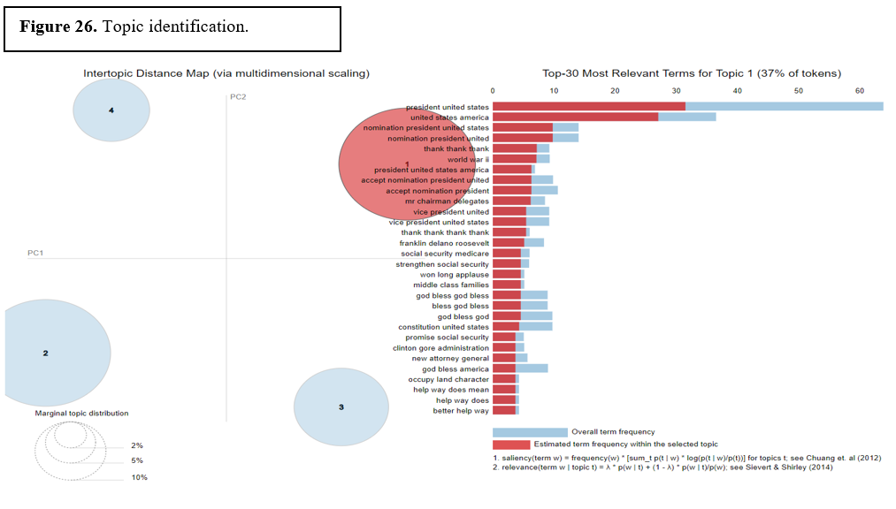
IST 736: Text Mining Model results
Latent Dirichlet Allocation (LDA)
Topic Modeling results
Unable to draw distinct topics due to nature of the corpus. Different nominees may touch on different topics in the same sentence and different keywords and phrases may be used repeatedly

Slide 27
Learning Objectives
Data Science can be applied in banking, healthcare, IT, marketing, etc.
Data was collected and organized in database in support of decision making
Patterns in data were identified in the Information Visualization project, statistical analysis and data mining were performed in Quantitative Reasoning and Data Analytics
Via Frequentist vs Bayesian, alternative strategies were developed in light of new data and a plan of action to implement business decisions based on the analysis from the data
Throughout the program, multiple assignments and projects were performed which provided solid foundation in communication skills
Care was exercised while collecting data to ensure no sensitive information was revealed, as well as compliance with rules governing data collection as implemented by data providers such API data rate limits

Slide 28
Conclusion
The Syracuse University’s School of Information Studies enables students to successfully complete the learning objectives outlined in the program
By providing opportunities to gather, pre-process, analyze, explore, mine, and visualize data leveraging different data analytics techniques such as regression, classification, clustering, topic modeling, and statistical modeling
The program enables students to develop a multifaceted approach for how to tackle a wide range of data analytics challenges and draw sensible conclusions from both structured and unstructured data and communicate results to various stakeholders in an organization

Slide 29
THANK YOU

