Slide 1
Heart Diseases in patients
Author: Jean Paul Uwimana
IST-707 Final Project
Notes:
13 clinical measurements collected by healthcare providers that can be used to predict the presence or absence of heart disease in patients

Slide 2
Problem Statement
Our heart is a very important organ for our body
Pumps blood throughout the body and several other functions
Sometimes getting properly diagnosed can take a while
May be also be expensive due to visiting more than one doctor to get a second opinion
Notes:
With that in mind, we can’t let our heart fail

Slide 3
Goal
Build a ML classifier that can help healthcare professionals detect the presence or absence of heart disease in patients given a number of parameters: clinical measurements such as blood sugar levels, chest pain, etc

Slide 4
Problem type: Binary Classification
Dataset description:
13 clinical measurements and tests plus target variable (303 observations)
Age (age)
Sex (sex)
Chest pain (cp)
Serum cholesterol (chol)
Fasting blood sugar (fbs)
Resting electrocardiographic results (restecg)
Maximum heart rate (thalach)
Notes:
Resting ECG: non-invasive test that can detect abnormalities including arrhythmias, evidence of coronary heart disease

Slide 5
Dataset description (continued)
Exercise induced angina (exang)
ST depression induced by exercise relative to rest (oldpeak)
slope of the peak exercise ST segment (slope)
number of major vessels colored by flouroscopy (ca)
thallium stress test (thal)
Notes:
Exercise induced angina: Angina is chest pain or discomfort caused when your heart muscle doesn't get enough oxygen-rich blood
ST depression induced by exercise relative to rest: impeding heart blockage
number of major vessels colored by flourosopy: Visualizing all patient’s major vessels
Thallium stress test: that shows how well blood flows into your heart while you're exercising or at rest

Slide 6
Algorithms
Support Vector Machine (SVM)
Naïve Bayes
RWeka - DT

Slide 7
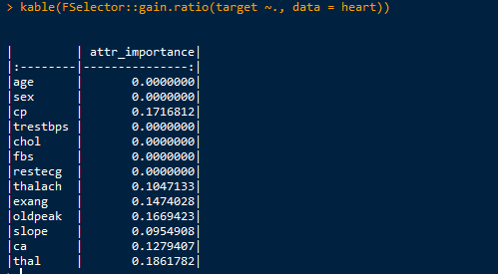
Information Gain

Slide 8
Significant variables
Chest pain (cp)
Maximum heart rate (thalach)
Exercise induced angina (exang)
ST depression induced by exercise relative to rest (oldpeak)
slope of the peak exercise ST segment (slope)
Number of major vessels colored (ca)
Thallium stress test (thal)

Slide 9
Prediction Performance
Notes:
Train: 70 % = 202 observations
Test: 30% = 91 observations

Slide 10
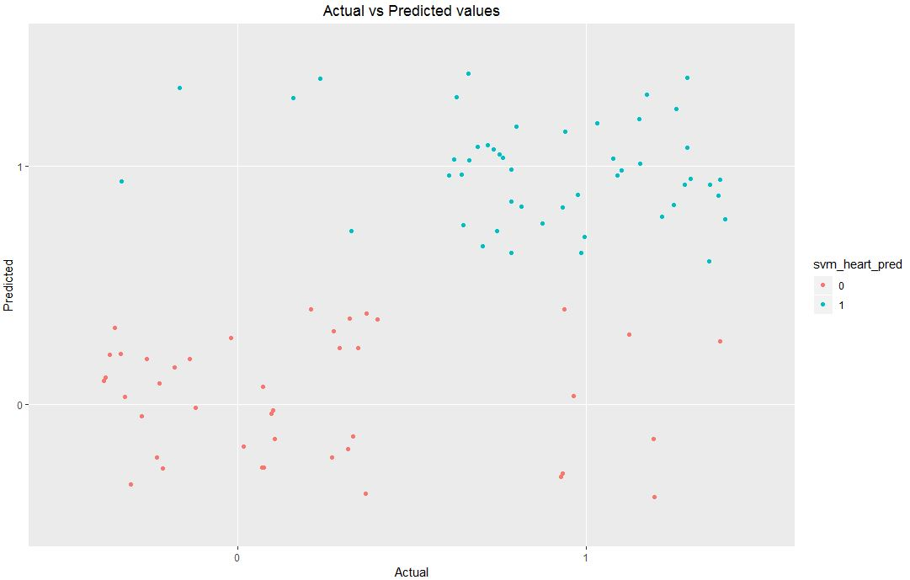
Visualization

Slide 11
Conclusion
Strongest predictors:
Thallium stress test (thal)
Chest pain (cp)
Number of major vessels (ca)
But these 3 alone only achieve an accuracy of 70%
Model composed of 7 predictors produced better results (85%, 86%, 77%) for SVM, NB, RWeka

