Slide 1
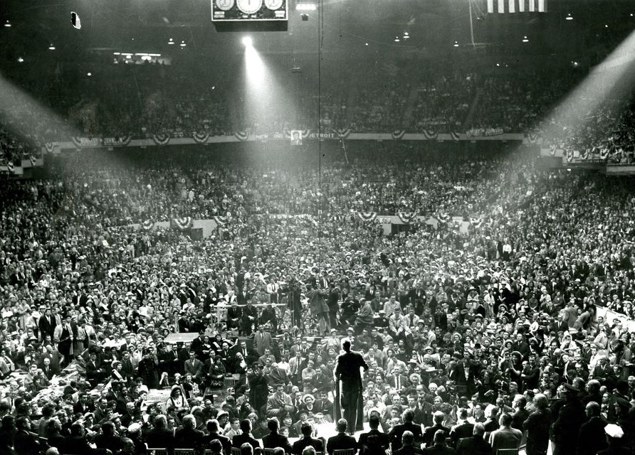
“I accept your nomination…”
Applying text mining and machine learning to
party nomination acceptance speeches
1900 to 2016
IST 736: Text Mining
Final Project
Connor Gendron Jeremiah Graff
Jean Paul Uwimana
David Yamin

Slide 2
Background

Slide 3
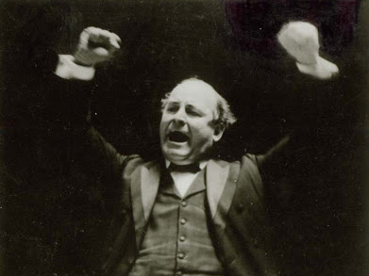
Convention Hall Spellbinder
William Jennings Bryan (D – Nebraska)
Democratic nominee in 1896, 1900 and 1908

Slide 4
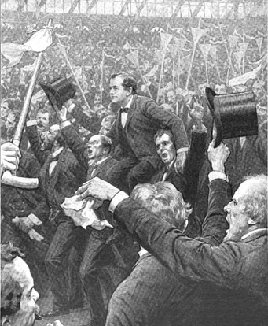
Crowd carries Bryan out of convention hall on their shoulders after 1896 speech.

Slide 5
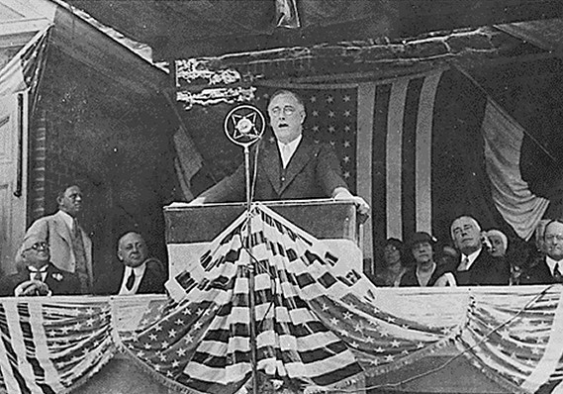
Master of the Radio Address
Franklin Delano Roosevelt (D-New York)
Democratic nominee in ‘32, ’36, ‘40 and ‘44

Slide 6
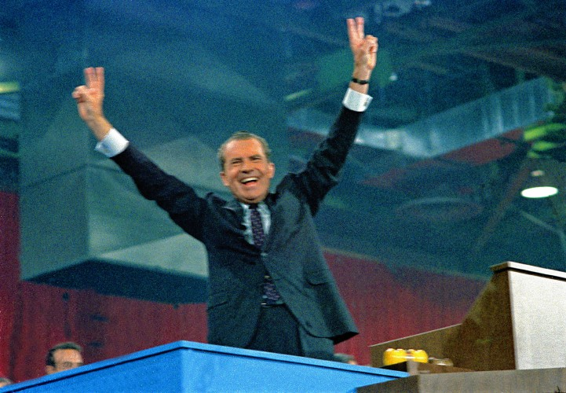
Golden Age of Televised Conventions
Richard Nixon (R-California)
Republican nominee in ‘60, ’68 and ‘72

Slide 7
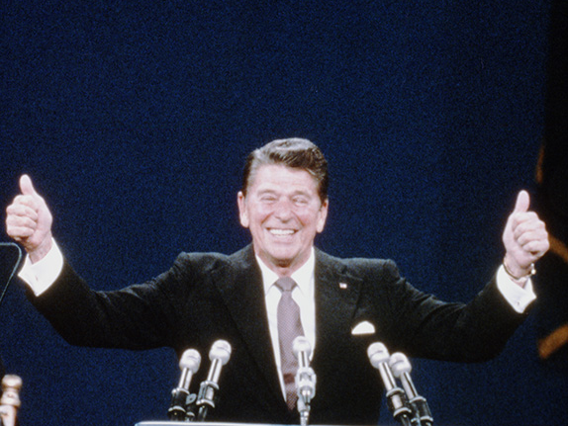
Master of the Televised Address
Ronald Reagan (R-California)
Republican nominee in ‘80 and ‘84

Slide 8
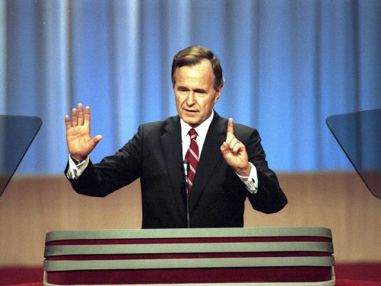
“Read my lips…”
George H.W. Bush (R-Texas)
Republican nominee in ‘88 and ‘92

Slide 9
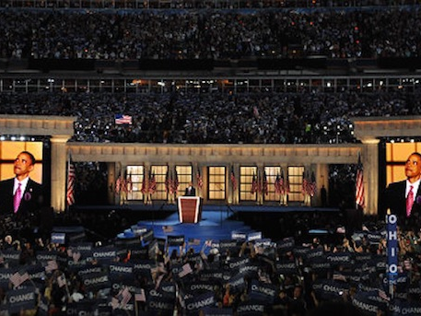
Return of Oratorical Charisma
Barack Obama (D-Illinois)
Democratic nominee in ‘08 and ‘12

Slide 10
Corpus

Slide 11
Convention Speeches
Full text: 55 of the 60 convention speeches from 1900 to 2016
Missing 5 from the early-1900s and 1920s

Slide 12
Prediction Categories
Win or lose?
Party
Unemployment rate
GDP growth
Interest rates
Inflation
Consumer Confidence Index
Consumer Price Index
Dow volume
Presidential approval
Tax rate change
Real income growth
Incumbency?
Sentiment

Slide 13
Naïve Bayes

Slide 14
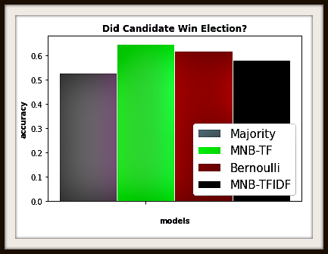
Predict Election Winner
All NB Models Beat Majority Rule

Slide 15
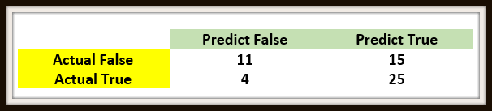
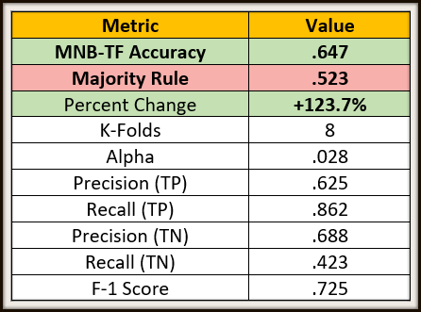
Metrics: MNB-TF
Confusion Matrix
Other Metrics

Slide 16

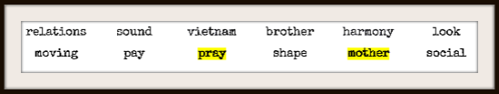
Most likely words…
Losers
Winners

Slide 17
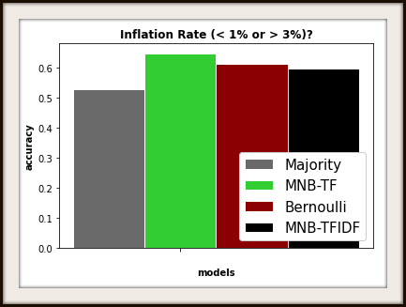
Predict Inflation Rate
All NB Models Beat Majority Rule

Slide 18
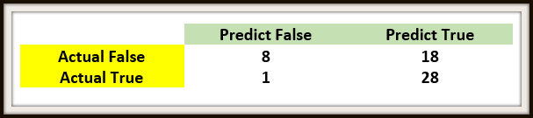
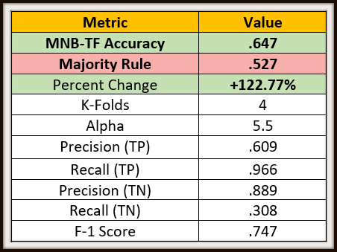
Metrics: MNB-TF
Confusion Matrix
Other Metrics

Slide 19
SVM

Slide 20
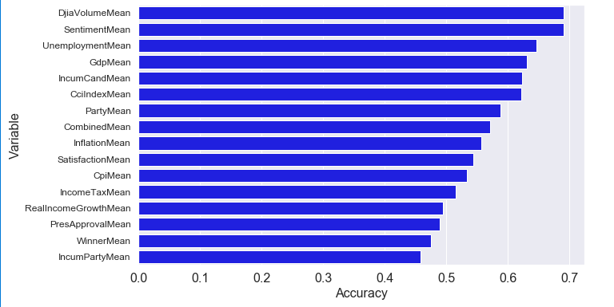
SVM Results
Above are the average accuracy ratings of each of the 15 variables measured
The DJIA Volume and the Sentiment rating were the two most successfully predicted variables from the nomination acceptance speeches, both averaging 69% accuracy across all 15 models
7 of the 15 variables averaged an accuracy higher than the combined average, with the other 8 falling below the average

Slide 21
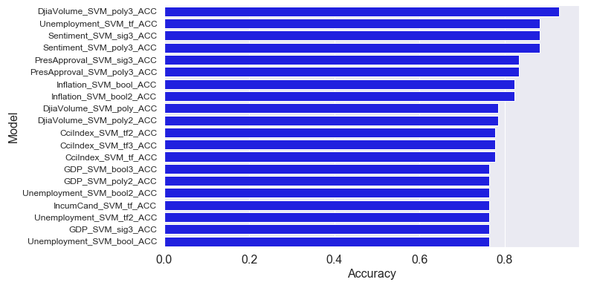
SVM: Top 20 Models
Above are the top 20 SVM Models from the 225 total that were run
Average was 57% accurate, all 20 came in higher, with the lowest being at 76.5% accuracy and the highest at 94%

Slide 22
Clustering

Slide 23
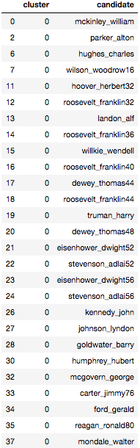
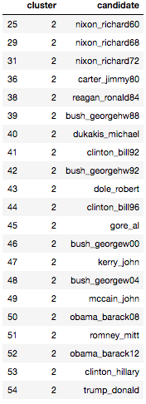
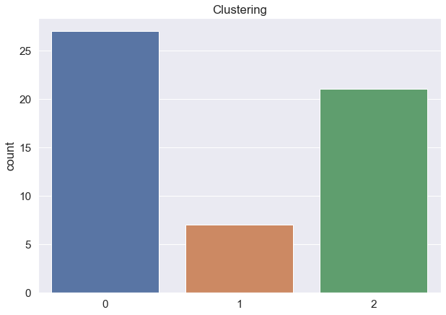
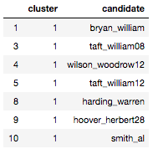
K-Means Clustering

Slide 24
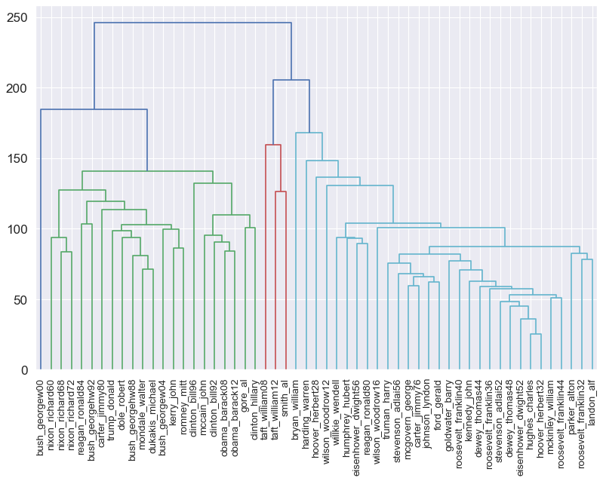
Hierarchical Clustering

Slide 25
Observations
Both K-Means and hierarchical clustering seem to show that speeches of similar time periods tend to be grouped together.
Results from the different clustering techniques also support the notion that William Taft and Al Smith are particularly unique.
In both clustering techniques, Jimmy Carter and Ronald Reagan are the only two candidates who have a speech in each cluster.

Slide 26
Topic Modeling

Slide 27
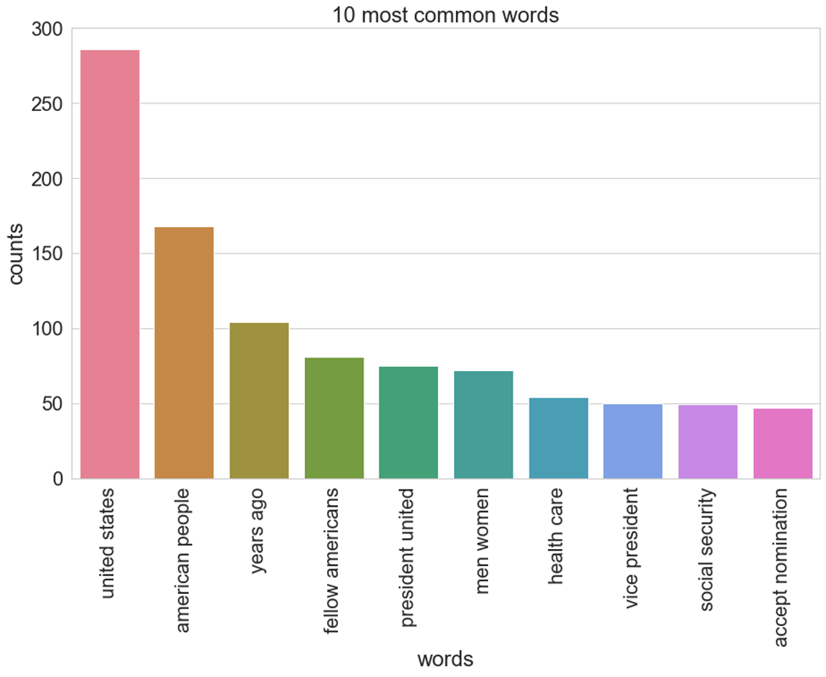
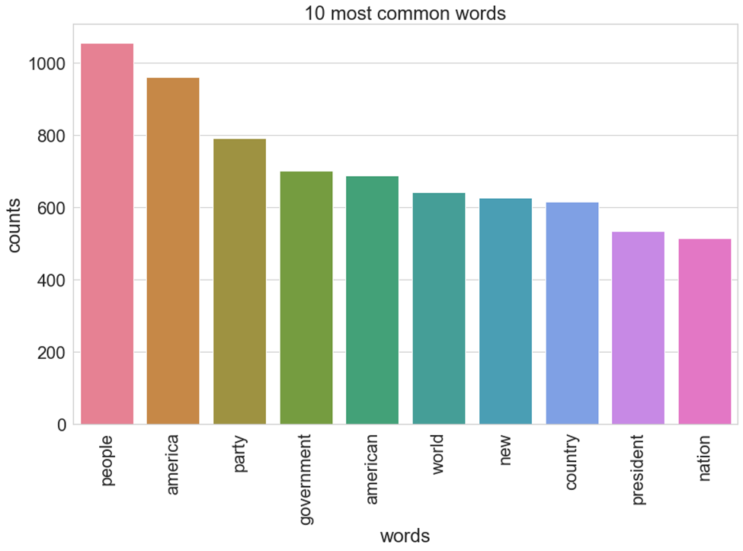
Topic Modeling: Top Words/Phrases
Top 10 Unigrams by Frequency
Top 10 Bigrams by Frequency

Slide 28
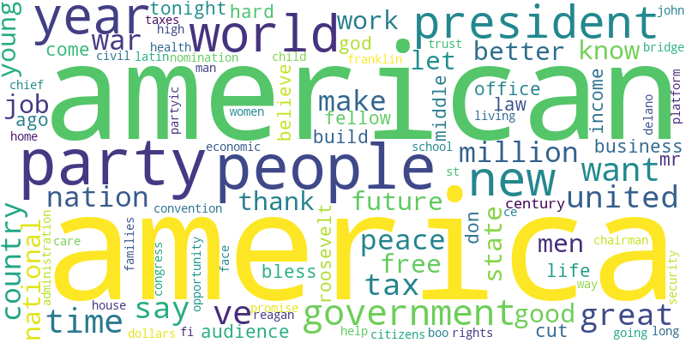
Word Cloud

Slide 29
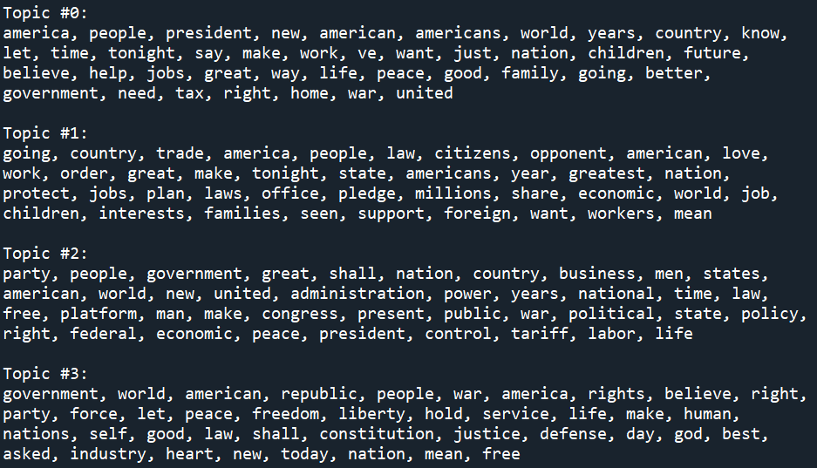
Topics
Jobs/
Economy
Healthcare/
Social Security
Tax
Trade

