Slide 1
Project Data engineering
Marcou Corentin
TRAN Jean-Pierre
DELARONCIERE IVAN

Slide 2
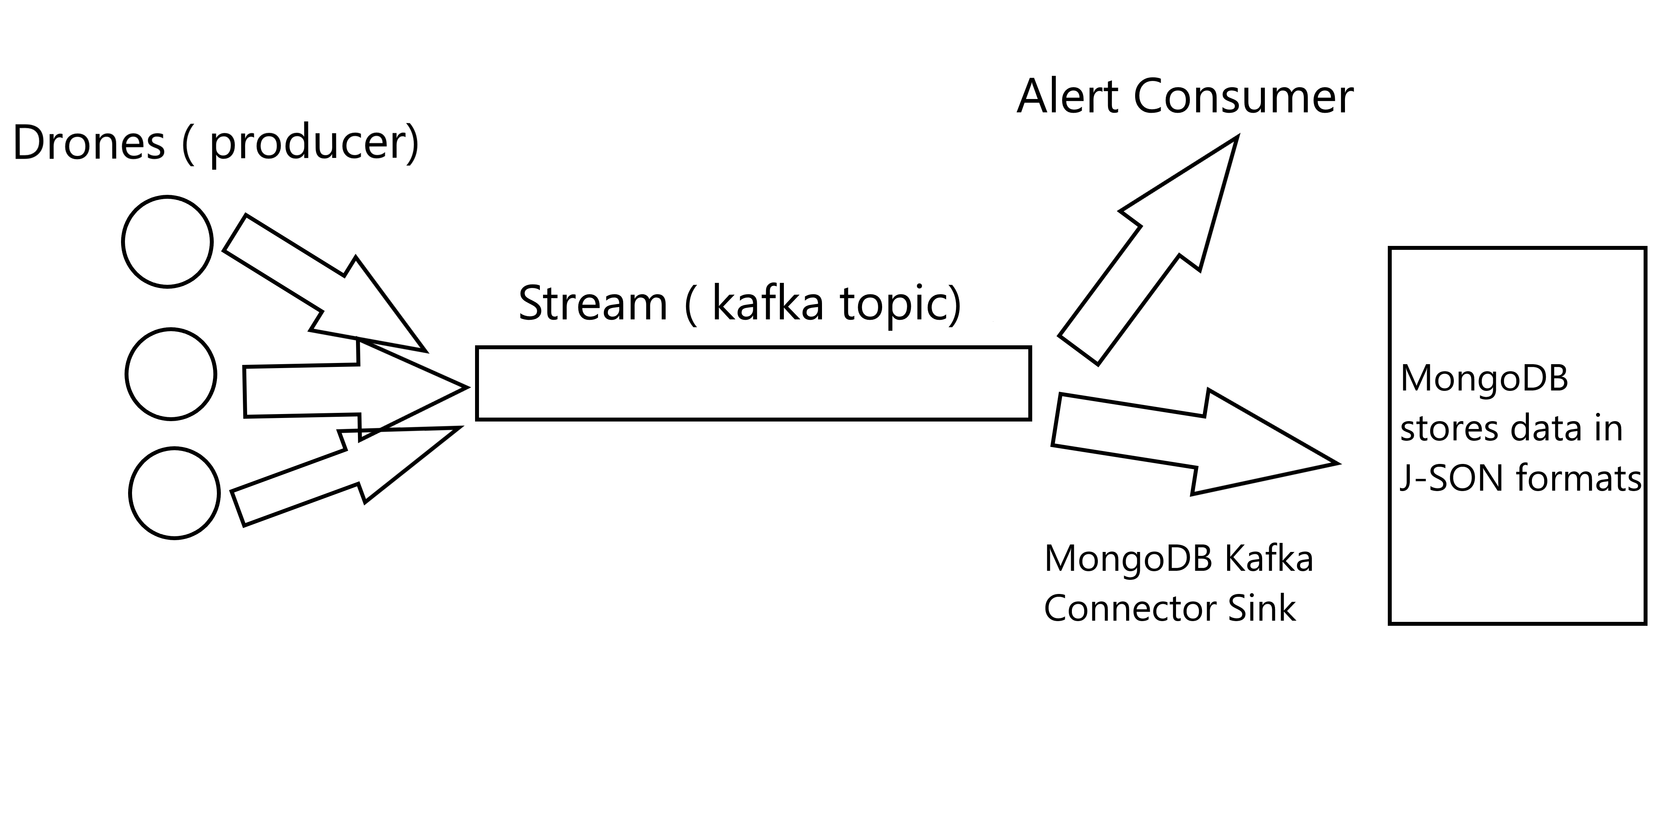
Diagram

Slide 3
Done and Not Done
DONE | NOT DONE
1) a program simulating the drone and sending drone like data to your solution (see subject for details on a message). Your system will store message in a distributed stream making it available to the component 2 and 3. (this part should not be done with spark) 2) handle riot alert message from stream | 3) store message formatted as drone message in a distributed storage (ex: HDFS/S3) 4) analyse stored data with a distributed processing component (like spark). As a proof of your system capacity to analyse the store data answer 4 questions of your choice. (ex: is there more riot during the week or during week-end?).

