Slide 1
Project 1
Cryptocurrency Study
Taking a pick on Crypto.
By Jean Stibel

Slide 2
What is Cryptocurrency: Cryptocurrency is a type of digital or virtual currency that uses cryptography for security. Unlike traditional currencies issued by governments (such as dollars, euros, or yen), cryptocurrencies operate on
decentralized systems, typically based on blockchain technology.
How does cryptocurrency work? Cryptocurrency operates as a digital currency system where transactions are verified
and recorded on a decentralized public ledger called a blockchain, eliminating the need for a central authority like a bank
to manage transactions, and allowing users to send and receive funds directly with each other using cryptographic
encryption for security; essentially, each transaction is verified by multiple computers on the network before being added
to the blockchain, making it highly secure and transparent.
What market cap means in crypto? Crypto market cap, or market capitalization, is a metric that measures the
total value of a cryptocurrency. It's calculated by multiplying the current price of one coin by the total number of
coins in circulation.
What is circulating supply in cryptocurrency? "Circulating supply" in cryptocurrency refers to the total number of coins or tokens that are currently available for trading and actively being used in the market, essentially representing the amount of a cryptocurrency that is accessible to the public to buy or sell at any given time;
What volume means in crypto: In cryptocurrency, "volume" refers to the total number of coins or tokens that have been traded within a specific timeframe, usually measured over 24 hours, indicating how much activity there is in buying and selling a particular cryptocurrency.

Slide 3
Dataset in Cryptocurrency
The dataset for each cryptocurrency.
Date : date of observation
Hour: Hour of the day
Open : Opening price on the given day
High : Highest price on the given day
Low : Lowest price on the given day
Close : Closing price on the given day
Volume : Volume of transactions on the given day
Market Cap : Market capitalization in USD
Circulating supply: refers to the total number of coins or tokens that are currently available for trading

Slide 4
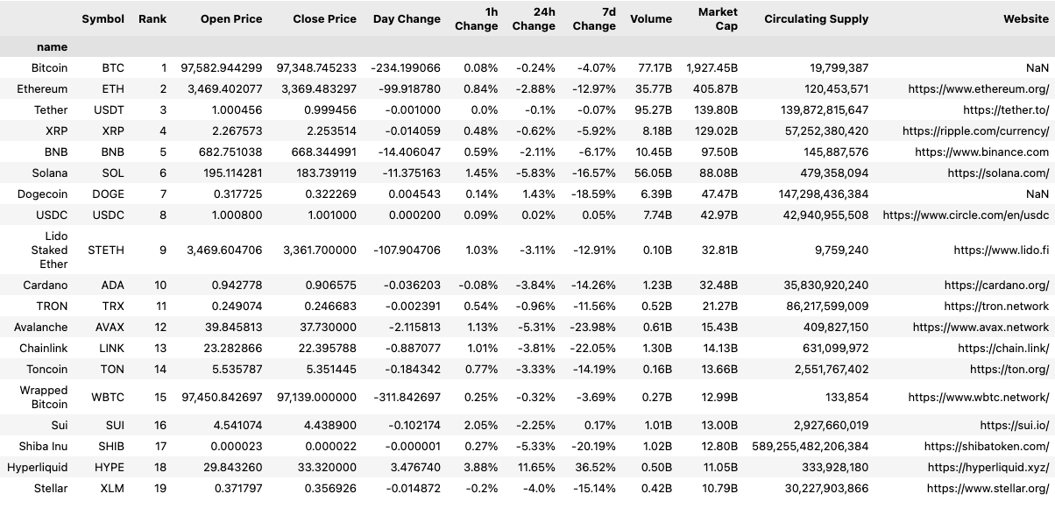
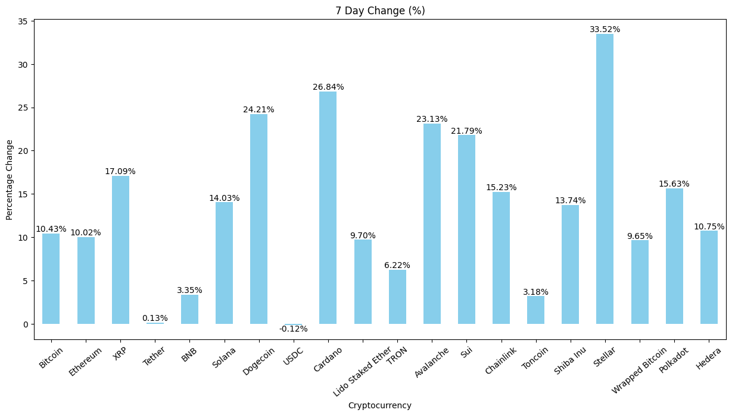
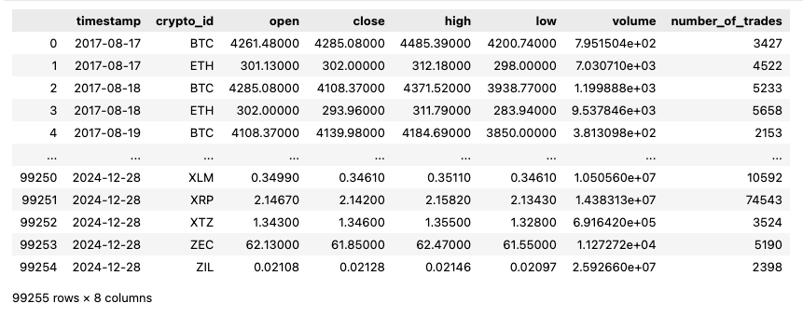
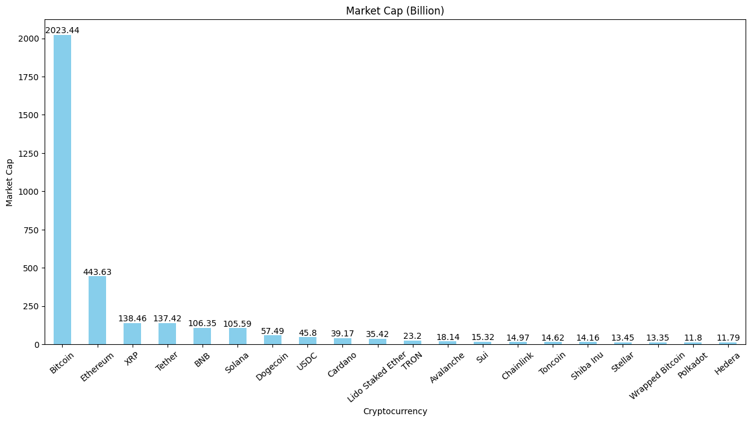
BTC: Bitcoin, ETH: Ethereum, XRP: Ripple, BNB: Binance Coin, SOL: Solana, DOGE: Dogecoin, ADA: Cardano,TRX: Tron, AVAX: Avalanche, LINK: Chainlink, SHIB: Shiba Inu, XLM: Stellar, DOT: Polkadot

Slide 5
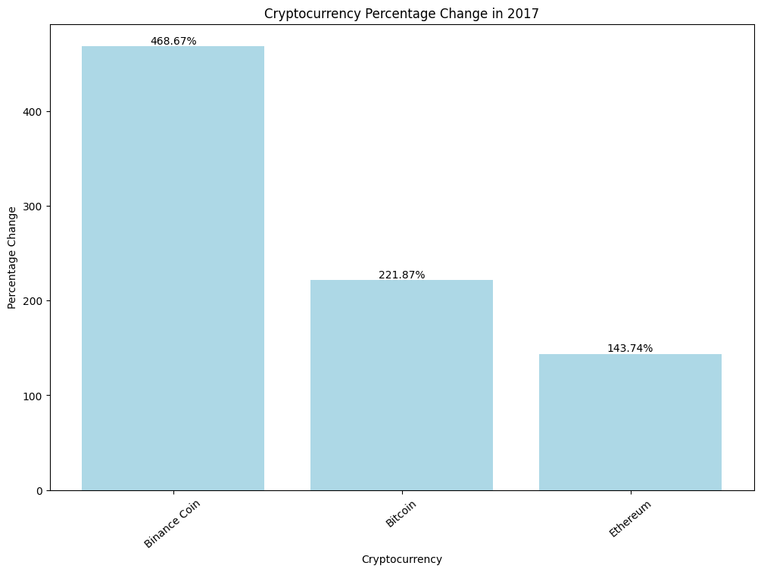
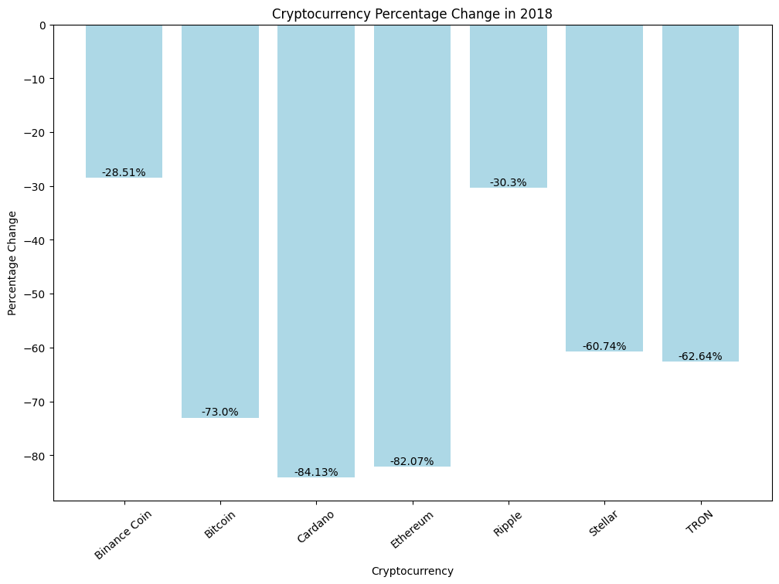
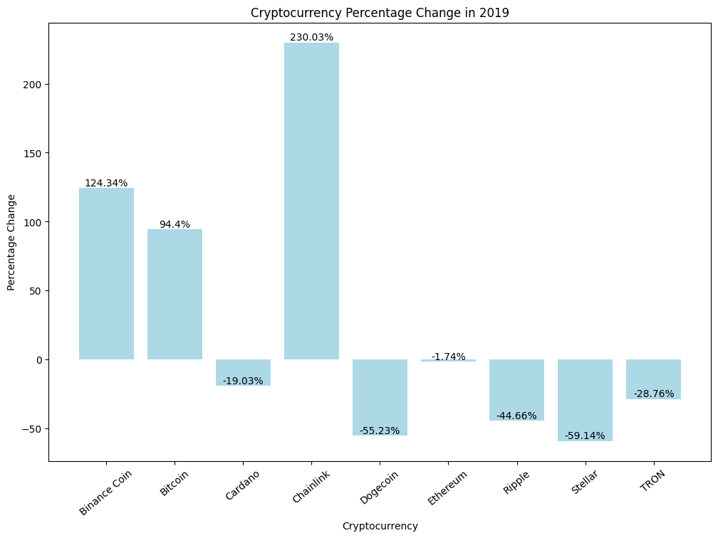
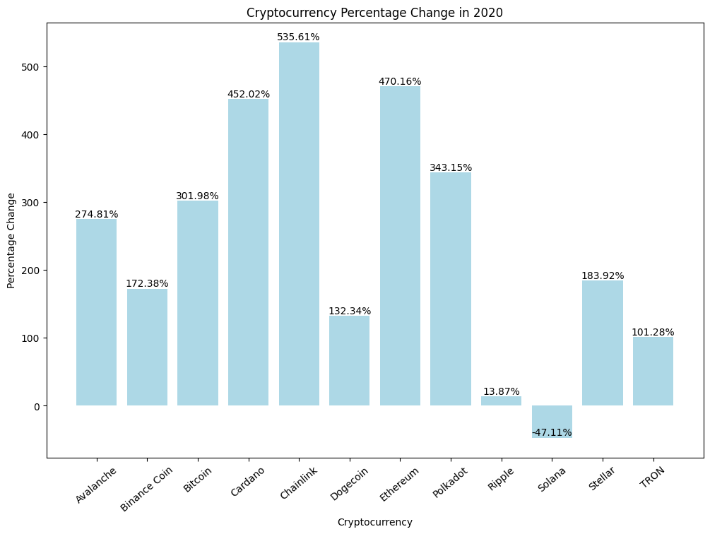

Slide 6
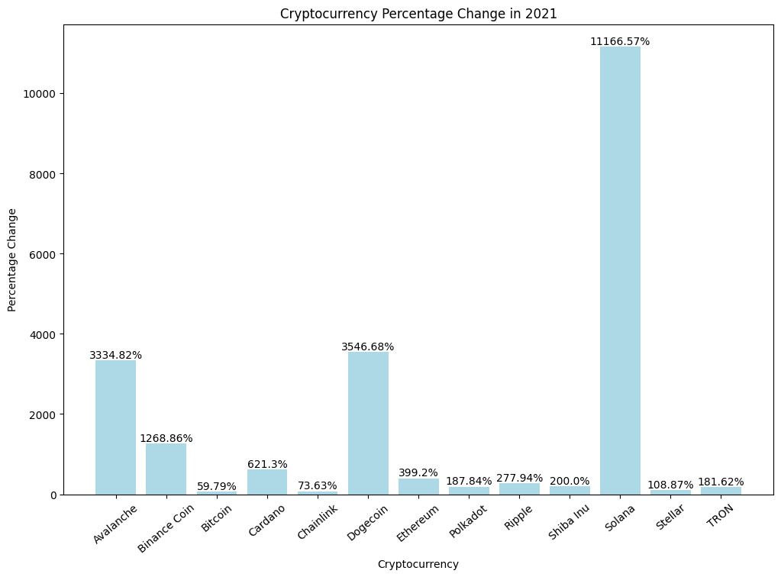
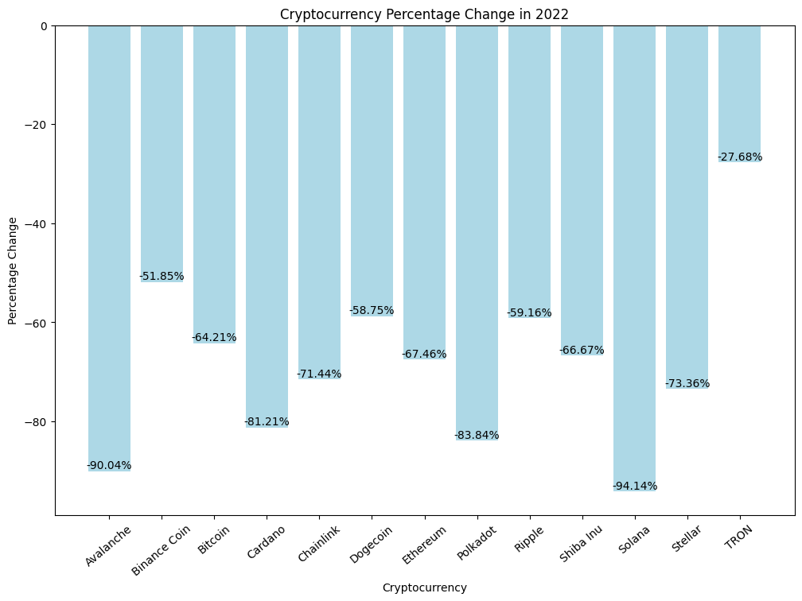
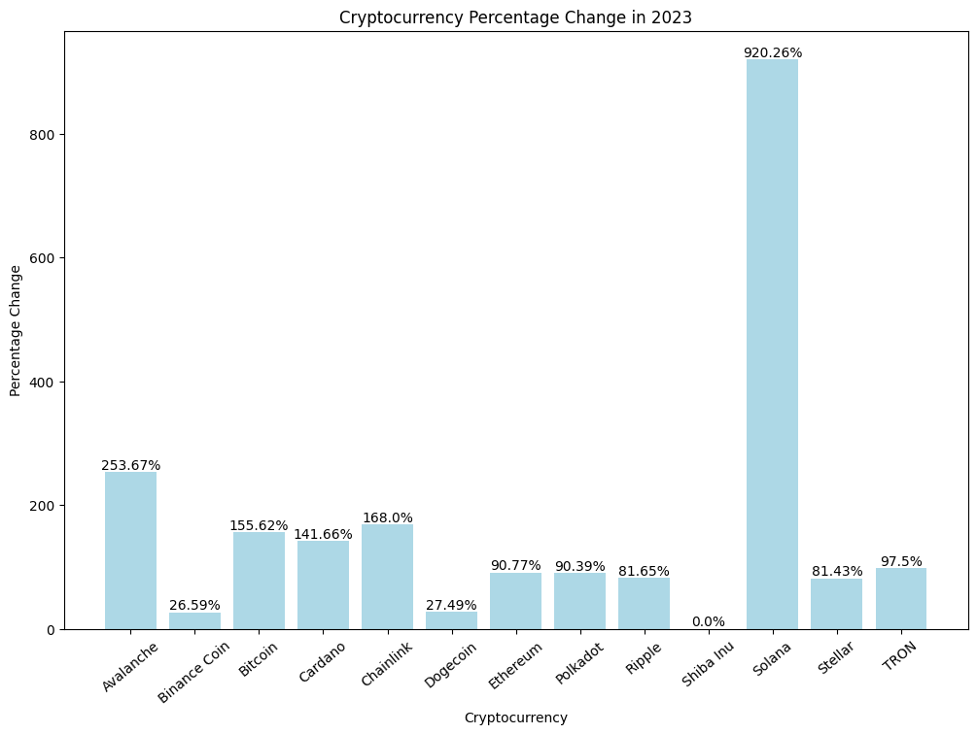
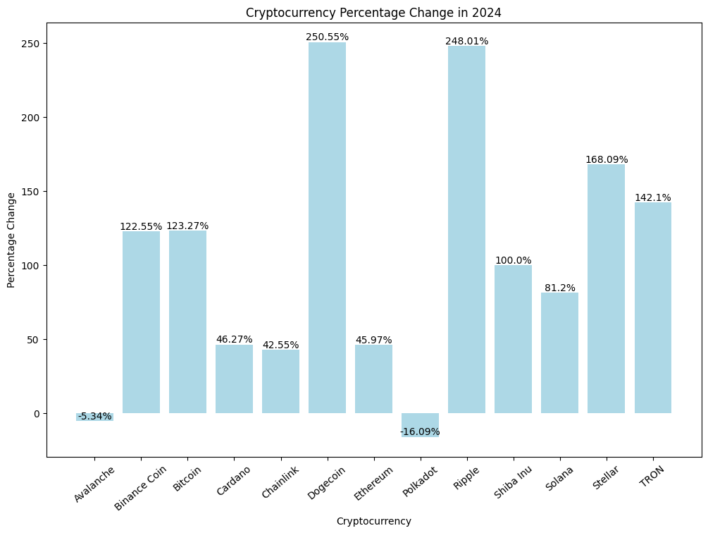

Slide 7
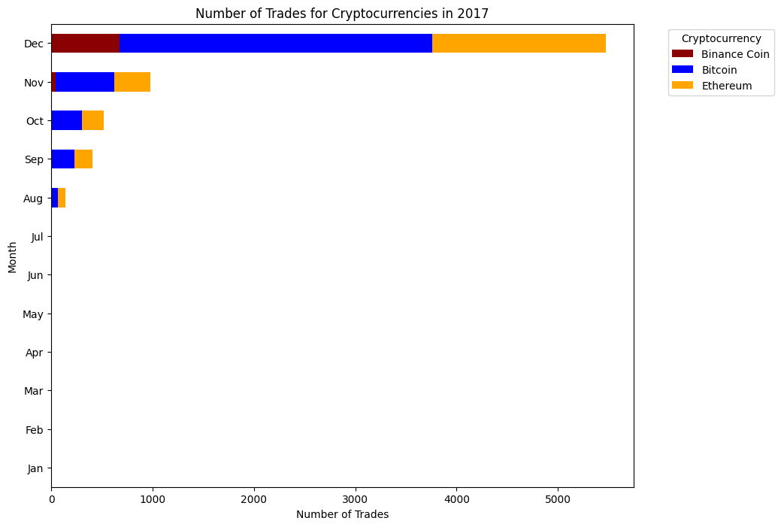
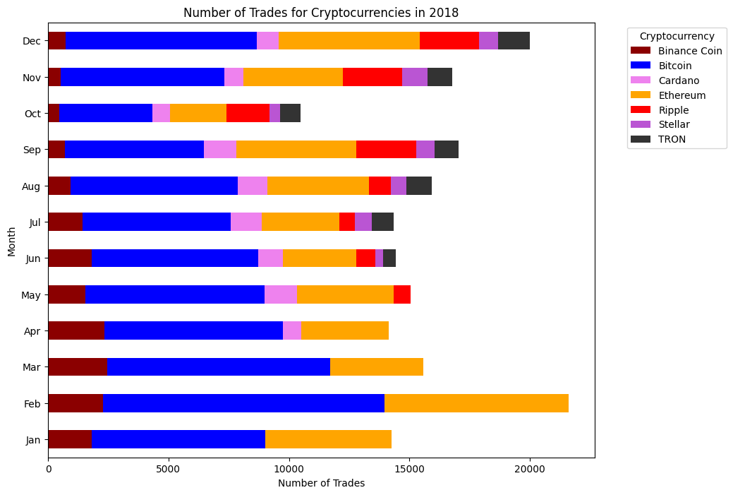
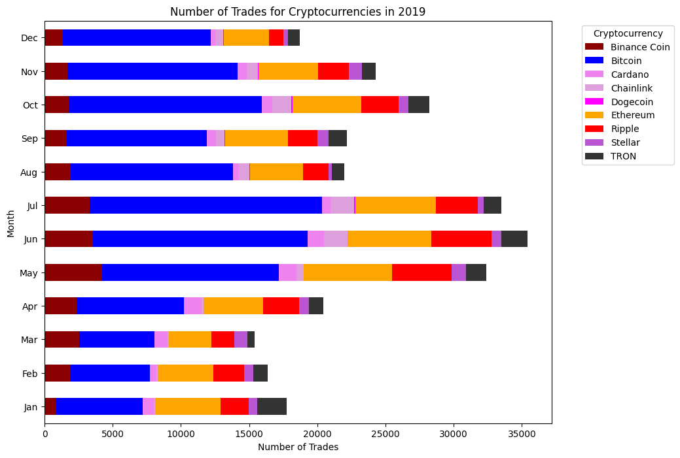
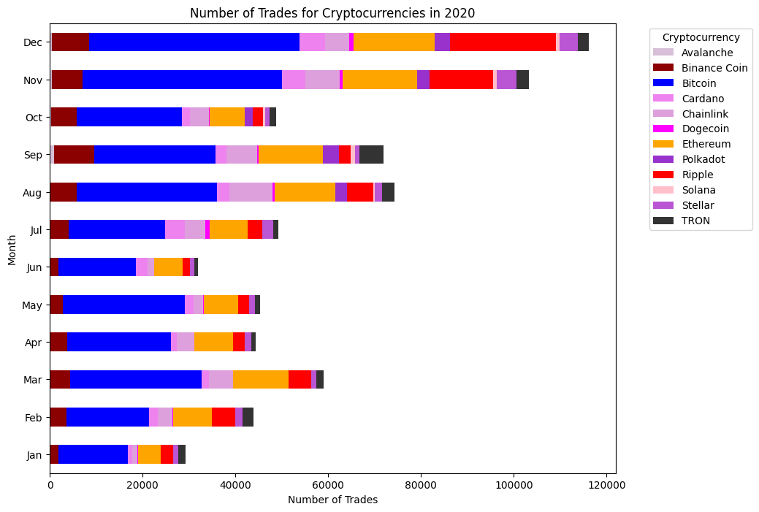

Slide 8
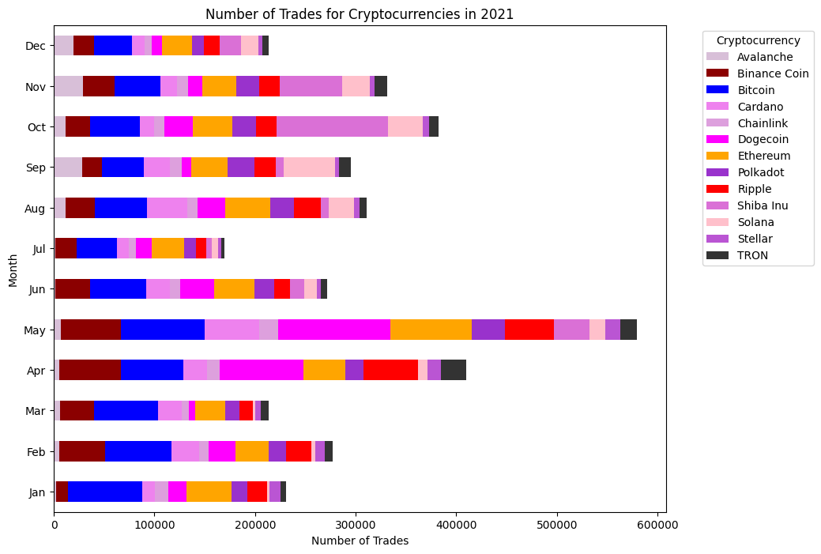
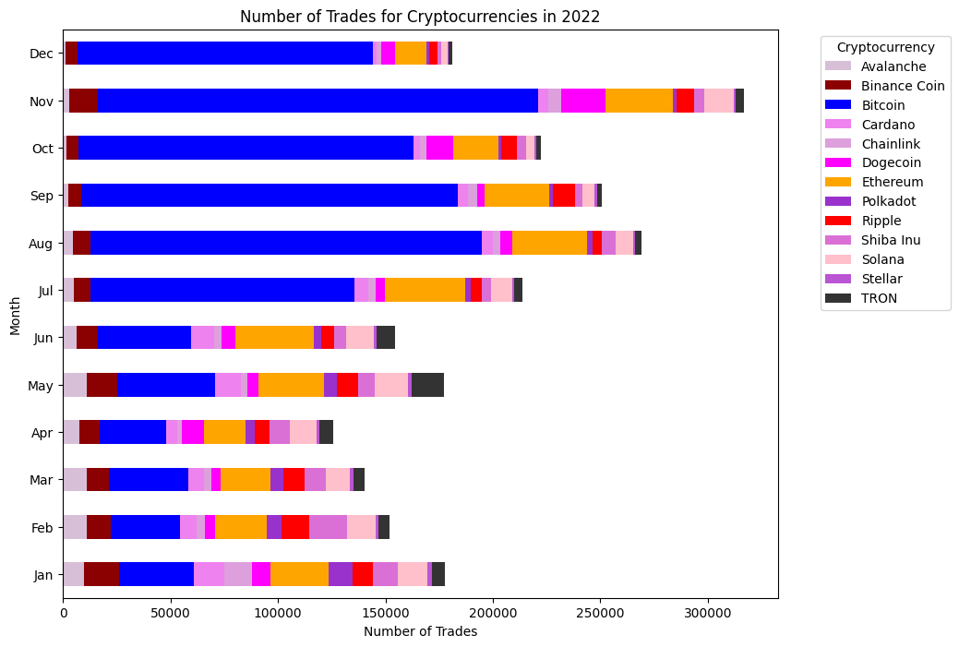
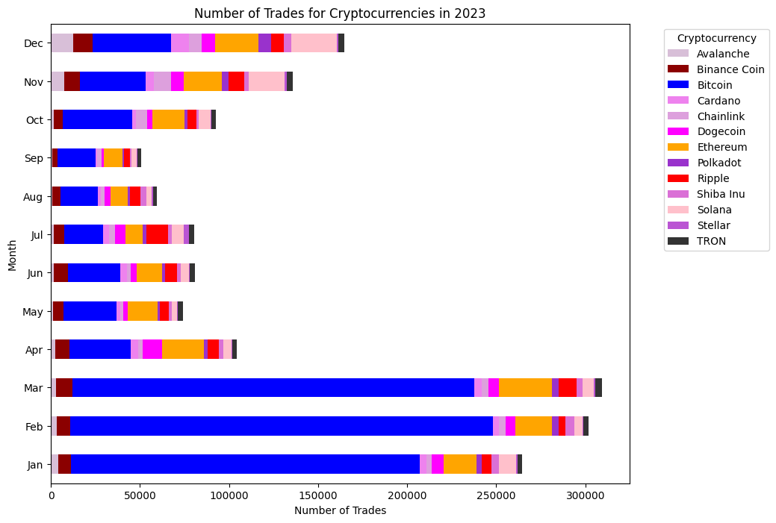
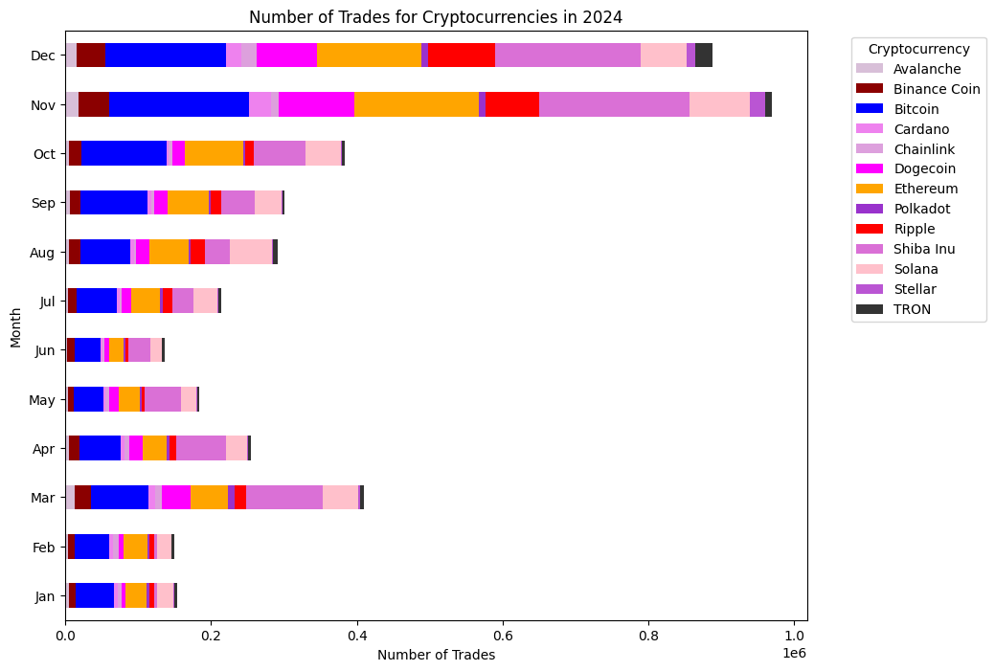

Slide 9
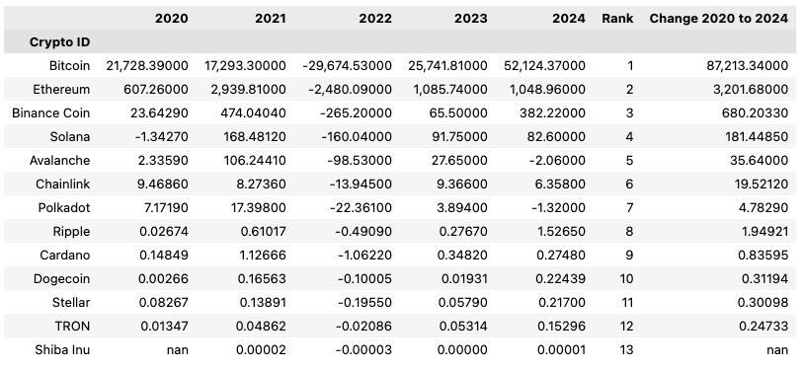
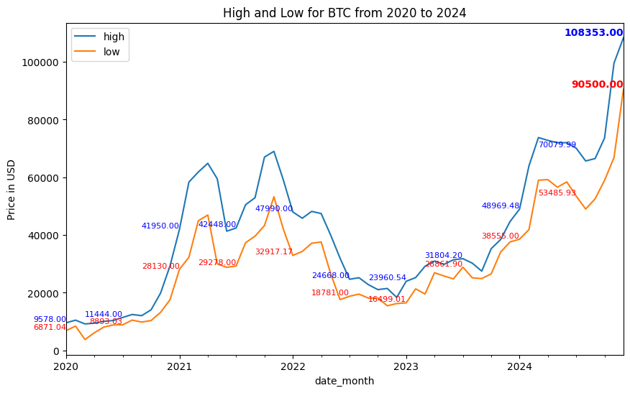
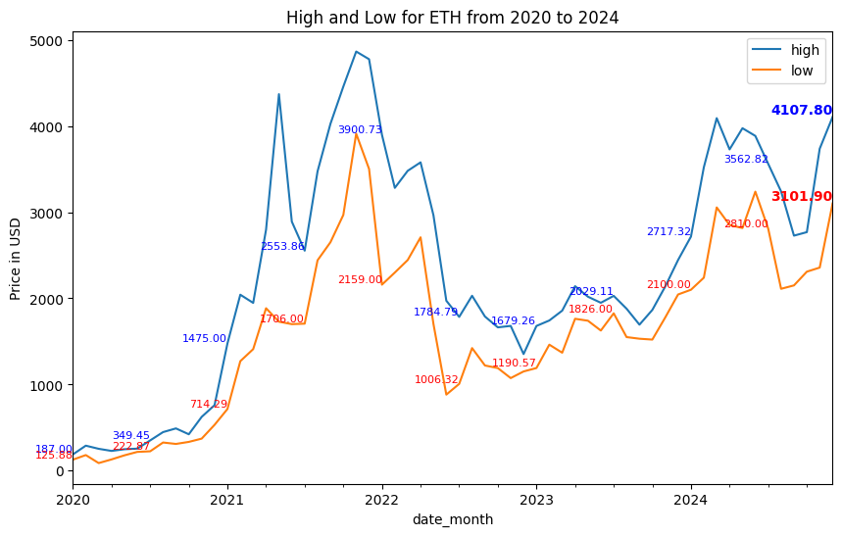

Slide 10
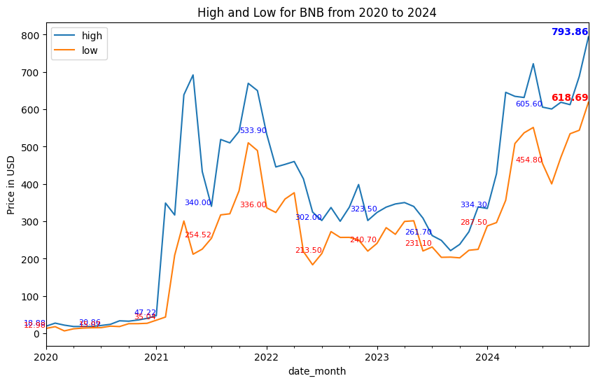
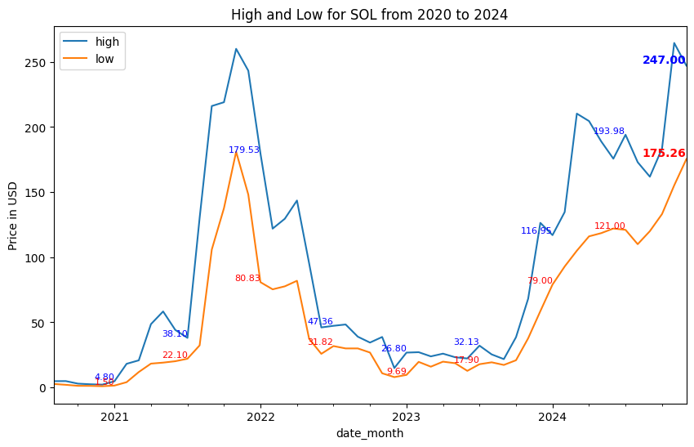
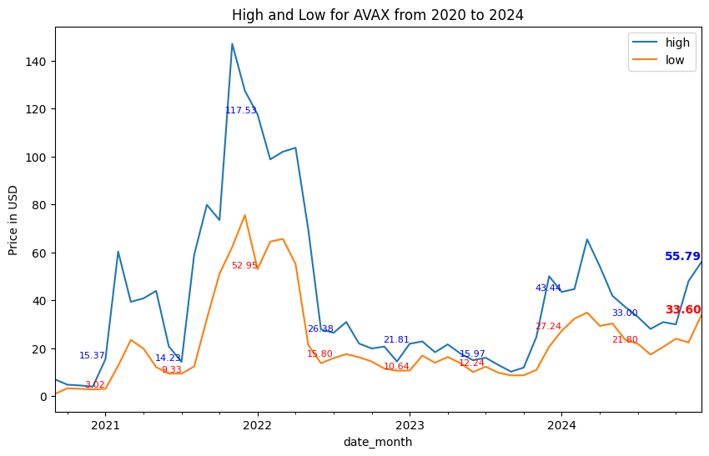

Slide 11
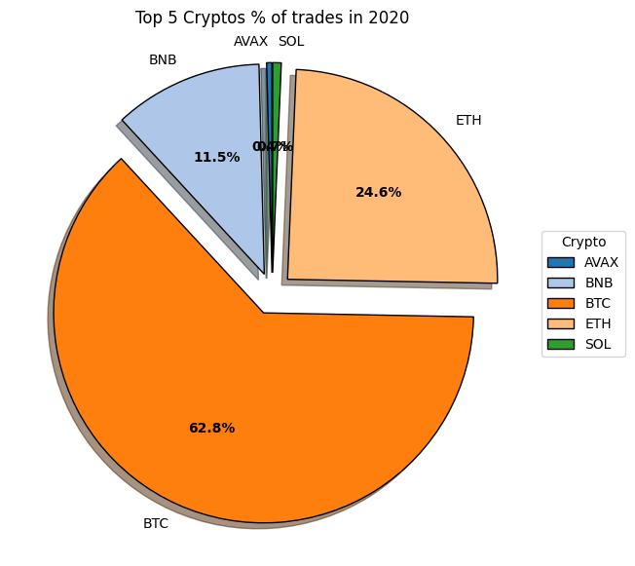
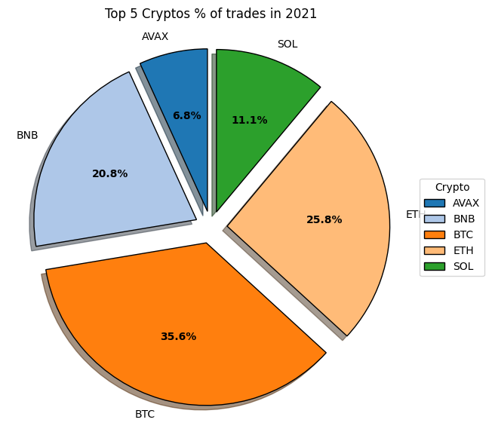
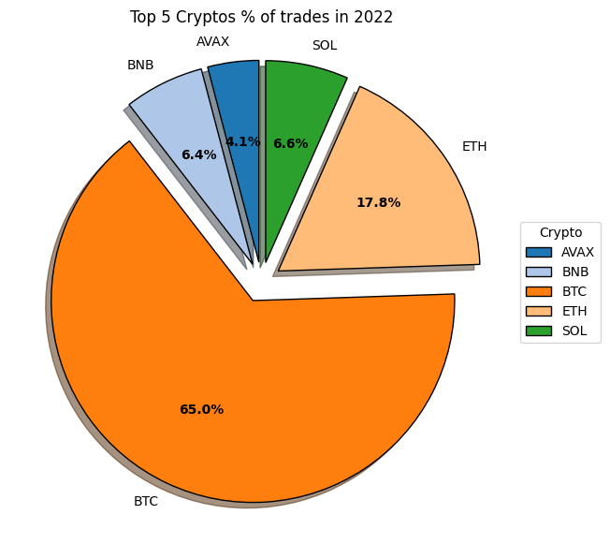
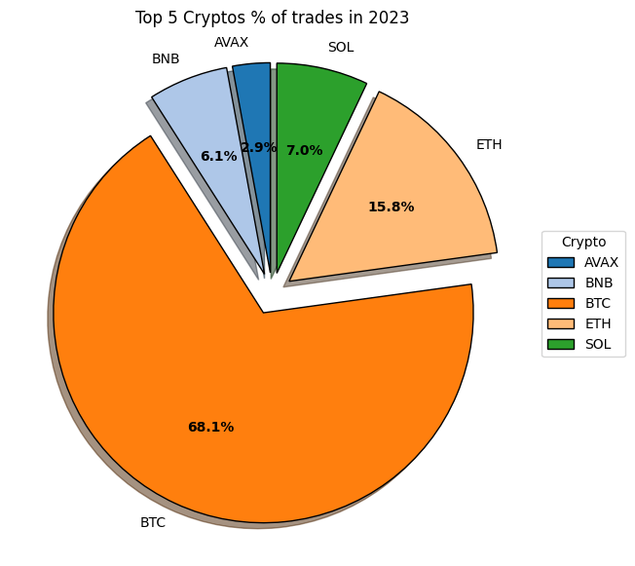
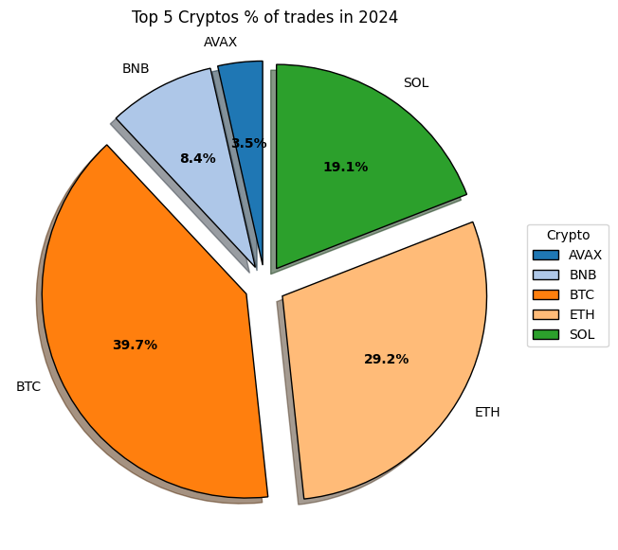

Slide 12
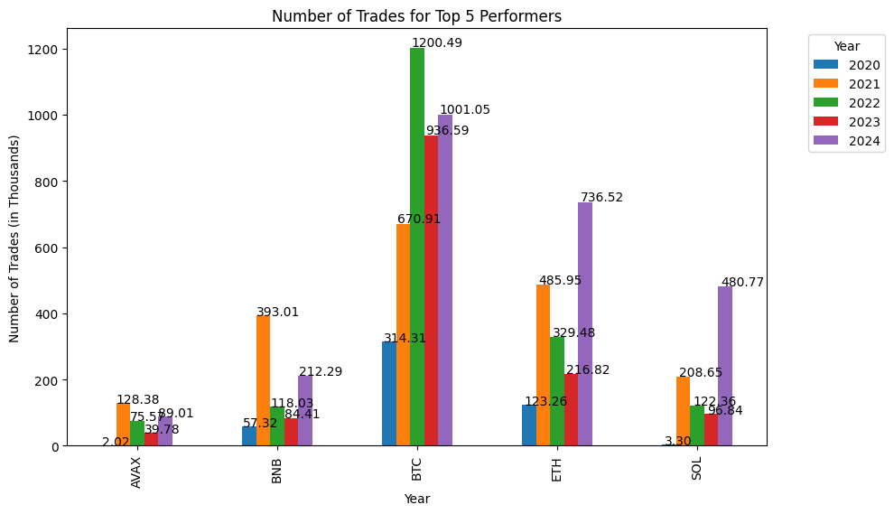

Slide 13
