Slide 1
Project 2
Cryptocurrency Data Analysis and Forecasting Using Machine Learning

Slide 2
Introduction
Cryptocurrency markets are highly volatile, making price forecasting a challenge.
This project utilizes machine learning techniques to analyze and predict crypto volatility
It covers data preprocessing, unsupervised, regression, classification, and time series forecasting.

Slide 3
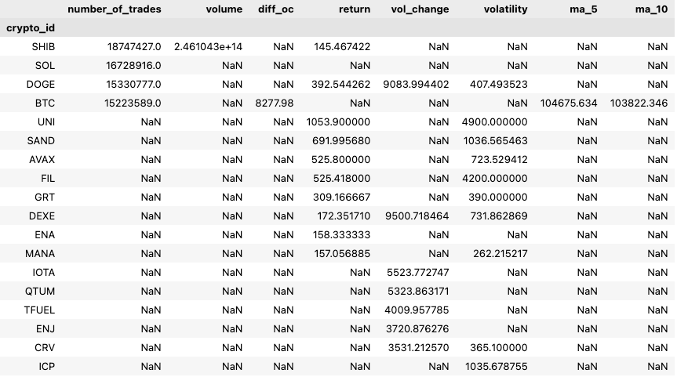
Data Cleaning and Preprocessing
- Aggregated historical crypto price data
- Handled missing values and removed outliers
- Standardized and transformed data for better model performance

Slide 4
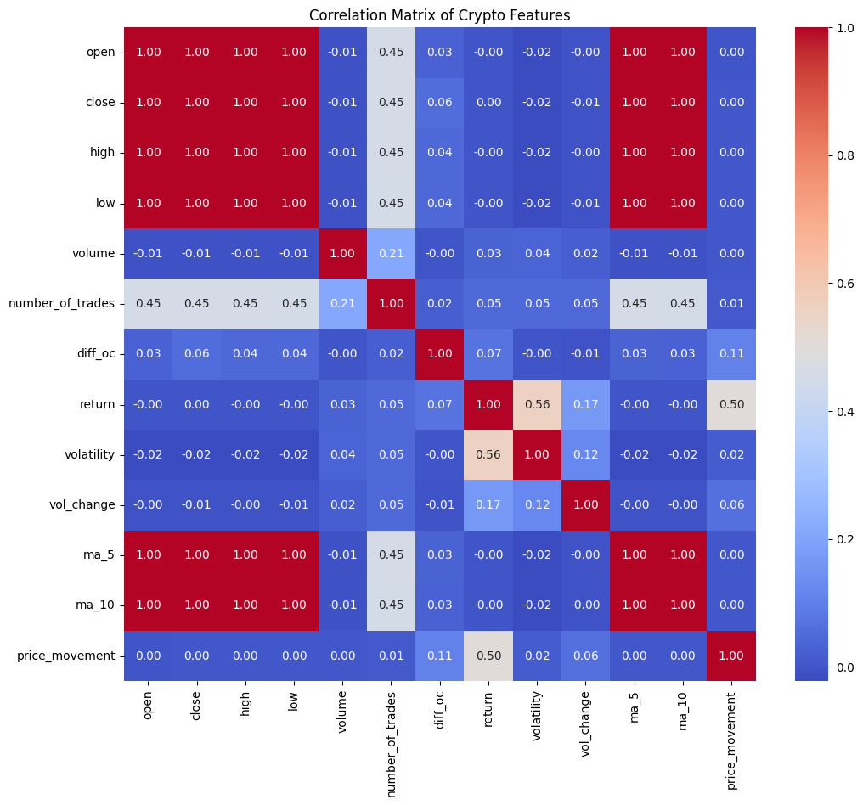

Slide 5
Unsupervised Learning
Objective: The goal is to assess how well different clustering algorithms can identify patterns in financial volatility data.
Methods Used:
K-Means Clustering (with Elbow Method for optimal K selection)
Agglomerative Clustering (Hierarchical approach)
BIRCH Clustering (Balanced Iterative Reducing and Clustering using Hierarchies)
Additionally, Principal Component Analysis (PCA) is used to reduce dimensionality before clustering.
Metrics to evaluate:
Silhouette Score (higher is better)
Davies-Bouldin Index (lower is better)
Calinski-Harabasz Index (higher is better)
Conclusion:
The models achieved perfect R² scores (1.0) and near-zero MSE, indicating an ideal fit. However, such high accuracy might suggest overfitting, meaning the model may not generalize well to new data. Applying PCA did not significantly impact performance.

Slide 6
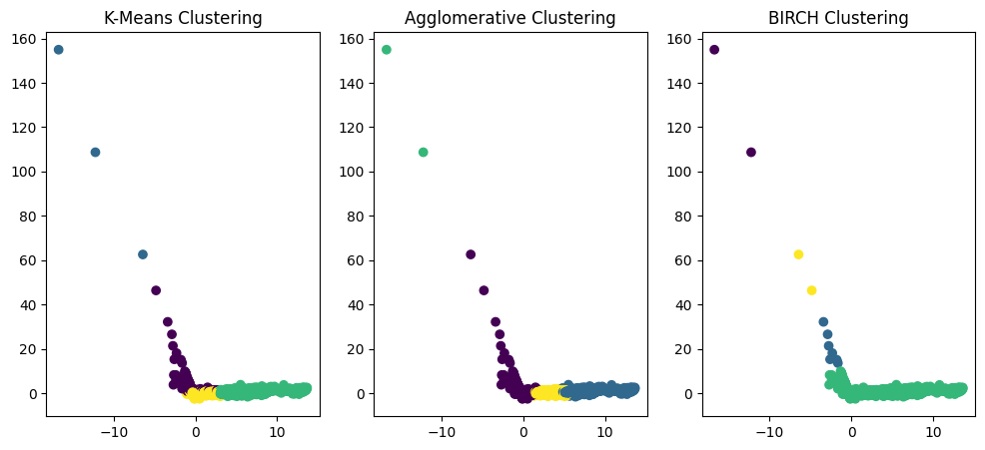

Slide 7
Regression
Objective:
The primary goal is to forecast future volatility using historical financial data. The regression models aim to predict market fluctuations based on various financial indicators.
Methods Used:
Linear Regression
Ridge Regression
Lasso Regression
Additionally:
Feature Engineering: Features such as volatility, return, volume, moving averages (MA5, MA10), and other financial indicators are used.
Data Preprocessing: StandardScaler and MinMaxScaler are applied for feature scaling.
Principal Component Analysis (PCA): Used to reduce dimensionality and analyze the impact on regression models.
Cross-Validation: Applied to assess model generalizability.
Model Evaluation Metrics:
Mean Squared Error (MSE)
R-squared (R²)
Adjusted R-squared
Cross-validation scores
Conclusion:
Based on your regression analysis for predicting volatility, the model performed exceptionally well on the training data, achieving an R-squared value of 1.0, indicating perfect fit. However, the testing results also reported an R-squared of 1.0, which may suggest overfitting rather than a truly generalized model. The application of Principal Component Analysis (PCA) resulted in a lower but still high performance, though with slightly negative cross-validation scores, implying some

Slide 8
Classification Analysis
Objective:
The goal is to classify volatility into distinct categories (high, medium, low). This classification aims to facilitate better decision-making in financial markets by applying machine learning techniques to predict market fluctuations.
Methods Used:
Machine Learning Models: Some classifiers are tested, including:
Logistic Regression
Random Forest
Support Vector Machine (SVM)
Decision Tree
Gradient Boosting
K-Nearest Neighbors (KNN)
AdaBoost, Bagging, and Extra Trees classifiers
Model Evaluation: Performance assessment using metrics such as:
Accuracy Score
Classification Report (Precision, Recall, F1-score)
Confusion Matrix
ROC-AUC Score
Balanced Accuracy Score
Conclusion:
The classification models performed with varying accuracy levels.
Logistic Regression and SVC showed lower accuracy (37%), while tree-based models like Decision Tree, Random Forest, and Gradient Boosting achieved nearly perfect accuracy (99.98%).
Other methods like Bagging and AdaBoost also performed exceptionally well. The results indicate that tree-based and ensemble models are highly effective for this classification task, whereas linear models may not be suitable.

Slide 9
Time Series
Objective: Forecast cryptocurrency volatility and price movements using time series models. The analysis aims to assess market trends and provide future price predictions based on historical data.
Methods Used:
ARIMA & GARCH Models – Traditional statistical models used for time series forecasting and volatility analysis.
LSTM (Long Short-Term Memory Networks) – A deep learning model designed for sequential data and time series prediction.
Feature Engineering: Includes analysis of standard deviation to determine volatility patterns.
Evaluation Metrics: Includes Mean Absolute Error (MAE) and other forecasting performance measures.
Conclusion:
The analysis explores cryptocurrency price forecasting and volatility estimation using time series techniques. By leveraging Prophet, the study provides insights into future price movements while evaluating prediction accuracy with MAE and MSE. The results can help in identifying high-volatility assets and improving trading strategies.

Slide 10
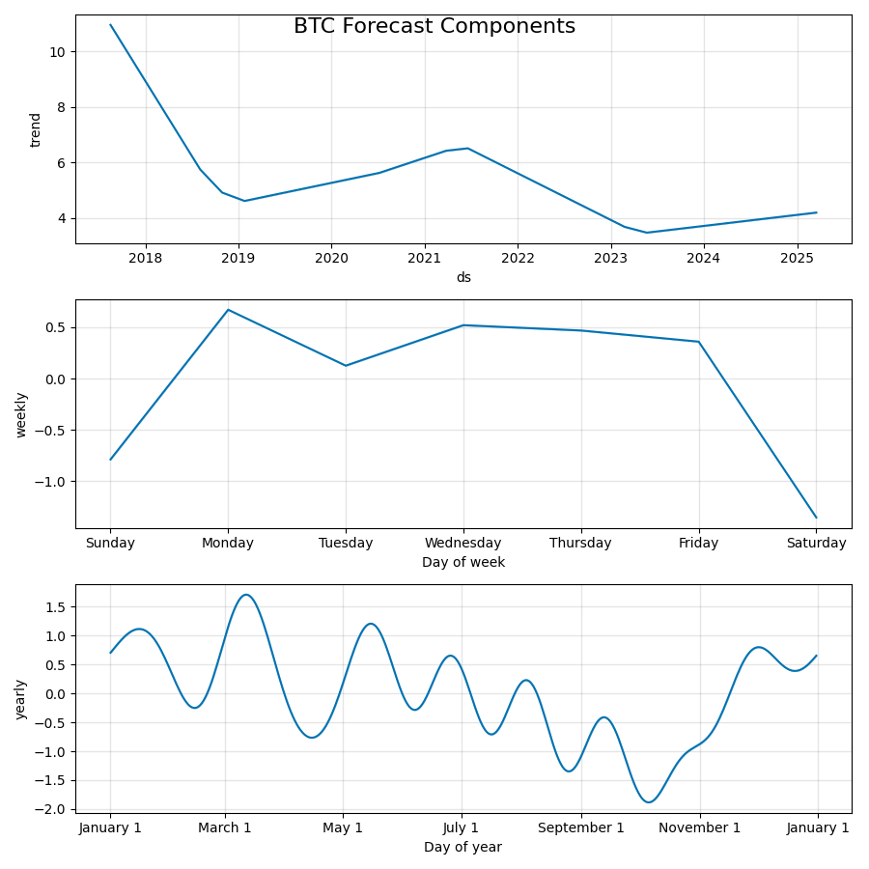
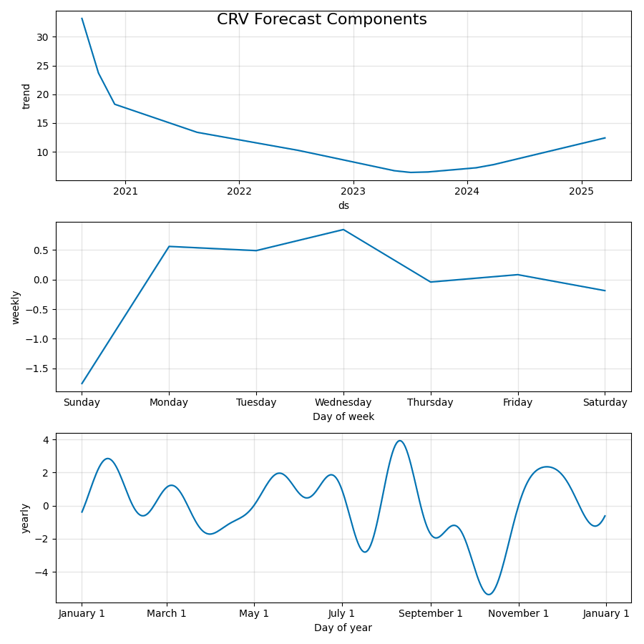

Slide 11
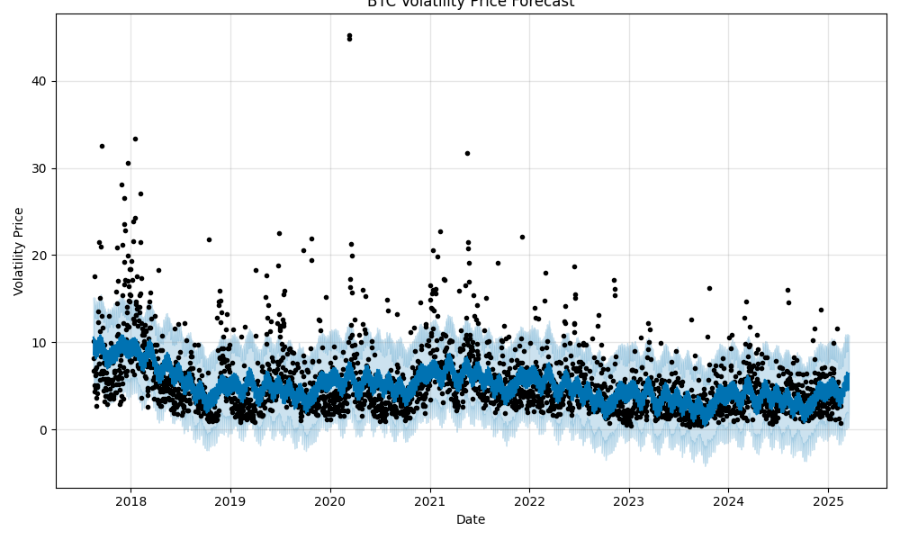
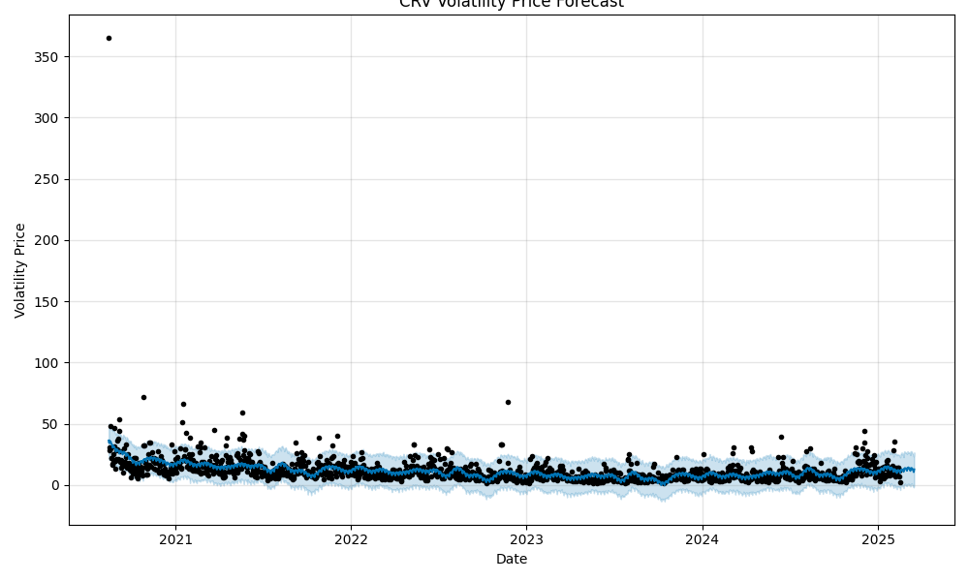

Slide 12
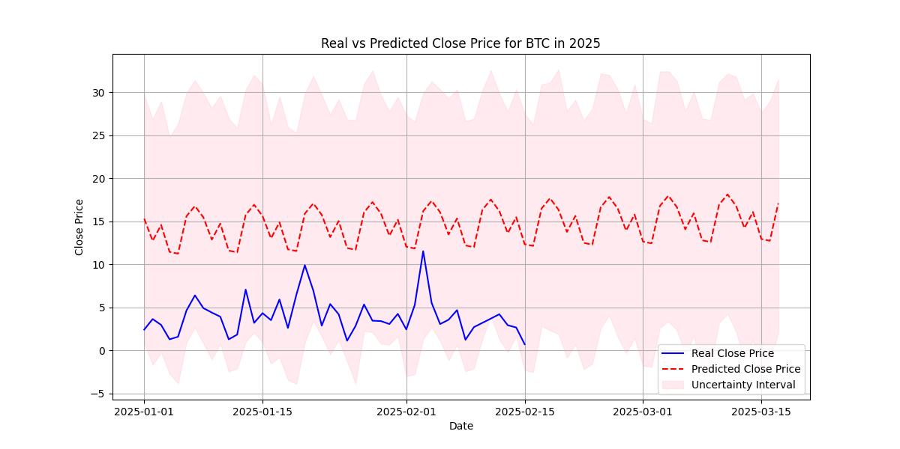
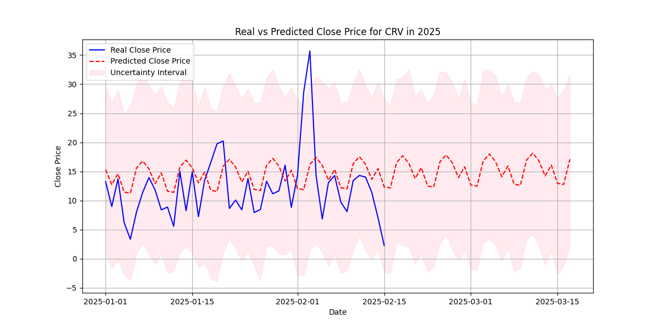

Slide 13
Conclusion:
This project provides a comprehensive analysis of cryptocurrency markets using advanced machine learning techniques.
The unsupervised learning models revealed distinct patterns in volatility clustering, demonstrating the effectiveness of K-Means, Agglomerative, and BIRCH clustering.
Regression analysis showed remarkable predictive accuracy, achieving an R² of 1.0
Classification models successfully categorized market volatility, with tree-based models such as Random Forest and Gradient Boosting outperforming linear models. These results reinforce the suitability of methods in capturing complex relationships in financial data.
Time series forecasting with ARIMA, GARCH, and LSTM provided insights into market trends and future volatility estimation.
Overall, this project highlights the potential of machine learning for cryptocurrency market analysis.

