Slide 1
Project 3
Document QA
&
Summarization System
AI-Powered Document Processing
Jean Stibel

Slide 2
Project Overview
Project Overview
Objective: Automate document analysis using NLP
Key Features:
- Extract text from PDFs, Word, and text files
- Answer questions about document content
- Generate compact summaries

Slide 3
Key Features
Text Extraction: Supports PDF, DOCX, and TXT
Multi Page Extraction
Question Answering: Uses DistilBERT fine-tuned on SQuAD
- Finds answers with confidence scores
Summarization: Uses Facebook's BART-large-CNN
Condenses documents to key points
- User Interface: Built with Gradio for ease of use

Slide 4
Technical Components
Libraries: transformers, torch, gradio, PyPDF2, python-docx
Models:
distilbert-base-cased-distilled-squad for QA
facebook/bart-large-cnn for summarization
Functions:
extract_text_from_file()
process_document()

Slide 5
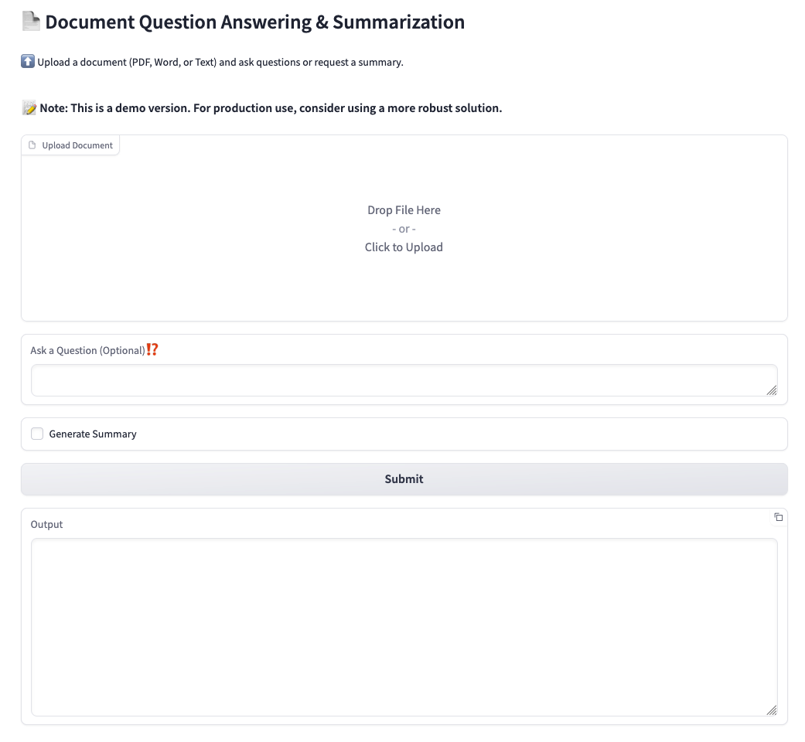
Gradio Web Interface
File upload and question input
Summary button option
Real-time results with confidence scores
Clean and interactive output display
Running on public URL: https://459a8683ab6e341d1d.gradio.live/

Slide 6
Conclusion
Makes document analysis accessible
Combines powerful NLP with simplicity
Ready for expansion into legal, academic, and business use cases

