Slide 1
Tutorial for Dependency Finder
by Jean Tessier,
March 30, 2004

Slide 2
What are dependencies?
Functioning of A requires the presence of B.
A
B
source
dependent
outbound
inbound
target
dependable
C₁
C₂
UML:
P₁
P₂

Slide 3
Why Should I Care?
Improve compilation time
  Smaller parts are easier on the compiler
Verify encapsulation
  Validate design assumptions
Indicator of complexity
Assist with maintenance
  Impact of change

Slide 4
Where Do They Come From?
Class-to-Class
  Class inheritance via extends keyword
  Interface realization via implements keyword
  From fields and methods of the class
P₁
P₂
C₁
C₂
F₁
F₂

Slide 5
Where Do They Come From?
Feature-to-Class
  Field type
  Method parameter type
  Exception types in throws clause
  Local variable type
P₁
P₂
C₁
C₂
F₁
F₂

Slide 6
Where Do They Come From?
Feature-to-Feature
  Field access
  Method call
  Method cannot depend on itself, as in recursive calls
P₁
P₂
C₁
C₂
F₁
F₂

Slide 7
No Dependency on Self
Does not add information
Compile time
  Class is unit of compilation
Runtime
  Class is unit of loading
Maintenance
  Already editing class or feature
P
C
F

Slide 8
Explicit Dependencies
Source code
  static final constants
  Needed for compilation
Compiled code
  Fully qualified names
  No 3rd party JARs
  Needed for runtime
P₁
P₂
C₁
C₂
F₁
F₂

Slide 9
Implicit Dependencies
Derived from explicit
Minimize
  Reduce space
  Augment time
Maximize
  Augment space
  Reduce time
P₁
P₂
C₁
C₂
F₁
F₂

Slide 10
Implicit Dependencies
classes of a package
features of a class
self
P
P
P
C₁
C₂
C
C
F₁
F₂
F₁
F₂
F

Slide 11
Package Instability (from Robert C. Martin)
Ca
Number of classes outside the package that depend upon classes inside the package.
Ce
Number of classes outside the package that classes inside the package depend upon.
Ce
I =
Ca + Ce
High Ce or low Ca means hard to change
If Ca and Ce are 0, then I = 0
Depend on packages with lower I than you

Slide 12
A vs I Graph (from Robert C. Martin)
1
Depend on abstract packages
Concrete packages should have no dependents
uselessness
A
A + I – 1 = 0
pain
0
I
1

Slide 13
Are Dependencies Transitive?
A
B
C
?
?
?
It depends! ☺
Case-by-case, not automatic
Is part of B that A depends on impacted by changes in C?

Slide 14
Transitive Closure
callers
dependents
dependencies

Slide 15
Transitive Closure
+
2
1
0
0
1
2
+

Slide 16
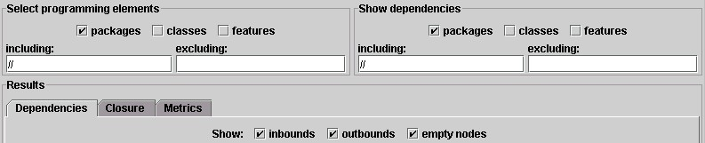
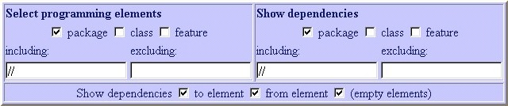
Package-to-Package Example
Default configuration
Complete package-level graph

Slide 17
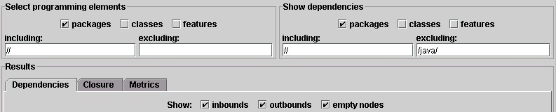
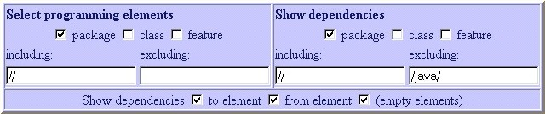
Package-to-Package Example
Excluding /java/
Don’t list dependencies on anything with java

Slide 18
Why Do I See java <-- jeantessier?
Scope
Factory
P₁
P₂
Filter
Factory
C₁
C₂
P₁
P₂
F₁
F₂
C₁
C₂
P₁
P₂
original
F₁
F₂
C₁
C₂
copy
F₁
F₂

Slide 19

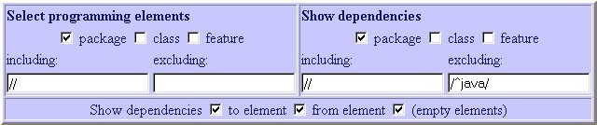
Package-to-Package Example
Excluding /^java/
Don’t list dependencies on java.*

Slide 20
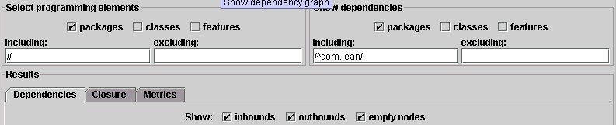
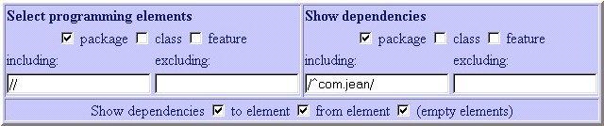
Package-to-Package Example
Including /^com.jean/
Only list dependencies with com.jean*

Slide 21
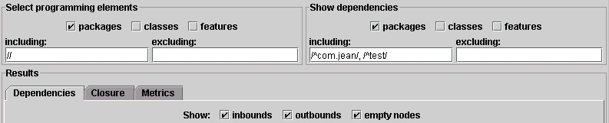
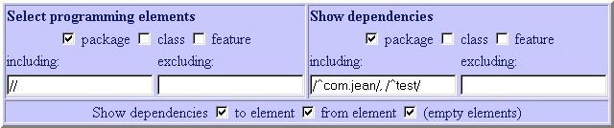
Package-to-Package Example
Including /^com.jean/, /^test/
Only list with com.jean* and test.*

Slide 22
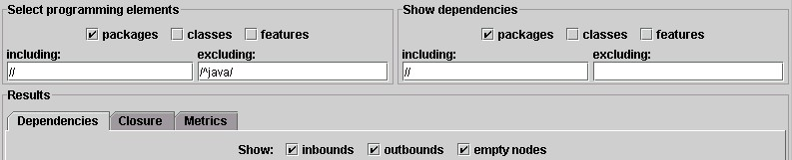
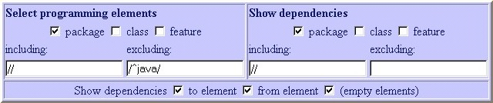
Package-to-Package Example
Excluding /^java/
Don’t list packages in java.*

Slide 23
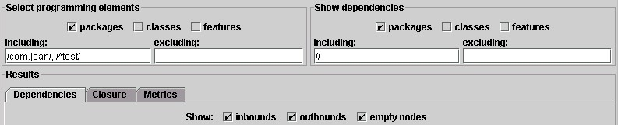
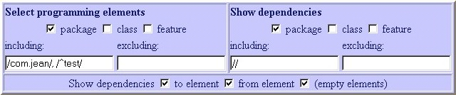
Package-to-Package Example
Including /com.jean/, /^test/
Only list test.* and com.jean*

Slide 24
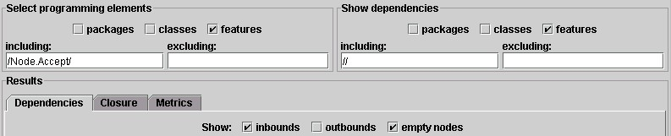
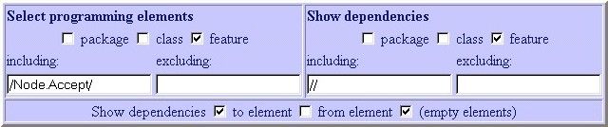
Feature-to-Feature Example
Including /Node.Accept/
Calls to *Node.Accept() methods

Slide 25
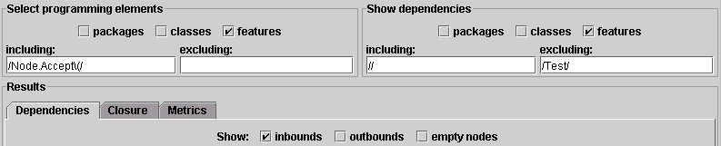
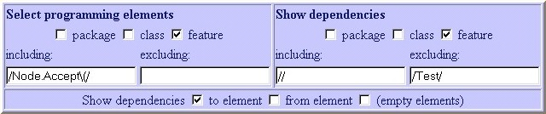
Feature-to-Feature Example
Including /Node.Accept\(/
Calls to *Node.Accept() methods, less output

Slide 26

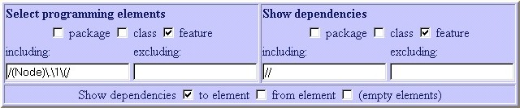
Feature-to-Feature Example
Including /(Node)\.\1\(/
Calls to constructors of Node

Slide 27

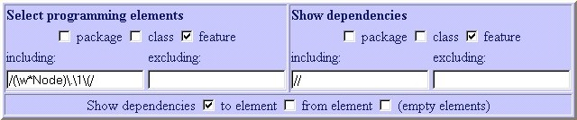
Feature-to-Feature Example
Including /(\w*Node)\.\1\(/
Calls to constructors of classes ending in Node

Slide 28


Feature-to-Feature Example
Including /NodeFactory/
Calls to methods of NodeFactory

Slide 29
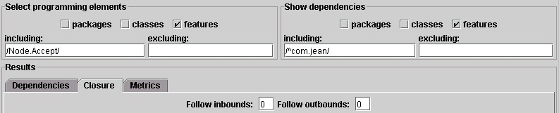
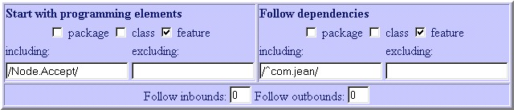
Transitive Closure Example
Shows Accept*() methods

Slide 30

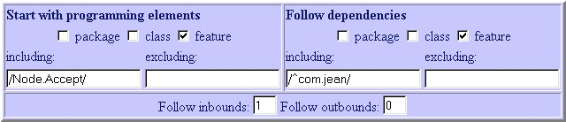
Transitive Closure Example
Direct callers of Accept*()

Slide 31

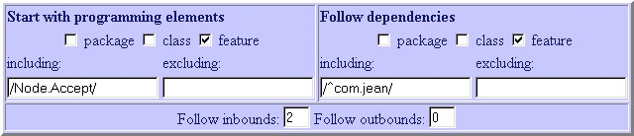
Transitive Closure Example
Second degree callers of Accept*()

Slide 32

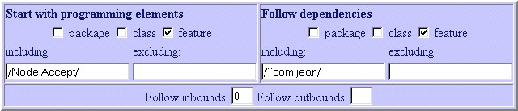
Transitive Closure Example
Everything reachable from Accept*()

Slide 33
Perl Regular Expressions
[A-Z] Capitals
\w Alphanumeric [A-Za-z0-9_]
\W Non-alpha [^A-Za-z0-9_]
\w+ At least one alphanumeric
\s Space, including tab and eol
\s* Zero or more white space
\. ‘.’ as opposed to any character

Slide 34
The End
depfind.sourceforge.net

