Slide 1

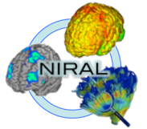
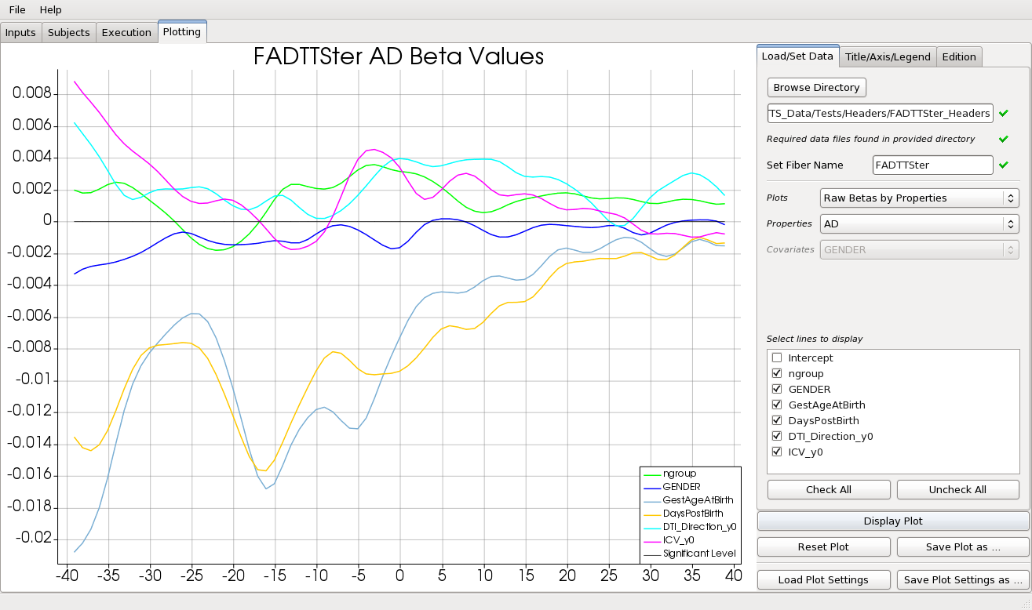
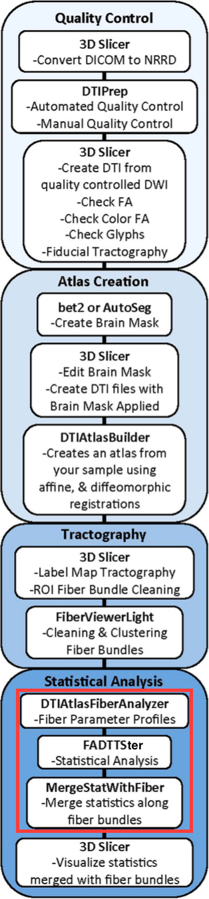
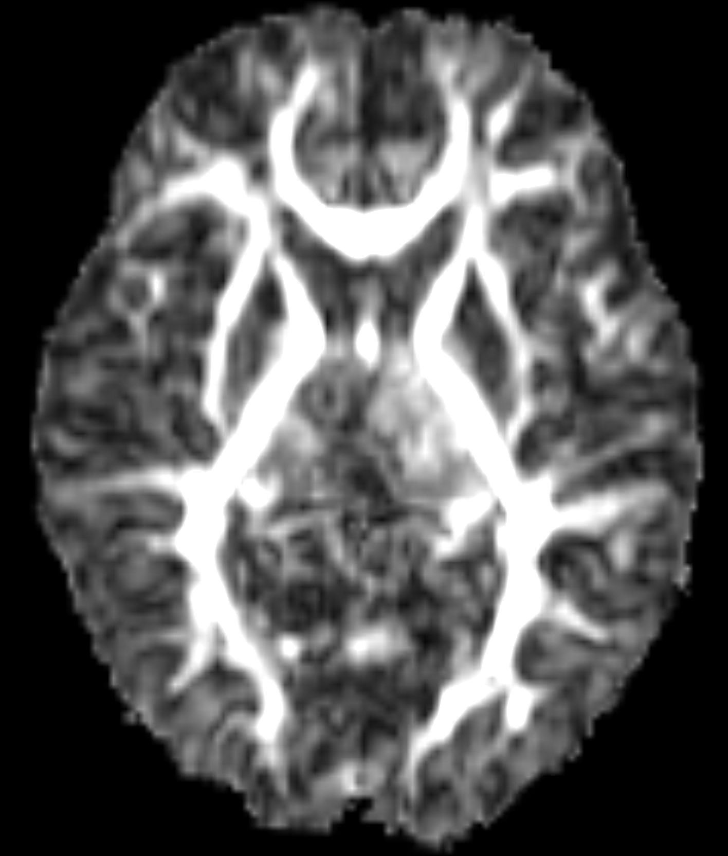
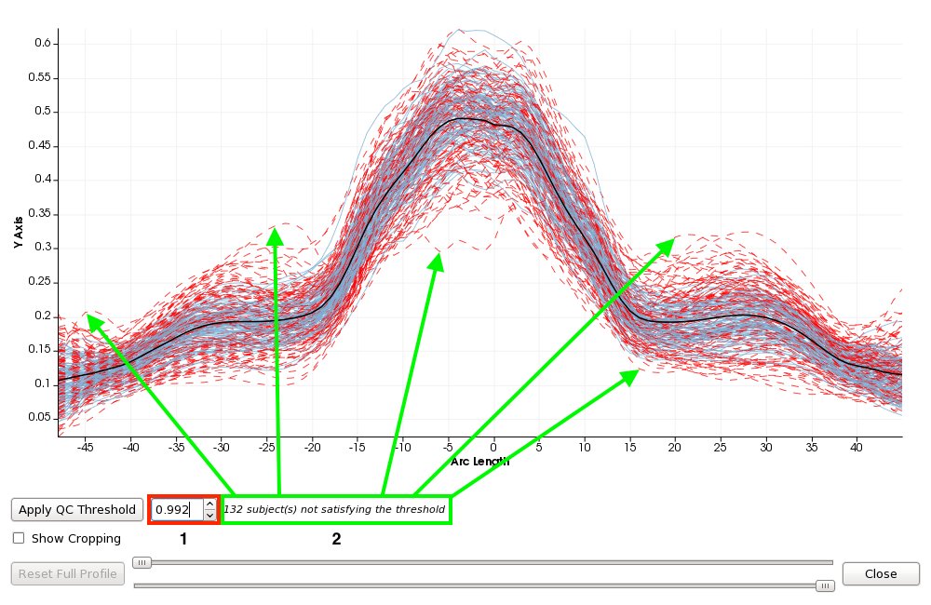
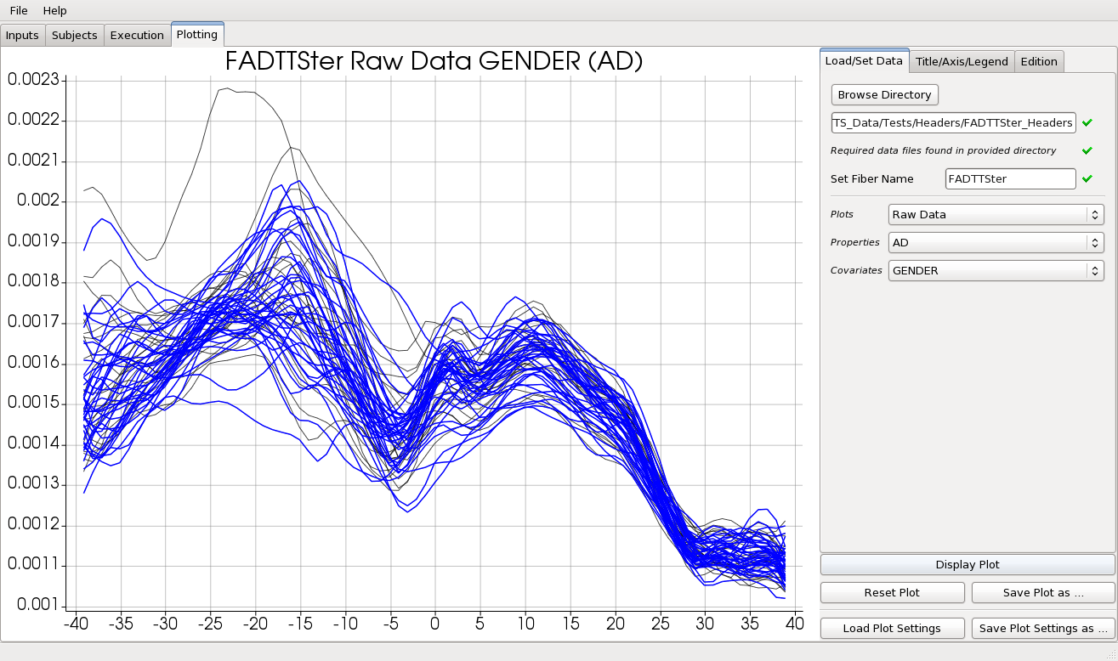
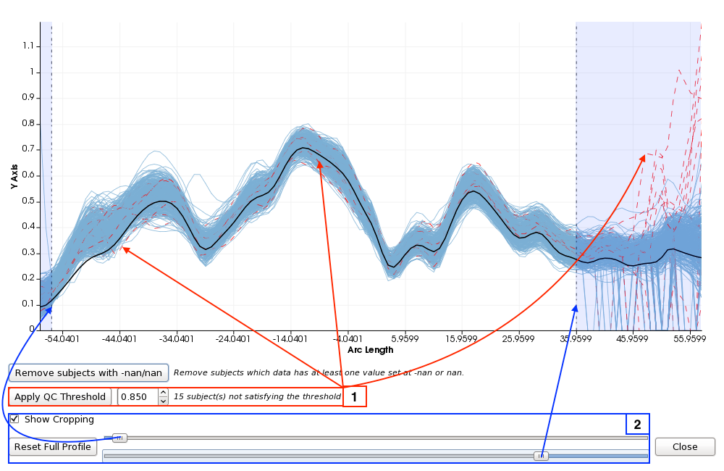

FADTTSter: Accelerating Hypothesis Testing With Functional Analysis of Diffusion Tensor Tract Statistics Jean Noel, Juan C. Prieto and Martin Styner NIRAL, University of North Carolina, Chapel Hill, NC, USA
INTRODUCTION
The main contribution of this work is enabling researches to drill down in the statistical analysis produced by FADTTS using interactive charts.
Additionally, this tool facilitates setting up FADTTS execution and guides the user through a series of steps including quality control
Functional Analysis of Diffusion Tensor Tract Statistics (FADTTS) is a powerful statistical tool box developed to outline the evolution of diffusion properties such as axial diffusivity (AD), radial diffusivity (RD), mean diffusivity (MD) and fractional anisotropy (FA) along white matter fiber tracts and their correlation with a set of covariates of interest, such as age or gender.
MATERIALS
Figure 6: Omnibus FDR significant betas by properties
Images from healthy full-term infants (75 males and 53 females) were taken from a larger study designed to investigate early brain development. All 128 infants were less than one year old at the time of the first imaging session. Using the DTIs from this population of subjects, an atlas is generated with a set of fiber bundles of interest for each subject. These bundles are used in the statistical analysis.
CONCLUSIONS
METHODS
The first contribution presented in this work is to enable FADTTS to non-technical users. The tool guides users through a series of steps which simplifies setting up FADTTS. FADTTSter is actively being used by researchers at the University of North Carolina.
The second contribution presented here is the new set of interactive plots. FADTTS outputs may be difficult to understand with out having the possibility to drill down on the raw data and statistics.
We have shown several plots that will enhance the researcher’s capability to understand the results.
By enabling FADTTS to a broader audience, we seek to accelerate hypothesis testing in neuroimaging studies involving heterogeneous clinical data and diffusion tensor imaging. We expect that this novel tool will lead to new findings in our clinical applications.
RESULTS
Figure 2: FA image
Figure 3: Subject filtering
REFERENCES
[1] Feldman, H. M., Yeatman, J. D., Lee, E. S., Barde, L. H., and Gaman-Bean, S., “Diffusion tensor imag- ing: a review for pediatric researchers and clinicians,” Journal of developmental and behavioral pediatrics: JDBP 31(4), 346 (2010).
[2] Basser, P., Mattiello, J., and Lebihan, D., “MR Diffusion Tensor Spectroscopy and Imaging,” Biophysical Journal 66, 247–254 (January 1994).
[3] Basser, P., Mattiello, J., and Lebihan, D., “Estimation of the Effective Self-Diffusion Tensor from the NMR Spin Echo,” Journal of Magnetic Resonance Series B 103, 247–254 (March 1994).
[4] Zhu, H., Kong, L., Li, R., Styner, M., Gerig, G., Lin, W., and Gilmore, J. H., “FADTTS: Functional analysis of diffusion tensor tract statistics,” NeuroImage 56, 1412–1425 (June 2011).
[5] Verde, A. R., Budin, F., Berger, J.-B., Gupta, A., Farzinfar, M., Kaiser, A., Ahn, M., Johnson, H., Matsui, J., Hazlett, H. C., Sharma, A., Goodlett, C., Shi, Y., Gouttard, S., Vachet, C., Piven, J., Zhu, H., Gerig, G., and Styner, M., “UNC-Utah NA-NAMIC framework for dti fiber tract analysis,” Frontiers in Neuroinformatics 7 (January 2014).
[6] Goodlett, C. B., Fletcher, P. T., Gilmore, J. H., and Gerig, G., “Group analysis of dti fiber tract statistics with application to neurodevelopment,” Neuroimage 45(1), S133–S142 (2009).
[7] Joshi, S., Davis, B., Jomier, M., and Gerig, G., “Unbiased diffeomorphic atlas construction for computational anatomy,” NeuroImage 23, S151–S160 (2004).
[8] Fletcher, P. T. and Joshi, S., “Riemannian geometry for the statistical analysis of diffusion tensor data,” Signal Processing 87(2), 250–262 (2007).
[9] Prieto, J. C., Yang, J. Y., Budin, F., and Styner, M., “Autotract: automatic cleaning and tracking of fibers,” in [SPIE Medical Imaging], 978408–978408, International Society for Optics and Photonics (2016).
Figure 1: UNC-Utah NA-MIC DTI frame- work
Figure 4: Raw data plot
Figure 5: Fiber profile cropping
2017 University of North Carolina

