Slide 1
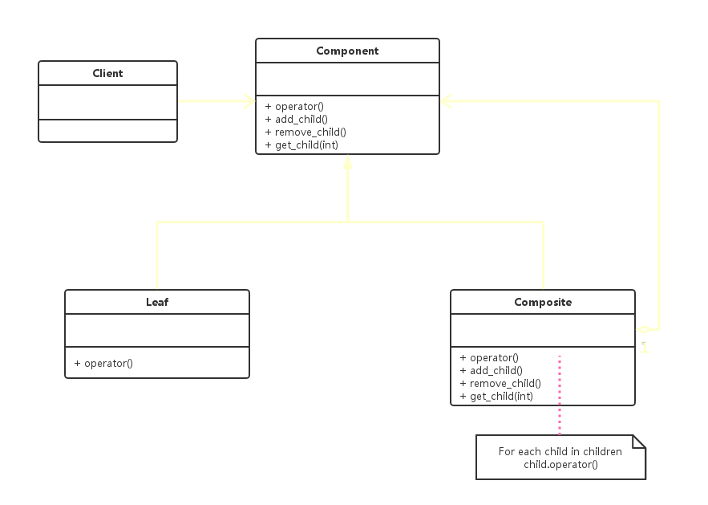
Composite Pattern – Transparent Implementation
Notes:
Motivation
To "compose" objects into tree structures to represent part-whole hierarchies.
It enables clients to treat the individual objects and compositions uniformly.

Slide 2
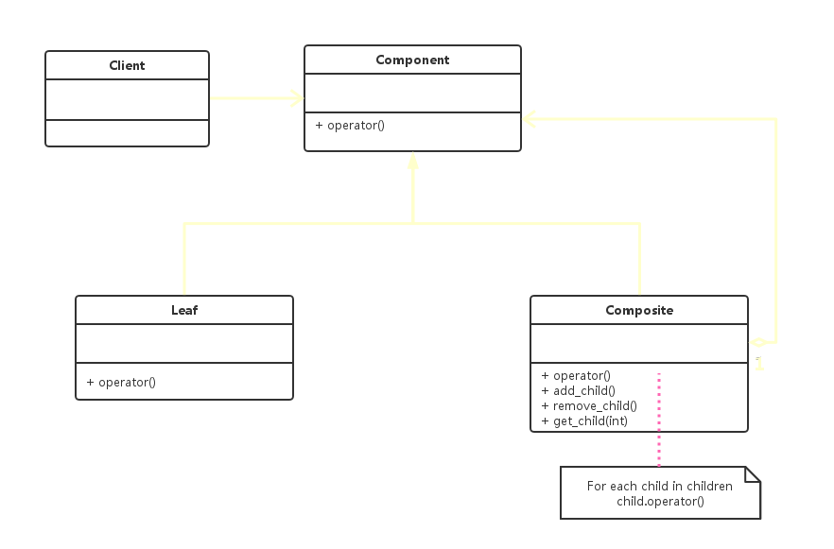
Composite Pattern – Safe Implementation
Notes:
Motivation
To "compose" objects into tree structures to represent part-whole hierarchies.
It enables clients to treat the individual objects and compositions uniformly.

Slide 3
Application In File Systems
document /
flower.jpg
music /
sunrise.mp4
love.mp3
beat it.mp3

Slide 4
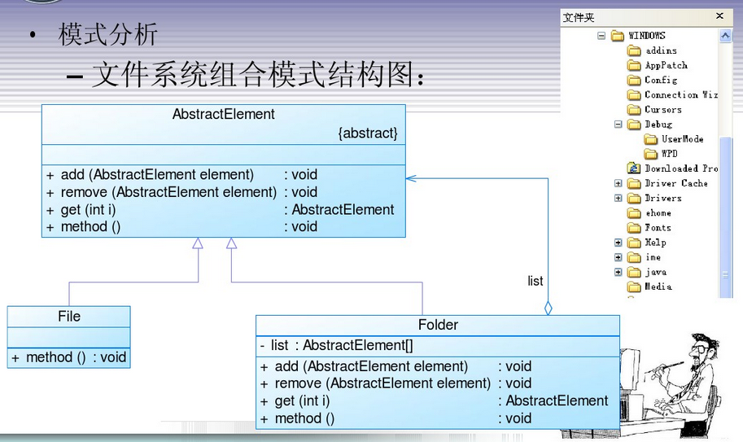
Application In File Systems (UML)

Slide 5
Pros and Cons
Pros
Complex tree structures to represent part-whole hierarchies with multiple layers
Simplify clients’ codes by using Component class interface
Easy to create new implementations for component or add more objects into composite
Cons
Sometimes is too general : hard to restrict the objects which can be included in the composite group
Transparent Implementation : client may do meaningless things to leaf at run-time
Safe implementation : client needs to distinguish between leaf and composite

Slide 6
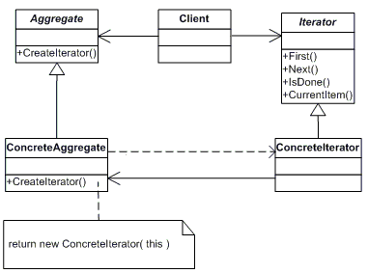
Iterator Pattern
An iterator is used to traverse a container and access the container's elements
It decouples algorithms to manipulate data from its container

Slide 7
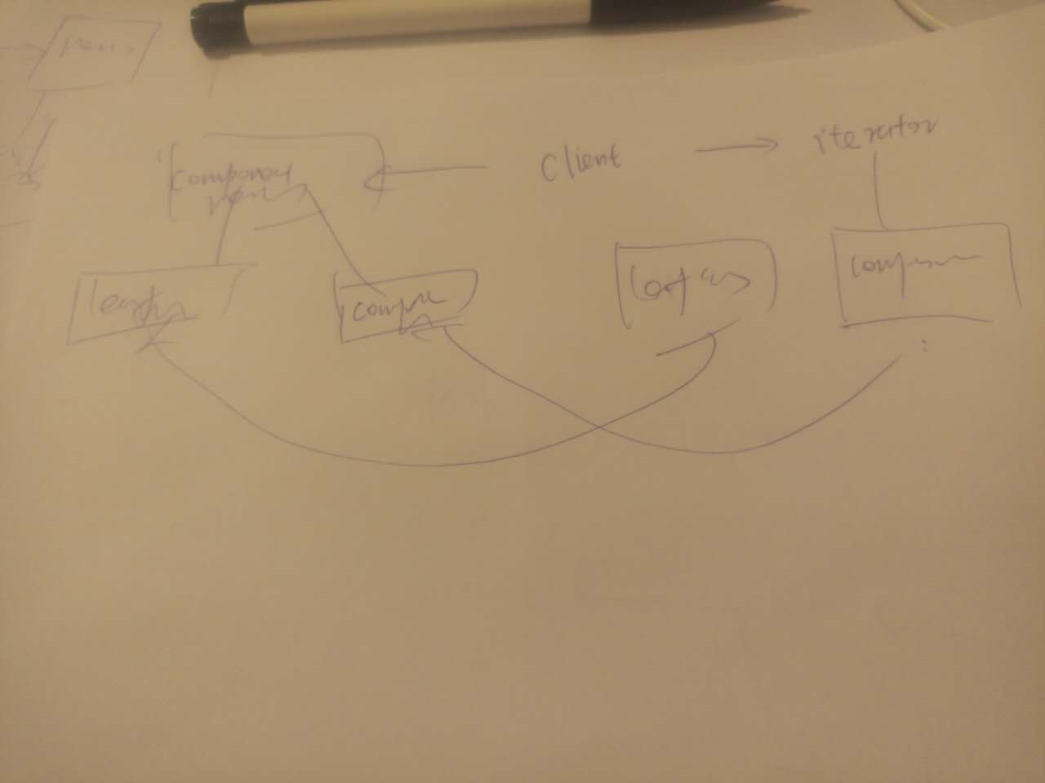
Iterator Pattern meets Composite Pattern

Slide 8
Q&A

