Slide 1
Predict Amazon Book Sales Rank
Yi Zhao

Slide 2
Problem and motivation
Client: A book publisher
Goal: Help publisher choose manuscripts with better potential sales
Method: Use Amazon book reviews to identify characteristics of a better selling book– predict book sales using features extracted from book reviews
Notes:
Increase spaces between bullets

Slide 3
Data Collection
Get 20+ books from the following book lists: ‘best seller’, ‘thriller’, ‘children’, ‘biography’, ‘100 must read books in a life time’– total 126 books
Scrape Amazon book reviews
Organize book meta data and review texts in json files
Variables: Publisher , publishing date, book list name, ASIN , Average rating out of 5 star, 1-5 star rating percentage out of all reviews, Ranking in its sales, The number of reviews, A list of all review titles, A list of all review texts
Notes:
Add screen shot of an amazon review
Explain two sets of variables, meta and word count

Slide 4
Data Wrangling
Convert the review texts into word counts of all present words in all books’ reviews
Coding functions to count words of each book and then creating a dictionary of words from all books, then reshape the counts into an array format
CountVectorizer function in sklearn

Slide 5
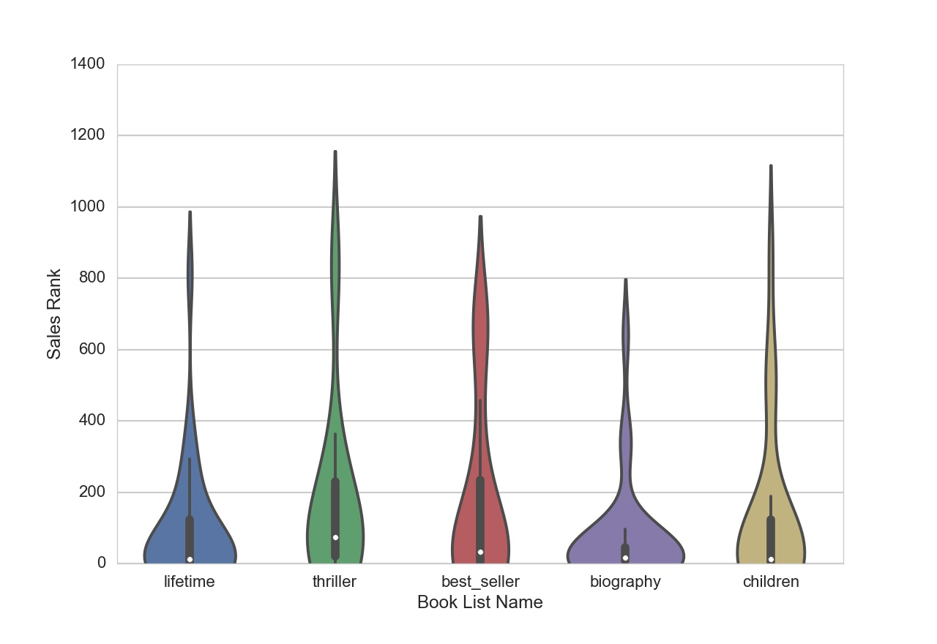
Sales rank is highly skewed across all book lists and needs log transformation to normalize its distribution

Slide 6
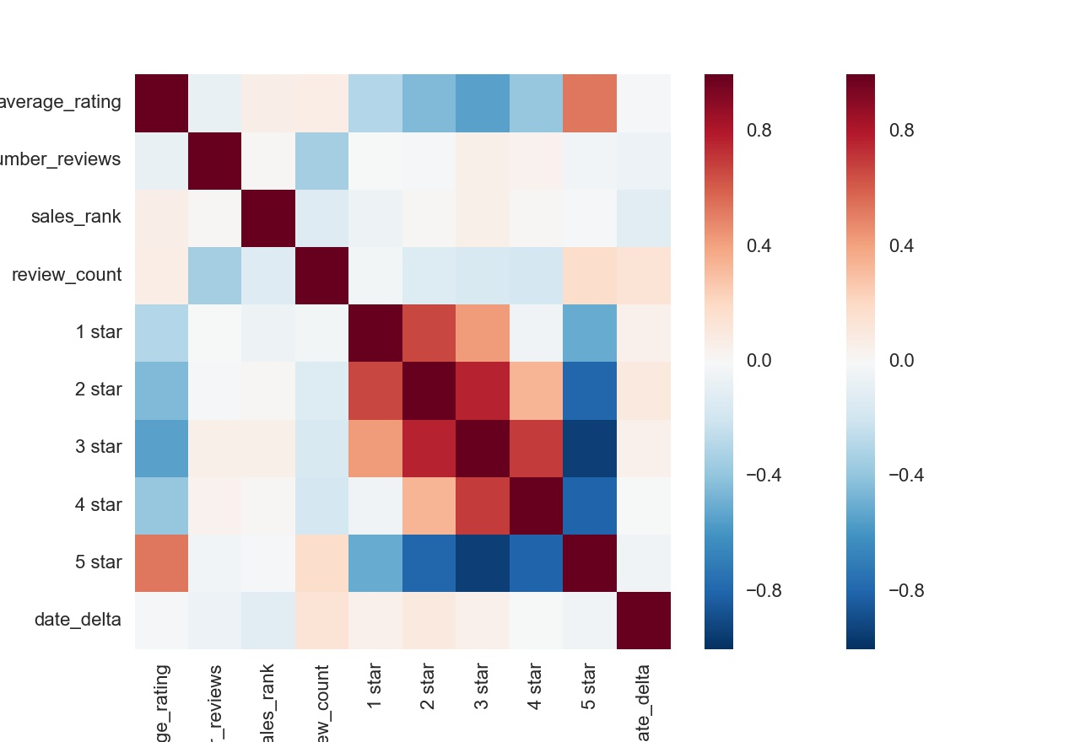
Explanatory analyses findings
Notes:
Shrink figure to show axis

Slide 7
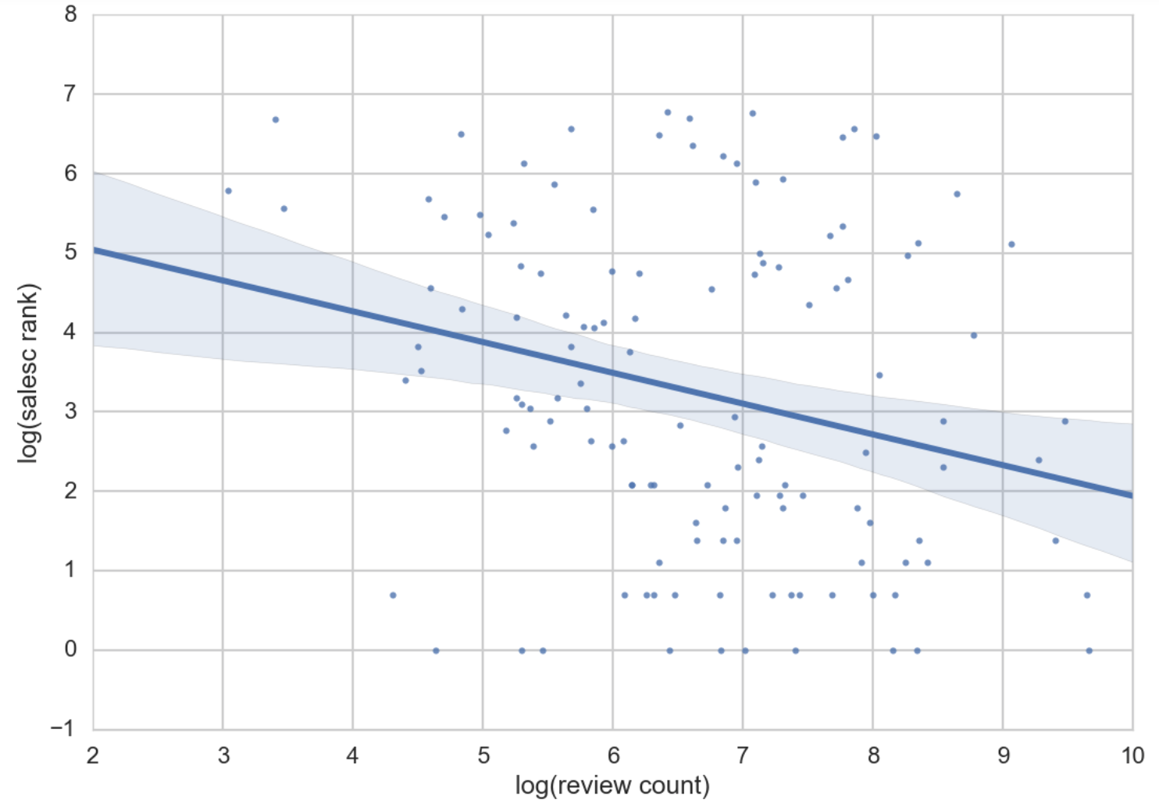
The number of reviews is significantly negatively correlated with sales rank

Slide 8
Use Random Forest, Adaboost, XGBoost and Lasso methods
Why mostly regression tree based?
This is a prediction problem, not classification problem, so all classification methods are excluded, such as SVM, Naïve Bayes, etc
Why ensemble methods
Built in feature selection
Better practical performance
Why Lasso
Built in feature selection
Captures nonlinear relationships

Slide 9
Key findings & recommendations

Slide 10
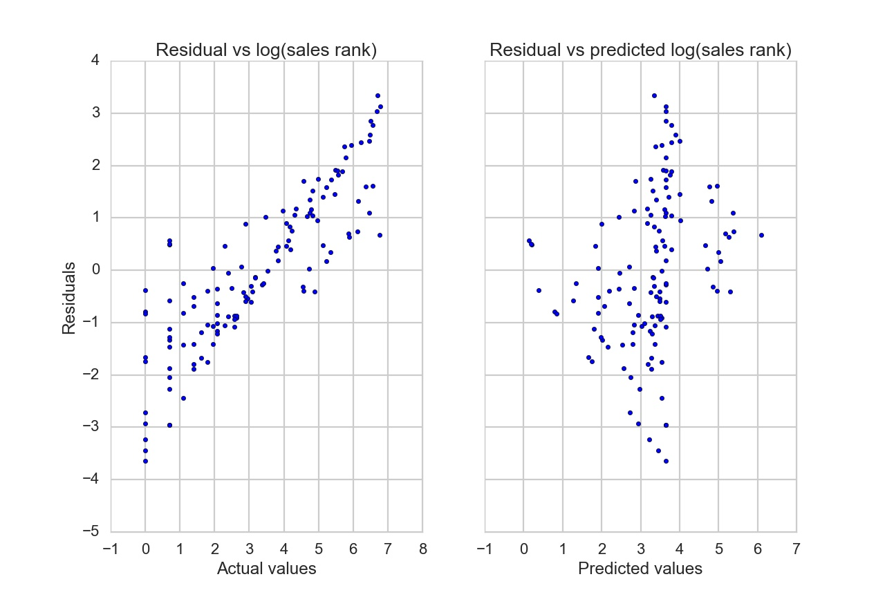
Model residuals are positively related with actual values but not the predicted values

Slide 11
Conclusions
Most important words
----improving sales rank : “withdraw”, “paradox”, “dissipated”
--- worsening rank: “otherworldly”, “cline”, “gait”, “pain”
Topic analyses didn’t improve results
Including and excluding meta variables made no difference
Overall, there was a weak prediction strength using review words

Slide 12
Potential improvements
Increase sample size to 10K +
Make sure to scrape all reviews, rather than the most recent 500 pages
Use word2vec analyses to further identify major themes

Slide 13
Thank You!

