Slide 1
Predict Santander Customer Satisfactions
Yi Zhao

Slide 2
Problem and motivation
Client: Santander Bank
Goal: Predict whether customers were satisfied or dissatisfied with the services
Method: Use an anonymized Santander customer survey dataset to classify dissatisfied from satisfied customers
Notes:
Increase spaces between bullets

Slide 3
Data Description
76020 observations and 370 predictive features Scrape Amazon book reviews
customer satisfaction is a binary variable: 1 for dissatisfied customers and 0 for satisfied customers
3008 out of 76020 customers are dissatisfied, or only 4%
Notes:
Add screen shot of an amazon review
Explain two sets of variables, meta and word count

Slide 4
Data Wrangling
Distinguish categorical from continuous variables for the Logistic Regression
Variables with 20 or less unique values among all 76020 observations were assumed to be categorical variables
Test the sensitivity of logistic regression classification accuracy to the threshold minimum number of unique values fornumerical variables
→ Difference in Area Under the ROC Curve (AUC) was <0.003 when using a threhold of 10, 20 and 30 unique values

Slide 5
Feature Selection and Data Transformation Methods
Principal Component Analysis (PCA) and cross-validate to optimize the number of components
Scale features with a min-max methods, or dividing by the difference between max and min values for each feature
Chi-squared feature selection
Notes:
Add screen shot of an amazon review
Explain two sets of variables, meta and word count

Slide 6
Classification Methods
Logistic Regression
Required feature transformation: distinguishing categorical from numeric variables, and scaling features
Regression tree ensemble methods
Random Forest
Gradient Boost
Naïve Bayes
Bernoulli Naïve Bayes
Extreme Gradient Boost (XGBoost)

Slide 7
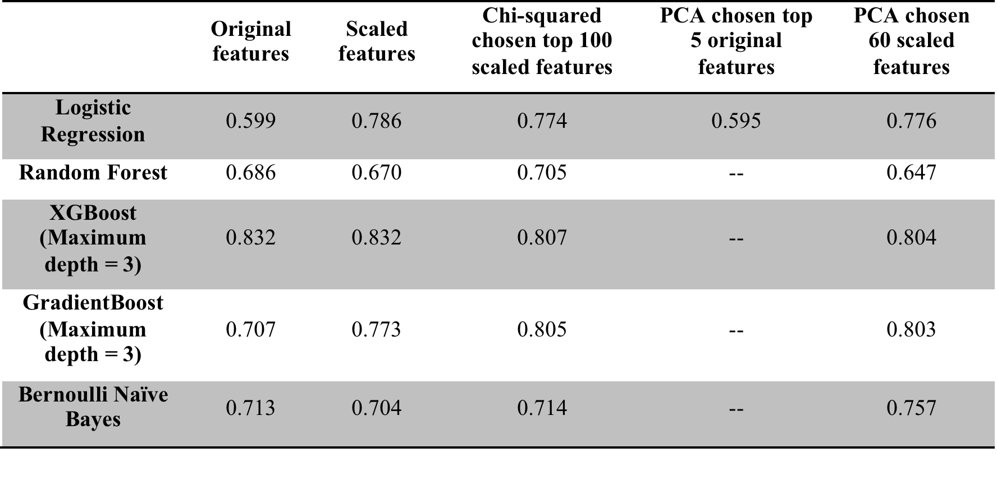
Key findings from Model Selection
Area under the ROC curve for the testing set of various model and feature selection combinations

Slide 8
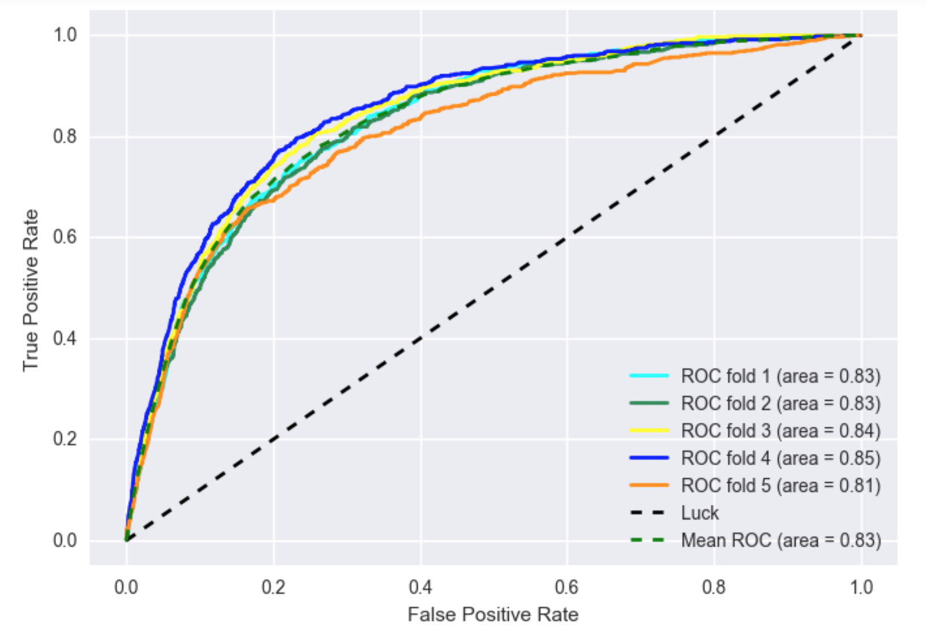
ROC curves computed from 5-fold cross validation of XGBoost model

Slide 9
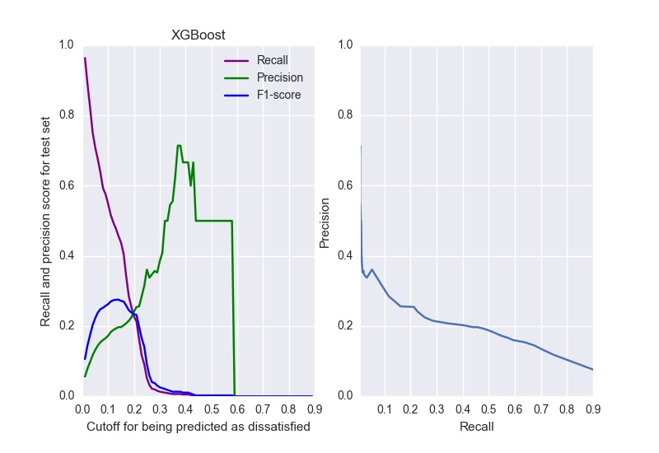
Precision, recall and F1-score of XGBoost classifier at a range of probability thresholds

Slide 10
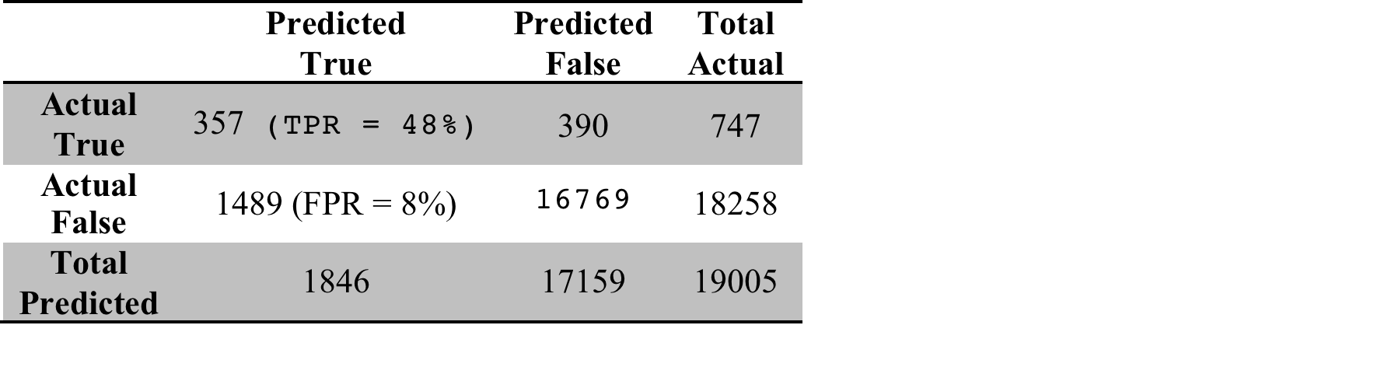
Confusion Matrix of XGBoost classifier at probability threshold 0.13

Slide 11
Conclusions
a simple logistic regression predicts dissatisfied customers of Santander’s at a reasonable performance level (0.79 Average AUC), outperforming Naïve Bayes and Random Forest models.
The extreme gradient ensemble classifier, XGBoost, has a better performance overall in terms of AUC (0.83) and F1-score (0.26), and recall (48%).
For Santander, recall is more important than precision or other measures, because the number of False Positives is less alarming than the number of False Negatives.

Slide 12
Thank You!

