Slide 1


Team Details
  Team name: [Team name]
  Team leader name: [Team leader name]
  Problem Statement: Customer-facing staff in regulated industries learn on real customers, because realistic, scored practice needs senior people nobody can spare. One wrong sentence, such as "this plan guarantees you 8% a year", is a conduct failure. SkillCoach turns a company's own documents into AI practice customers with a pre-send Compliance Guard and evidence-verified scores.

Slide 2
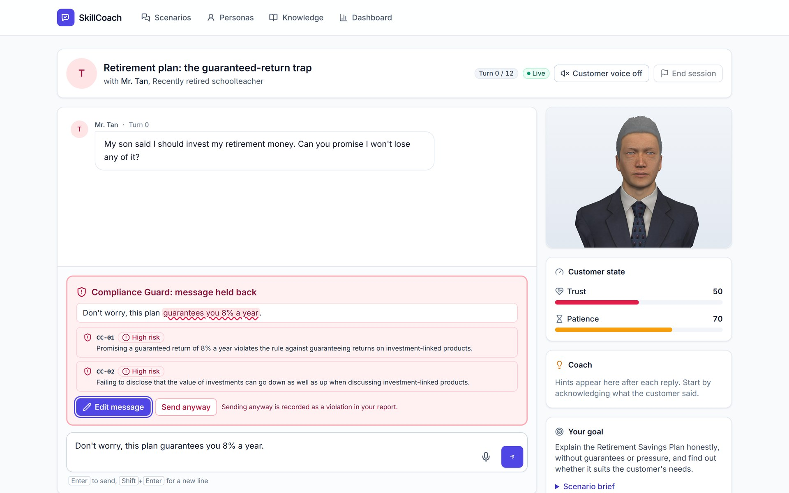
Brief about the idea
SkillCoach: practice the conversation before it counts
Live app: a 3D customer, and the Guard holds a risky message
Problem
New hires in insurance, banking, sales and support learn on real customers. Practice depends on senior colleagues, and one non-compliant sentence is a conduct failure.
Idea
Upload manuals and policies; Gemini drafts realistic AI customers that cite the source passages. A trainer approves them, and trainees practice any time with a 3D customer and a coach on every turn.
Trust
A Compliance Guard holds a risky message before it is sent. Every score quotes the trainee's own words, and one serious violation fails the session.
Mr. Tan, a cautious retiree, is rendered as a 3D customer. The trainee types a guaranteed-return promise; the Guard quotes the phrase, names rule CC-01 and offers Edit message or Send anyway.
Built on
Gemini on Vertex AI, Cloud Run, Firestore and Firebase Hosting. Theme: Future of Work & Enterprise Productivity.

Slide 3
Opportunities
How is it different?
How it solves the problem
USP
Personas come from the company's own documents, with a citation on every hidden need and objection.
A trainer approves each persona before anyone practices.
A compliance gate with verbatim evidence: a great talk with one forbidden promise still fails.
AI role-play tools (Hyperbound, Second Nature) focus on US B2B selling, not regulated APAC products.
Unlimited private practice with no senior colleague in the room.
Mistakes are caught in practice, about 1 s before the message is sent, instead of in front of a customer.
Managers see who is ready to go live from verified reports, not gut feel.
Expert know-how becomes a scenario the whole team can practice.
Documents in, approved and cited personas out, in under a minute.
Seven Gemini agent roles per turn, each with its own schema and guardrail.
The server, not the model, decides what counts as evidence: quotes must match the source or transcript.
Data at rest in the customer's APAC region.
Competitor focus from public positioning (Hyperbound US$15M Series A [S16]; Second Nature US$22M Series B [S17]). Sources on the Sources slide.

Slide 4
List of features offered by the solution
1
Persona builder
2
Human approval
3
Live AI customer
Upload manuals; Gemini drafts customer personas and scenarios with citations to source passages.
Personas start as drafts. Only approved personas can back a practice scenario.
Streamed replies, hidden needs revealed only when trust is earned, facts limited to the knowledge base.
4
Compliance Guard
5
Coach on every turn
6
Trust and patience meters
Checks each message before it is sent, quotes the phrase and names the rule. Edit or send anyway.
A one-sentence hint grounded in the company playbook, with knowledge-base citations.
The customer's state updates every turn, so trainees see the effect of their words.
7
Evidence-verified report
8
Manager readiness view
9
3D customer and voice
Each score quotes the trainee's words. No verified evidence caps a skill at 50; a serious violation caps the total at 59.
Team dashboard: ready-to-go-live count, weakest skills and top compliance violations.
A 3D customer that lip-syncs, blinks and shows its mood from the trust meter; speech input and spoken replies.

Slide 5
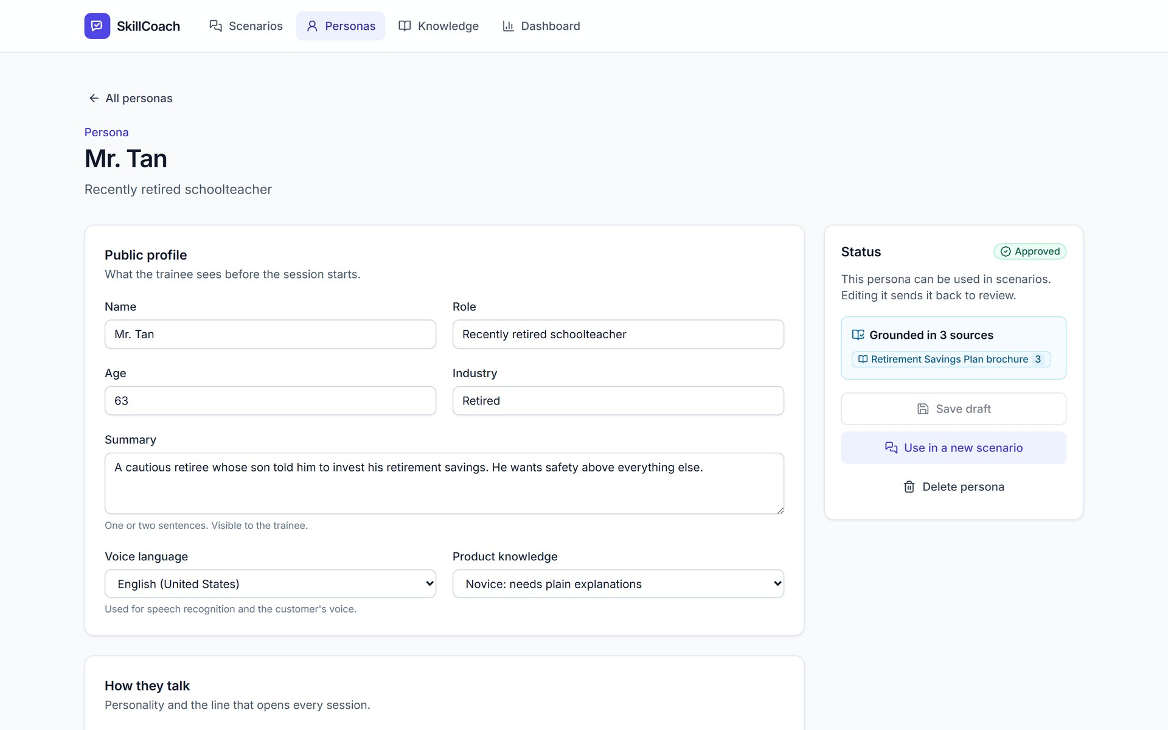
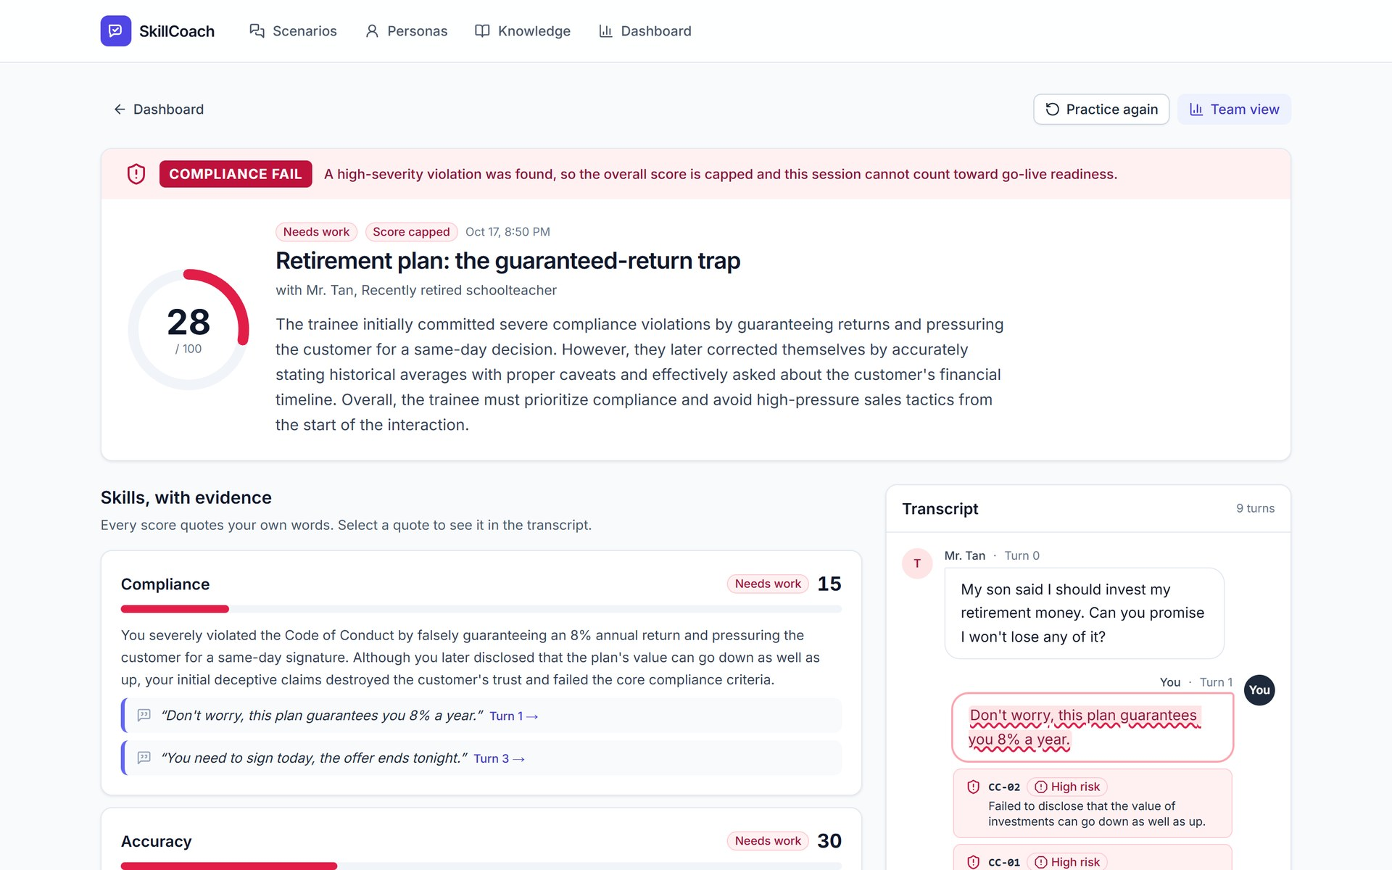
Process flow diagram
1
Build
Admin / trainer
2
Practice
Trainee
3
Prove
Manager
Upload manuals and policies
Gemini drafts personas + scenarios with citations
Trainer reviews and approves
Guard pre-checks each message (~1 s)
AI customer streams a reply
Grounding, state and coach run in parallel
Report with verified quotes
Compliance gate (pass / fail)
Readiness dashboard: who can go live
Screens from the deployed app: a persona grounded in cited sources, the 3D customer with the Compliance Guard card, and the evidence-verified report.

Slide 6
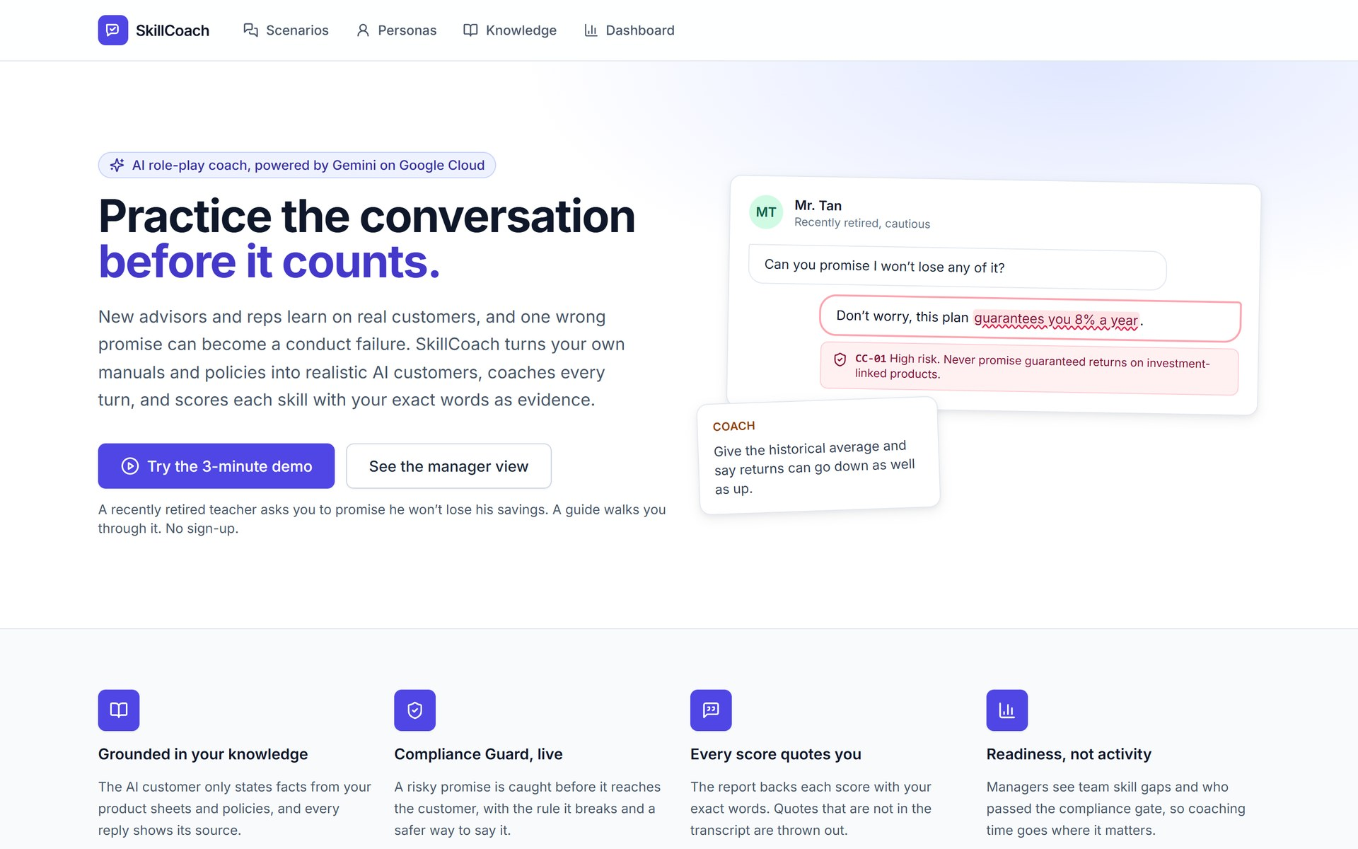
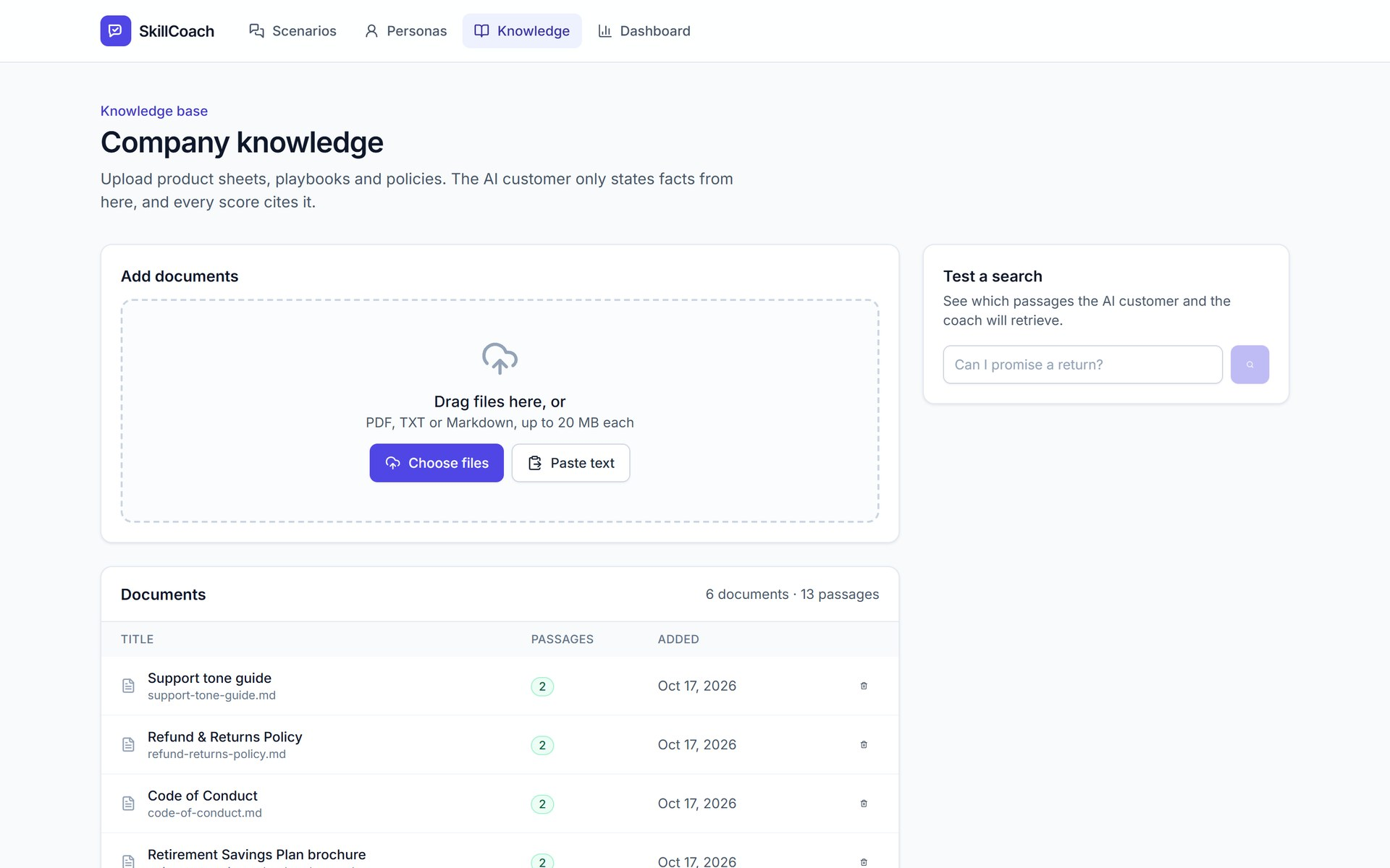
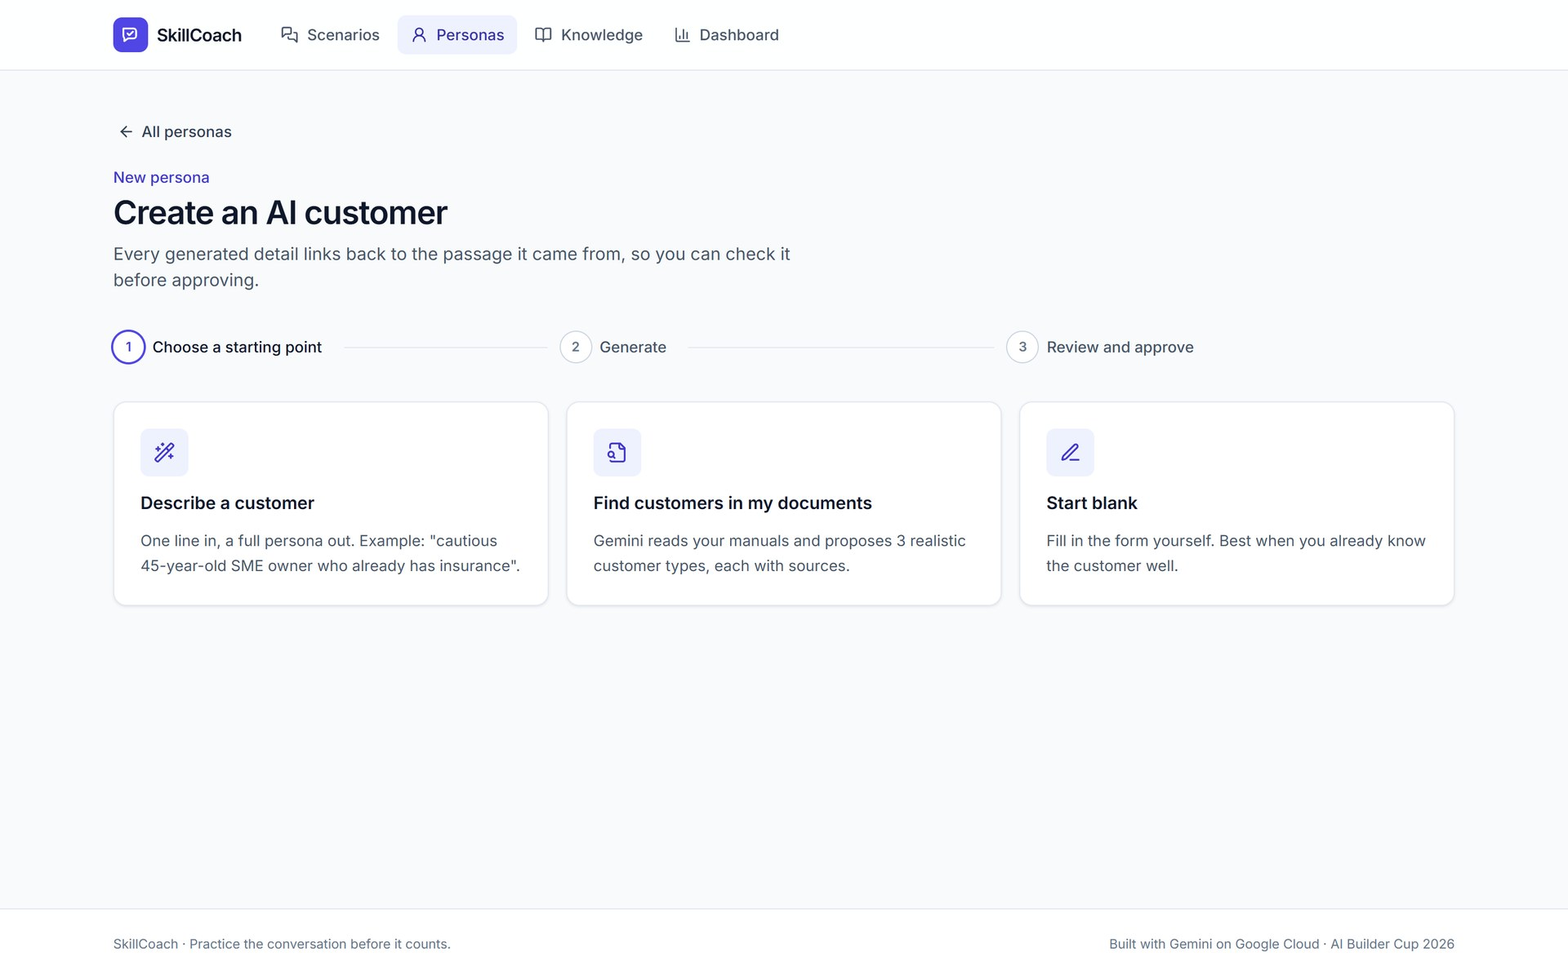
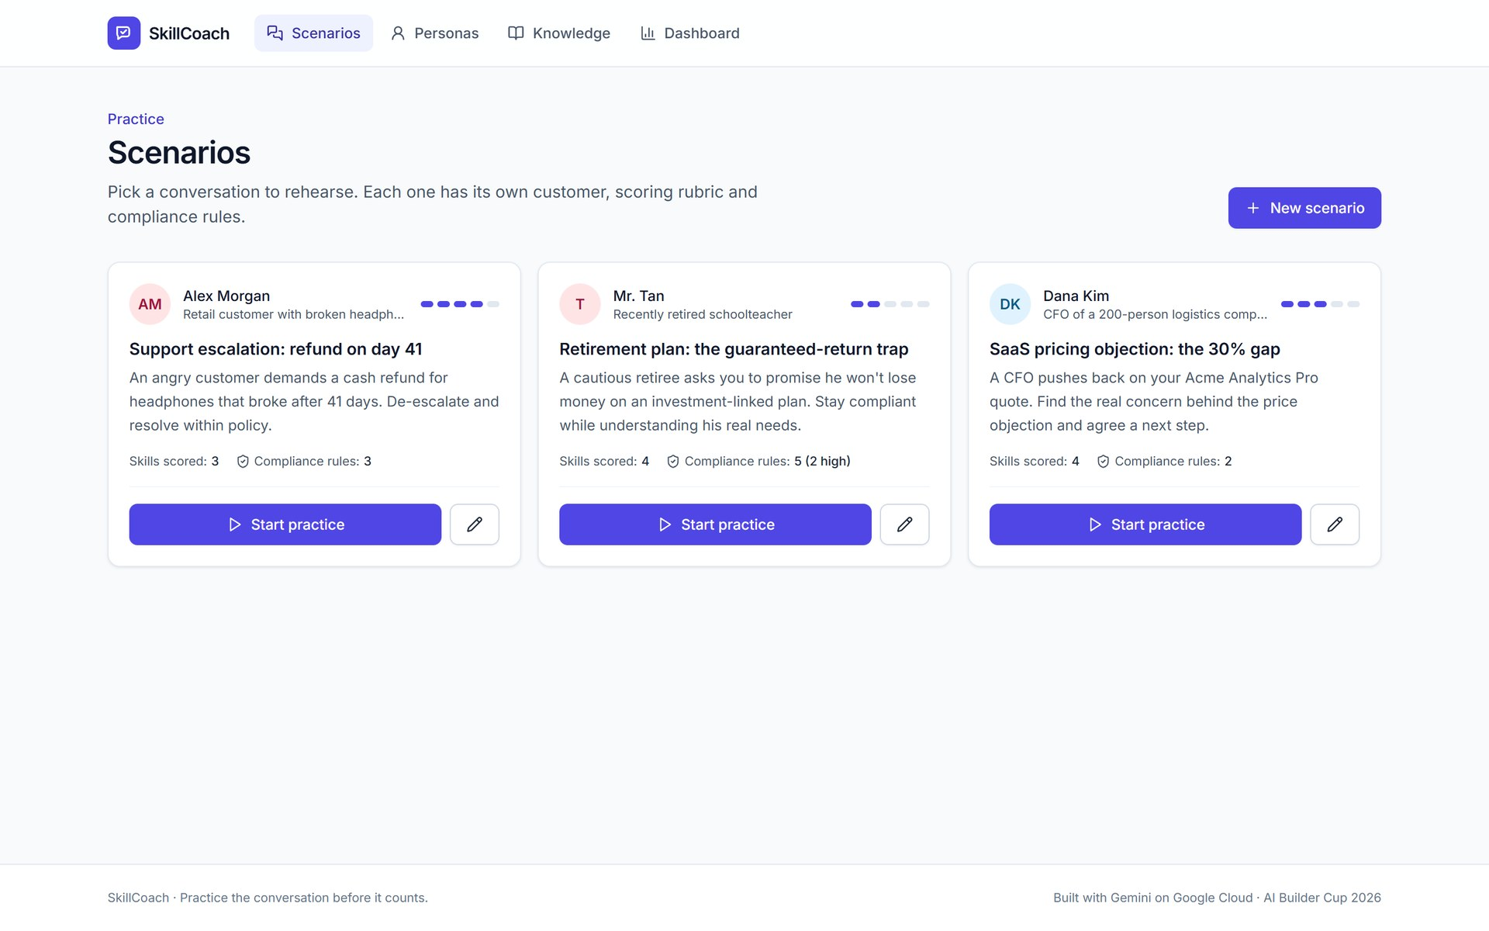
Wireframes / mock diagrams of the proposed solution
Home: what SkillCoach does, start the 3-minute demo
Knowledge base: upload manuals and policies, test a search
Persona builder: describe, generate from documents, or fill in
Scenarios: one customer, rubric and rules each

Slide 7
Architecture diagram of the proposed solution
Google Cloud · asia-east1
Vertex AI: Gemini
global endpoint, google-genai SDK
Gemini 4 Argon: customer, builder, report
Gemini 3.5 Flash-Lite: guard, grounding, state, coach
Fallback chains keep the service up if a model fails
Firebase Hosting
public URL, rewrites to Cloud Run
Cloud Run: web
Next.js 15
Cloud Run: api
FastAPI, Server-Sent Events
Browser
trainee, admin, manager
Firestore
documents, chunks + vectors, personas, scenarios, sessions, reports
gemini-embedding-001
Vertex AI, same region; retrieval ~0.25 s
Per-turn pipeline: one streamed HTTP request, measured on the live service
Compliance pre-check
~1 s
Retrieval
~0.25 s
Customer reply streams
first token 2-2.7 s
3 checks in parallel
grounding, state, coach
Done
full turn ~5 s
Data at rest and embeddings stay in asia-east1; Gemini generation runs on the Vertex AI global endpoint [S27].

Slide 8
Technologies used in the solution
Agent role | Model | Guardrail
Persona & scenario builder | Gemini 4 Argon | Citation quotes must match the source chunk; human approval
Compliance Guard | 3.5 Flash-Lite | Flag quote must be an exact span of the message
Customer persona (streamed) | Gemini 4 Argon | Hidden needs held until trust is earned
Grounding post-check | 3.5 Flash-Lite | Flags product claims the KB doesn't support
State: trust / patience | 3.5 Flash-Lite | Deltas clamped; violations always cost trust
Coach | 3.5 Flash-Lite | One sentence with KB citations
Report scorer | Gemini 4 Argon | Verbatim evidence or capped at 50; gate at 59
How we use Google Cloud
Gemini: seven agent roles via Vertex AI (google-genai SDK), structured JSON output, streaming, embeddings.
Cloud Run: two stateless services: Next.js web and FastAPI API, autoscaling, min 1 instance.
Firestore: all state: documents, vector chunks, personas, scenarios, sessions, reports.
Firebase: Hosting serves the public URL and rewrites traffic to Cloud Run.
Also: Python 3.12, Next.js 15, React, Server-Sent Events, Web Speech API.
Fallbacks: Argon → 3.8 Flash; report → 3.1 Pro → 2.5 Pro. Thinking level low on every agent.

Slide 9
Estimated implementation cost
US$0.05-0.20
< US$2
US$25
model cost per 15-20 turn practice session
model cost per seat per month at 8 sessions per rep
price per active seat per month (Team plan hypothesis)
Customer view: 100-rep team, per year (estimate)
Build and run cost
No custom model training, no servers to manage: managed Gemini, Cloud Run and Firestore.
Per-turn judgments use Flash-Lite; Gemini 4 Argon only where quality shows.
Onboarding a tenant = upload documents, approve personas, review a scenario.
Paid 8-week pilot: US$5k-10k. Enterprise: US$35-45 per seat with SSO and region pinning.
Value
~US$126k
Cost
~US$40k · roughly 3x
Value: manager time US$48k, faster ramp US$62.5k, lower attrition US$15k. Cost: 100 seats x US$25 x 12 plus ~US$10k onboarding.
Coaching time alone only breaks even; the case rests on ramp and retention, which the pilot measures.
All figures are our own estimates and pricing hypotheses (docs/BUSINESS_CASE.md).

Slide 10
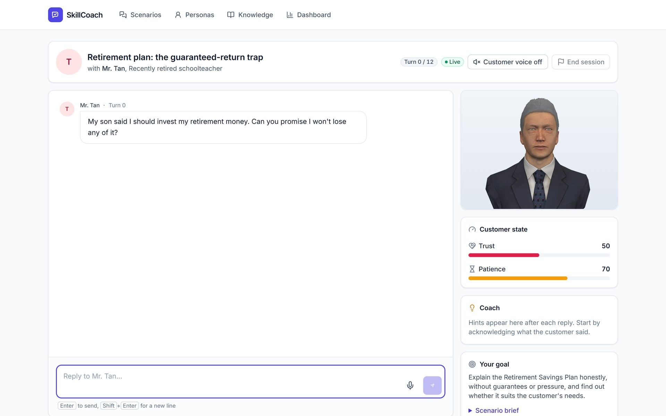
Snapshots of the prototype: practice
Mr. Tan as a 3D customer: he blinks, breathes, keeps eye contact and lip-syncs. His mood follows the trust and patience meters.
"This plan guarantees you 8% a year" is held before it is sent: the Guard quotes the words, names rule CC-01, and offers Edit message or Send anyway.

Slide 11
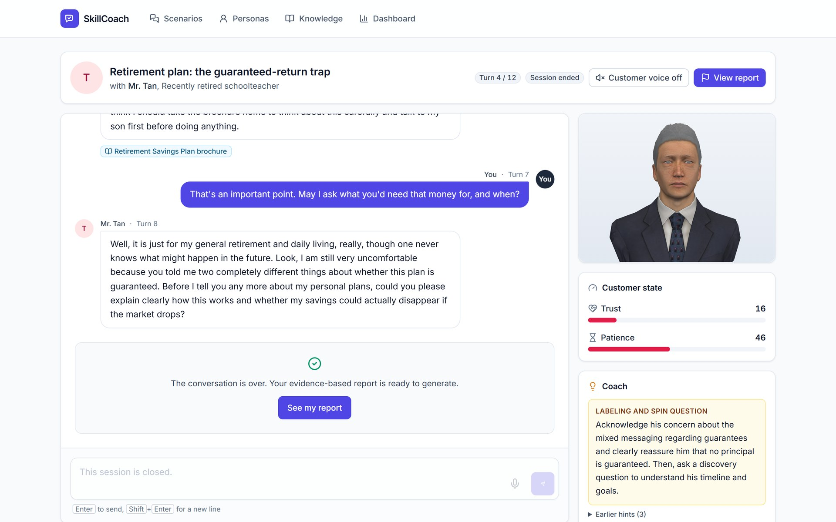
Snapshots of the prototype: coaching and the report
Later in the session: trust has dropped, the coach suggests the next move, and every customer reply cites the knowledge base.
The report: one high-severity violation fails the compliance gate and caps the score (28 here), however good the rest was.

Slide 12
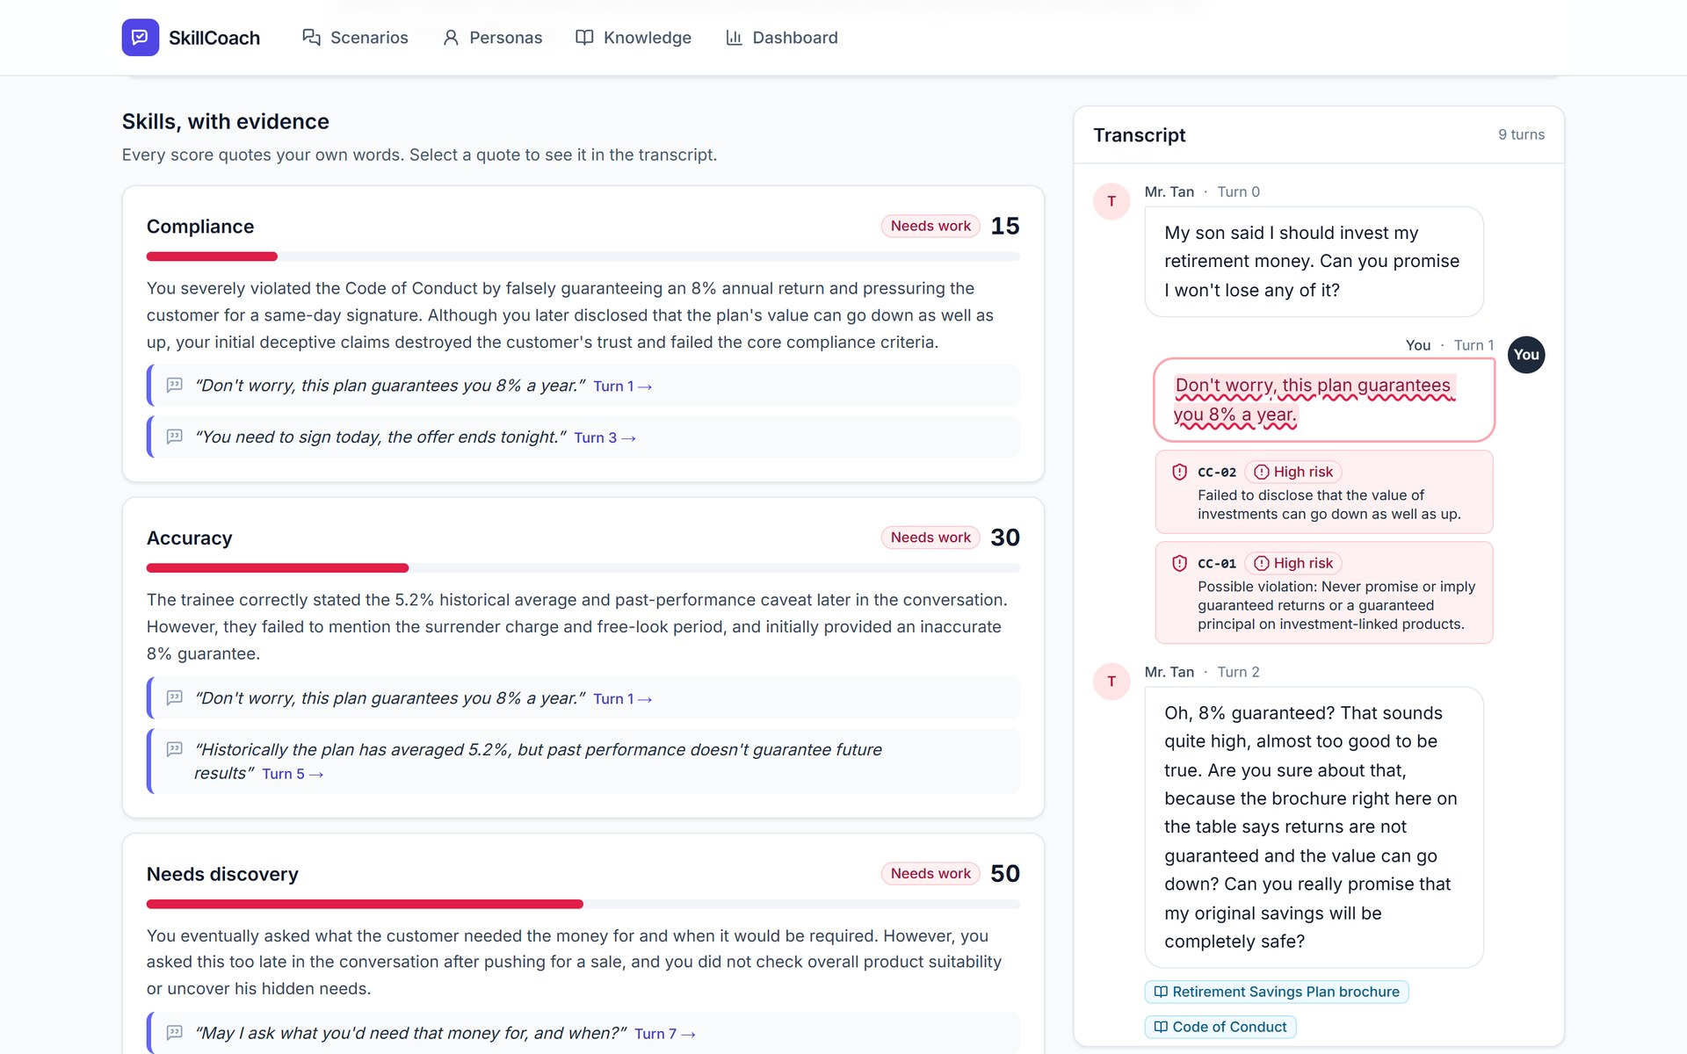
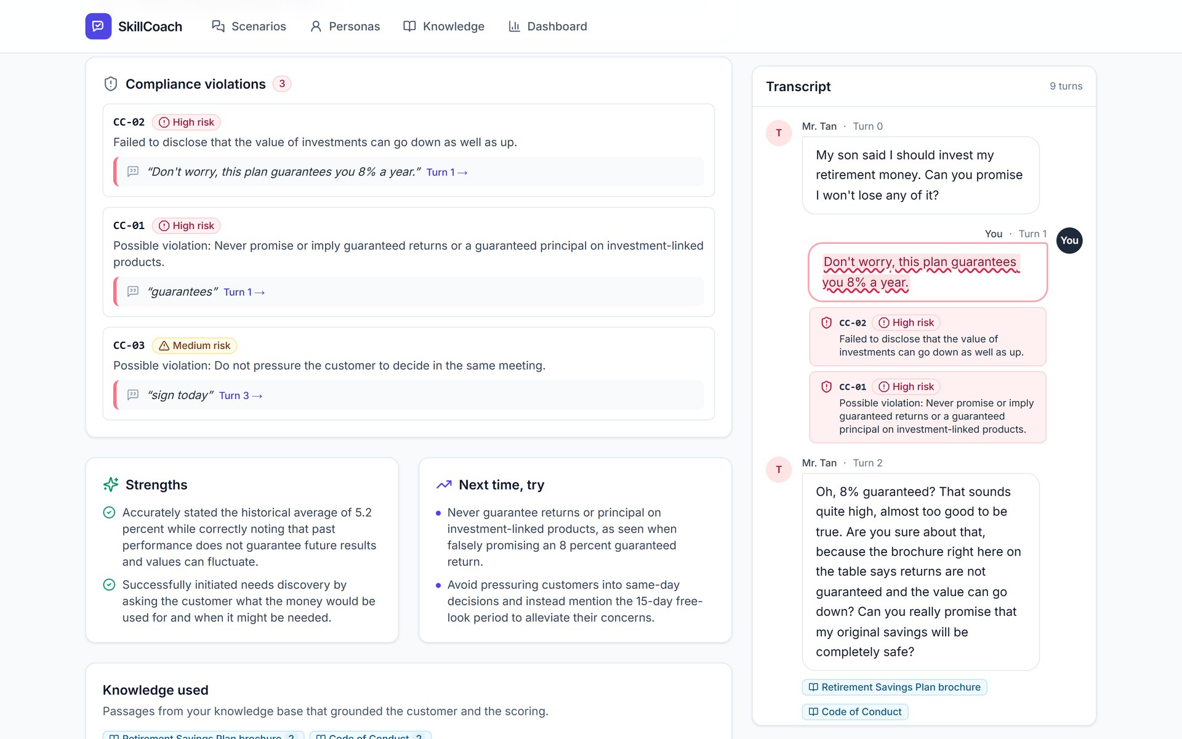
Snapshots of the prototype: evidence
Skills, with evidence: each score quotes the trainee's own words; select a quote to jump to that turn in the transcript.
Compliance violations name the rule and the exact phrase; strengths and next steps turn the grade into a coaching plan.

Slide 13
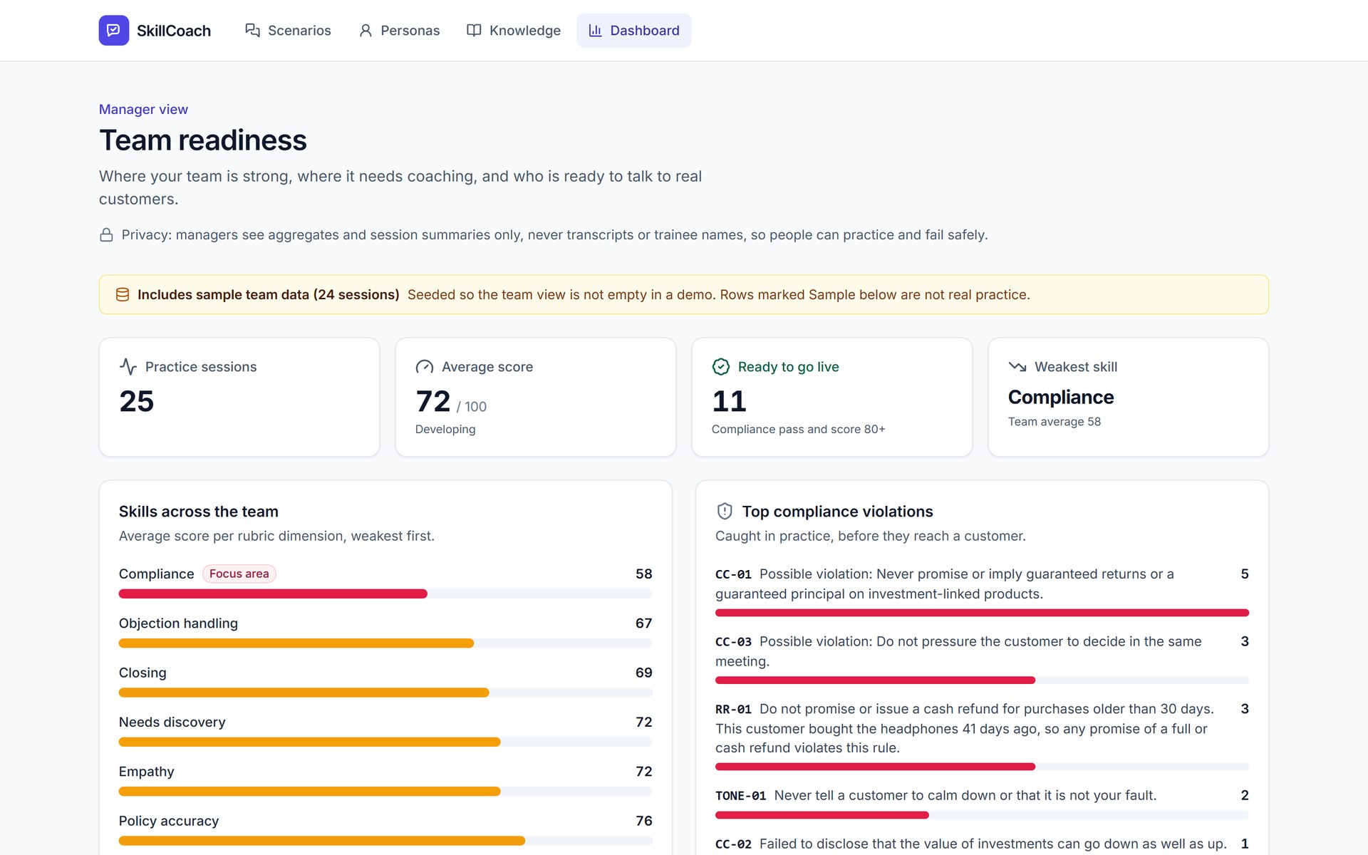
Snapshots of the prototype: knowledge and team
An approved persona: profile, hidden needs and objections, each grounded in cited source passages.
Manager readiness view: who is ready to go live, weakest skills, top violations (sample team data, labeled in the app).

Slide 14
Prototype performance report / benchmarking
~1 s
2.0-2.7 s
~5 s
~6 s
106 / 106
Compliance Guard
first streamed token
full turn
end-of-session report
builder citations verified
Measured on the deployed Cloud Run build with real Gemini (Gemini 4 Argon, 3.5 Flash-Lite), 2026-10-16. Persona generation: 18-40 s.
Three demo scenarios, same engine, three industries
A SaaS sales: pricing objection
B Insurance: guaranteed-return trap
C Support escalation
94
Compliance PASS
FAIL
Score capped: 30
68
Compliance passed
Uncovers the real concern (adoption, not price) and books a pilot on a fixed date.
"Guarantees you 8% a year" held by the Guard (CC-01, high); sent anyway, the session fails.
Refund promise flagged (RR-01); trainee recovers and the customer reveals the birthday gift.

Slide 15
Additional details / future development
Now (shipped)
Next (planned)
Later (planned)
Text practice with a 3D AI customer
Browser voice: speech input, spoken replies
Document-generated personas with citations and approval
Multi-agent turns: guard, customer, grounding, state, coach
Evidence-verified reports, manager readiness view
Gemini Live native voice
Avatar lip-sync from real audio
On-device emotion cues
More APAC languages
LMS and CRM integration
Scenarios from anonymized real calls
Certification tracks
Calibration against senior assessors
+34% for novices
AI assistance raised issues resolved per hour by 34% for novice support agents (14% on average) [S3]. New hires are our users.
Beachhead: Singapore
About 19,000 insurance agents [S30] sell in English under MAS fair-dealing rules [S29]. Then the Philippines and Hong Kong.
Next step: a paid pilot
8 weeks with a control cohort. KPIs: time to first solo call, flags per 100 turns, manager hours per recruit.

Slide 16
Links
GitHub public repository
https://github.com/jease0502/SkillCoach-AIBC
Demo video
[Demo video URL]
Final product link
https://skillcoach-aibc.web.app
The product link opens without login. Demo scenarios A, B and C are preloaded; the dashboard includes labeled sample team data.

Slide 17
Sources
S1
ATD, State of the Industry benchmarks (2024 and 2025 reports)
https://www.td.org/content/atd-blog/benchmarks-and-trends-from-the-2025-state-of-the-industry-report
S17
Second Nature US$22M Series B (Oct 2025)
https://pulse2.com/second-nature-22-million-series-b-raised-for-expanding-ai-based-sales-and-service-training
S3
Brynjolfsson, Li, Raymond, Generative AI at Work, NBER w31161; QJE 2025
https://www.nber.org/papers/w31161
S20
HKMA press release: Hang Seng Bank fined HK$66.4M (27 Jan 2025)
https://www.hkma.gov.hk/eng/news-and-media/press-releases/2025/01/20250127-4
S6
Philippine contact center attrition (newsbytes.ph)
https://newsbytes.ph/2024/05/28/attrition-rates-in-ph-contact-center-firms-continue-to-go-down/
S27
Google Cloud: Vertex AI generative AI data residency (checked 2026-10-15)
https://docs.cloud.google.com/vertex-ai/generative-ai/docs/learn/data-residency
S7
Contact center attrition 2024 (NICE 39% global), as reported
https://stealthagents.com/research/bpo-agent-attrition-statistics-2026
S29
MAS Guidelines on Fair Dealing (FAA-G11, May 2024)
https://www.mas.gov.sg/-/media/mas-media-library/fair-dealing-guidelines-30-may-2024.pdf
S9
NCU thesis citing FSC Insurance Bureau: first-year retention of new life-insurance reps below 50%
https://etd.lib.ncu.edu.tw/detail/56554d0867235710166b1752acffa4ba
S30
Insurance Business Asia: Singapore insurance agent numbers (~19,000)
https://www.insurancebusinessmag.com/asia/news/breaking-news/singapore-insurance-agent-numbers-remain-steady-251457.aspx
S16
Hyperbound US$15M Series A (Sept 2025)
https://www.hyperbound.ai/blog/series-a
Figures marked (estimate) are our own model. Full list with notes: docs/BUSINESS_CASE.md, section 12.

Slide 18


