Slide 1
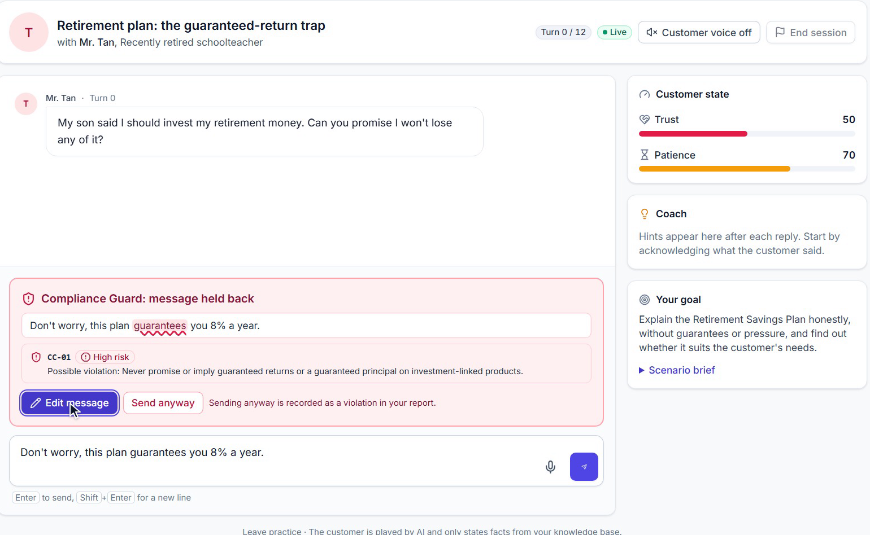
S
SkillCoach
Live app: Compliance Guard holds a risky message before the customer hears it
Google Cloud AI Builder Cup 2026
Theme: Future of Work & Enterprise Productivity
Practice the
conversation
before it counts.
AI customers built from your company's own documents, a Compliance Guard on every message, and scores that quote your words.
The trainee types a guaranteed-return promise; the Guard names rule CC-01 and offers Edit message or Send anyway.
[Team name]
Live demo: skillcoach-web-817759648389.asia-east1.run.app
Video: [Video URL]
GitHub: github.com/jease0502/SkillCoach-AIBC
Notes:
Customer-facing work is one of the largest parts of the workforce, and new hires still learn it on real customers. SkillCoach gives every new hire a realistic practice customer and a coach, built from the company's own manuals and rulebooks, and running on Gemini and Cloud Run today. Everything in this deck is in the deployed build unless it is labeled "planned".

Slide 2
Every customer-facing employee gets a tireless practice partner that knows the company's products and rules
VISION
1
2
3
4
Manuals and policies
AI customer + coach
Verified skill report
Ready to go live
What the company already has
Realistic practice, any time
Every score quotes the trainee
Decided on evidence
Private, unlimited, always on
Know-how becomes practice
Readiness based on evidence
Practice at any time, as often as needed, with no senior colleague in the room.
How the best people handle objections turns into a scenario the whole team can practice, instead of leaving with the expert.
Managers decide who is ready for customers from verified reports, not gut feel.
Notes:
The theme asks how AI changes the way people access knowledge, make decisions and get everyday work done. Our answer: company knowledge stops being something you read and becomes something you practice. A new insurance advisor rehearses the conversation they are most afraid of, until they can handle it without breaking a rule, before they ever meet a real customer.

Slide 3
New hires learn on real customers, because realistic practice needs senior people nobody can spare
PROBLEM
< 50%
13.7 h
HK$66.4M
one-year retention of new life-insurance reps in Taiwan [S9]
formal learning per employee per year, down from 17.4 h [S1]
fine on Hang Seng Bank in Hong Kong [S20]
People leave before they are productive
Practice doesn't scale
One sentence can be a conduct failure
Contact-center attrition averages 39% globally [S7] and 43-45% in the Philippines [S6].
A human-operated simulation costs about US$49 per 30-minute session [S23].
MAS expects representatives to be competent before they advise on their own [S29] and acts against firms and individuals [S21].
Notes:
Three pains show up together in regulated selling. First, churn: across the region, new agents and service staff leave quickly, and every departure throws away recruiting, licensing and training spend. Second, practice depends on senior people: training hours are shrinking, and live simulations cost tens of dollars per session, so most recruits get very little realistic practice. Third, compliance: a single phrase such as "this plan guarantees your principal" breaches the rules. Fines per firm are small, so we don't sell on fines. The real cost is complaints, remediation and licence risk, and regulators like MAS expect firms to prove competence before a representative advises alone.

Slide 4
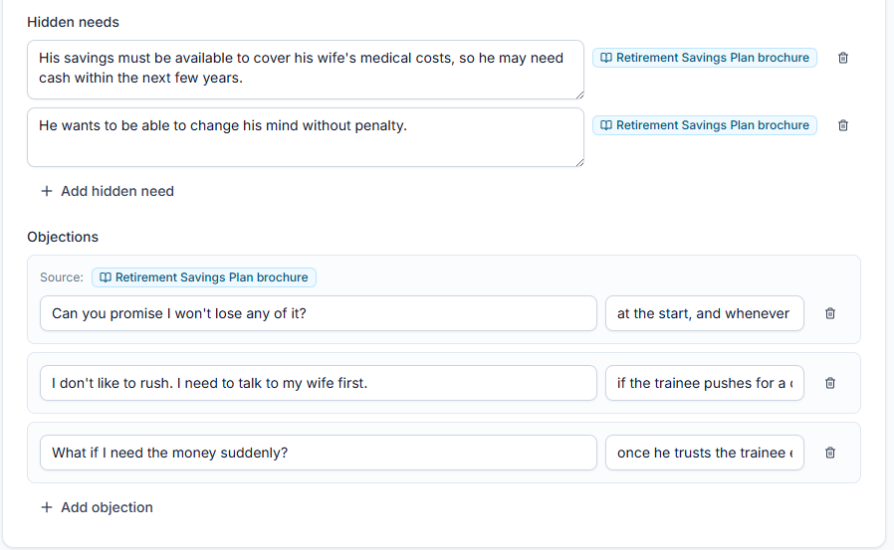
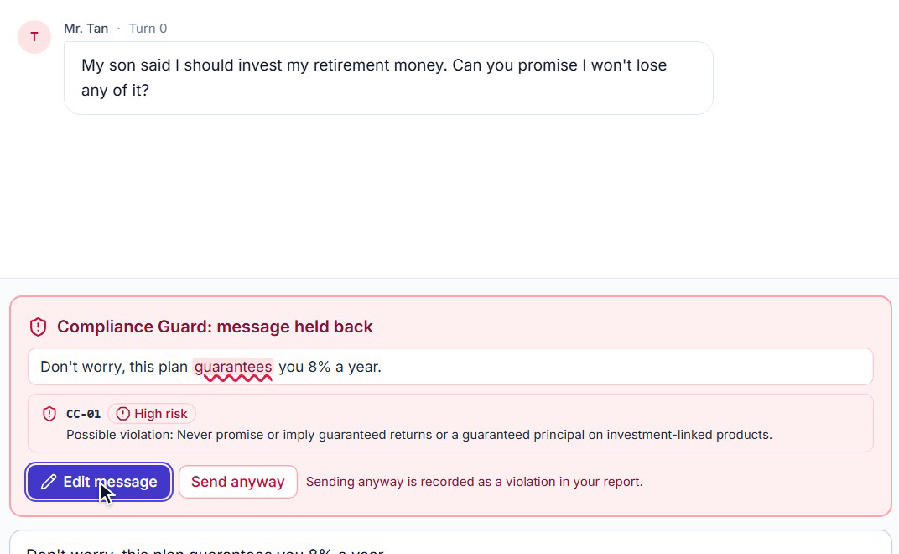
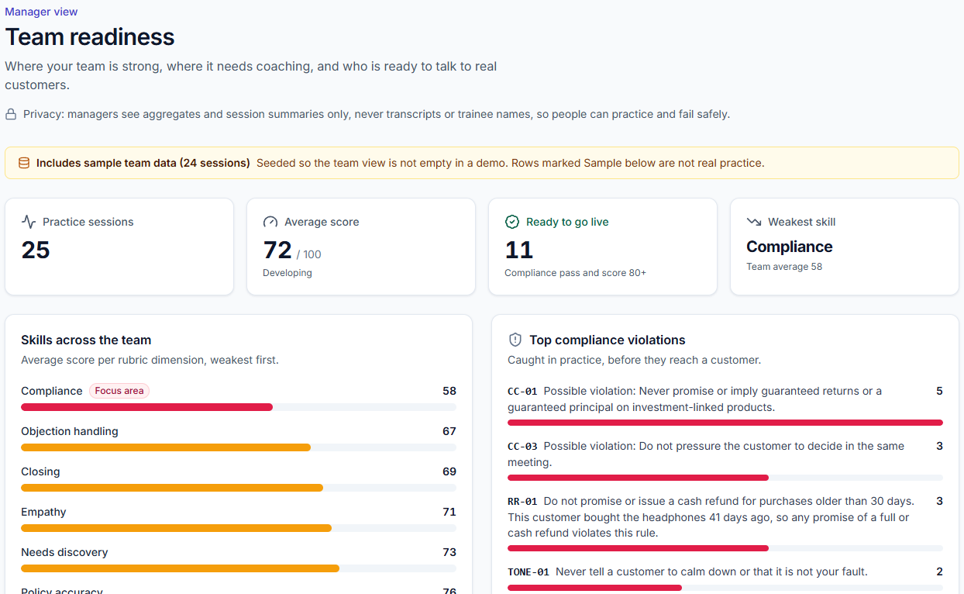
Upload your knowledge, approve AI-drafted customers, practice, and get a report you can trust
SOLUTION
1
Build
Admin + trainer
2
Practice
Trainee
3
Prove
Manager
Persona draft: each hidden need and objection cites its source
Live app: Compliance Guard holds a risky message before the customer hears it
Sample team data, clearly labeled
Upload manuals and policies. Gemini drafts personas and scenarios that cite the source passages; a trainer approves them before anyone practices.
A live AI customer with hidden concerns, a Compliance Guard that intercepts a risky message before it is sent, and a one-sentence coach hint every turn.
An evidence-verified report with a compliance gate, and a manager view of who is ready to go live.
Notes:
The loop has three steps. Build: an admin uploads documents, and in well under a minute Gemini drafts a set of realistic customers from them. Each objection and hidden need carries a citation to the passage it came from, and nothing is used until a human approves it. Practice: the trainee talks to the AI customer, who has a real concern they won't reveal unless asked well. Before each message is sent, the Compliance Guard checks it against the company's rules in about a second. Prove: the report quotes the trainee's own words for every score, and one serious violation fails the session.

Slide 5
Same engine, three industries, three different outcomes
DEMO · MEASURED ON THE LIVE SERVICE
A
SaaS sales: pricing objection
B
Insurance: guaranteed-return trap
C
Support escalation
The trainee uncovers the real concern (adoption, not price), answers with product facts and books a pilot.
“This plan guarantees you 8% a year” is held back by the Compliance Guard (rule CC-01, high). Sent anyway, it fails the session.
A refund promise outside policy is flagged (RR-01, medium). The trainee recovers, and the customer reveals the story behind the anger.
94 overall
FAIL
68 overall
Compliance PASS
Score capped
Compliance passed
Gemini 4 Argon, session 034508c874
30 in the recorded run (5867b49a17)
Gemini 4 Argon, session 3ca9d80201
Gemini 4 Argon build on Cloud Run (asia-east1), 2026-10-16. Every customer line is generated live, so wording varies by run; behavior is anchored in seed rules and triggers.
Notes:
These are not replays. Every customer line is generated live by Gemini, so the wording changes each time, but the behaviors are stable because they are anchored in seed data: verbatim opening lines, explicit compliance rules with citations, and objections tied to triggers. In A, a good discovery question makes the CFO admit her team abandoned the last tool, and the trainee closes on a pilot with a date. In B, the Guard stops a guaranteed-return promise before it reaches the customer. In C, the customer only shares that the headphones were a birthday gift after the trainee apologizes, offers real options and asks gently. That is the soft skill we want to train.

Slide 6
Next.js and FastAPI on Cloud Run, Gemini on Vertex AI, Firestore for state: all managed Google Cloud
ARCHITECTURE
Google Cloud · asia-east1 (Taiwan)
Vertex AI: global endpoint
Browser
Cloud Run: skillcoach-web
Cloud Run: skillcoach-api
Gemini 4 Argon + Gemini 3.5 Flash-Lite via the google-genai SDK
Per-tier fallback chains
(7 agent roles, next slide)
Trainee, admin, manager
Next.js frontend
FastAPI, Server-Sent Events
Firestore
gemini-embedding-001
Docs, chunks + vectors, personas, sessions, reports
Vertex AI, same region
Per-turn pipeline, one streamed HTTP request (measured on the live service)
Compliance pre-check
Retrieval
Persona reply streams
3 checks in parallel
Done
~1 s
~0.25 s
first token 2-2.7 s
grounding, state, coach
full turn ~5 s
Data at rest and embeddings: asia-east1. Gemini generation: Vertex AI global endpoint [S27].
Notes:
The system has no servers to manage and no custom model training. The frontend and API are stateless Cloud Run services that autoscale. Every turn is one HTTP request that streams events back to the browser: the compliance pre-check, the customer's reply token by token, the grounding post-check, the trust and patience meters, and the coach hint. Retrieval takes about 0.25 seconds on the live service. Data at rest and embeddings stay in the APAC region we choose; Gemini generation runs through the Vertex AI global endpoint, and we say exactly that to buyers [S27].

Slide 7
Seven Gemini agent roles, each with its own model, schema and guardrail
Gemini 4 Argon
Gemini 3.5 Flash-Lite
→ = automatic fallback order
HOW GEMINI IS USED
Agent | Model | How | Guardrail
Persona & scenario builder | Gemini 4 Argon gemini-4-argon → 3.8-flash | Structured output (Pydantic JSON schema); segments planned, then personas expanded in parallel | Each citation quote must appear verbatim in the cited chunk, or it is dropped; drafts need human approval
Compliance Guard (/precheck) | Flash-Lite gemini-3.5-flash-lite | Keyword pass plus structured JSON judge, about 1 s | Flag quote must be an exact span of the trainee's message
Customer persona | Gemini 4 Argon gemini-4-argon → 3.8-flash | Streamed text over SSE | Hidden needs withheld until trust is earned; only knowledge-base facts allowed
Grounding post-check | Flash-Lite gemini-3.5-flash-lite | Structured JSON, in parallel with state and coach | Flags product claims the retrieved passages don't support
State (trust / patience) | Flash-Lite gemini-3.5-flash-lite | Structured JSON | Deltas clamped; a high-severity violation always costs trust
Coach | Flash-Lite gemini-3.5-flash-lite | Structured JSON with KB citations | One sentence, grounded in the playbook
Report scorer | Gemini 4 Argon gemini-4-argon → 3.1-pro → 2.5-pro | Long-context structured output, ~6 s | Evidence must be a verbatim transcript quote, else the dimension caps at 50; a high-severity violation caps the score at 59
Right model for the job
Fallback chains (→)
Thinking low, quotes verified
Argon for quality; Flash-Lite for ~1 s checks
An outage degrades quality, not availability
Turn ~5 s; 106 of 106 builder citations verified
Notes:
This is the core of our technical story. Instead of one big prompt, each job is a separate Gemini call with its own system instructions and JSON schema, and the cheapest model that does the job well. Calls that don't depend on each other run in parallel. The compliance judge starts while retrieval and the reply run. After the reply, the grounding check, the state update and the coach hint all run at once. The most important design decision is that nothing the model claims as evidence is trusted. Persona citations, scenario rules and report quotes are all checked by the server against the documents or the transcript, and anything that doesn't match is dropped or marked unverified.
Right model for the job: Gemini 4 Argon where quality shows (the customer's voice, the builder, the report); Flash-Lite for per-turn judgments that must finish in about a second. Every tier has an automatic fallback chain (Argon to 3.8 Flash; report to 3.1 Pro to 2.5 Pro), so a model outage degrades quality, not availability. Thinking control: low on every agent keeps a full turn at about 5 s with the first words in 2-2.7 s. Argon drafts richer, more heavily cited personas than 3.8 Flash (106 of 106 citations verified) at about 3x the generation time, a trade-off we accept for a one-off authoring step.

Slide 8
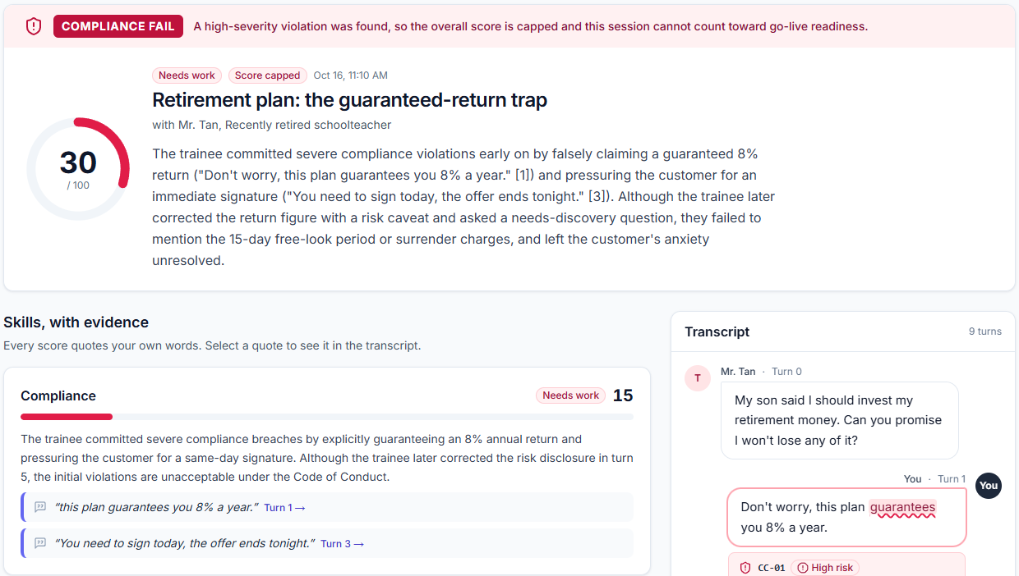
Every score quotes your words. No verified evidence, no score above 50. One serious slip fails the session
TRUST BY DESIGN
1
Before sending
The Compliance Guard quotes the exact phrase and names the rule (CC-01, “guarantees you 8% a year”).
2
While talking
Persona drafts, scenario rules and rubric items all cite the source passage; a trainer approves every persona before use.
3
After the session
Quotes are verified against the transcript. A high-severity violation fails the compliance gate and caps the score at 59 (Scenario B: FAIL, 30 in the recorded run).
Live report from the recorded demo session: B: FAIL, score capped (30 in the recorded run), each score backed by quoted turns.
Regional regulators ask for explainable AI [S13]; MAS competence expectations need evidence [S29].
Notes:
In regulated industries, an AI score nobody can explain is a score nobody will accept, not the trainee, not HR and not the Compliance Officer. So trust is designed in at three points. The compliance gate mirrors real life: a great conversation with one forbidden promise still fails. This kind of explainability is what regional regulators ask for in their AI guidance [S13] and what MAS's competence expectations need as evidence [S29].
The screenshot is the real report from the recorded demo session: compliance FAIL, score capped at 30.

Slide 9
Faster ramp, fewer senior hours, compliance mistakes caught in practice instead of in front of customers
IMPACT
ROI for a 100-rep team, per year (estimate)
+34%
Value
~US$126k
issues resolved per hour for novice and low-skilled support agents with AI assistance (14% on average; 5,179 agents) [S3]
Cost
~US$40k · roughly 3x
Manager time US$48k
Faster ramp US$62.5k
Lower attrition US$15k
New hires are exactly our users.
Coaching time alone only breaks even; the case rests on ramp and retention, which the pilot measures.
Who benefits
Trainees
Managers
Compliance teams
Customers
SMEs & nonprofits
a safe place to fail
objective readiness data
violations caught with evidence
better-informed staff
role-play they could never staff
Notes:
We are careful with impact claims. The evidence that AI assistance helps new workers most is strong and peer-reviewed [S3], and new hires are exactly our users. Our own ROI model is an estimate. We show it with its weak point: if SkillCoach only saved manager time, it would roughly break even. The value comes from faster ramp and lower early attrition, so the pilot is designed to prove or disprove exactly those numbers. Pilot KPIs: time to first solo call, compliance flags per 100 turns, manager hours per recruit, and AI-vs-assessor score agreement.

Slide 10
Working today on managed Google Cloud; onboarding a new company means uploading documents, not writing code
FEASIBILITY AND SCALABILITY
~1 s
2.0-2.7 s
~5 s
~6 s
18-40 s
Compliance Guard
first token
full turn
end-of-session report
persona / scenario generation
Measured on the deployed Cloud Run build with real Gemini (Gemini 4 Argon, 3.5 Flash-Lite), 2026-10-16. Generation: 106 of 106 citations verified.
Feasible now
Scales
Honest limits
Deployed on Cloud Run with real Gemini
No custom model training
A new tenant uploads documents, approves generated personas and reviews a scenario
Stateless Cloud Run autoscaling, Firestore per tenant
Flash-Lite for the per-turn judgments to keep cost down
Model cost well under US$2 per seat per month at 8 sessions per rep (estimate)
Live wording varies by run; behavior is anchored in seed rules and triggers
Data at rest and embeddings stay in asia-east1; Gemini generation runs on the Vertex AI global endpoint [S27]
Notes:
Everything shown is running on the live service. The numbers we measured there: about 1 second for the Compliance Guard, about 5 seconds per full turn with the first words in 2 to 3 seconds, and about 6 seconds for the report. On data residency we are deliberately precise: documents, transcripts, scores and embeddings stay in the chosen APAC region, Gemini generation goes through the Vertex AI global endpoint because that is where Gemini 4 Argon and the 3.x models are served, and Vertex AI does not train on customer data [S27]. We never claim that data never leaves a country.

Slide 11
Beachhead: insurance and financial advisors in Singapore. English first, built to localize
MARKET AND BUSINESS MODEL
Go-to-market waves
Category validated, APAC regulated selling unserved
1
Singapore (beachhead)
 | Personas from own documents, with approval | Compliance gate with verbatim evidence | APAC data at rest
Hyperbound US$15M raised [S16] | not stated | not stated | not stated
Second Nature US$22M raised [S17] | not stated | not stated | not stated
Mindtickle / Allego AI role-play in broad suites | not stated | not stated | not stated
SkillCoach | Yes | Yes | Yes (asia-east1)
About 19,000 insurance agents [S30] sell regulated products in English under MAS fair-dealing rules [S29].
2
Philippines and Hong Kong
Contact centers and advisors.
3
Taiwan, Japan, Korea
After localization.
not stated = we could not source it; our assessment from public positioning. Hyperbound and Second Nature focus on US B2B selling.
Pricing (hypothesis)
Paid 8-week pilot
Team
Enterprise
US$5k-10k
US$25 / active seat / month
US$35-45 / seat · SSO, region pinning, LMS
Notes:
Insurance is where all four pains meet: churn, untested new hires, compliance risk and know-how trapped in senior people, and the buyer already has a training budget line. Singapore lets us sell in English today under a regulator whose expectations map directly to evidence-backed practice. AI role-play itself is not new, so our wedge is specific: documents in, approved personas out, and a compliance gate with verbatim evidence. We price per active seat because agency headcount churns.

Slide 12

Shipped today: text and browser-voice practice, cited personas with approval, multi-agent turns, verified reports
ROADMAP AND TEAM
Now
shipped
Next
planned
Later
planned
Text practice with a live AI customer
Browser voice (Web Speech): speech-to-text input, spoken customer replies
Document-generated personas with citations and approval
Multi-agent turns: Guard, persona, grounding, state, coach
Evidence-verified reports with a compliance gate
Manager readiness view
Gemini Live native voice
VRM avatar
On-device emotion cues
More APAC languages
LMS and CRM integration
Scenarios from anonymized real calls
Certification tracks
Calibration against senior assessors
Next step: a paid 8-week pilot with a control cohort and pre-agreed KPIs.
[Team name]
GitHub: github.com/jease0502/SkillCoach-AIBC
Live demo
Scan to try it
Video: [Video URL]
[ ]
[Name]
[Role, one-line background]
[ ]
[Name]
[Role, one-line background]
[ ]
[Name]
[Role, one-line background]
Notes:
Everything under "Now" is in the deployed build and in the video. Everything else is labeled planned, and the next step is a paid 8-week pilot with a control cohort and pre-agreed KPIs. SkillCoach: practice the conversation before it counts.

Slide 13
References cited in this deck
SOURCES
S1
ATD, State of the Industry benchmarks (2024 and 2025 reports)
https://www.td.org/content/atd-blog/benchmarks-and-trends-from-the-2025-state-of-the-industry-report
S17
Second Nature US$22M Series B (Oct 2025)
https://pulse2.com/second-nature-22-million-series-b-raised-for-expanding-ai-based-sales-and-service-training
S3
Brynjolfsson, Li, Raymond, Generative AI at Work, NBER w31161; QJE 2025
https://www.nber.org/papers/w31161
S20
HKMA press release: Hang Seng Bank fined HK$66.4M (27 Jan 2025)
https://www.hkma.gov.hk/eng/news-and-media/press-releases/2025/01/20250127-4
S6
Philippine contact center attrition (newsbytes.ph)
https://newsbytes.ph/2024/05/28/attrition-rates-in-ph-contact-center-firms-continue-to-go-down/
S21
MAS key regulatory and enforcement actions, Q3 2025
https://www.mas.gov.sg/news/media-releases/2025/key-regulatory-and-enforcement-actions-taken-by-mas-in-q3-2025
S7
Contact center attrition 2024 (NICE 39% global), as reported
https://stealthagents.com/research/bpo-agent-attrition-statistics-2026
S23
Inc.: Mursion simulation cost (about US$49 per 30-minute session)
https://www.inc.com/sophie-downes/mursion-virtual-reality-simulation-empathy-workplace-training-learning.html
S9
NCU thesis citing FSC Insurance Bureau: first-year retention of new life-insurance reps below 50%
https://etd.lib.ncu.edu.tw/detail/56554d0867235710166b1752acffa4ba
S27
Google Cloud: Vertex AI generative AI data residency (checked 2026-10-15)
https://docs.cloud.google.com/vertex-ai/generative-ai/docs/learn/data-residency
S13
Baker McKenzie / Lee and Li on Taiwan FSC AI guidelines (2023-2024)
https://www.leeandli.com/EN/Newsletters/7287.htm
S29
MAS Guidelines on Fair Dealing (FAA-G11, May 2024)
https://www.mas.gov.sg/-/media/mas-media-library/fair-dealing-guidelines-30-may-2024.pdf
S16
Hyperbound US$15M Series A (Sept 2025)
https://www.hyperbound.ai/blog/series-a
S30
Insurance Business Asia: Singapore insurance agent numbers (~19,000)
https://www.insurancebusinessmag.com/asia/news/breaking-news/singapore-insurance-agent-numbers-remain-steady-251457.aspx
Figures marked (estimate) are our own model. Full list with notes: docs/BUSINESS_CASE.md, section 12.
Notes:
Full source list with notes: docs/BUSINESS_CASE.md, section 12. Numbers labeled (estimate) are our own model, not facts.

