Slide 1

Robotics Team Design Project M Simulated RoboCup Soccer Teams
Supervisor – Dr. Euan McGookin
Team 10

Slide 2
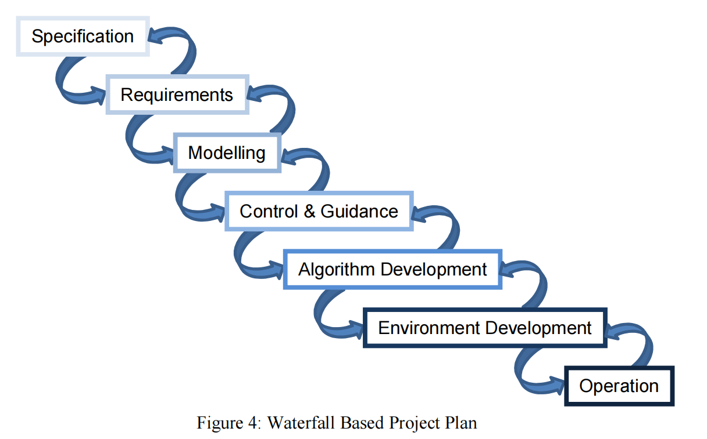
Project Plan

Slide 3
Daily meeting content this week
Week 3 (Group meeting)
Meeting Date: 1/2
Meeting mins: 120mins
Meeting Content:
The first step is to make self-improvement on the suggestions made by the supervisor during the meeting with Dr. Euan McGookin. Make further adjustments to the project time allocation and increase the time devoted to the project.
To summarise the progress of work completed.
MATLAB build of the field simulation environment.
Implementation of MATLAB simulation of tracking ball.
Implementation of the ball passing route simulation.
2. Group discussion on the next parts to be done (brainstorming)
The modelling section first seeks a solution to the physical modelling of football.
Co-creation of flowcharts for the algorithm part of the game.
To-Do List
Divide the work the in next meeting.
Updated the Gant chart.
Official team meetings held on every Wednesday at 3.30pm

Slide 4
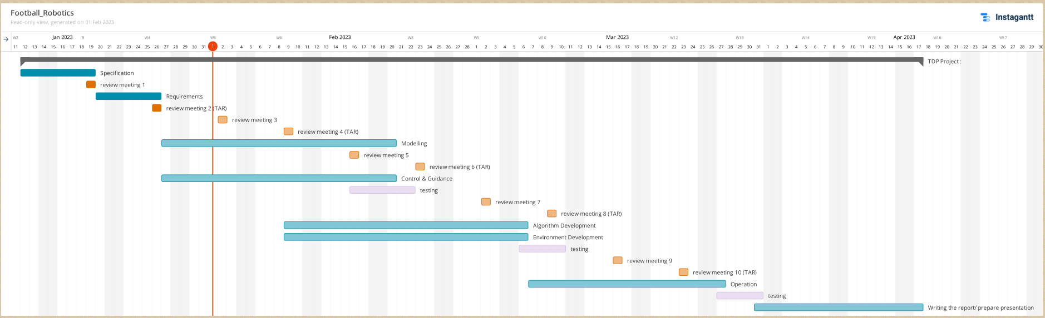
Updated the Gant chart

Slide 5
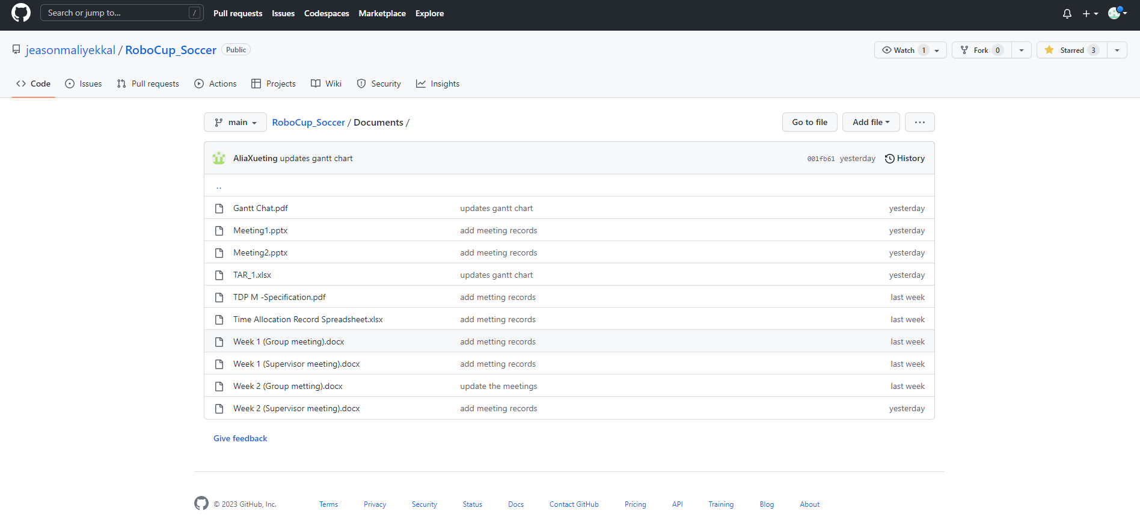
Team github set-up

Slide 6
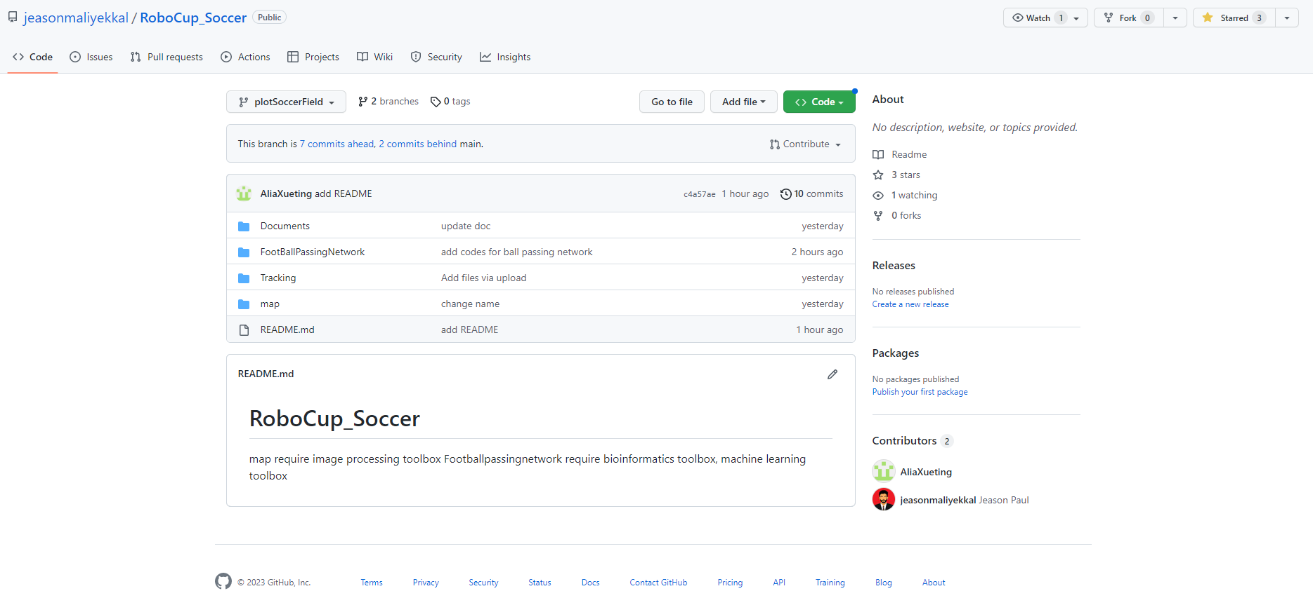
Team github set-up

Slide 7
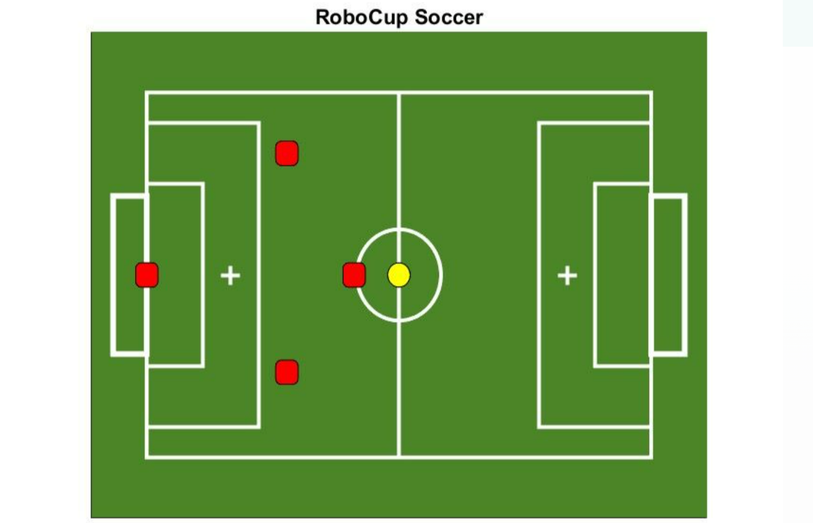
Field set-up

Slide 8
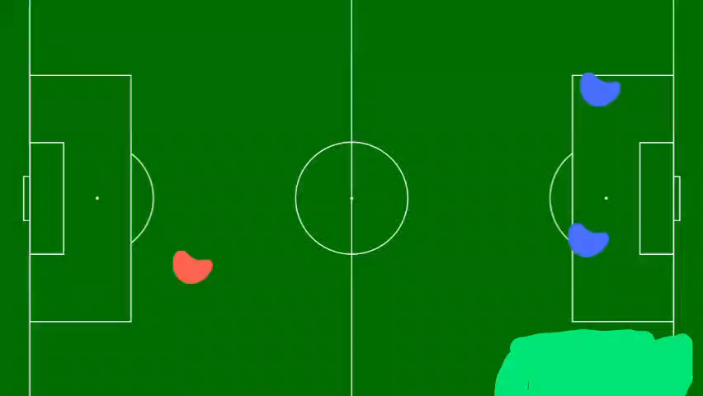
Object（ball） tracking

Slide 9
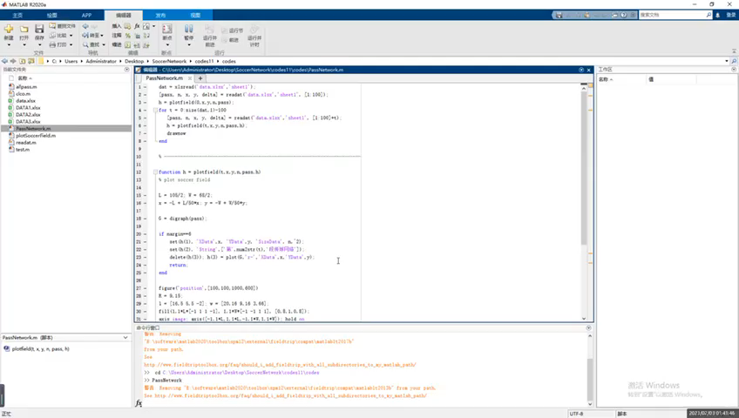
Ball passing route simulation
The frame-by-frame passing network is based on 100 drills of actual position data of players on the court.
The arrow lines in the video indicate the direction in which the ball can be passed, and the size of the circle represents the probability that the player will catch the ball.
(If you choose a player who has the more probability to receive the ball, then the chances of winning will increase.)

Slide 10
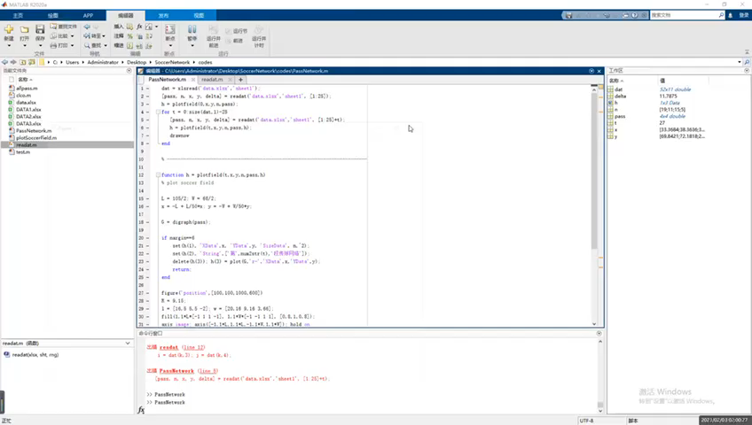
Ball passing route simulation (1 TEAM TRY)
This one is for train one team only, there still have a little bit of issues— such as the much less train dataset, the lack of Goal keeper on right side…. But this is just a test

Slide 11
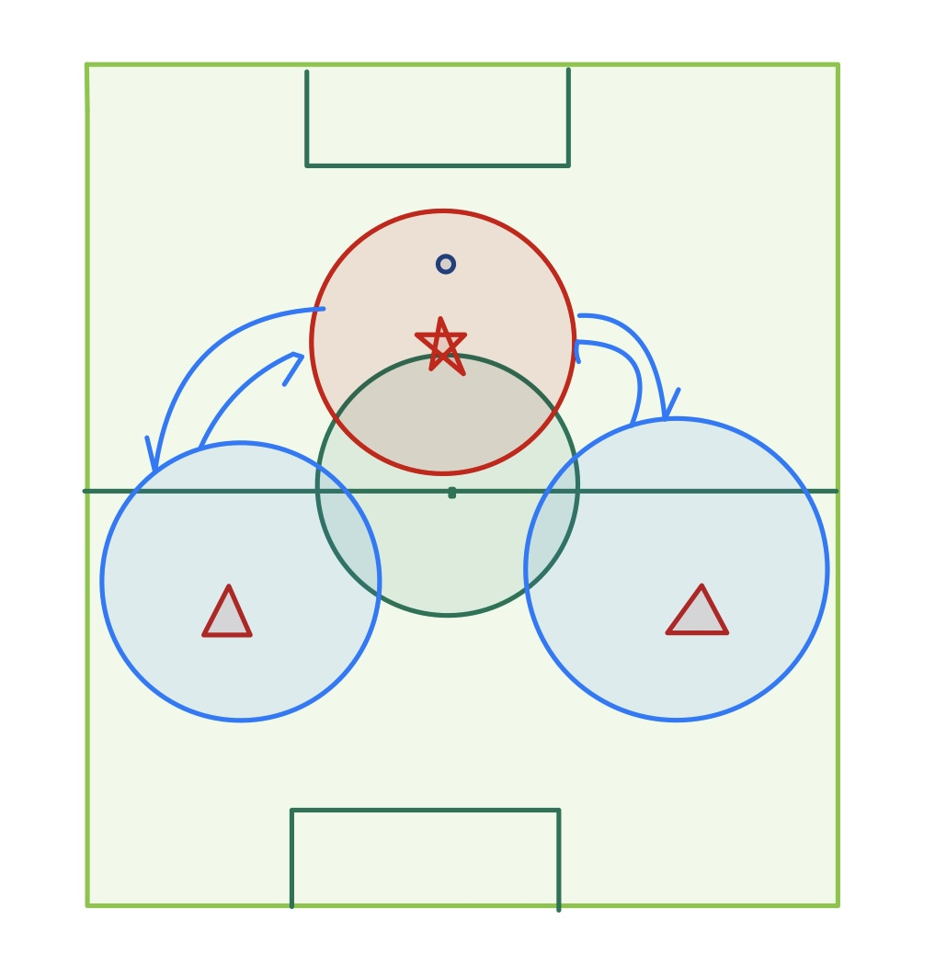
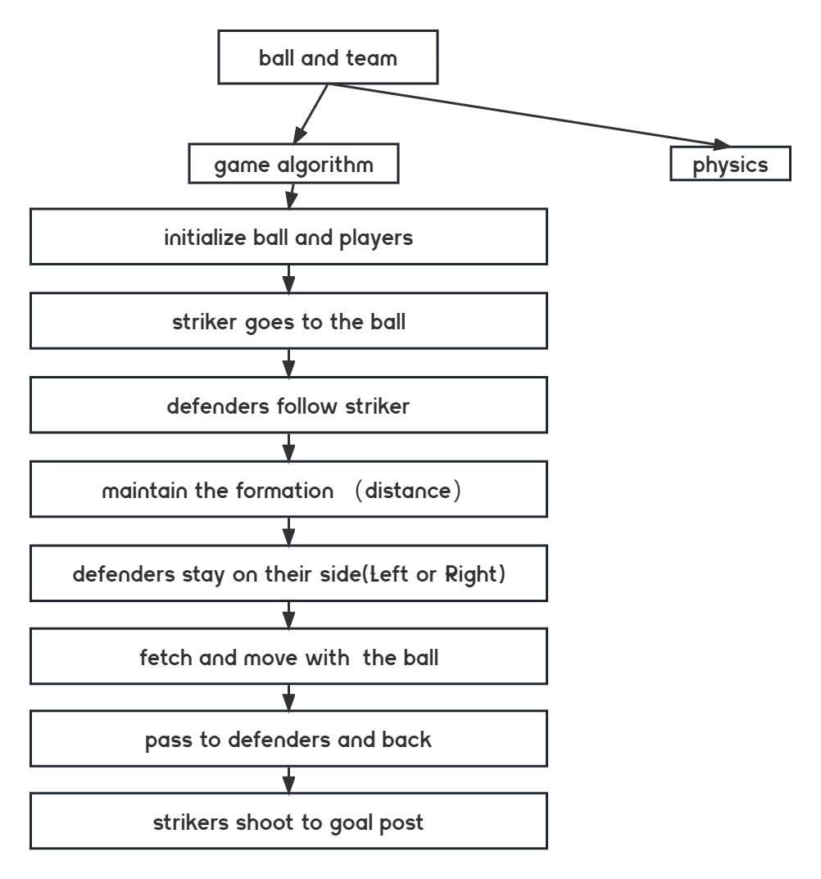
Game algorithm flowchart(brainstorm)

Slide 12
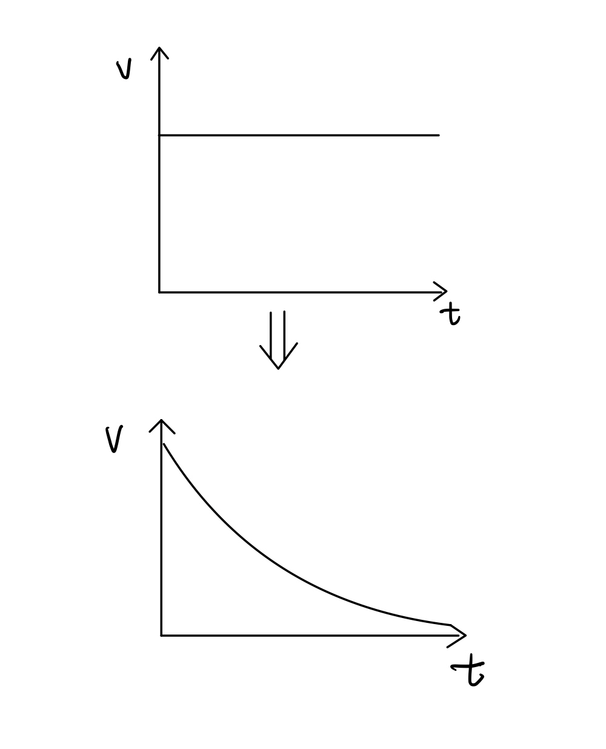
Ball physics
The modelling is divided into two parts, the ball and the player.
For example, in the simulation the speed of the ball movement seems to remain constant, but in reality the speed of the ball movement decays gradually to a stop without external interference.
We should start by modelling the physics of the ball.

Slide 13
Divide the work the for next week
Xu and Minghao and in charge of modelling the physical analysis of the ball.
ML algorithm research goes to Xueting.
One team algorithm development goes to Athul Jeason and Hari

Slide 14

Thank you for your time!

