Slide 1

Robotics Team Design Project M Simulated RoboCup Soccer Teams
Supervisor – Dr. Euan McGookin
Team 10

Slide 2
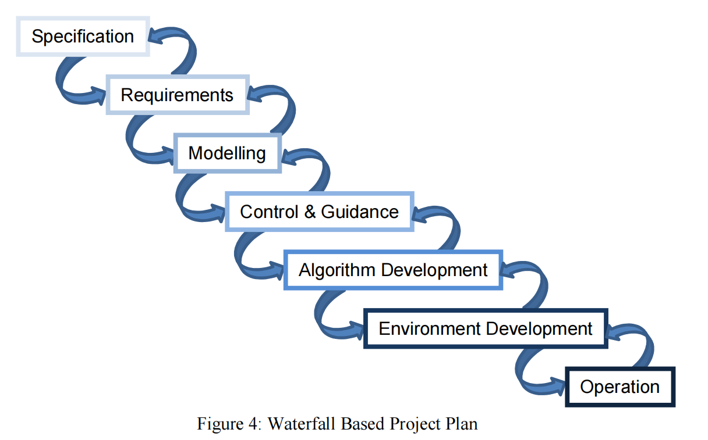
Project Plan

Slide 3
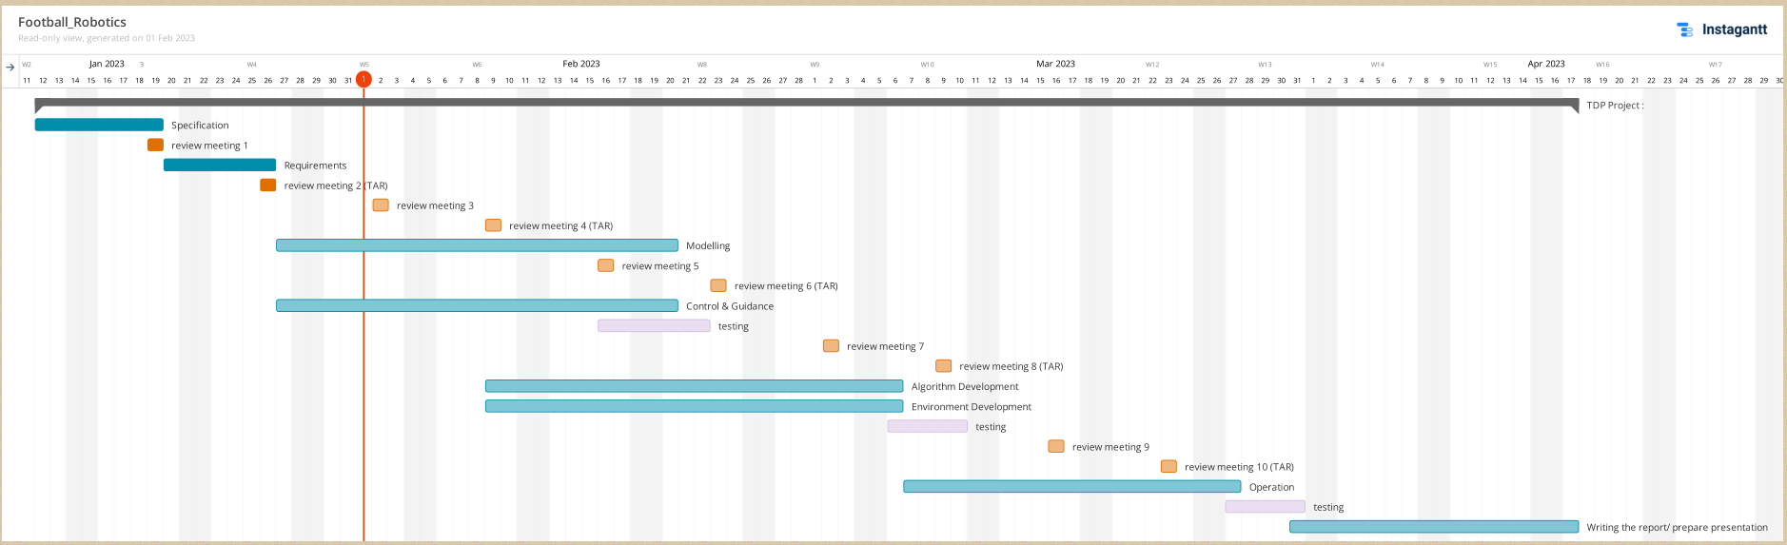
Gant chart

Slide 4
Daily meeting content this week
Week 3 (Group meeting)
Meeting Date: 9/2
Meeting mins: 120mins
Meeting Content:
To summarise the progress of work completed.
Made the frame work for the game, created plot objects for ball and players, animated these objects, integrated object tracking algorithm with the framework and did a test run for the setup.
Research on the state-of-art passing ball network, implemented the dl algorithm for passing ball network, improving the algorithm for passing ball, established Ros environment and write the demo code to realize Matlab to RosImplementation of the ball passing route simulation.
Research on how to model the ball for a robotic football match using MATLAB
2. Group discussion on the next parts to be done (brainstorming)
Pay more attention to control and guidance area.
Co-creation of flowcharts for the algorithm part of the game strategy.
To-Do List
Divide the work the in next week.

Slide 5
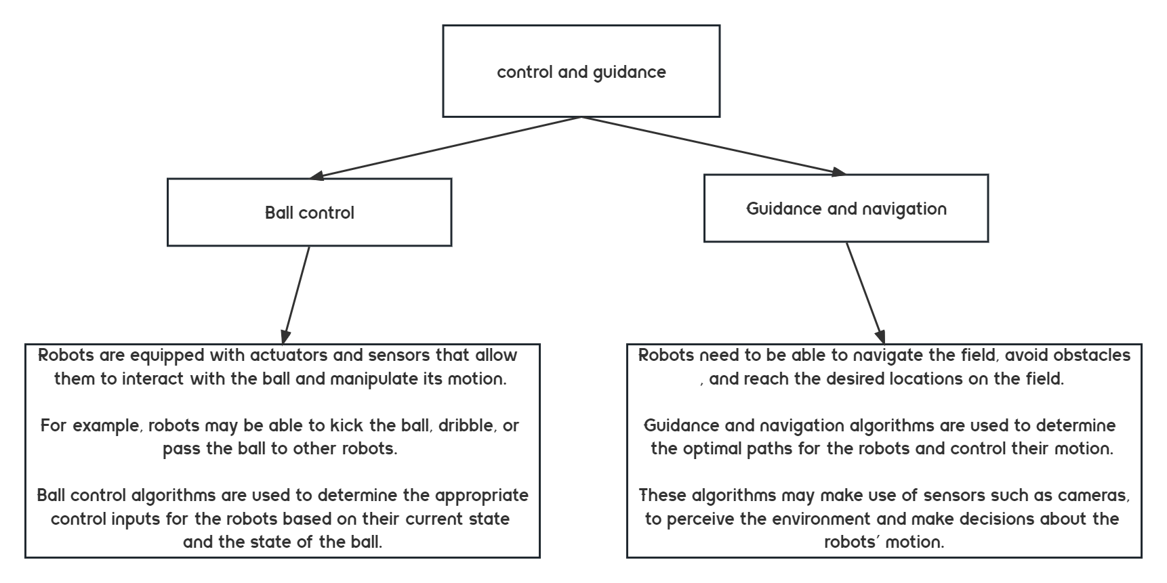
Control and Guidance
First we considered the control and guidance area we should pay more attention to , which our mentor had suggested at the last meeting.

Slide 6
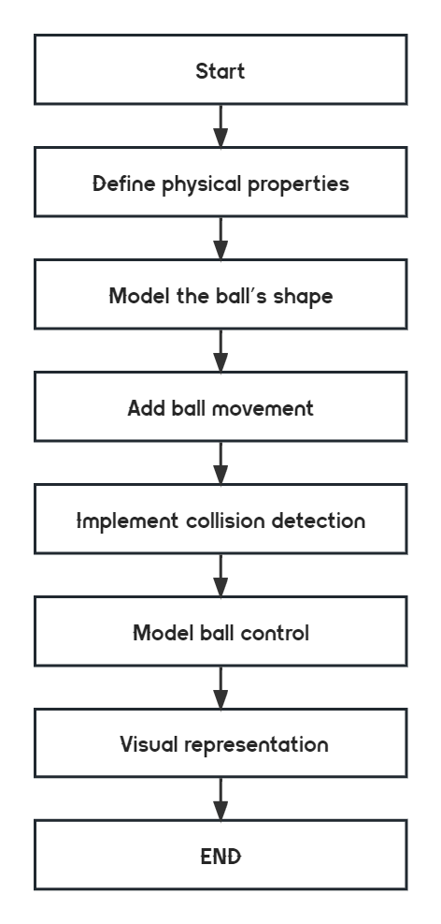
Model the ball
Define physical properties: Determine the physical properties of the ball that we want to model, such as size, weight, and surface friction.
Model the ball's shape: Model the shape of the ball in the simulation platform, taking into account its size and physical properties.
Add ball movement: Implement the movement of the ball in the simulation, including factors such as ball speed, spin.
Implement collision detection: Implement collision detection for the ball in the simulation, taking into account factors such as ball velocity, angle of impact, and surface area.
Model ball control: Implement ball control in the simulation, allowing the robots to control the ball effectively.
Visual representation: Ensure that the visual representation of the ball in the simulation is visually appealing and easy to understand.

Slide 7
Model the ball
Model the motion of the ball. Mathematical models can be used to simulate the motion of the ball in a simulated environment. This can be done by integrating the equations of motion in time and updating the position and velocity of the ball at each time step.
Implement collision detection. Use collision detection algorithms to determine when the ball collides with other objects in the simulation, such as walls or robots. The effect of the collision on the ball's velocity and trajectory can also be considered.
Build a control model of the ball. Implement a ball control model for the robots that allows them to interact with the ball and manipulate its movement. This can be achieved by assigning control inputs to the robot, such as kicking or dribbling the ball, and using these inputs to update the ball's velocity and position.
Visualisation of the simulation. Use MATLAB's built-in visualisation functions to create a visualisation of the simulation. This can be used to observe and analyse the behaviour of the ball and the robot in the simulation.

Slide 8
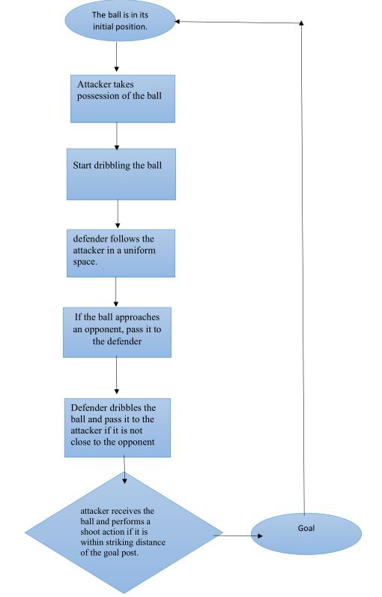
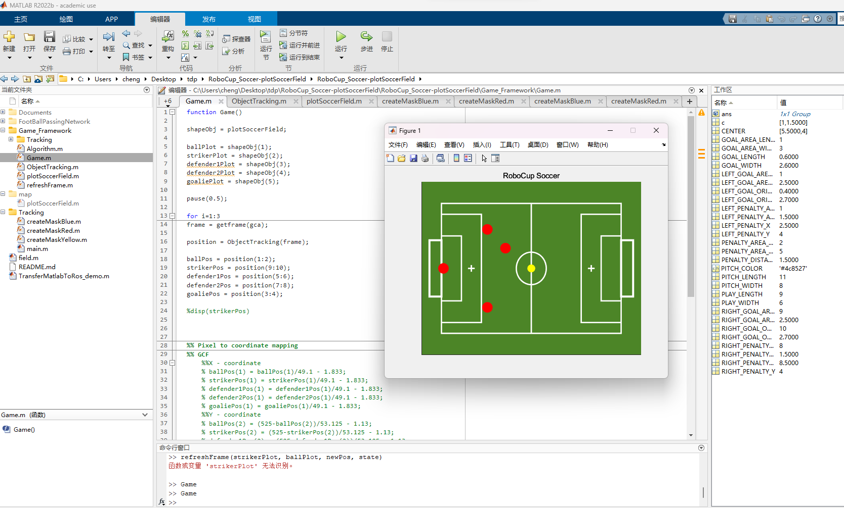
Game strategy flowchart

Slide 9
Frame work for the game

Slide 10
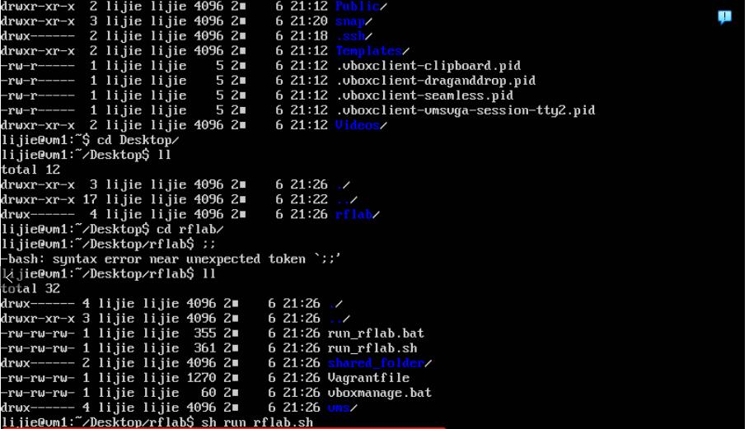
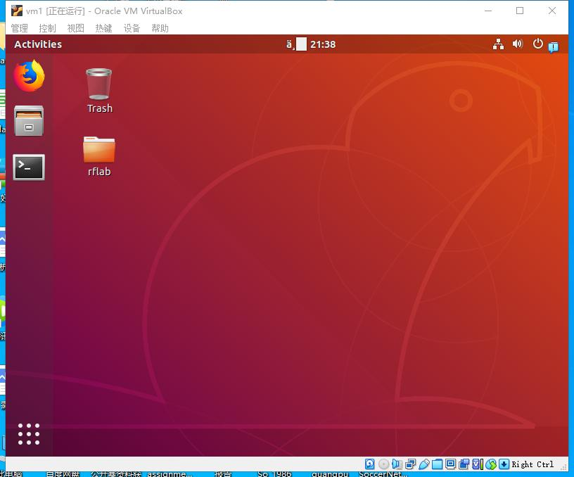
Matlab to Ros 2D->3D (Explore and try)
Why do we want to make such an experiment?
Because during the process of our project we thought that we might be able to achieve a better 3D effect using ROS, and during research we found a way to transfer matlab code directly to ROS, so we decided to give it a try.
Those are the visual machine for ROS environment

Slide 11
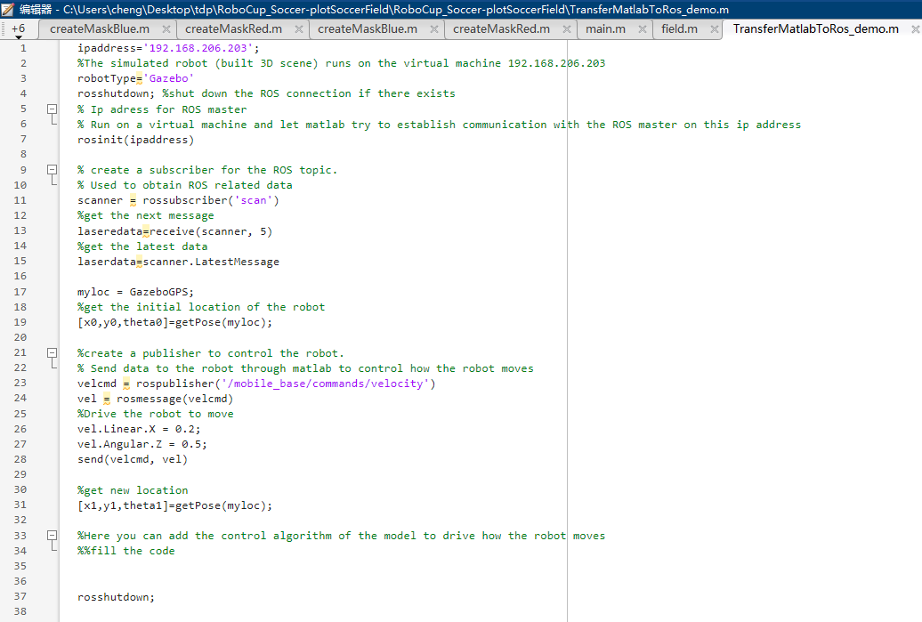
Matlab to Ros 2D->3D (Explore and try)
The demo codes for how the Matlab connect the Ros
RoboCup_Soccer/TransferMatlabToRos_demo.m at plotSoccerField · jeasonmaliyekkal/RoboCup_Soccer (github.com)
Here's how it works: the robots built in ROS have sensors and so on. Then the ROS service will run with an ip, and then write code in matlab to connect to that ip. Then, through the ROS-related API in matlab, we can read the position and speed information of the robot, and send instructions to make the robot move
Then, when there are more than one robot, you can write code in matlab to obtain the information of all the robots. This information is then input as input to the control model established by state flow, and then the control model has some output information
Output information such as how far the robot is going in which direction
The resulting output is then sent to each robot via ROS control commands for them to play on the soccer field

Slide 12
NEXT WEEK
Next week we want to learn more about state flow
Matlab implementation of propulsion ball modelling
further implementation of a 2D goal in matlab for robotic football.
While this is going on we would like to continue to try to explore a 3D implementation of matlab direct transfer to ROS

Slide 13

Thank you for your time!

