Slide 1

Robotics Team Design Project M Simulated RoboCup Soccer Teams
Supervisor – Dr. Euan McGookin
Team 10

Slide 2
Team Members
Jeason Paul
Athul Prasad P G
Xu Cheng
Minghao Ji
Xueting Pan
Hari Sudarsan
Focus on Engineering
Modelling, design and control
Focus on Computer Science
Focus on algorithm and environment development

Slide 3
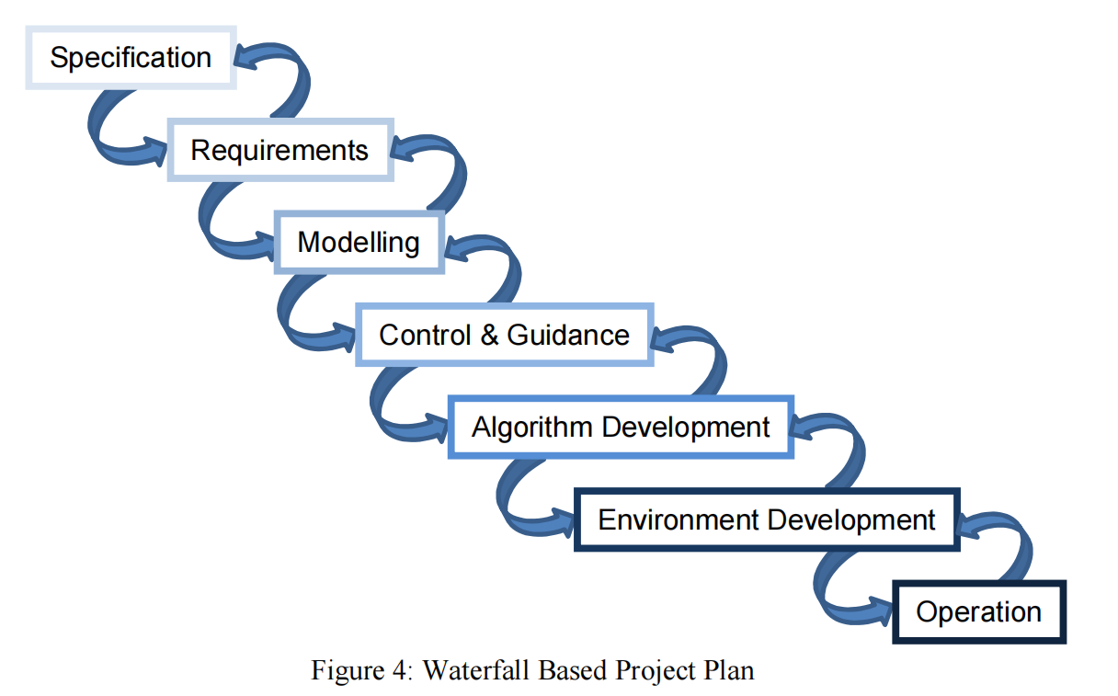
Project Plan

Slide 4
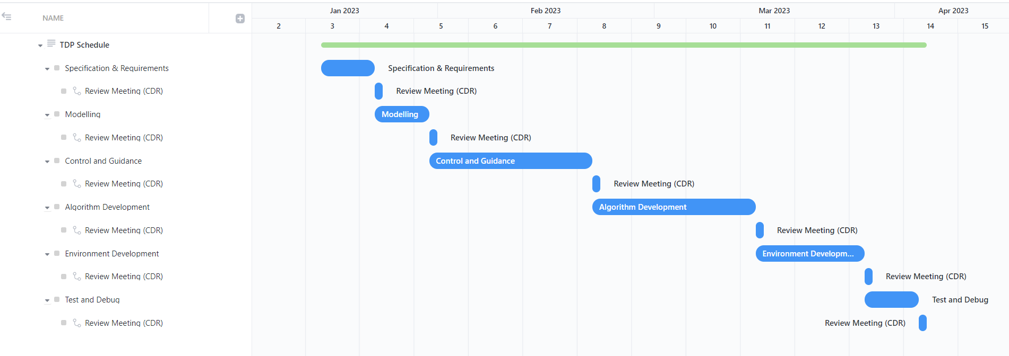
Project Plan
1 Week
2 Weeks
3 Weeks
3 Weeks
2 Weeks
1 Week
Official team meetings held on every Tuesdays at 3.30pm

Slide 5
Cost Estimation
Course Requirement:
200 hours per individual throughout the project
1st week: Approximately 8 hours
2nd to 12th week:
Assuming 18 hours per week
i.e. 11 × 18 = 198 hours
In total: 8 + 198 = 206 hours

Slide 6
Questions
2D or 3D
NAO6 Robot design
Critical Design Reviews
Meetings with the supervisor

Slide 7
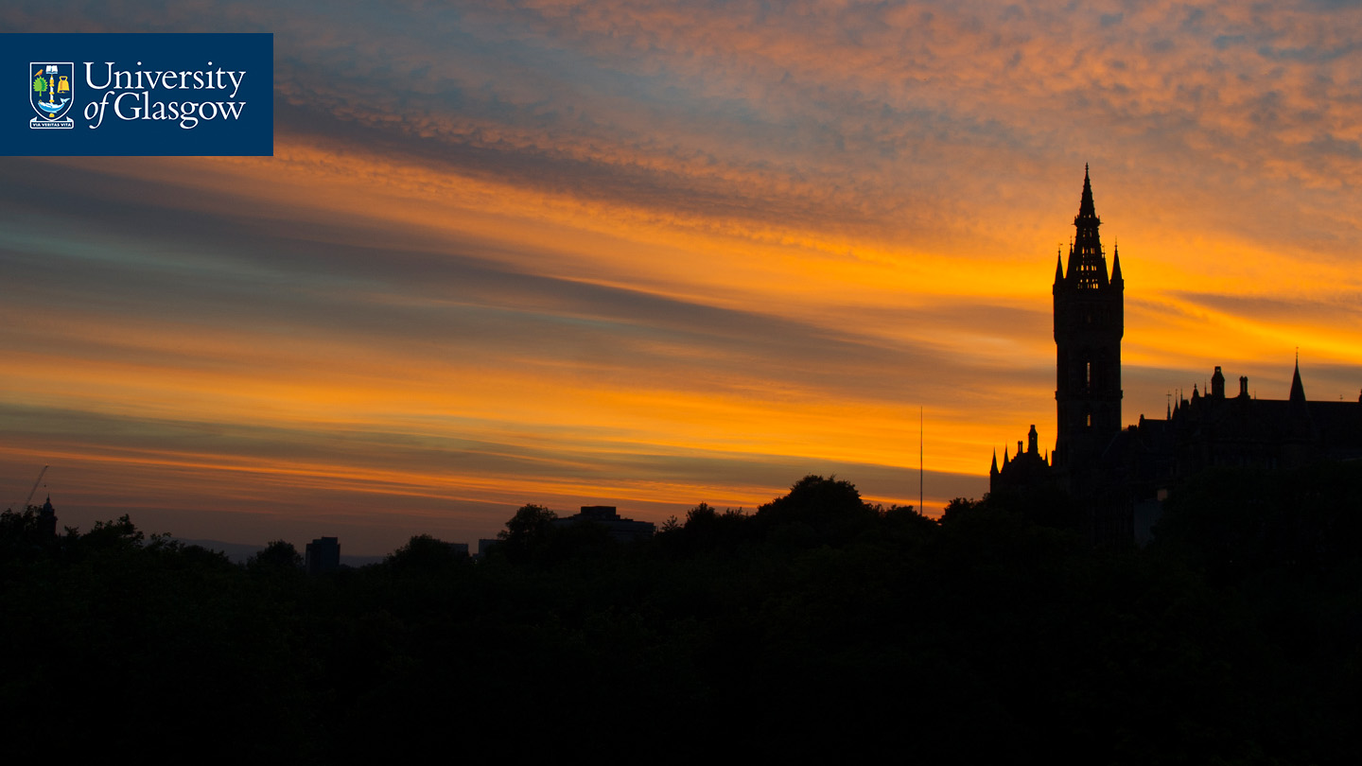
Thank you for your time!

