Slide 1

Robotics Team Design Project M Simulated RoboCup Soccer Teams
Supervisor – Dr. Euan McGookin
Team 10

Slide 2
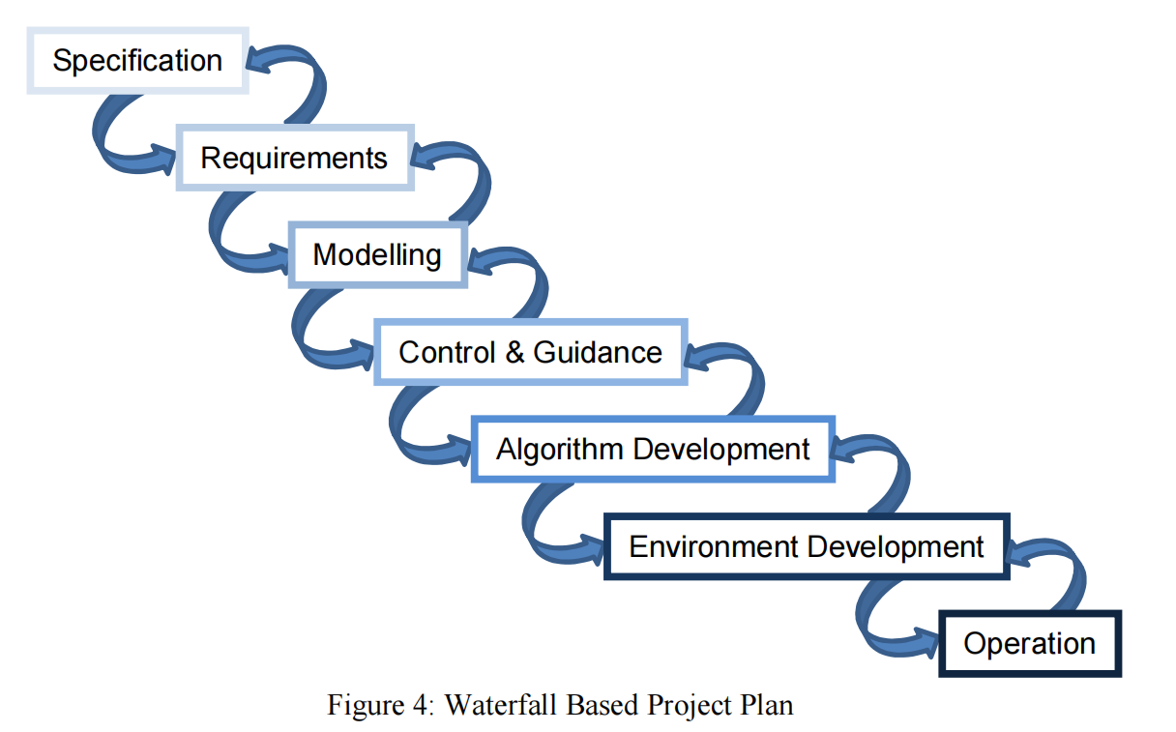
Project Plan

Slide 3
Daily meeting content this week
Week 2 (Group meeting)
Meeting Date: 24/1
Meeting mins: 97mins
Meeting Content:
Setting the basic flow chart for the modeling part, the draft like below: (Brain Storm)
Flow chart for the coding part, shows that: (Brainstorm)
To-Do List
Need to divide the work the in next meeting.
PPT also needs to be prepared for the next meeting with the supervisor.
Updated the Gant chart.
Official team meetings held on every Tuesdays at 3.30pm

Slide 4
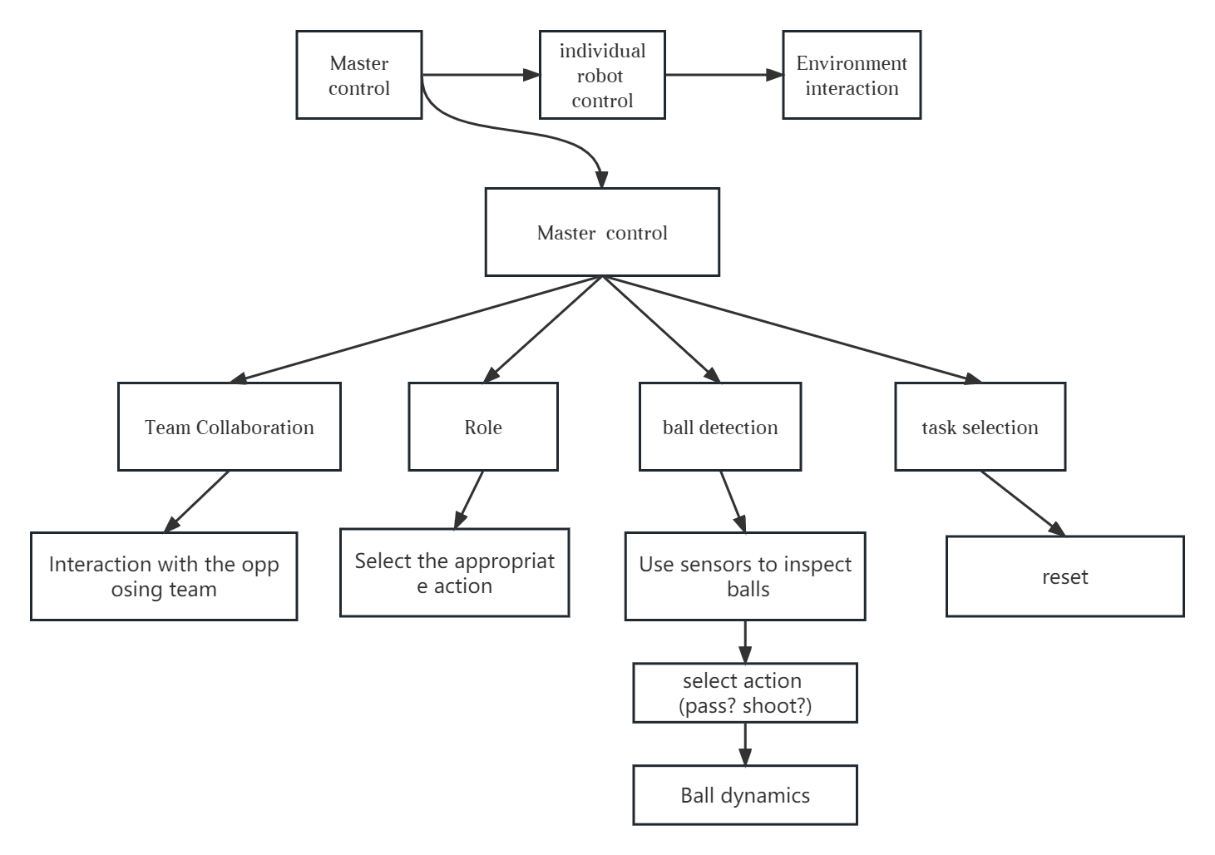
Flow chart for the modelling part
Sensors:
Camera
IMU
Proximity sensor
Env:
Checkerboard?
State machines?

Slide 5
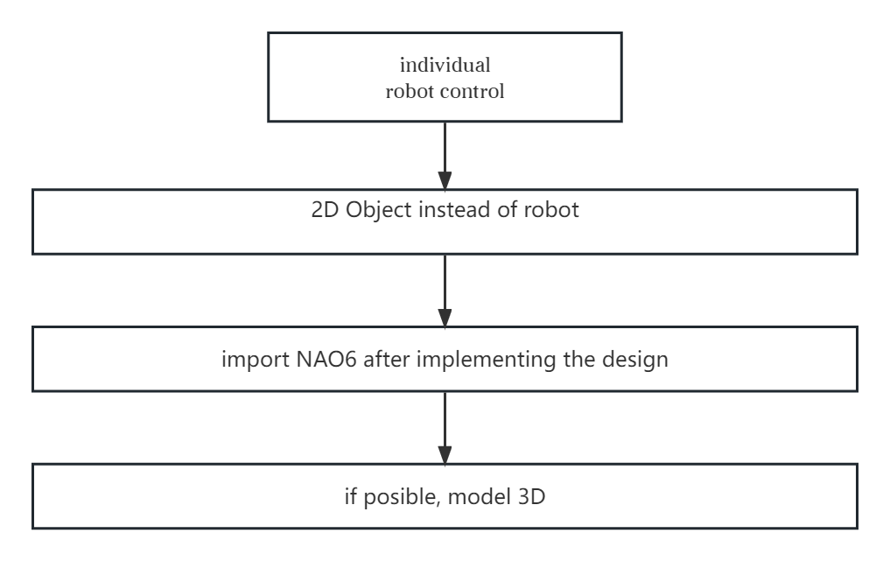
Flow chart contd.

Slide 6
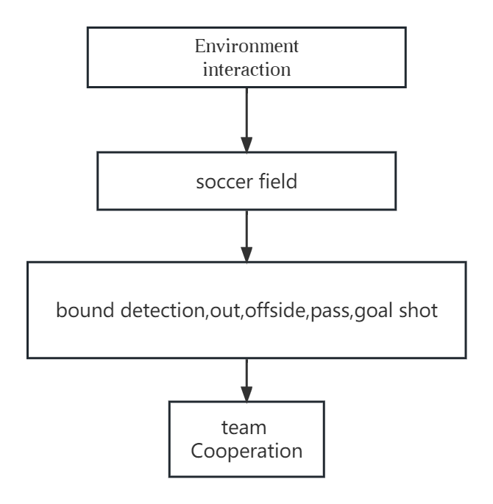
Flow Chart Contd.
Inertial measurement unit:6DOF,
Proximity sensor:to locate the player

Slide 7
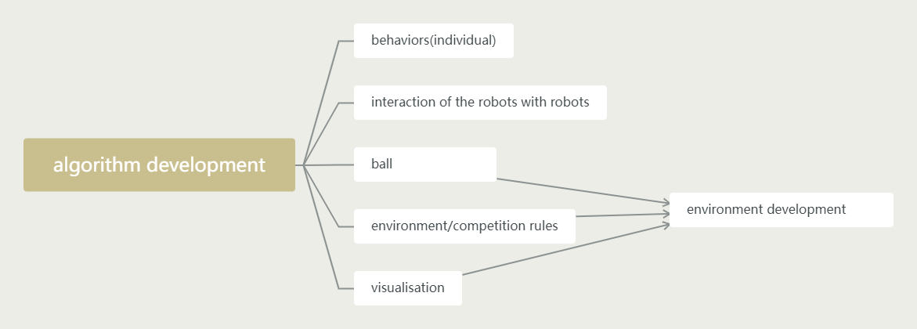
Flow chart for the coding part

Slide 8
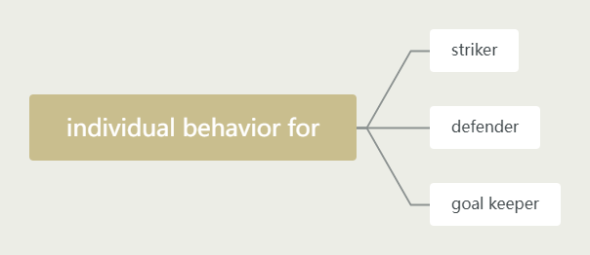
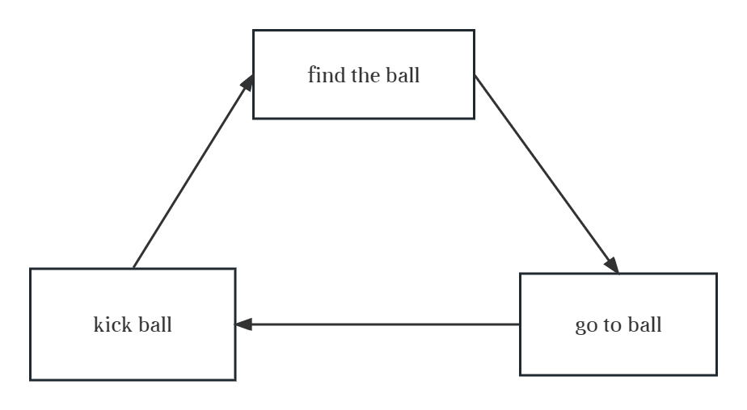
Flow chart for the coding part
Q: 4 type？3type？
To do:
1.Define each type robot
2.Draw each type flow chart (like striker)
3.Write the class for each of type

Slide 9
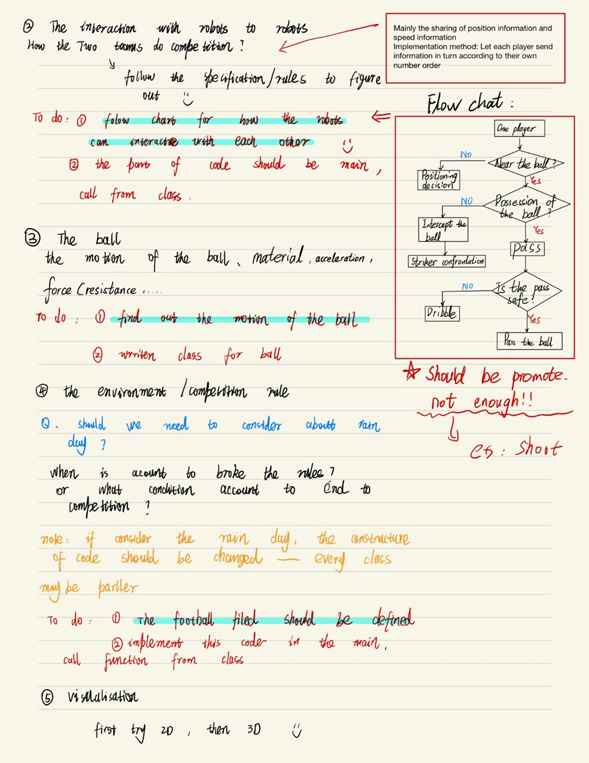
Flow chart for the coding part

Slide 10

Thank you for your time!

