Slide 1
Multiple Condition Coverage
MC/DC
Condition/Decision Coverage
Condition Coverage
Decision Coverage
Statement Coverage

Slide 2
S
1st test case based on Control flow Test
1
Path | TC #
1,2 | TC1
1,3,4,6 | TC2
1,3,5,7 | TC3
1,3,4,7 | TC4
1,3,5,6 | TC5
2
N
D1
Y
3
Y
D2
N
4
5
2nd test case define to cover MC/DC
ex) D1 ➔ if (A and B)
A (condition) | B (condition) | Result (decision)
T | T | T
T | F | F
F | T | F
D3
N
6
Y
7
TC1-1 : A is true and B is false 의 test case 생성 TC1-2 : A is false and B is true 의 test case 생성
E

Slide 3
S
Path | TC #
1,2 | TC1
1,3,4,6 | TC2
1,3,5,7 | TC3
1,3,4,7 | TC4
1,3,5,6 | TC5
1
D1
2
N
D1
If (age < 18 and isStudent) {
amount = 0;
}else{
if ( has Coupon or with dog) {
amount = amount * 50%;
}else{
amount = amount * 10%;
}
If ( isSingle) {
amount = amount * 50%;
}
}
Y
3
Y
D2
N
D2
4
5
Amount =Amount* 50%
Amount =Amount* 10%
Amount=0
D3
N
D3
6
Y
7
Amount =Amount* 50%
E

Slide 4
S
1
D1 (A and B)
A (condition) | B (condition) | Result (decision)
T | T | T
T | F | F
F | T | F
2
N
D1
Y
3
Y
D2
N
4
5
D2(C or D)
C (condition) | D (condition) | Result (decision)
T | F | T
F | T | T
F | F | F
Amount =Amount* 50%
Amount =Amount* 10%
Amount=0
D3
N
6
Y
D3(E)
E (condition) | Result (decision)
T | T
F | F
7
Amount =Amount* 50%
E

Slide 5
S
1
2
N
D1
Y
3
Y
D2
N
Path | Caudated TC #
1,2 | TC1
1,3,4,6 | TC2
1,3,5,7 | TC3
1,3,4,7 | TC4
1,3,5,6 | TC5
4
5
Amount =Amount* 50%
Amount =Amount* 10%
Amount=0
D3
N
6
Y
7
Amount =Amount* 50%
E

Slide 6
S
D1 (A and B)
A (condition) | B (condition) | Result (decision)
T | T | T
T | F | F
F | T | F
Path | TC #
1,2 | TC1
1,3,4,6 | TC2
1,3,5,7 | TC3
1,3,4,7 | TC4
1,3,5,6 | TC5
1
2
N
D1
Y
3
Y
D2
N
D2(C or D)
C (condition) | D (condition) | Result (decision)
T | F | T
F | T | T
F | F | F
4
5
Path | TC # | A Age | B Student | C Coupon | D With dog | E isSingle
1,2 | TC1-1 | 20 | F
1,2 | TC1-2 | 16 | T
1,3,4,6 | TC2-1 | 20 | T | T | F | T
1,3,4,6 | TC2-2 | 20 | T | F | T | T
1,3,5,7 | TC3 | 20 | T | F | F | F
1,3,4,7 | TC4-1 | 20 | T | T | F | F
1,3,4,7 | TC4-2 | 20 | T | F | T | F
1,3,5,6 | TC5 | 20 | T | F | F | T
Amount =Amount* 50%
Amount =Amount* 10%
Amount=0
D3
N
D3(E)
E (condition) | Result (decision)
T | T
F | F
6
Y
7
Amount =Amount* 50%
E
D1
If (age < 18 and isStudent) {
amount = 0;
}else{
if ( has Coupon#1 or with dog) {
amount = amount * 50%;
}else{
amount = amount * 10%;
}
If ( isSingle) {
amount = amount * 50%;
}
}
D2
D3

Slide 7
Path | TC # | A Age | B Student | C Coupon | D With dog | E isSingle
1,2 | TC1-1 | 20 | F
1,2 | TC1-2 | 16 | T
1,3,4,6 | TC2-1 | 20 | T | T | F | T
1,3,4,6 | TC2-2 | 20 | T | F | T | T
1,3,5,7 | TC3 | 20 | T | F | F | F
1,3,4,7 | TC4-1 | 20 | T | T | F | F
1,3,4,7 | TC4-2 | 20 | T | F | T | F
1,3,5,6 | TC5 | 20 | T | F | F | T
D1
If (age < 18 and isStudent) {
amount = 0;
}else{
if ( has Coupon#1 or with dog) {
amount = amount * 50%;
}else{
amount = amount * 10%;
}
If ( isSingle) {
amount = amount * 50%;
}
}
D2
D3

Slide 8
Requirement 1. ID (only character , length is over 5 characters)
2. PWD (only number, length is over 5)
ID
Sing-up
PWD
boolean isVaildUserID = checkUserID(strUserID);
boolean isValidPassword = CheckPassword(strPassword);
If (isVaildUserID && isValidPassword) {
doRegisterUser(strUserID, strPassword) }else{
showError(msgID_101)
}
Decision (A and B)
TC# | ID (condition) | PWD (condition) | Result (decision)
TC1 | T (abcdef) | T (123456) | T
TC2 | T (abcdef) | F (123) | F
TC3 | F (abc) | T (123456) | F
TC4 | F (abc) | F (123) | F

Slide 9
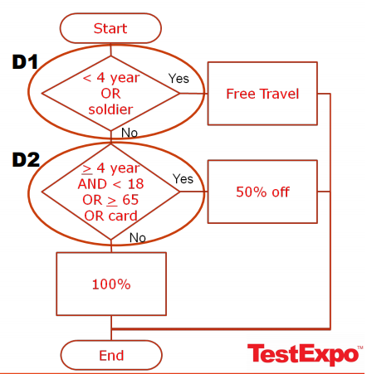
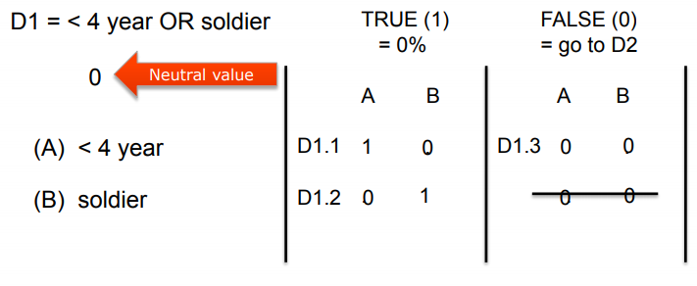
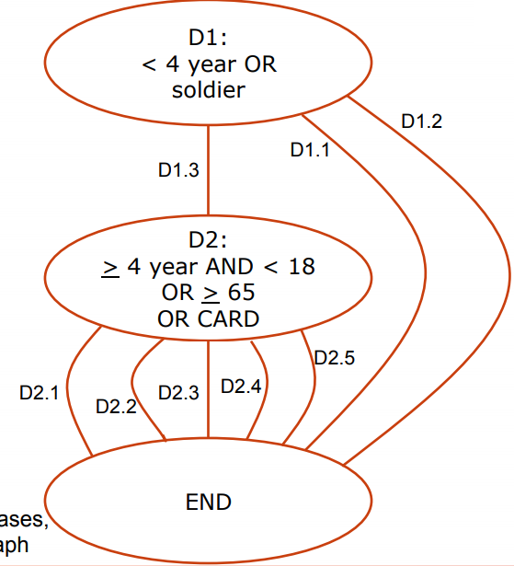
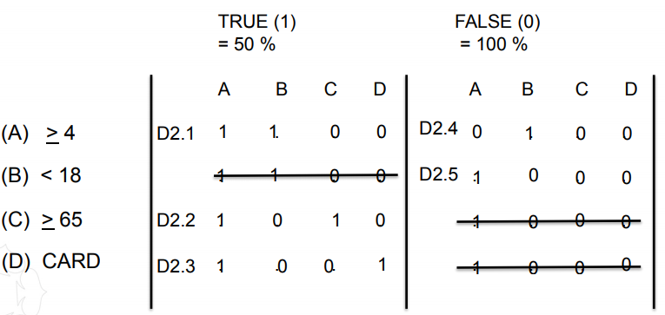
STEP 1. Identify the decision points
STEP 2. Determine test situations per decision point, using MCDC (MCDC = Modified Decision Coverage)
STEP 3: Create Logical Test Cases
(
(
(
(
)
)
)
)
(
)
(
)

Slide 10
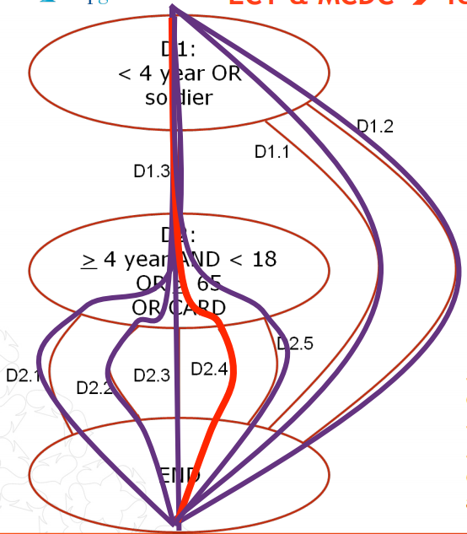
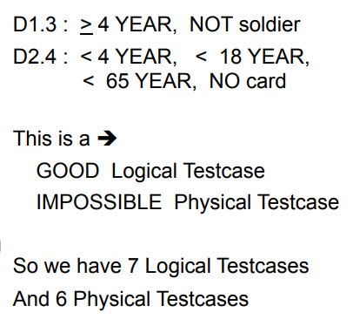
STEP 4. Combine test situations & Create Physical Test Cases
Decision | Result | Age | IsSoldier
D1.1 | Y | 3 | False
D1.2 | Y | 5 | True
D1.3 | N | 4 or 66 | False
Decision | Result | Age | isCARD
D2.1 | Y | 4 | False
D2.2 | Y | 66 | False
D2.3 | Y | 4 | True
D2.4 | N | 4 or 66 (impossible) | False
D2.5 | N | 19 | False
Test Case | Path | Age | IsSoldier | isCARD
TC1 | D1.1 | 3 | False
TC2 | D1.2 | 5 | True
TC3 | D1.3->D2.1 | 4 | False | False
TC4 | D1.3->D2.2 | 66 | False | False
TC5 | D1.3->D2.3 | 4 | False | True
TC6 | D1.3->D2.5 | 19 | False | False

Slide 11
1. Identify the decision points
2. Determine test situations per decision point, using MCDC (MCDC = Modified Decision Coverage)
(
(
)
)
(
)
(
)

Slide 12
STEP 3: Create Logical Test Cases, Sub-step 1: create graph
(
(
)
)

Slide 14
STEP 4 Create Physical Test Cases
Test Case | Result | Age | IsSoldier
D1.1 | Y | 3 | False
D1.2 | Y | 5 | True
D1.3 | N | 4 or 66 | False
Test Case | Result | Age | isCARD
D2.1 | Y | 4 | False
D2.2 | Y | 66 | False
D2.3 | Y | 4 | True
D2.4 | N | 4 or 66 (impossible) | False
D2.5 | N | 19 | False

Slide 15
Test Case | Result | Age | IsSoldier | isCARD
TC1 | Y | 3 | False
TC2 | Y | 5 | True
TC3 | N->Y | 4 | False | False
TC4 | N->Y | 4 | False | True
TC5 | N->Y | 66 | False | False
TC6 | N->Y | 19 | False | False
Test Case | Result | Age | isCARD
D2.1 | Y | 4 | False
D2.2 | Y | 66 | False
D2.3 | Y | 4 | True
D2.4 | N | 4 or 66 (impossible) | False
D2.5 | N | 4 | False

